Slide 1
RESTAURANT
+1-800-123-4567
EMAIL@REST.COM
New York

Slide 2
MENU
FAMILY FRIENDLY RESTAURANT
a casual, family friendly restaurant facing the Hudson River & Statue of Liberty.

Slide 3
APPETIZER
PUMPKIN SOUP
RESTAURANT NAME
DESCRIPTION OF WHAT IS ALL IIN HERE
FRENCH CUISINE
$ 7.00
MENU
MOZZARELLA CHEESE
DESCRIPTION OF WHAT IS ALL IIN HERE
$ 5.00
EGG SALAD
DESCRIPTION OF WHAT IS ALL IIN HERE
ESTABLISHED 1798
PREMIUM QUALITY
$ 5.00
KAYA BALL
DESCRIPTION OF WHAT IS ALL IIN HERE
$ 4.00
CUCUMBER SLICE
FAMILY FRIENDLY RESTAURANT
DESCRIPTION OF WHAT IS ALL IIN HERE
a casual, family friendly restaurant facing the Hudson River & Statue of Liberty.
$ 5.00

Slide 4
APPETIZER
SIMPLE AND DELICIOUS
Notes:
https://unsplash.com/photos/_jf4UDKcE-U

Slide 5
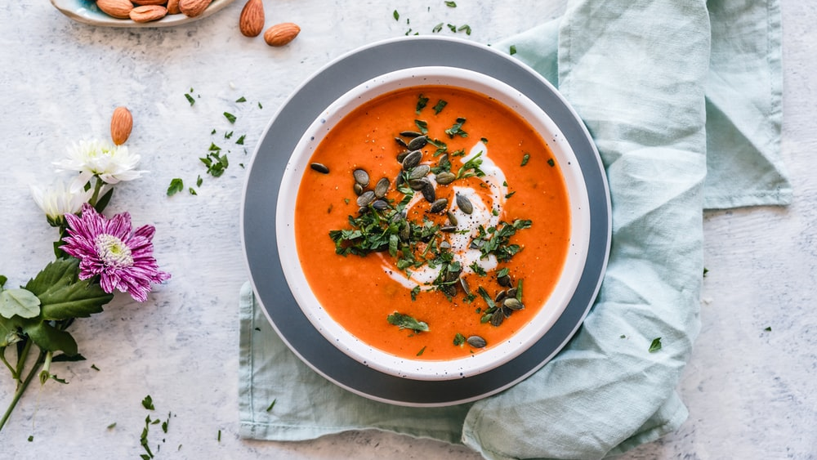
PUMPKIN SOUP
Pumpkin, carrots, baby leeks
$ 7.00
>
homemade pumpkin soup
In this chilly autumn weather, there’s nothing nicer than to cosy up with family over a bowl of hot soup.
Here’s our recipe for pumpkin soup
Notes:
https://unsplash.com/photos/fxJTl_gDh28

Slide 6
MOZARELLA
CHEESE
AWESOME CHEWYNESS
$ 9.00
>
Authentic Italian Flavor
16“ Eggplant & Ricotta/ Breaded Eggplant/ Cow's Milk Ricotta/ Crushed Tomatoes/ Buffalo Mozzarella
Notes:
https://unsplash.com/photos/fxJTl_gDh28

Slide 7
EGG SALAD
HEALTHY LIVING
$ 6.00
>
hearty SALAD For every day
Packed with Shrimp and chopped hard boiled eggs, This hearty recipe for Shrimp and Egg Salad makes a healthy and delicious lunch or light dinner.
Notes:
https://unsplash.com/photos/fxJTl_gDh28

Slide 8
MEAT BALLS
HOMEMADE TASTE
$ 7.00
>
From classic meatball TO MORE
Traditionally served with either: Chicken or Beef Meatballs, and Tomato Sauce
Notes:
https://unsplash.com/photos/fxJTl_gDh28

Slide 9
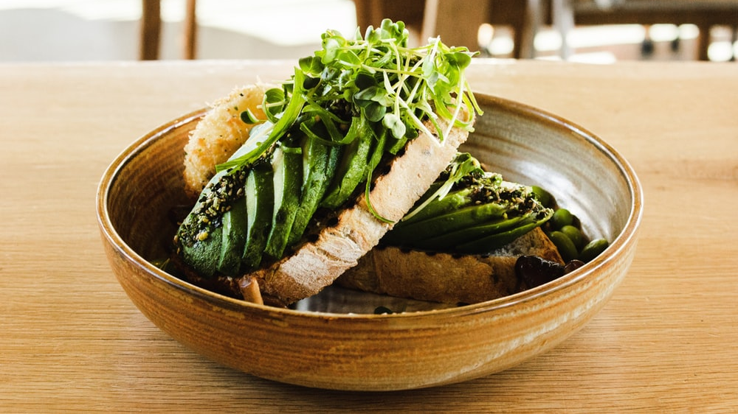
CUCUMBER
SLICE
OPENING UP YOUR TASTE
$ 5.00
>
GreEn & Healthy
Cucumbers are high in water and low in calories, fat, cholesterol, and sodium. They have a mild, refreshing taste and a high water content.
Notes:
https://unsplash.com/photos/fxJTl_gDh28

Slide 10
RESTAURANT
FOLLOW US

