Slide 1
TRANS LOGISTIC
INCORPORATED
COMPANY
Notes:
https://stock.adobe.com/au/images/truck-and-skyline/77366582

Slide 2
EMPLOYMENT
OPPORTUNITIES
Inject innovation,
Inspiration and
foresight into your career
Notes:
https://www.cleanpng.com/png-businessperson-management-skeppsbron-skatt-ab-orga-2151712

Slide 3
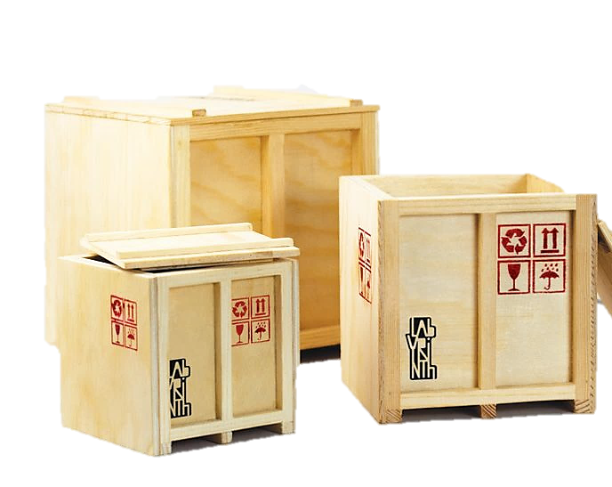
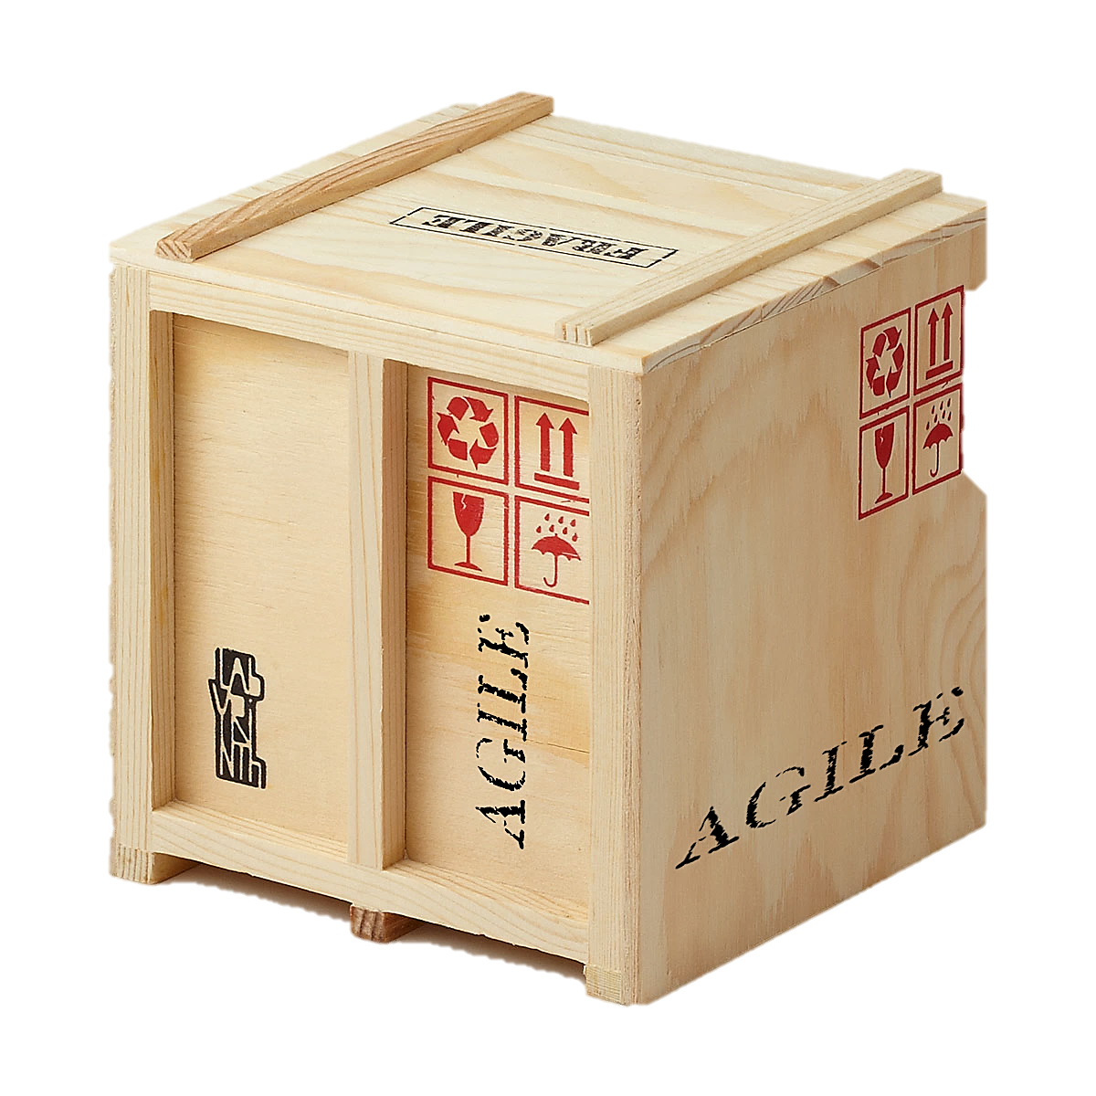
ISO certification
for Trans Cargo
Trans cargo, a division of
Trans Logistics, has achieved
ISO 22000 certification
Notes:
3.https://i.pinimg.com/originals/1c/a3/65/1ca3657ba4b5c78705568f19d97d1fe9.jpg
4.https://www.agilevelocity.com/media/AGILE-cargo-box.png

Slide 4
FREIGHT AND
TRANSPORT
TRANS LOGISTICS PROVIDE FREIGHT AND
TRANSPORT SOLUTIONS THAT ARE THE CORNERSTONES
OF OUR CLIENTS’ LEANS, GREEN,
EFFICIENT AND SUSTAINABLE SUPPLY CHAINS.
Our dedicated fleet comprises the complete range of vehicles,
including taut liners, flat decks, pantechnicons, trailers, rigid vehicles,
Tippers and refrigerated trucks.
We lead the logistics industry in environmental terms,
With innovations like the state-of-the-art eco Fridge,
Which utilizes a nitrogen ecosystem.
Notes:
https://pixabay.com/photos/truck-lorry-transportation-1030846/

Slide 5
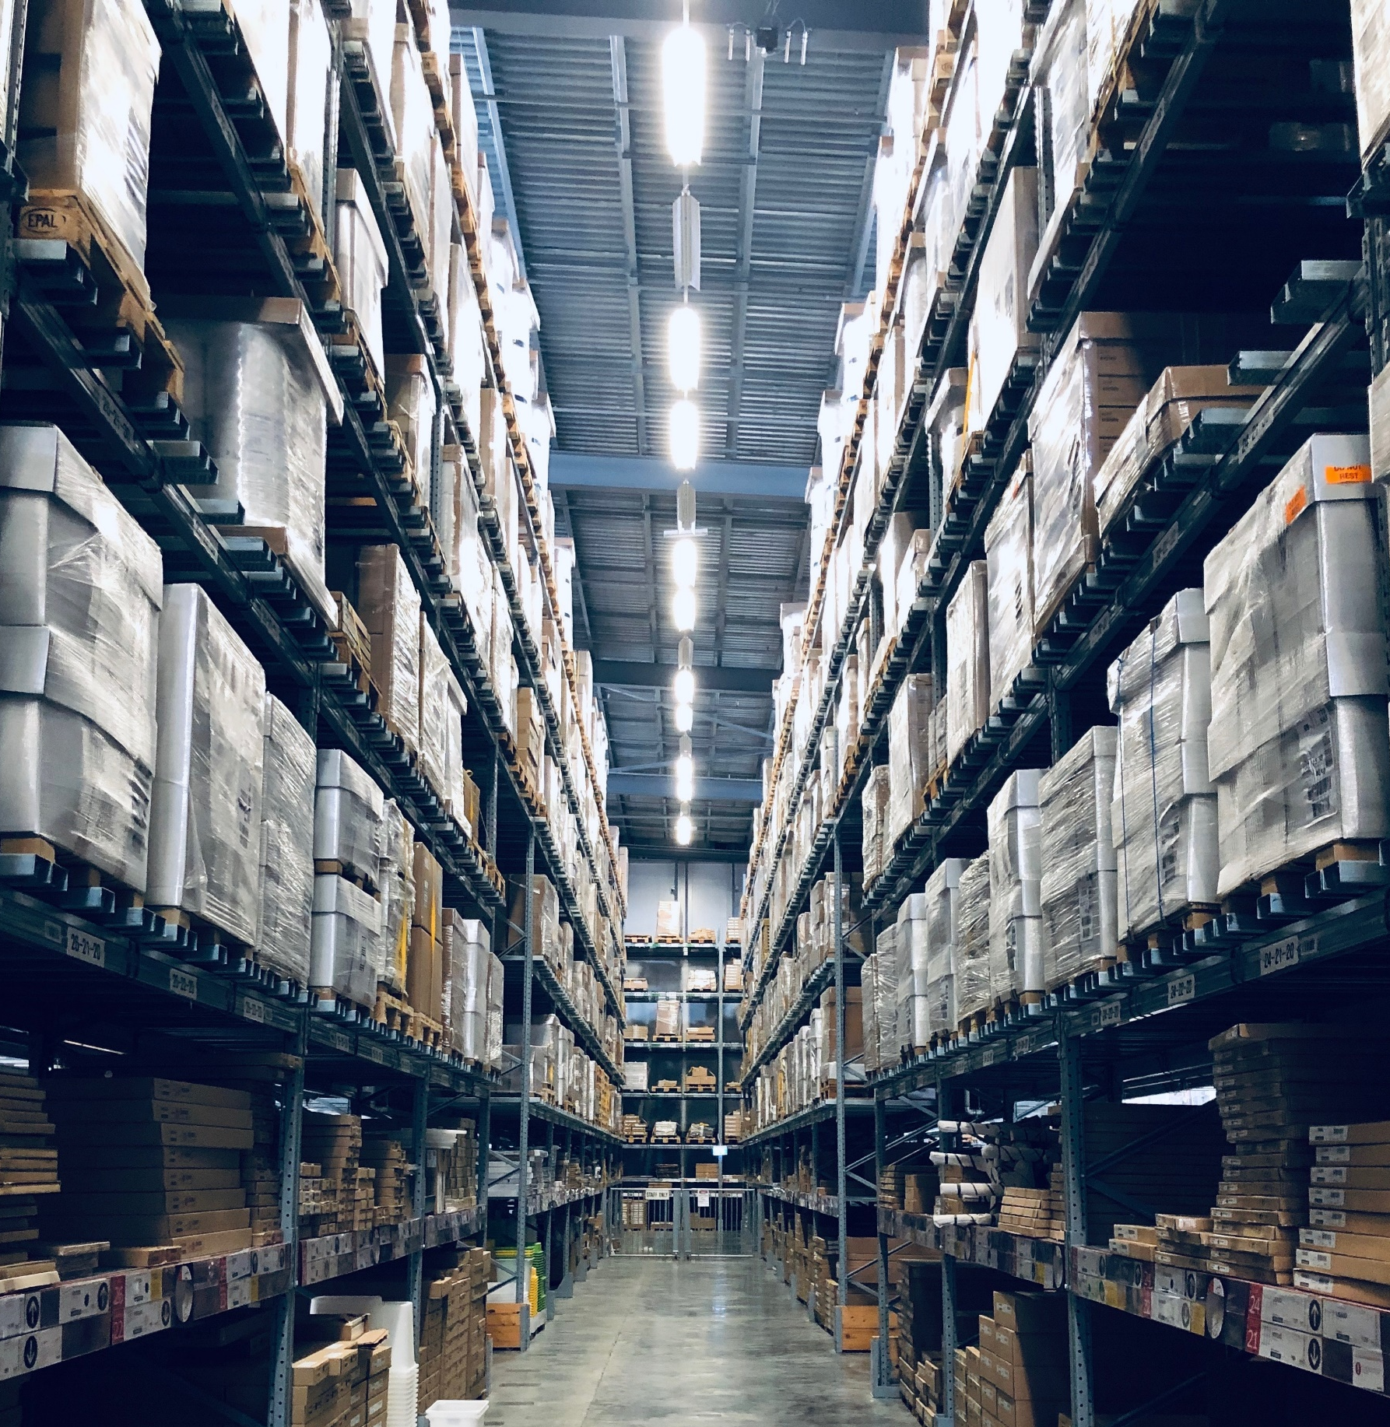
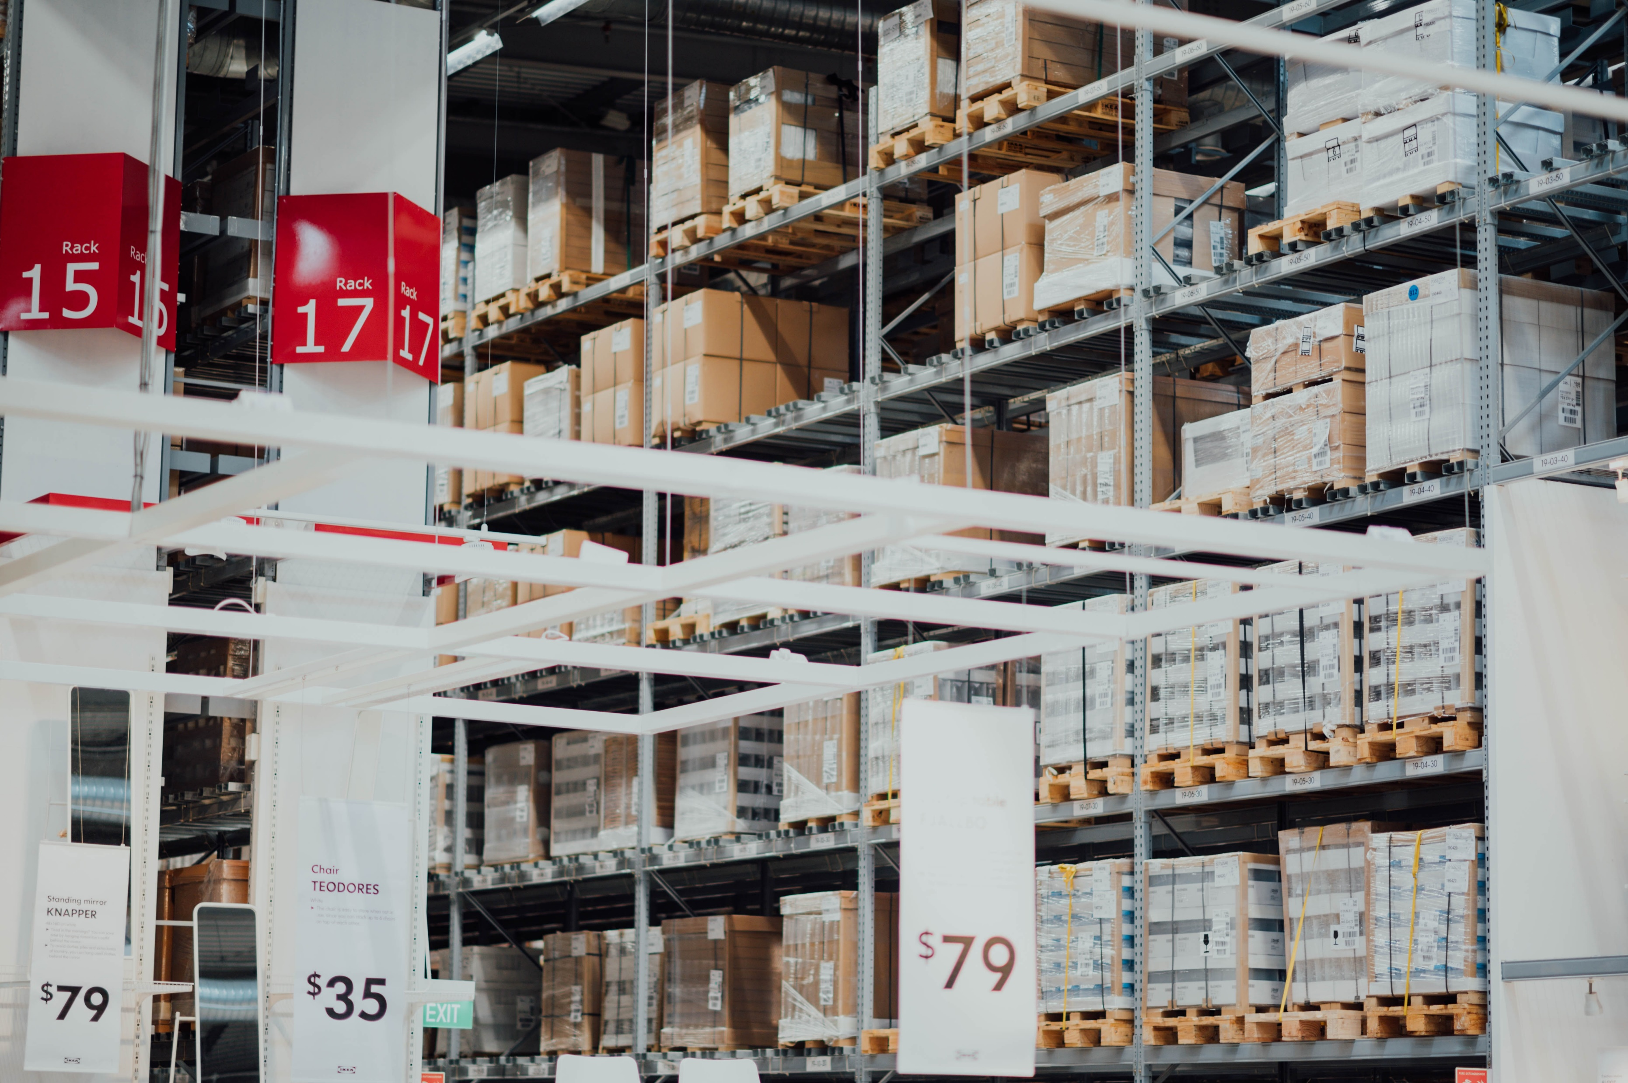
Warehousing and
Distribution
We provide fit-for-purpose and client specific warehouse storage solutions by managing and operating customized storage space.
Our world-class facilities are operated by trained employees
who are enabled by advanced technology systems,
and deploy safe and purpose-built material handling
Notes:
6.https://unsplash.com/photos/JWaXthlA9Cc
7.https://unsplash.com/photos/GK8x_XCcDZg

Slide 6
Logistics management is that part of the supply chain which, implements and
Controls the effect and effectiveness forward and reverse flow and
Storage of goods- between the point of origin and point of consumption
Managed
Logistics
Notes:
https://www.aacesoft.com/hubfs/Inventory%20Management5.jpg

Slide 7
Trans Logistics design and manages integrated
Operating procedures, supporting both the planning and
Execution of the distribution process with parallel
quality control systems intended to ensure order fulfilment
DEMAND DRIVEN ROUTE
TO MARKET FULFILMENT
Agency
And
Distributorship

Slide 8
SUPPLY CHAIN INTEGRATION
ADVISORY SERVICES
TECHNOLOGY SERVICES
PEOPLE ENABLEMENT
The right solutions and services are
Meaningless – without the right people to adopt,
Implement and support them. At trans Logistics,
we are committed to getting the best from out people – and yours.
Notes:
10.https://stock.adobe.com/images/helpline-operators-with-headphones-working-in-call-centre/205882281
11.https://es.123rf.com/photo_24490202_en-el-administrador-de-almac%C3%A9n-comprobar-cajas.html

Slide 9
BUILDING INTEGRATED SPECIALIST
CAPABILITIES IN A HIGHLY
COMPETITIVE EUROPEAN MARKET
In the European market, translogistic is
synonymous with a premium service provider
Notes:
12.https://www.pexels.com/photo/white-airplane-1098745/
13.https://stock.adobe.com/images/working-together/202169920

Slide 10
CASE STUDIES
ENERGY SAVING
Trans Logistics launches
Dual energy saving initiative for
Its fleet and warehousing
Notes:
https://www.cleanpng.com/png-world-map-wall-decal-globe-gold-world-map-5171702

Slide 11
MANAGEMENT TEAM
Peter Parker
Was appointed president of
Company in 2003 and chief
Executive officer in 2004
Notes:
https://stock.adobe.com/images/business-people-negotiating-at-boardroom-behind-closed-doors/249826261?prev_url=detail
17.https://stock.adobe.com/images/middle-aged-smiling-company-ceo-happy-team-leader-or-successful-business-man-looking-at-camera-posing-in-office-happy-professional-manager-confident-coach-or-friendly-male-boss-headshot-portrait/226258251
18.https://stock.adobe.com/images/happy-smiling-ceo-manager-at-office-space-possibly-real-estate-lawyer-non-profit-marketing/157631844

Slide 12
Company fosters a culture of diversity and inclusion in
which all employees contribute creative ideas, seek
challenges, and have the opportunity to grow
INNOVATIVE
A key element of our company
Vision is to develop and
embrace emerging
Technologies and processes
Notes:
https://stock.adobe.com/images/goldfish-jumping-improvement-and-career-concept/61026517
s

Slide 13
Drive Continuous
Improvements
Logistics management is that part of the supply chain
Which plans, implements and controls the efficient and
Effective forward and reverse flow and
storage of goods – between the point of origin and
The point of consumption.
Notes:
https://stock.adobe.com/images/young-asian-developers-working-in-their-start-up-home-office-with-brainstorming/175164813

Slide 14
AWARDS
DRIVING CLIENT’S COMPETITIVENESS
TAKES INTO FIRST PLACE AT
PRESTIGIOUS BUSINESS AWARDS.
Notes:
https://stock.adobe.com/images/young-business-team-receiving-award-prize-at-best-business-project-competition-event-business-and-entrepreneurship-award-ceremony-theme-focus-on-unrecognizable-people-in-audience/272670831

Slide 15
JOIN US IN SOCIAL NETWORKS
LEARN ABOUT INNOVATION AND
NEWS FIRST

