Slide 1
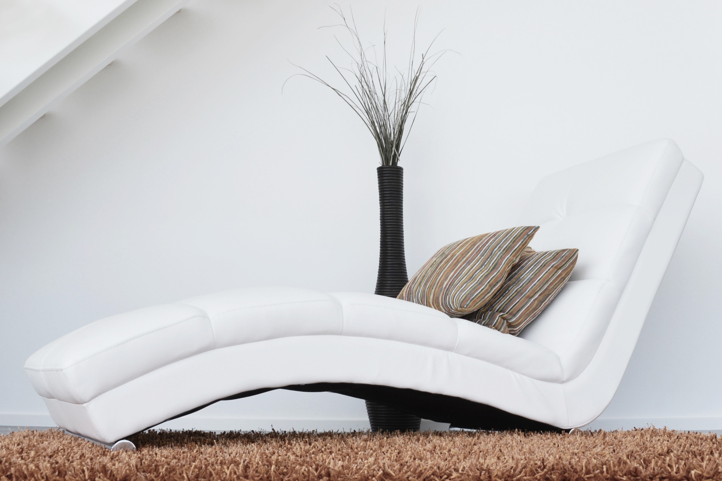
Luxury bed and sofas
Version
01
Luxury bed and sofas
Interior design for bed and sofas
LAMP
FURNITURE
CHAIR
Notes:
https://www.pexels.com/photo/architecture-carpet-chair-comfort-276534/

Slide 2
Luxury bed and sofas
Version
01
Luxury bed and sofas
Interior design for bed and sofas
No interior design is complete without a sofa
LAMP
FURNITURE
CHAIR
Notes:
https://www.pexels.com/photo/architecture-carpet-chair-comfort-276534/

Slide 3
LUXURY
BED AND
SOFAS
Interior design for bed and sofas
Notes:
https://www.pexels.com/photo/architecture-carpet-chair-comfort-276534/

Slide 4
LAMP
FURNITURE
CHAIR
LUXURY BED AND SOFAS
Luxury bed and sofas
Interior design for bed and sofas
Version
01
Notes:
https://www.pexels.com/photo/architecture-carpet-chair-comfort-276534/

Slide 5
LAMP
FURNITURE
CHAIR
Luxury bed and sofas
Version
01
Luxury bed and sofas
Modern Product Promo
Interior design for bed and sofas
No interior design is complete without a sofa. No interior design is complete without a sofa. No interior design is complete without a sofa
Version
01
Notes:
https://www.pexels.com/photo/architecture-carpet-chair-comfort-276534/

Slide 6
LAMP
FURNITURE
CHAIR
Luxury bed and sofas
Version
01
LUXURY BED AND SOFAS
Interior design for bed and sofas

Slide 7
24/7 Support Team
Contact: 1-800-123-4567
Email Address:
info@signagetube.com
Luxury bed and sofas
Version
01
LAMP
FURNITURE
CHAIR
Notes:
https://www.pexels.com/photo/architecture-carpet-chair-comfort-276534/

Slide 8
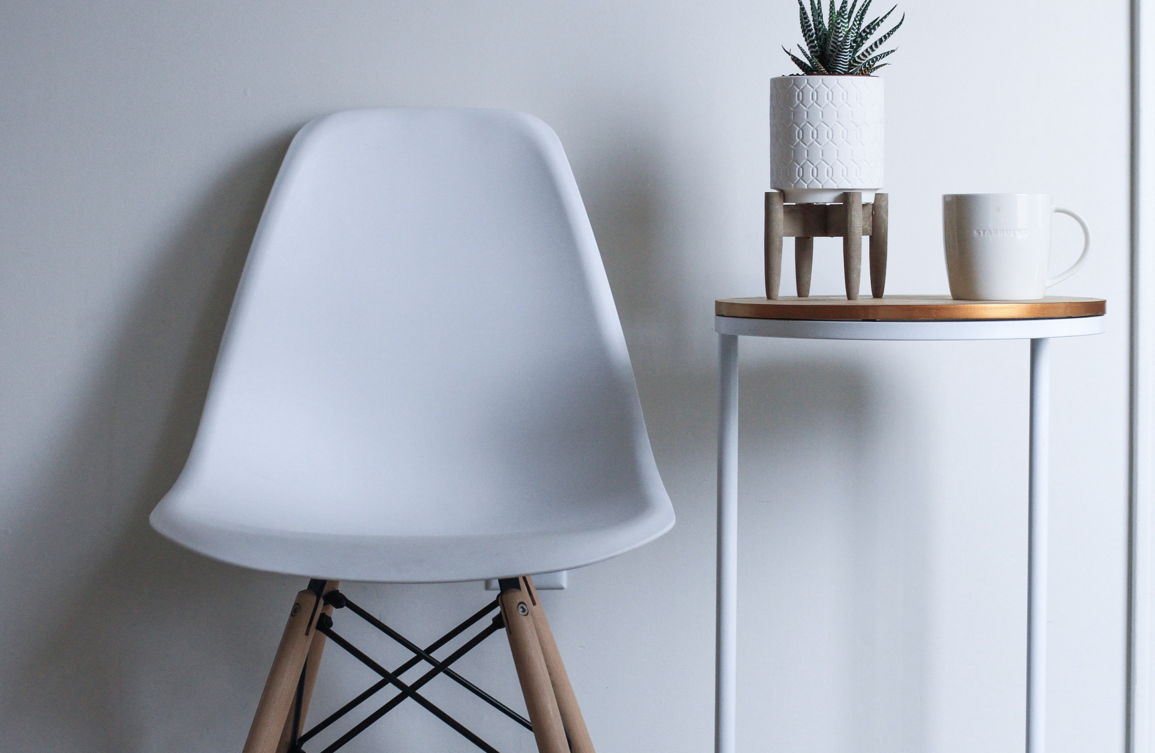
LAMP
FURNITURE
CHAIR
LUXURY BED AND SOFAS
Interior design for bed and sofas
Luxury bed and sofas
Version
01
Notes:
https://unsplash.com/photos/buhmhprfo3g

