Slide 1
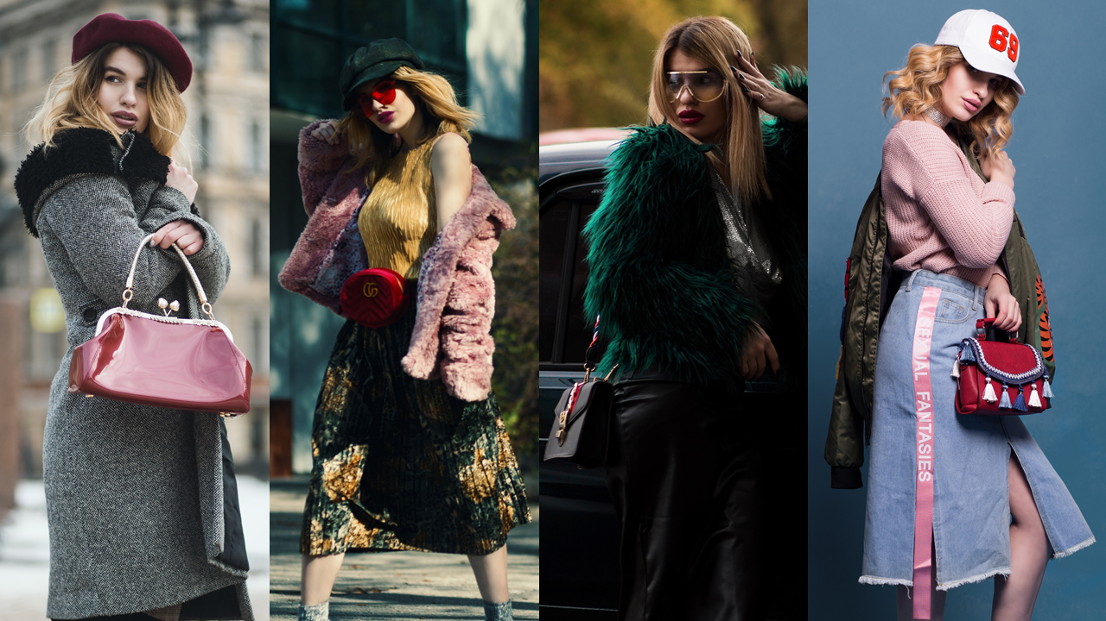
CHARLESLOUISE
PRESENT
NEW COLLECTION SPRING-SUMMER
SUPER ONLINE STORE
CHARLESLOUISE.COM
2019
Notes:
1. https://www.pexels.com/photo/selective-focus-photography-woman-wearing-gray-coat-standing-near-building-1381553/
2. https://www.pexels.com/photo/woman-in-white-off-shoulder-top-1360136/
3. https://www.pexels.com/photo/woman-standing-wearing-pink-coat-1187954/
4. https://www.pexels.com/photo/woman-leaning-on-car-surrounded-trees-1040124/
5. https://www.pexels.com/photo/woman-wearing-green-fur-jacket-1040173/
6. https://www.pexels.com/photo/adult-bag-beauty-model-blue-background-1126993/

Slide 2
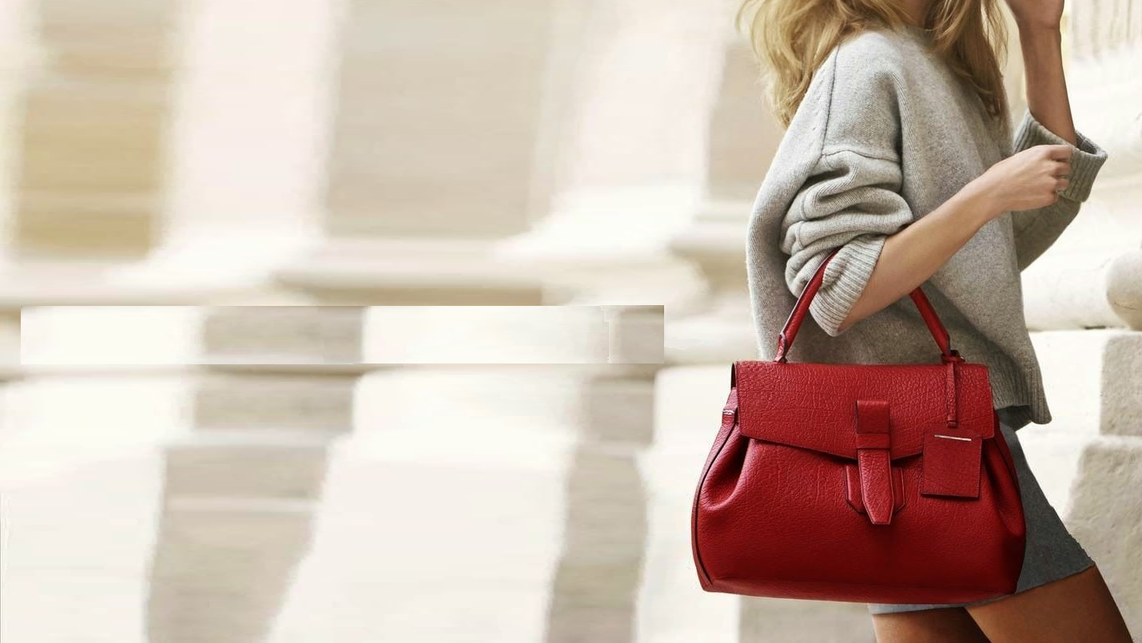
NEW
RED BAG
Red Leather Fashion Bag
$200
Notes:
https://i.pinimg.com/originals/75/5e/f9/755ef9f734c19974bf2398837a1886c8.jpg

Slide 3
BEST
PINK BAG
Nude Pink Leather Fashion Bag
$150
Notes:
https://i.pinimg.com/originals/89/db/40/89db40b864030d28379cfad9952941cc.jpg

Slide 4
BROWN
BAG
Original Louis Vuitton Shoulder Bag
$2000
Notes:
https://cdn.shopify.com/s/files/1/1536/6939/products/IMG_5040_1024x1024.JPG?v=1493231255

Slide 5
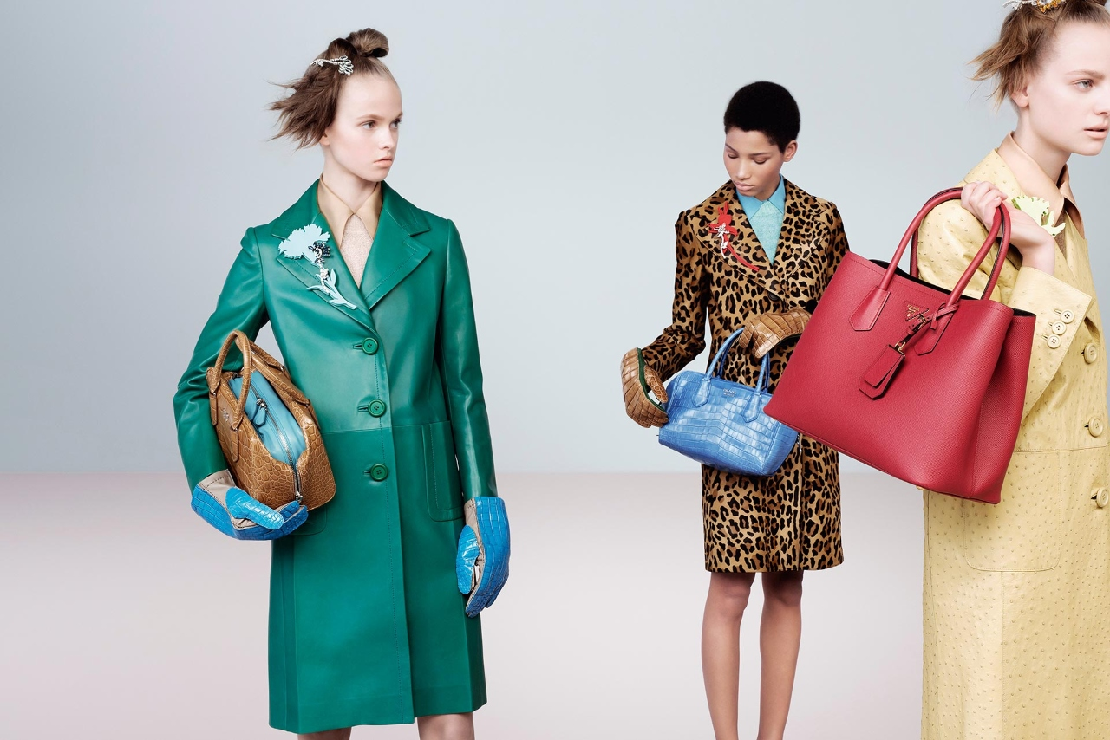
Light
brown
HandBAG
Korean Style Light Brown HandBag
$300
Notes:
http://cdn.luxuo.com/2015/07/Prada-FW2015-campaign.jpeg

Slide 6
COMING
SOON
BEST-SELLER – CHARLESLOUISE RED HANDBAG
2019
Notes:
https://unsplash.com/photos/TkwBK8nbA8I

Slide 7
COMING
SOON
BEST-DESIGN – CHARLESLOUISE BLUE LEATHER HANDBAG
2019
Notes:
https://unsplash.com/photos/TkwBK8nbA8I

Slide 8
CHARLESLOUISE
PRESENT
NEW COLLECTION SPRING-SUMMER
SUPER ONLINE STORE
CHARLESLOUISE.COM
2019
Notes:
1. https://www.pexels.com/photo/selective-focus-photography-woman-wearing-gray-coat-standing-near-building-1381553/
2. https://www.pexels.com/photo/woman-in-white-off-shoulder-top-1360136/
3. https://www.pexels.com/photo/woman-standing-wearing-pink-coat-1187954/
4. https://www.pexels.com/photo/woman-leaning-on-car-surrounded-trees-1040124/
5. https://www.pexels.com/photo/woman-wearing-green-fur-jacket-1040173/
6. https://www.pexels.com/photo/adult-bag-beauty-model-blue-background-1126993/

