Slide 1
BLACK
FRIDAY
SALE

Slide 2
NOW
LIVE

Slide 3
UPTO
50%
OFF

Slide 4
PROMOTE YOUR PRODUCT
Notes:
https://unsplash.com/photos/_3Q3tsJ01nc

Slide 5
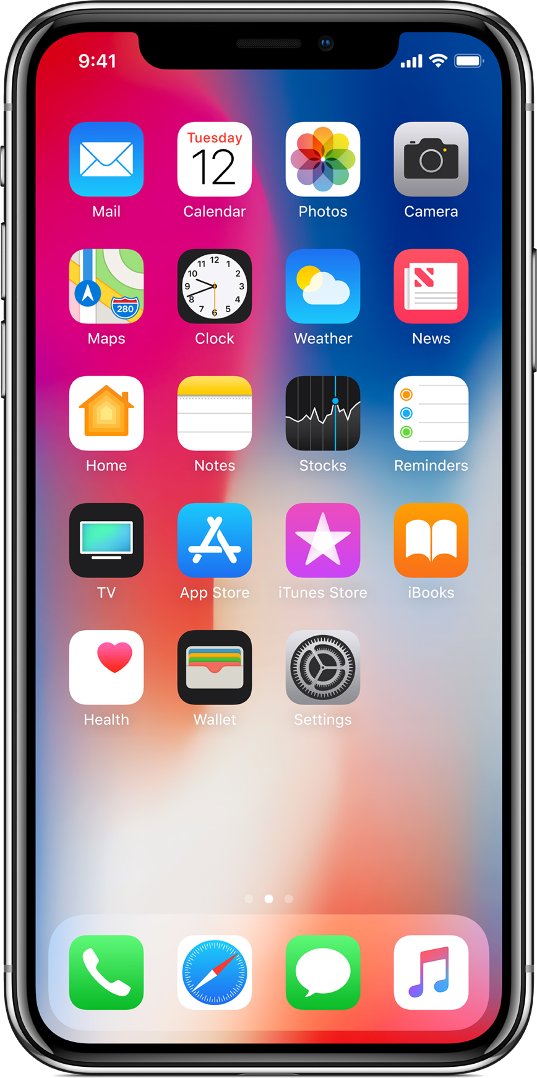
BLACK
FRIDAY
SALE
MOBILE PHONE
White – Silver
64 GB
5.8 inches
1125 x 2436 pixels
3D Touch
$1200
WWW.SALENAHERE.COM
Notes:
https://www.kisspng.com/png-iphone-4-iphone-8-plus-iphone-5-iphone-x-iphone-ap-658534/download-png.html
https://www.pngfly.com/png-fvco5p/

Slide 6
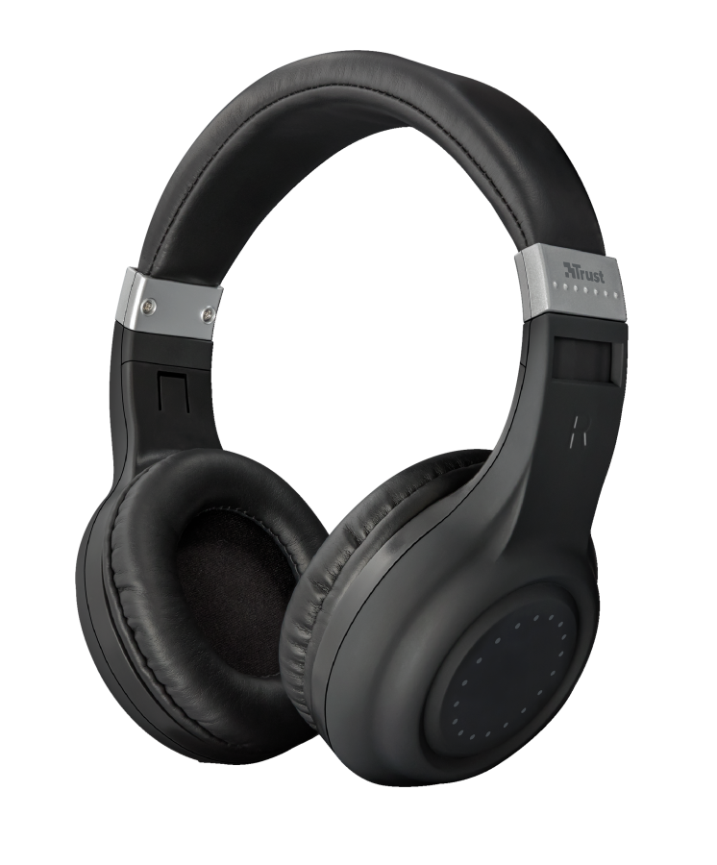
BLACK
FRIDAY
SALE
HEADPHONES
Used By Artists
Infinite Black
3.5mm
Wireless
Clear Sound
$50
WWW.SALENAHERE.COM
Notes:
https://www.pngfly.com/png-xy6ly5/

Slide 7
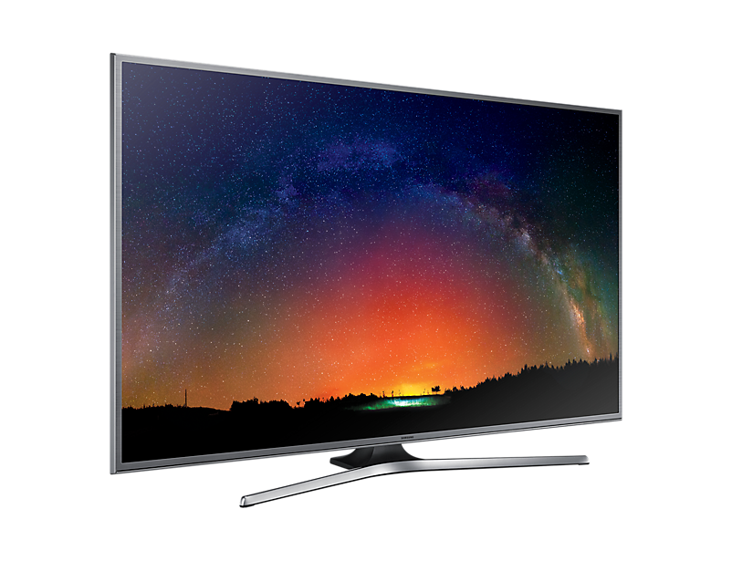
BLACK
FRIDAY
SALE
SMART LED TV
42 Inches
1920x1080p
16 : 9
Pixel Plus HD
Stereo Speakers
$250
WWW.SALENAHERE.COM
Notes:
https://www.pngfly.com/png-tkloak

Slide 8
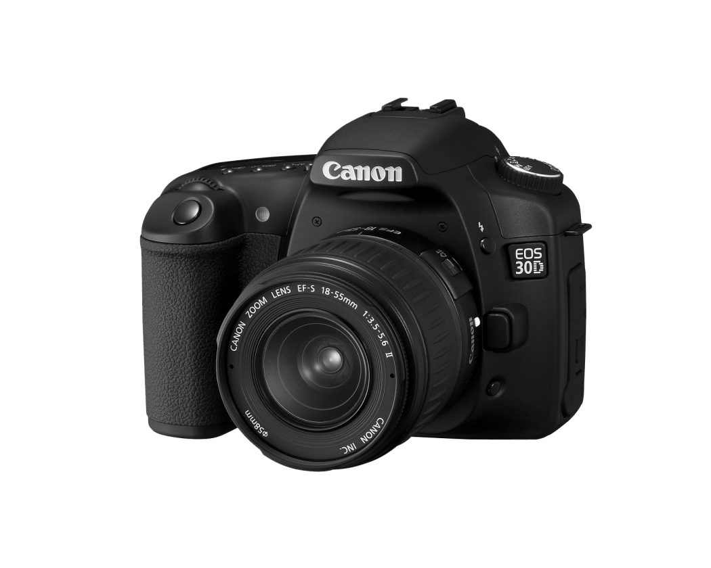
BLACK
FRIDAY
`
SALE
DSLR CAMERA
D3200
18 x 55 Lens
24.2 Pixel
Dust Reduction
Sensor Cleaning
$500
WWW.SALENAHERE.COM
Notes:
https://www.snipstock.com/image/png-images-camera-24-png-22255

Slide 9
BLACK
FRIDAY
SALE
LAPTOP
Core i7
64 GB
2 Tb HDD
16 inch Led
3D Touch
$1500
WWW.SALENAHERE.COM
Notes:
https://www.kisspng.com/png-laptop-intel-core-i5-lenovo-laptop-1545350/

Slide 10
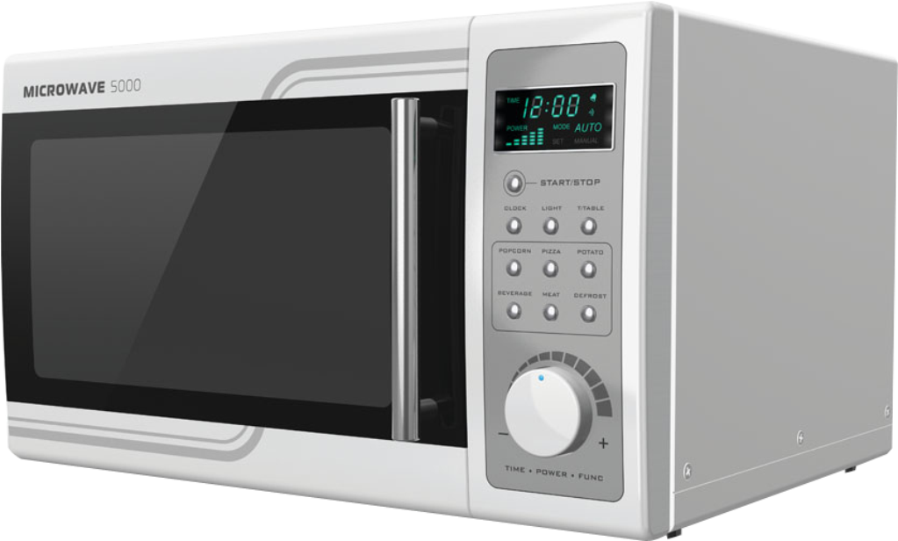
BLACK
FRIDAY
SALE
MICROWAVE
Powerful
220 volts
2450 MHz
700W- 850W
$100
WWW.SALENAHERE.COM
Notes:
https://www.kisspng.com/png-microwave-oven-home-appliance-dishwasher-washing-m-95904

Slide 11
BLACK
FRIDAY
SALE
DESKTOP PC
Core i7
Graphic Card
16 GB Ram
24-inch LED
Keyboard/Mouse
$950
WWW.SALENAHERE.COM
Notes:
https://www.kisspng.com/png-computer-desktop-pc-png-55725

Slide 12
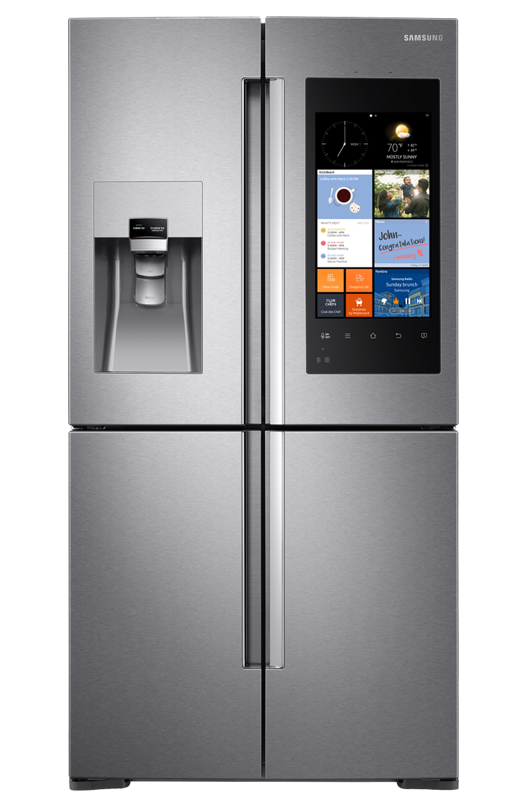
BLACK
FRIDAY
SALE
REFRIDGERATOR
2 Door
4 Colors
Perfect Cooling
Power Saving
Metal Body
$1400
WWW.SALENAHERE.COM
Notes:
https://www.pngfly.com/png-evymlc/

Slide 13
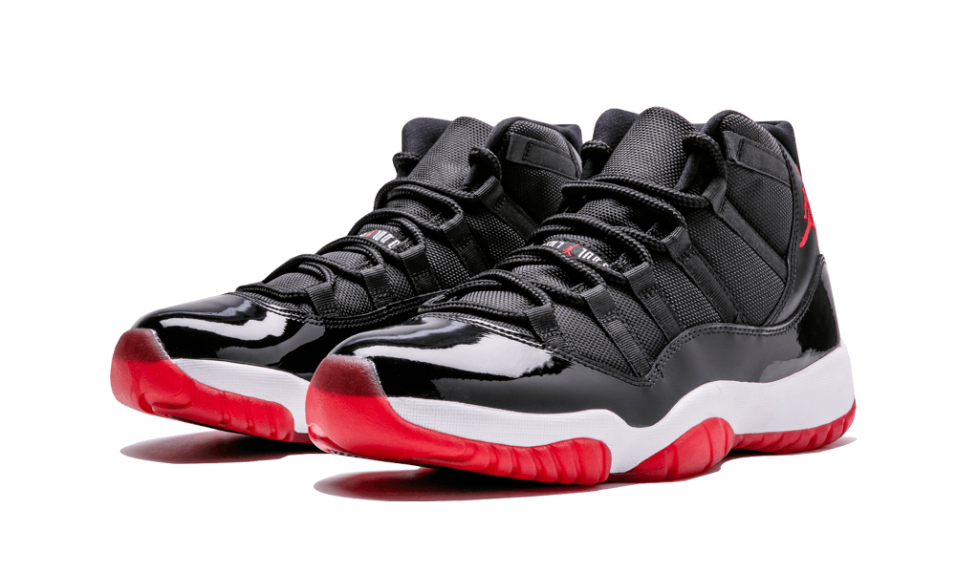
BLACK
FRIDAY
SALE
SHOES (FOR MEN)
Comfort
Running
Casual
3 Colors
Very Soft
$100
WWW.SALENAHERE.COM
Notes:
https://www.kisspng.com/png-playstation-2-playstation-tv-playstation-4-playsta-4179100/

Slide 14
BLACK
FRIDAY
SALE
VIDEO GAME
2 Controllers
150+ Games
Good Graphics
32Gb Storage
Full HD
$345
WWW.SALENAHERE.COM
Notes:
https://www.pngfly.com/png-tkloak

Slide 15
BLACK
FRIDAY
SALE
VALID FROM 20TH NOVEMBER 2019
VISIT SALENAHERE.COM FOR MORE INFO

