Slide 1
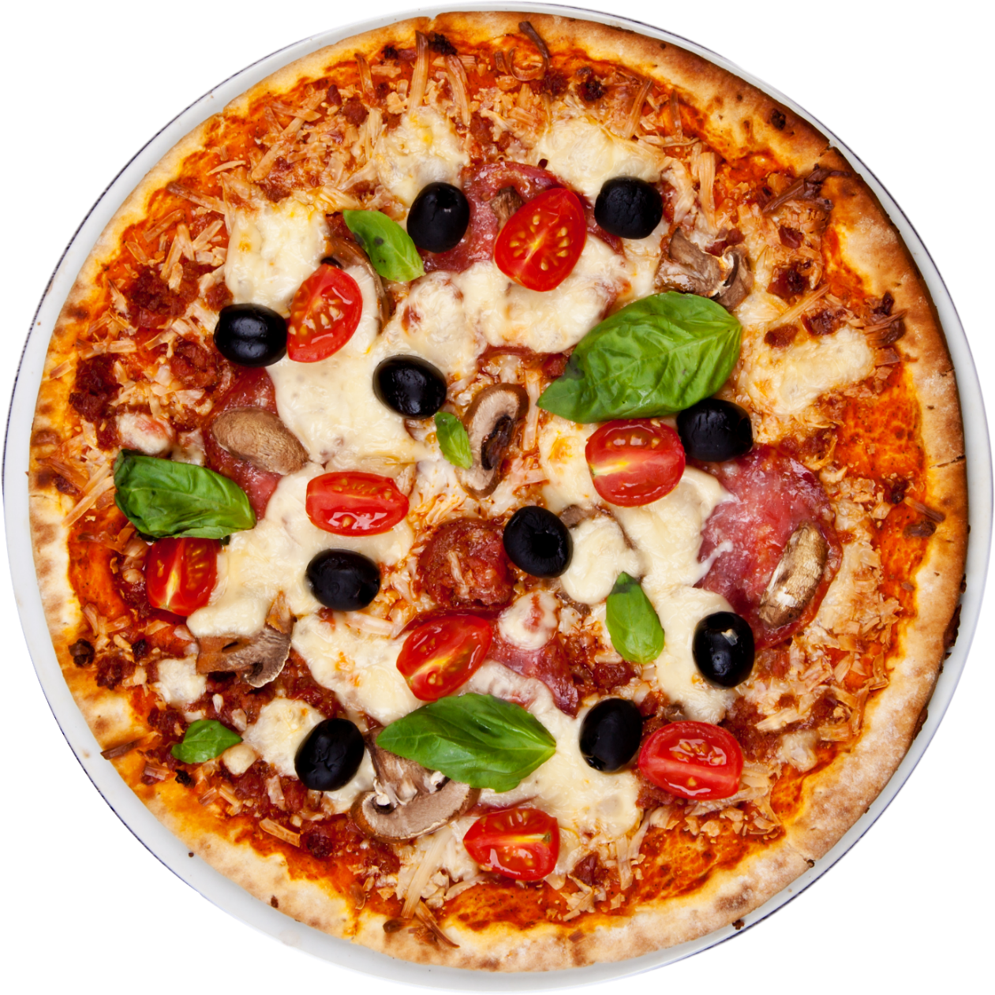
Free Delivery
BEST
PRICE
3
$
00
SUPREME PIZZA
Pepperoni, Seasoned Pork, Beef, Mushrooms, Green Bell Peppers And Red Onions.
Notes:
https://www.kisspng.com/png-new-york-style-pizza-italian-cuisine-take-out-pizz-79451/download-png.html

Slide 2
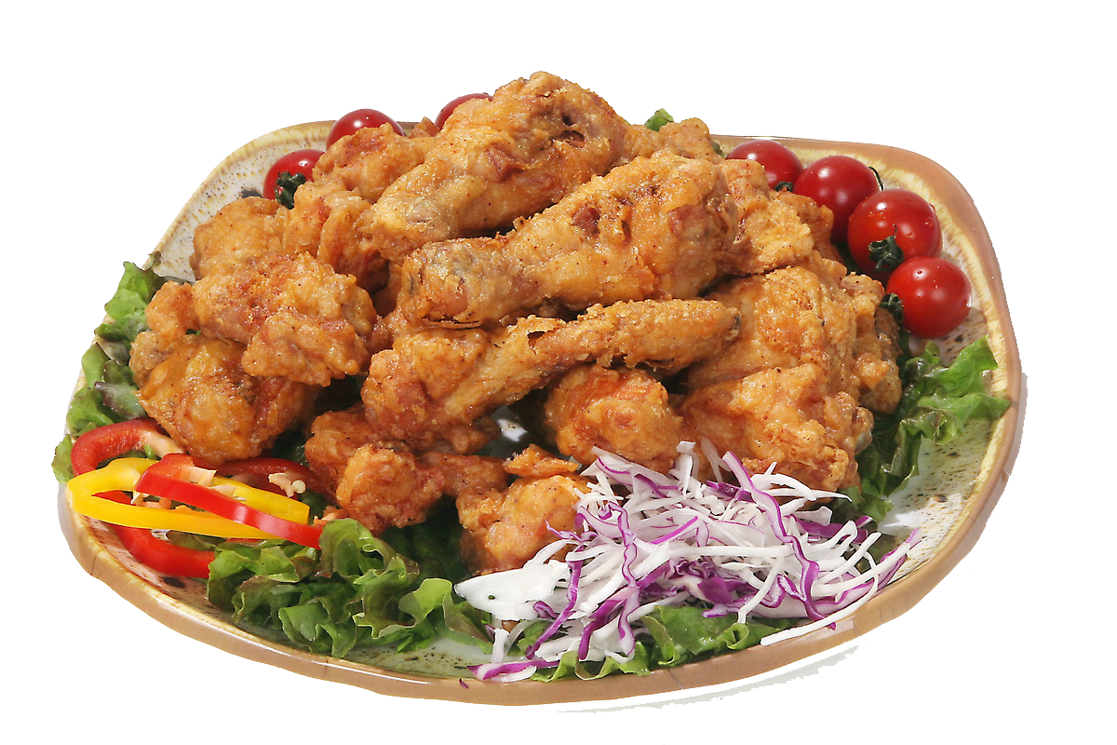
SPICY CHICKEN
Our Classic Juicy Grilled Chicken With Sauce And An Order Of Fries.
HOT
8
$
00
CARRYOUT DEAL
Notes:
https://www.kisspng.com/png-fried-chicken-churchs-chicken-buffalo-wing-chicken-226717/
https://www.pexels.com/photo/barbecue-blur-chicken-citrus-209406/

Slide 3
ABC Restaurant

Slide 4
CARRYOUT DEAL
¢
BEST
PRICE
59
Green Apple
The Fruit Has Hard, Light Green Skin And A Crisp, Juicy Flesh.
Notes:
https://www.pngfly.com/png-ey3f64/download.html

Slide 5
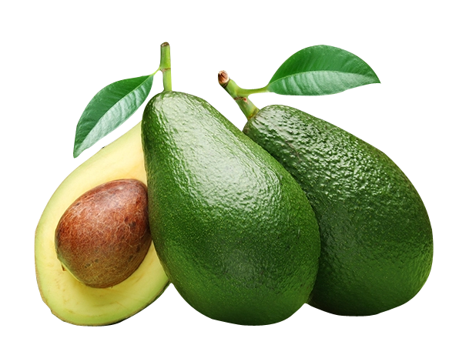
Avocado
Rich In Several B Vitamins And Vitamin K, With Good Content Of Vitamin C, Vitamin E
RICH IN VITAMINS
¢
59
LOWEST
PRICE
Notes:
https://www.pngfly.com/png-xjqihj/download.html

Slide 6
XME GroceryStore

Slide 7
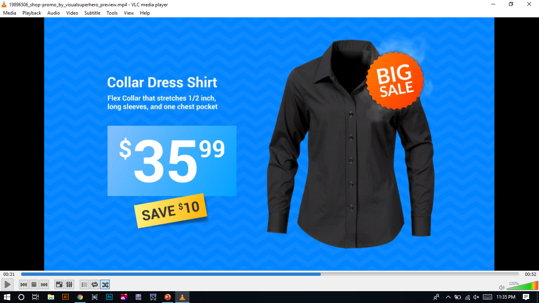
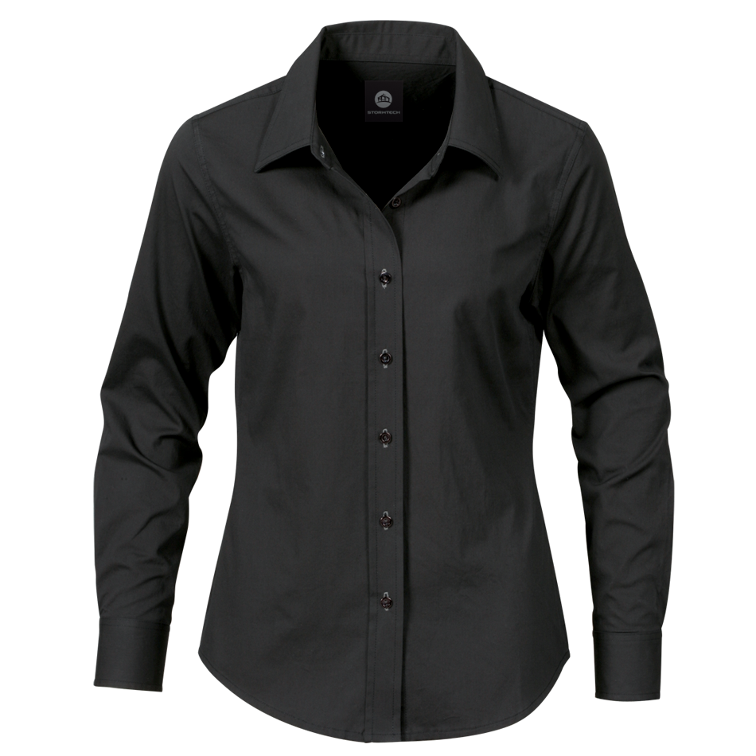
Collar Long Sleeve
BIG
SALE
Flex Collar That Stretches ½ Inch Long Sleeves, And One Chest Pocket
35
$
00
SAVE $10
Notes:
https://www.pngfly.com/png-g9vwc0/download.html

Slide 8
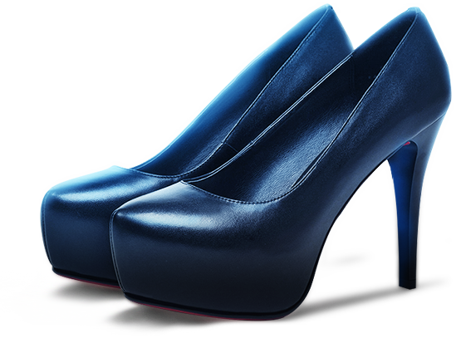
Blue High Heels Shoes
NEW
ARRIVAL
Fabric Upper With A Faux Leather Criss Cross Detail On The Vamp
40
$
00
REAL LEATHER
Notes:
https://www.pngfly.com/png-t81ev3/download.html

Slide 9
XME GroceryStore

