Slide 1
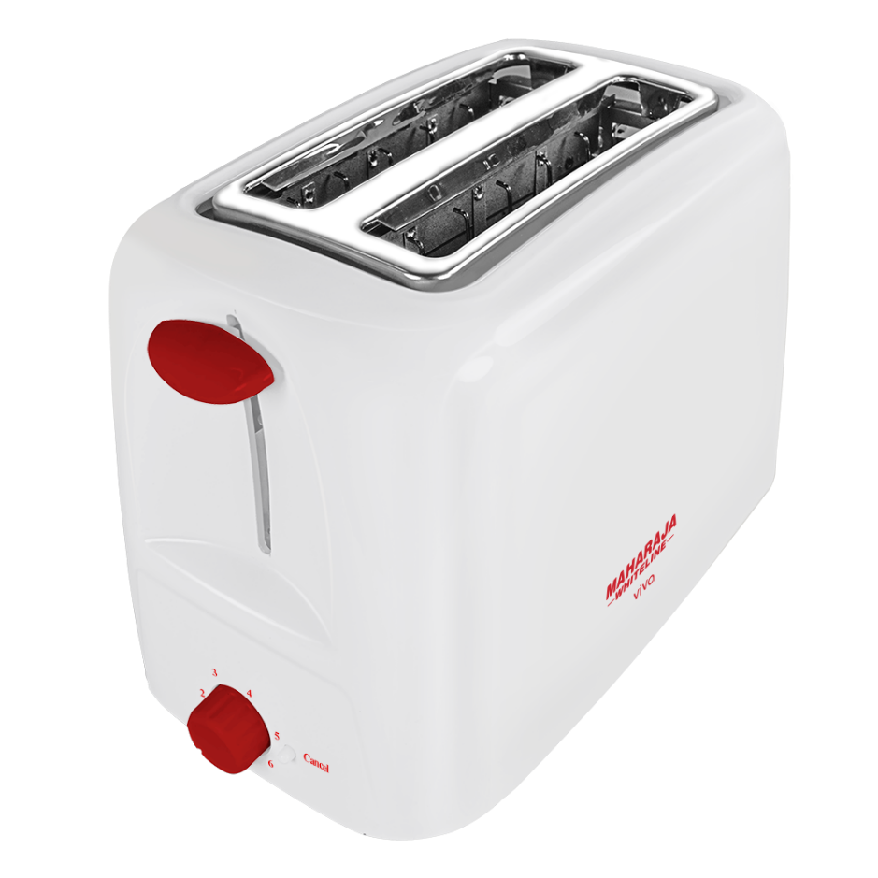
ONLINE
PRODUCT
PROMO
INNOVATIVE PRODUCT
THIS IS A TOASTER
59$
Notes:
http://pngimg.com/uploads/toaster/toaster_PNG54.png

Slide 2
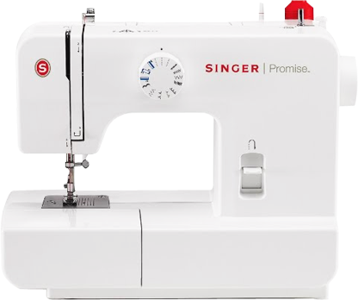
INNOVATIVE PRODUCT
INNOVATIVE PRODUCT
THIS IS A HAIR BLOWER
THIS IS A SEWING MACHINE
99$
$60
Notes:
https://www.kisspng.com/png-hair-dryer-beauty-parlour-barbershop-hairdresser-p-486197/download-png.html
http://pngimg.com/uploads/sewing_machine/sewing_machine_PNG52.png

Slide 3
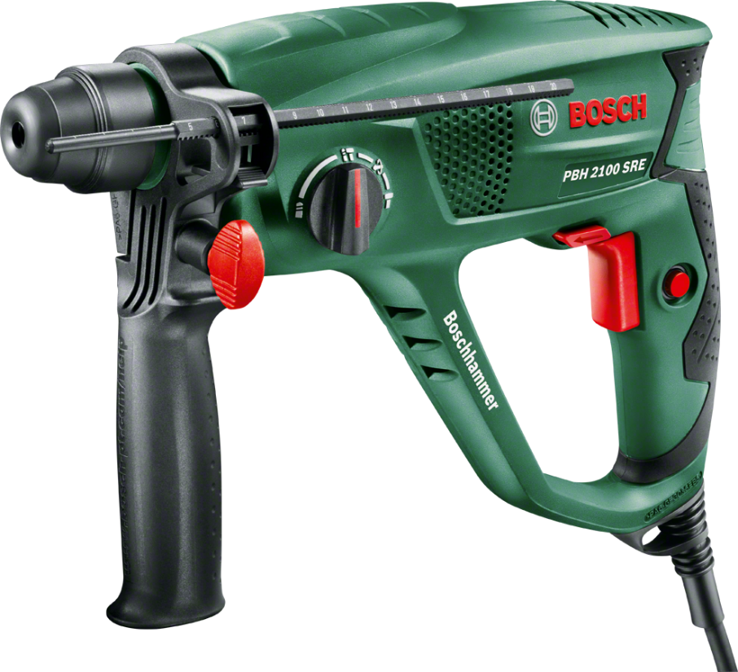
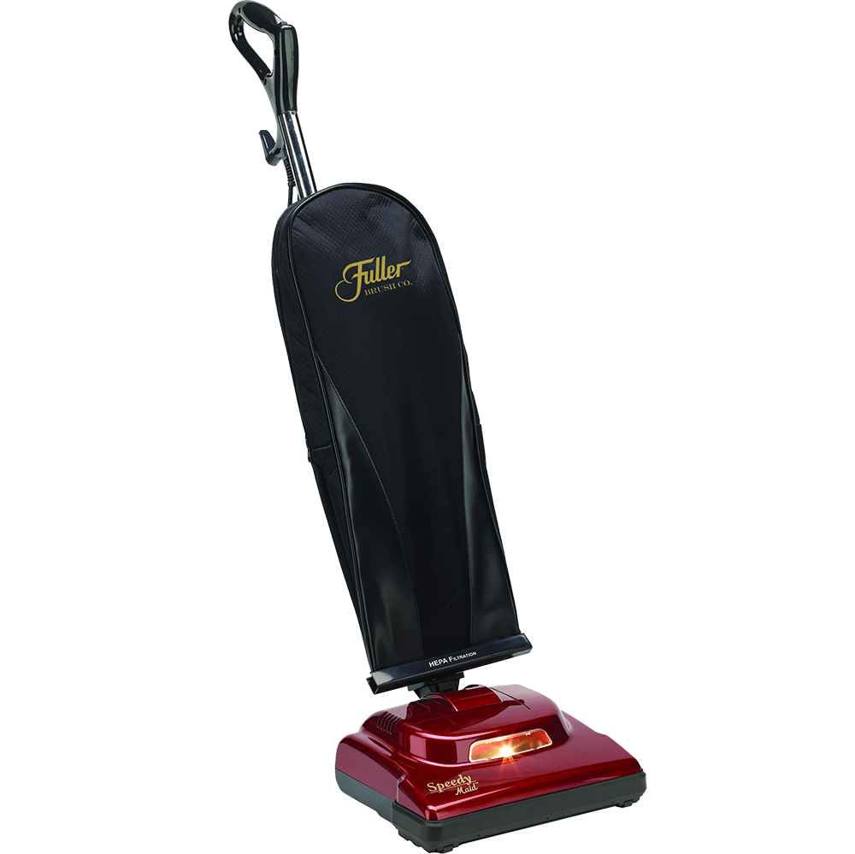
INNOVATIVE PRODUCT
THIS IS
A DRILL
19$
INNOVATIVE PRODUCT
THIS IS A VACCUM CLEANER
$75
Notes:
http://pngimg.com/uploads/vacuum_cleaner/vacuum_cleaner_PNG40.png
https://www.pngfly.com/png-epuhmg/download.html

Slide 4
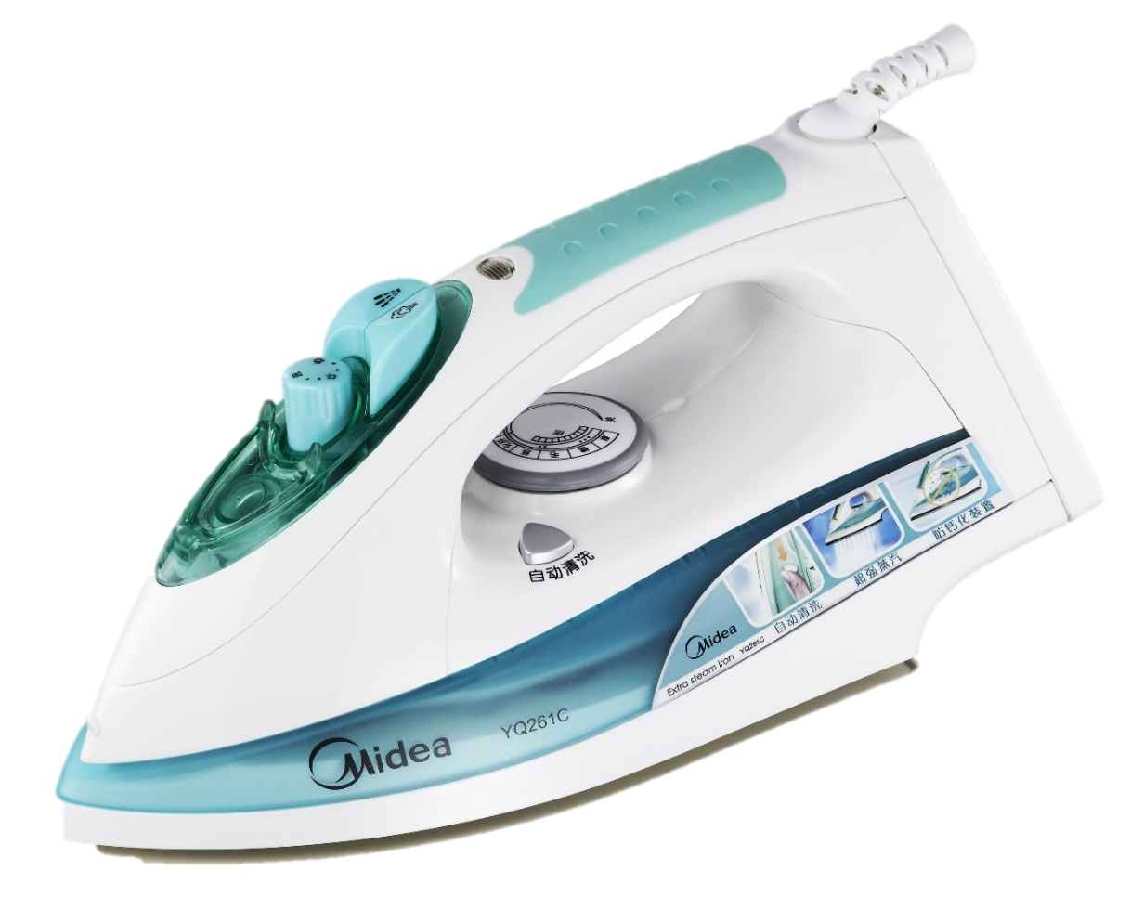
INNOVATIVE PRODUCT
INNOVATIVE PRODUCT
THIS IS
AN IRON
THIS IS A KETTLE
$30
59$
Notes:
https://www.pexels.com/photo/iron-small-appliances-home-appliances-59980/
http://pngimg.com/uploads/kettle/kettle_PNG8725.png

Slide 5
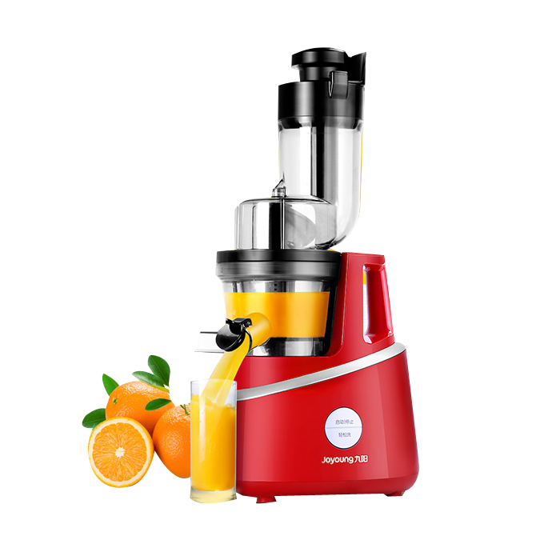
INNOVATIVE PRODUCT
THIS IS A CHAIR
79$
INNOVATIVE PRODUCT
THIS IS A BLENDER
$65
Notes:
https://www.kisspng.com/png-juicer-mixer-blender-red-juice-machine-141743/download-png.html

Slide 6
ONLINE
PRODUCT
PROMO
Notes:
http://pngimg.com/uploads/toaster/toaster_PNG54.png

