Slide 1
facebook.com/nearyouonlineshopmarket
the new season
It is important to buy quality products
In your time near you. We are happy to serve and give you the best.
2019
@nearyouonlineshopmarket
Nearyouonlineshopmarket.com

Slide 2
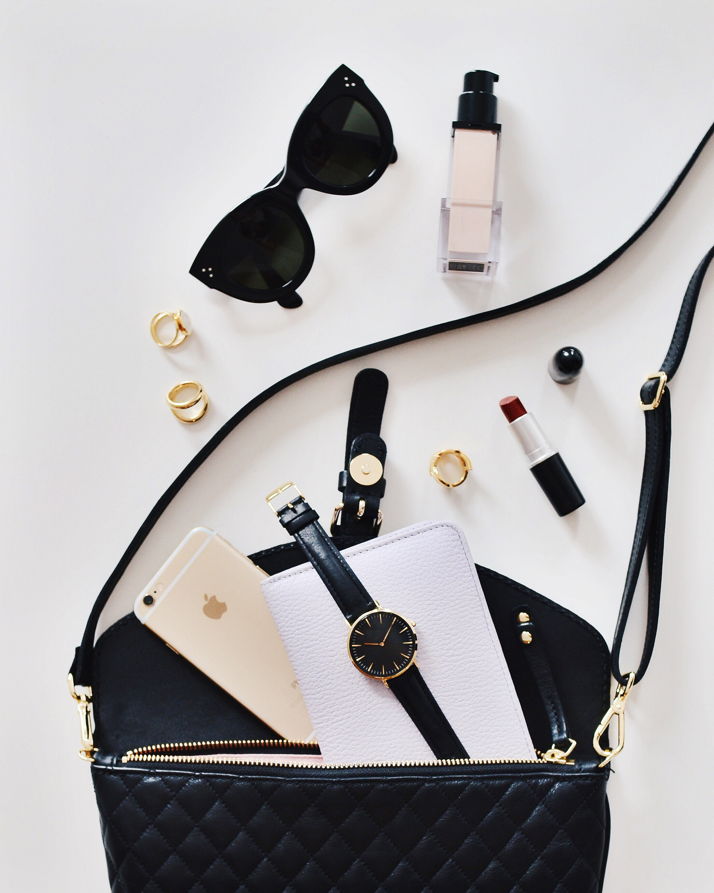
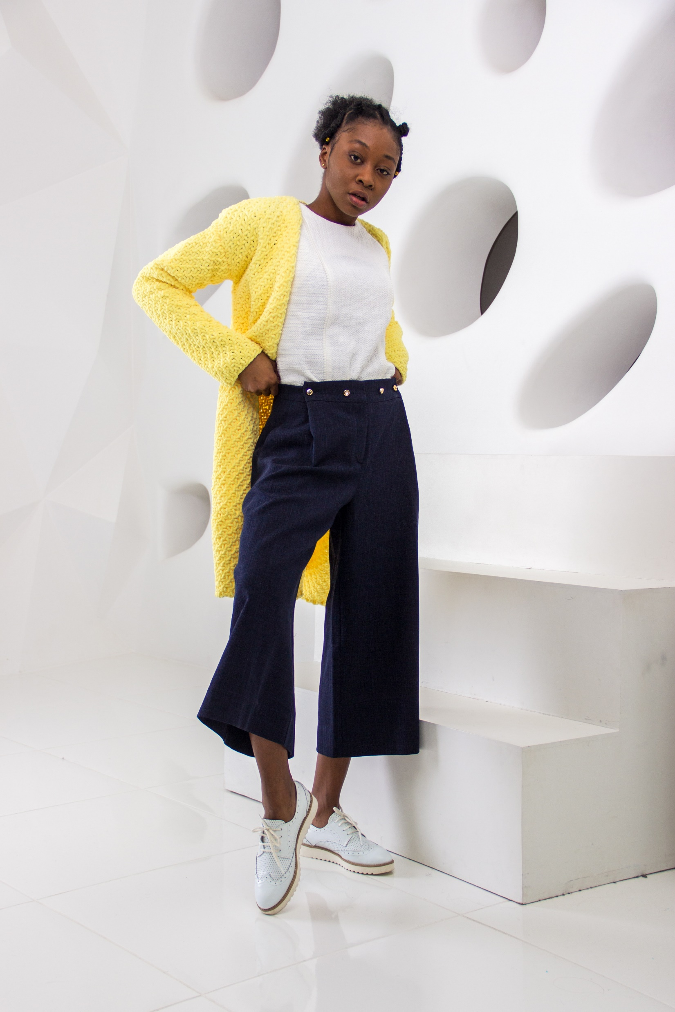
facebook.com/nearyouonlineshopmarket
WINTER
the new season
10% for every Winter Sports Wear
@bestmarket
bestmarket.com
Notes:
Photo by STIL on Unsplash
Photo by mentatdgt from Pexels
Photo by Godisable Jacob from Pexels
Photo by Quang Anh Ha Nguyen from Pexels
Photo by Dominika Roseclay from Pexels
Photo by Godisable Jacob from Pexels
Photo by Godisable Jacob from Pexels

Slide 3
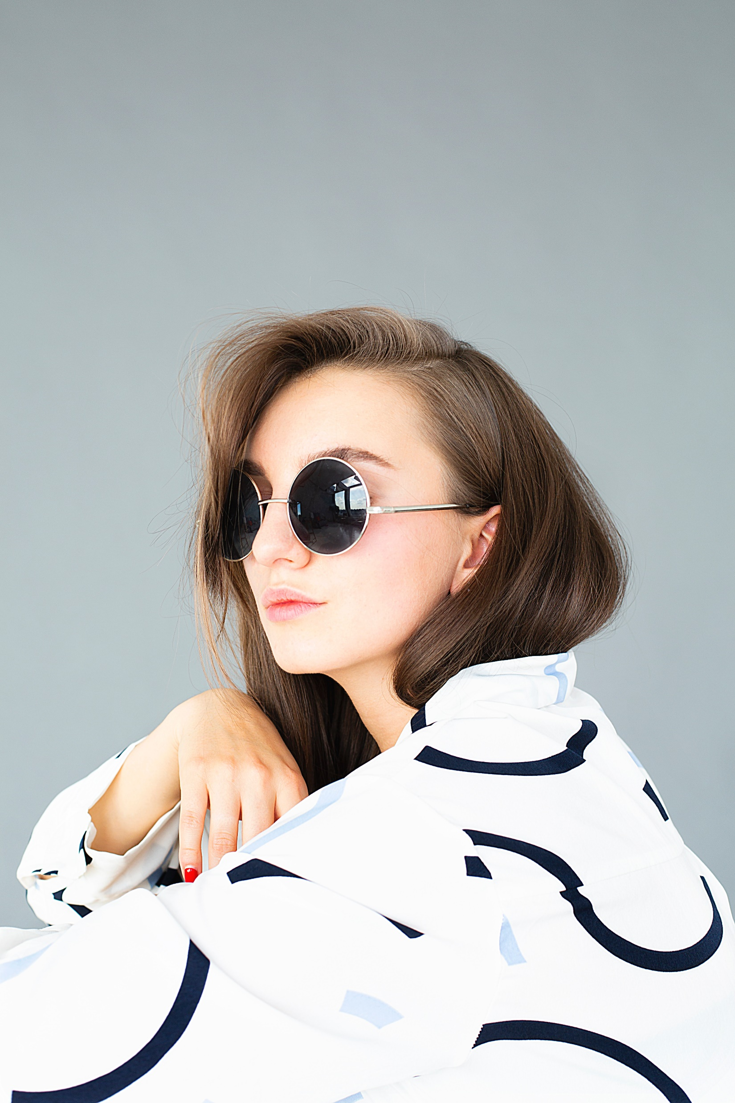
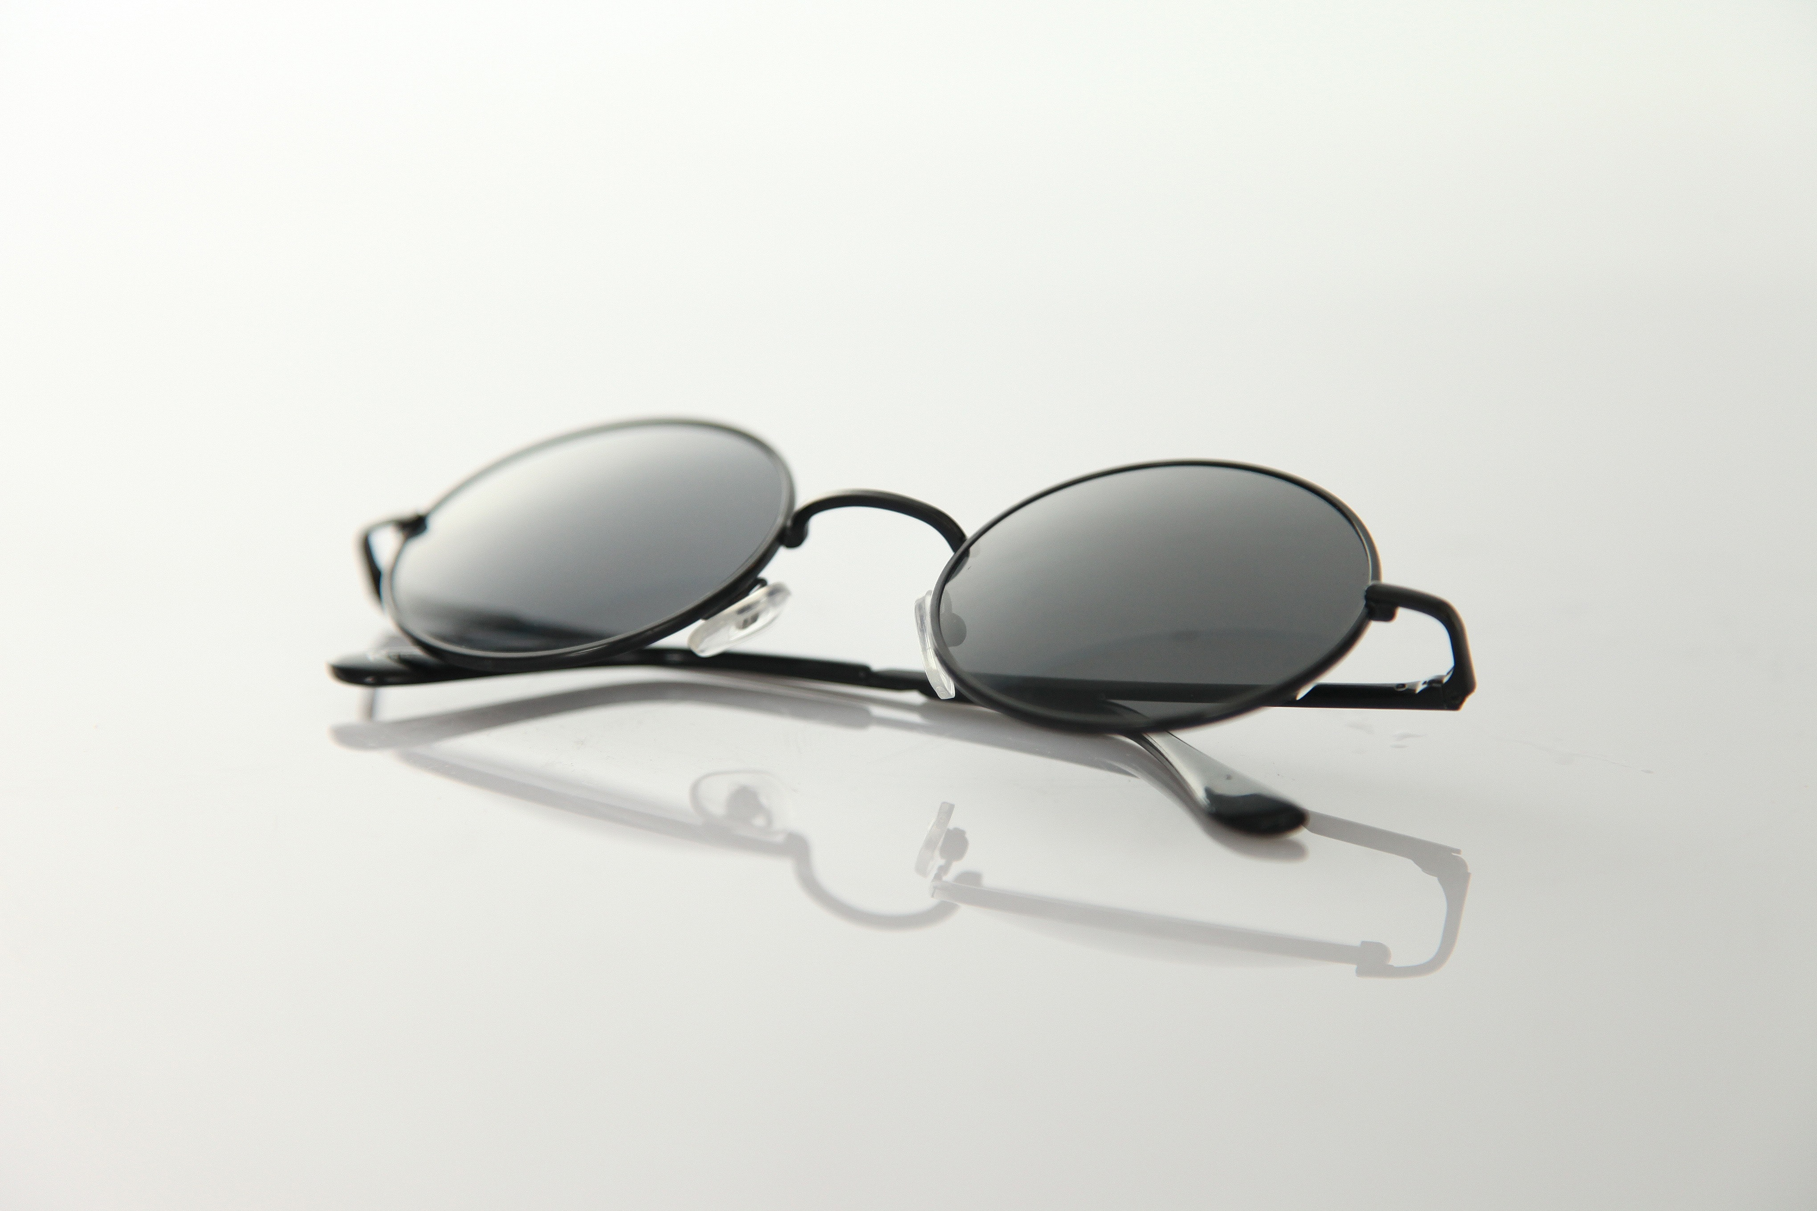
facebook.com/nearyouonlineshopmarket
SUNGLASS
99
Bluetooth Glass
$199.
-30%
Polarized RoundSun Glasses
$250
@nearyouonlineshopmarket
Nearyouonlineshopmarket.com
Notes:
Photo by Pixabay from Pexels
Photo by Daria Shevtsova from Pexels

Slide 4
facebook.com/nearyouonlineshopmarket
99
$199.
-30%
$250
HAND BAG
Leather Bag
@nearyouonlineshopmarket
Nearyouonlineshopmarket.com
Blue Ladies Bag
Notes:
Photo by Moose Photos from Pexels

Slide 5
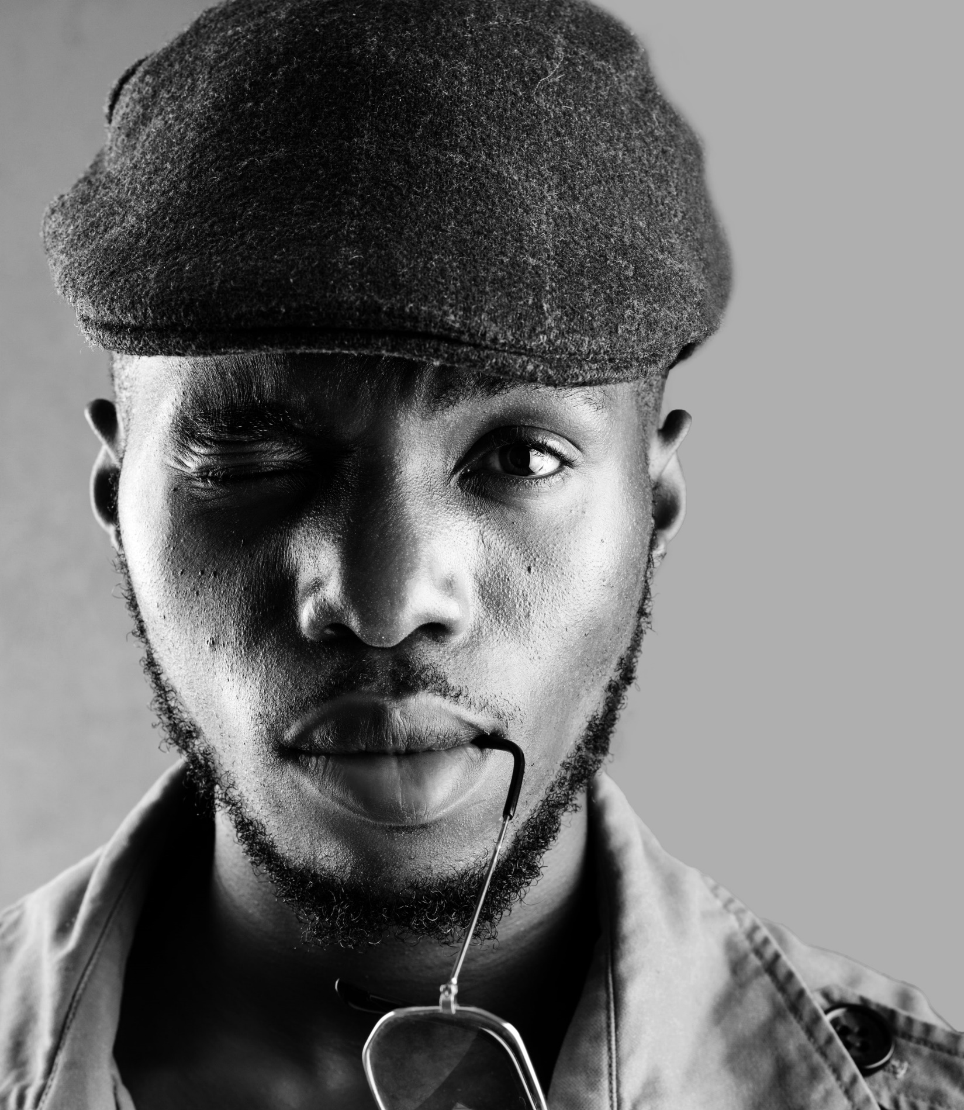
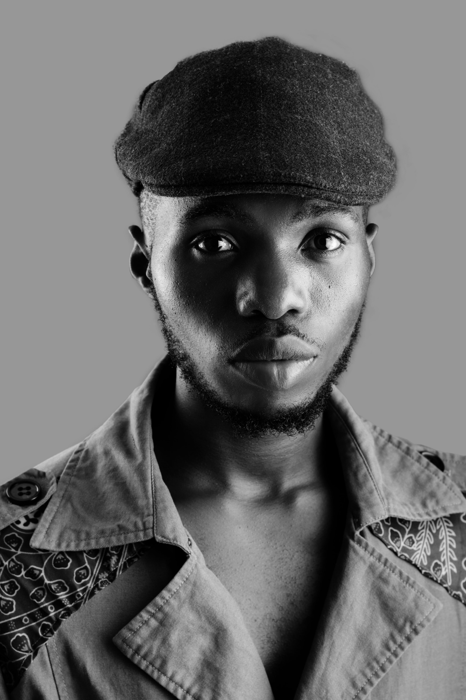
facebook.com/nearyouonlineshopmarket
GREY HAT
@nearyouonlineshopmarket
Nearyouonlineshopmarket.com
99
Assorted Designs
$219.
-35%
Cotton
Grey
$315
Notes:
Photo by Dazzle Jam from Pexels
Photo by Dazzle Jam from Pexels

Slide 6
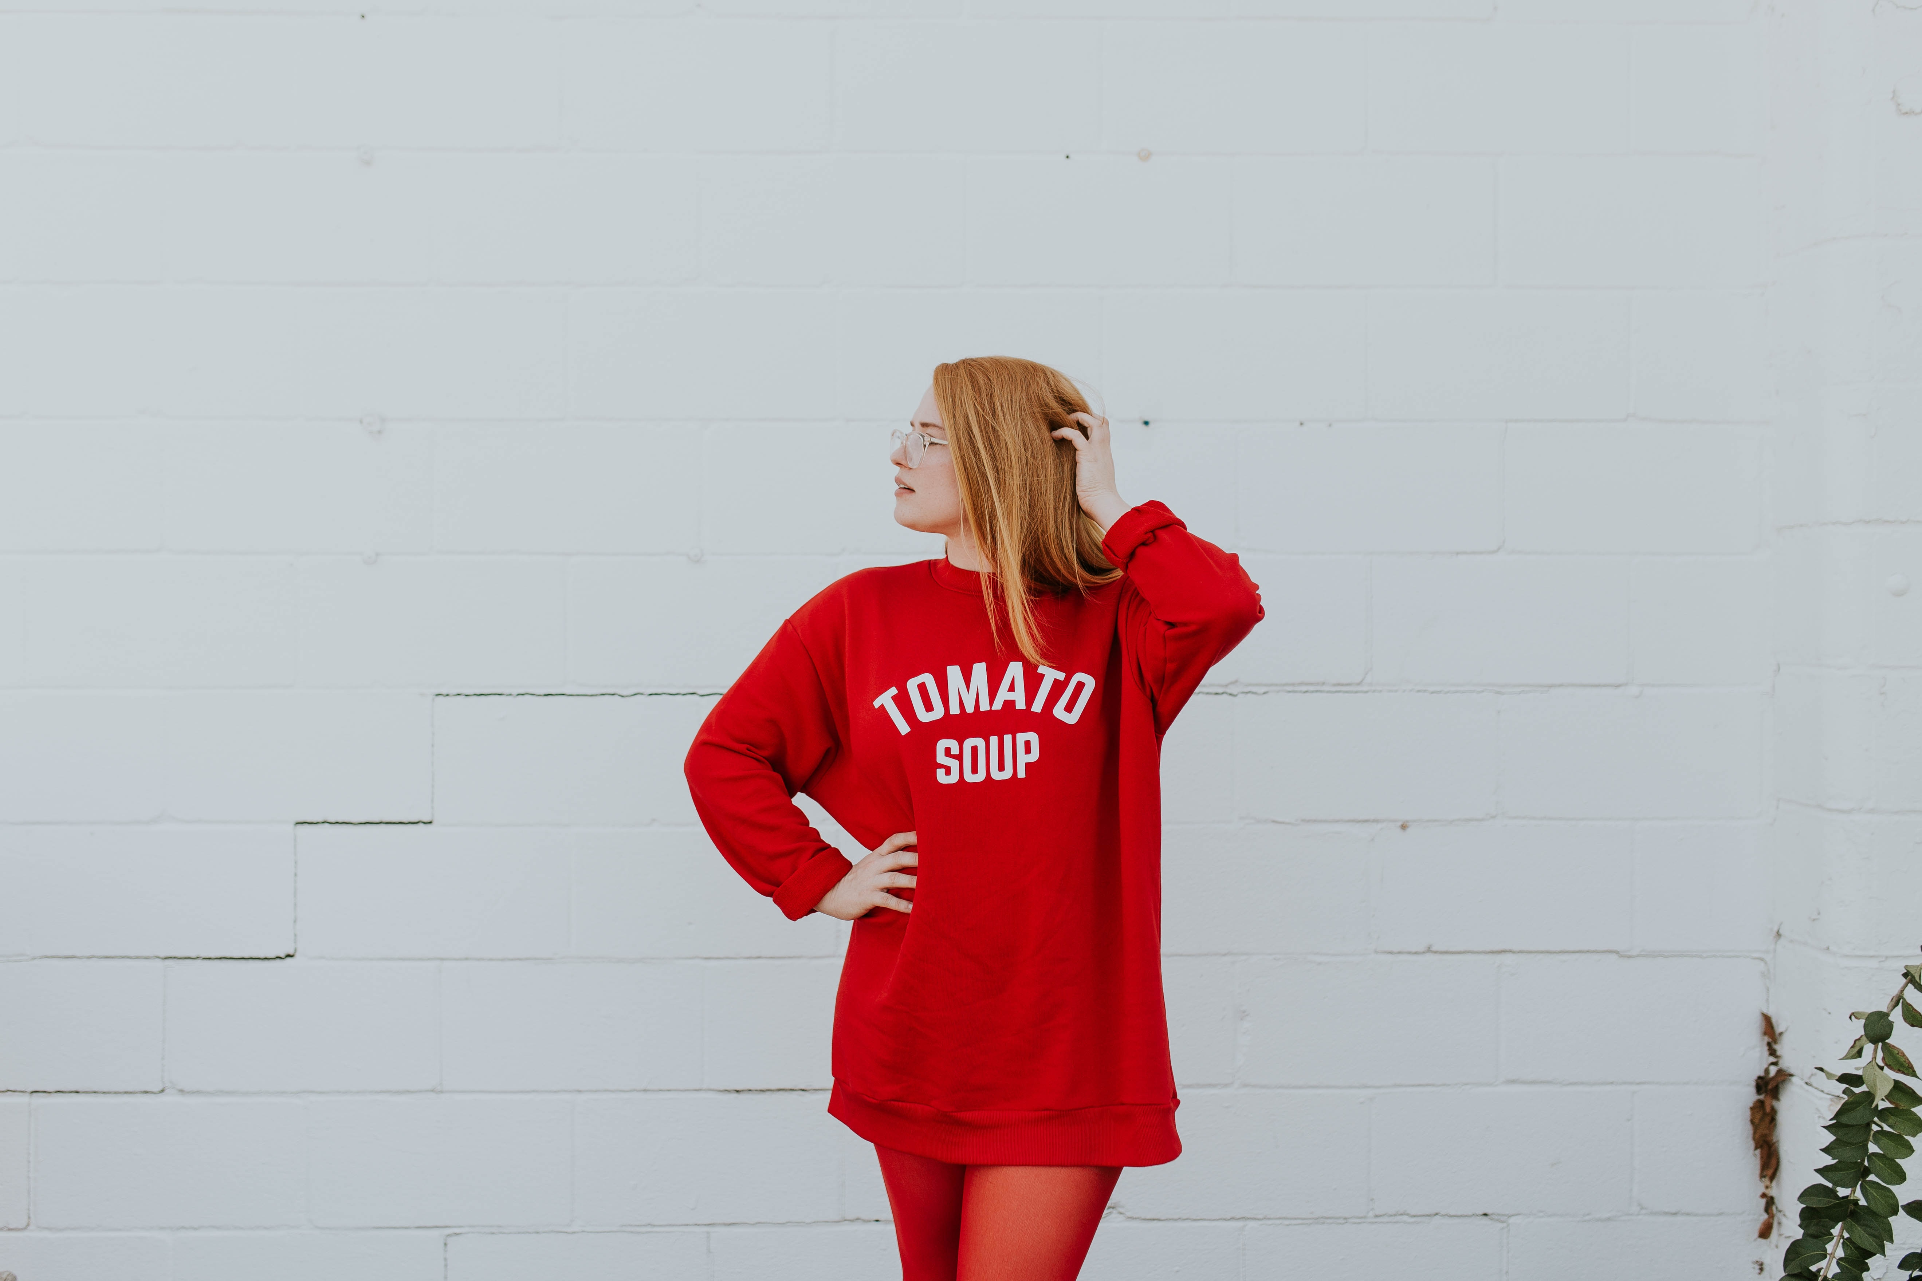
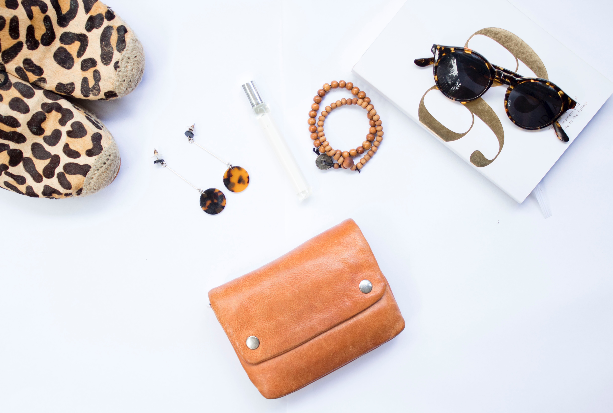
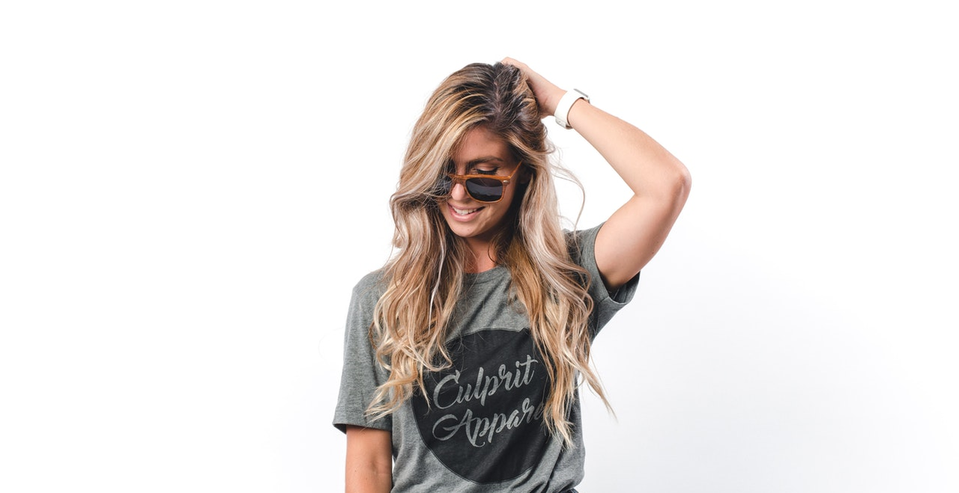
{
facebook.com/nearyouonlineshopmarket
WOMENS FASHION
UPTO 70% OFF
Collection 2018 – 2019
Women's Bag, Polo and Shirts
@nearyouonlineshopmarket
Nearyouonlineshopmarket.com
Notes:
Photo by S O C I A L . C U T on Unsplash
Photo by Brooke Cagle on Unsplash
Photo by freestocks.org on Unsplash
Photo by Spencer Selover from Pexels
Photo by Anastasiya Gepp from Pexels

Slide 7
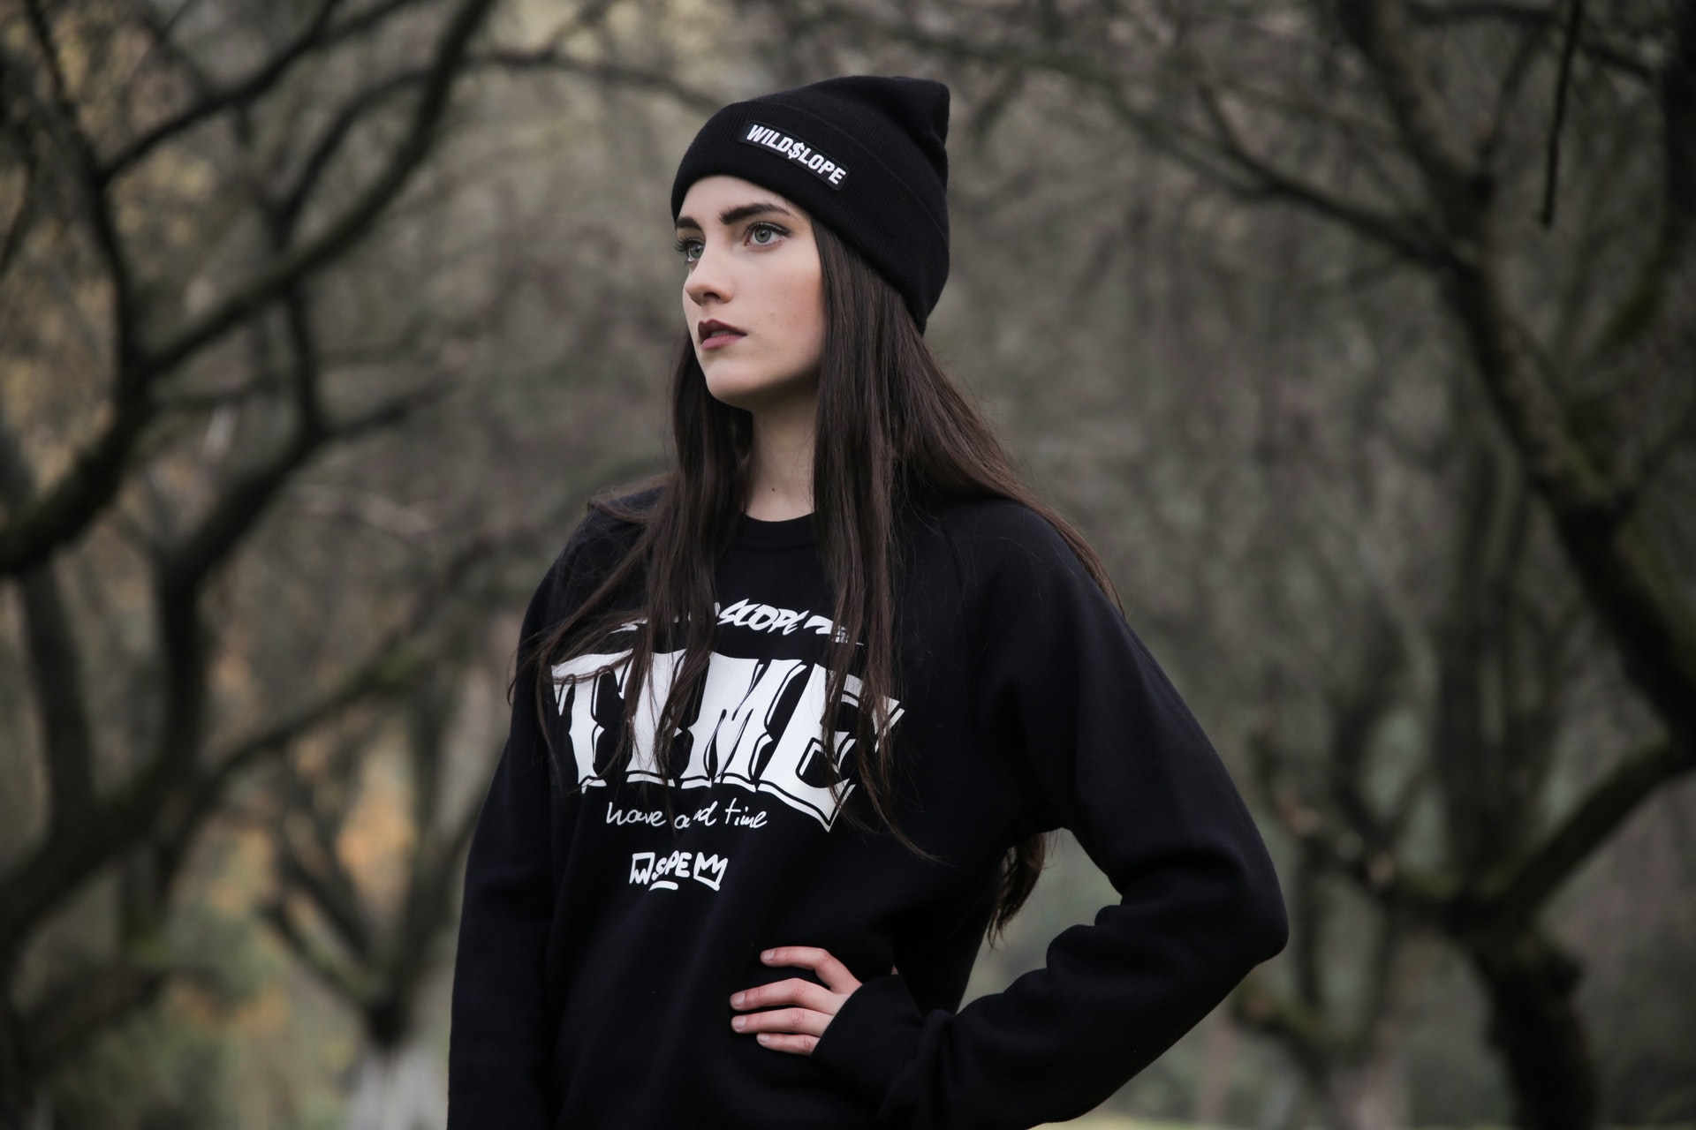
Nearyouonlineshopmarket.com
BLACK UNISEX
SWEATSHIRT
20% Off
Collection 2018 – 2019
100% Pure Cotton
Notes:
Photo by Pixabay from Pexels

Slide 8
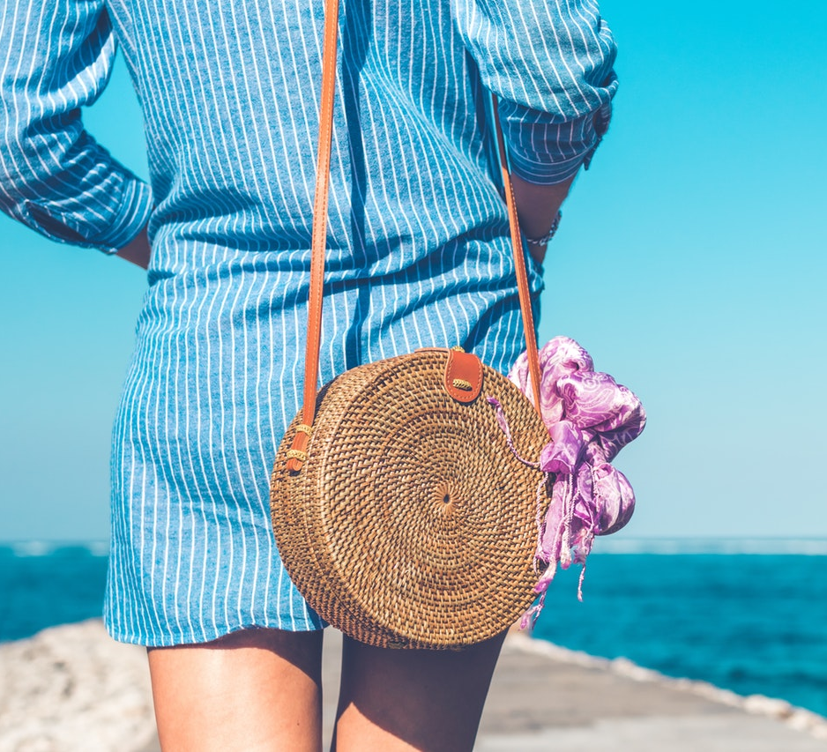
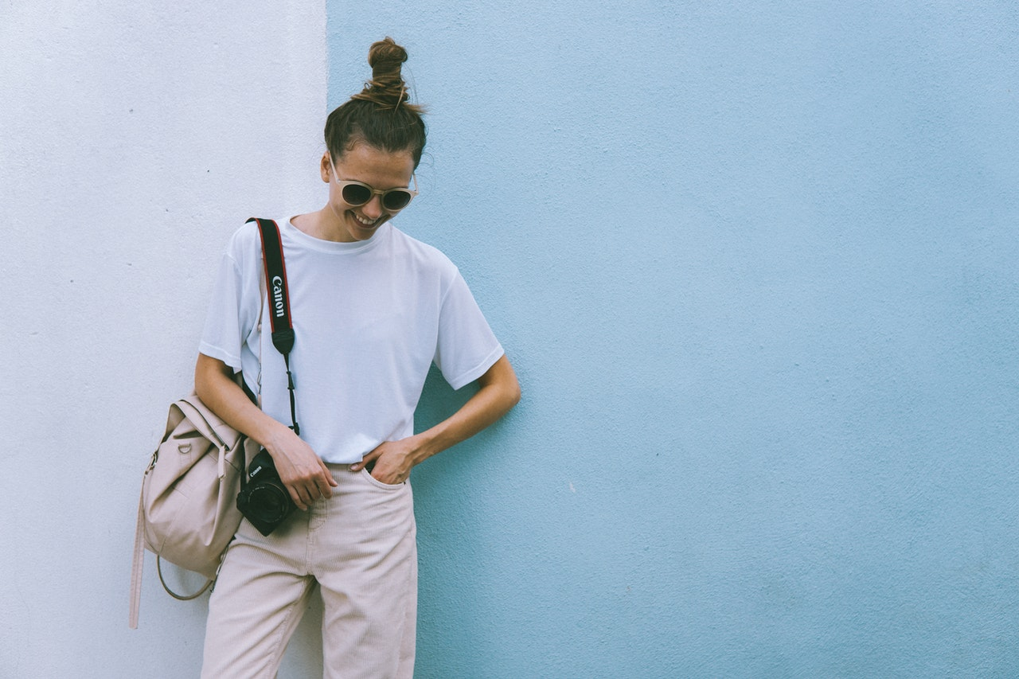
Nearyouonlineshopmarket.com
new arrivals
MORE COMING SOON
Collection 2018 – 2019
Branded items
Notes:
Photo by Moose Photos from Pexels
Photo by Elle Hughes from Pexels
Photo by flat hito from Pexels
Photo by ian dooley on Unsplash
Photo by Artem Bali from Pexels

Slide 9
facebook.com/nearyouonlineshopmarket
Polyester, spandex, cotton
Green, blue, yellow
XS, S, M, L, XL
99
SQUARE SCARF
$219.
new
$315
in pink
Notes:
Photo by bruce mars from Pexels

Slide 10
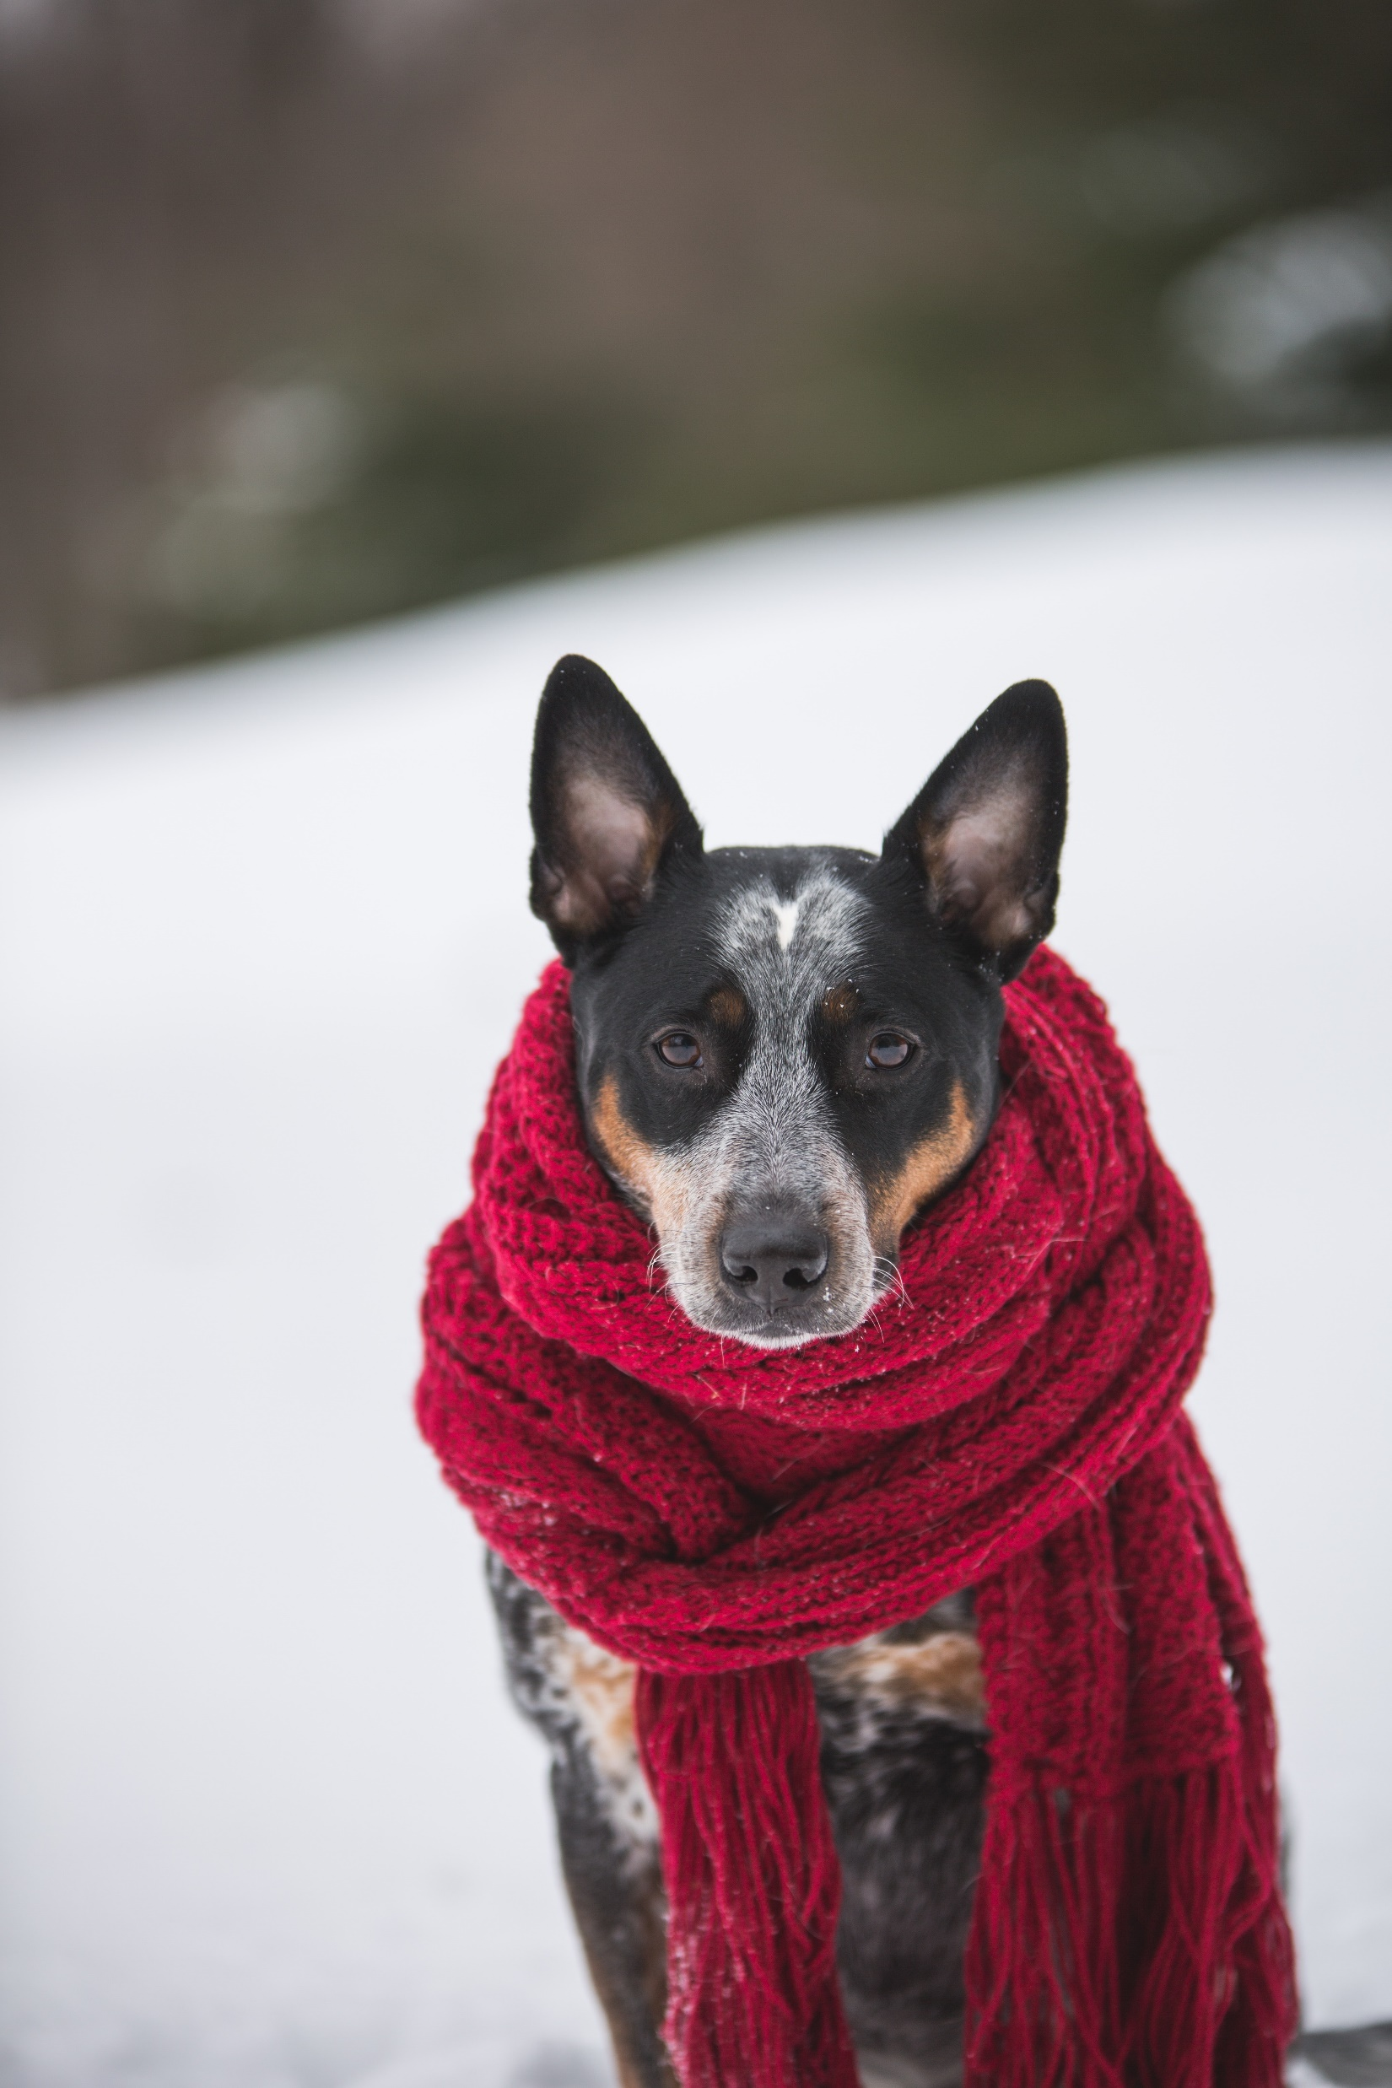
facebook.com/nearyouonlineshopmarket
Polyester, spandex, cotton
Green, blue, yellow
XS, S, M, L, XL
99
FLUFFY SCARF
$219.
new
$315
in red
Notes:
Photo by bruce mars from Pexels

Slide 11
the new season
2019
@nearyouonlineshopmarket
Nearyouonlineshopmarket.com
facebook.com/nearyouonlineshopmarket
Notes:
Photo by Moose Photos from Pexels

