Slide 1
BRANDED QUALITY PRODUCTS – Made in Korea

Slide 2
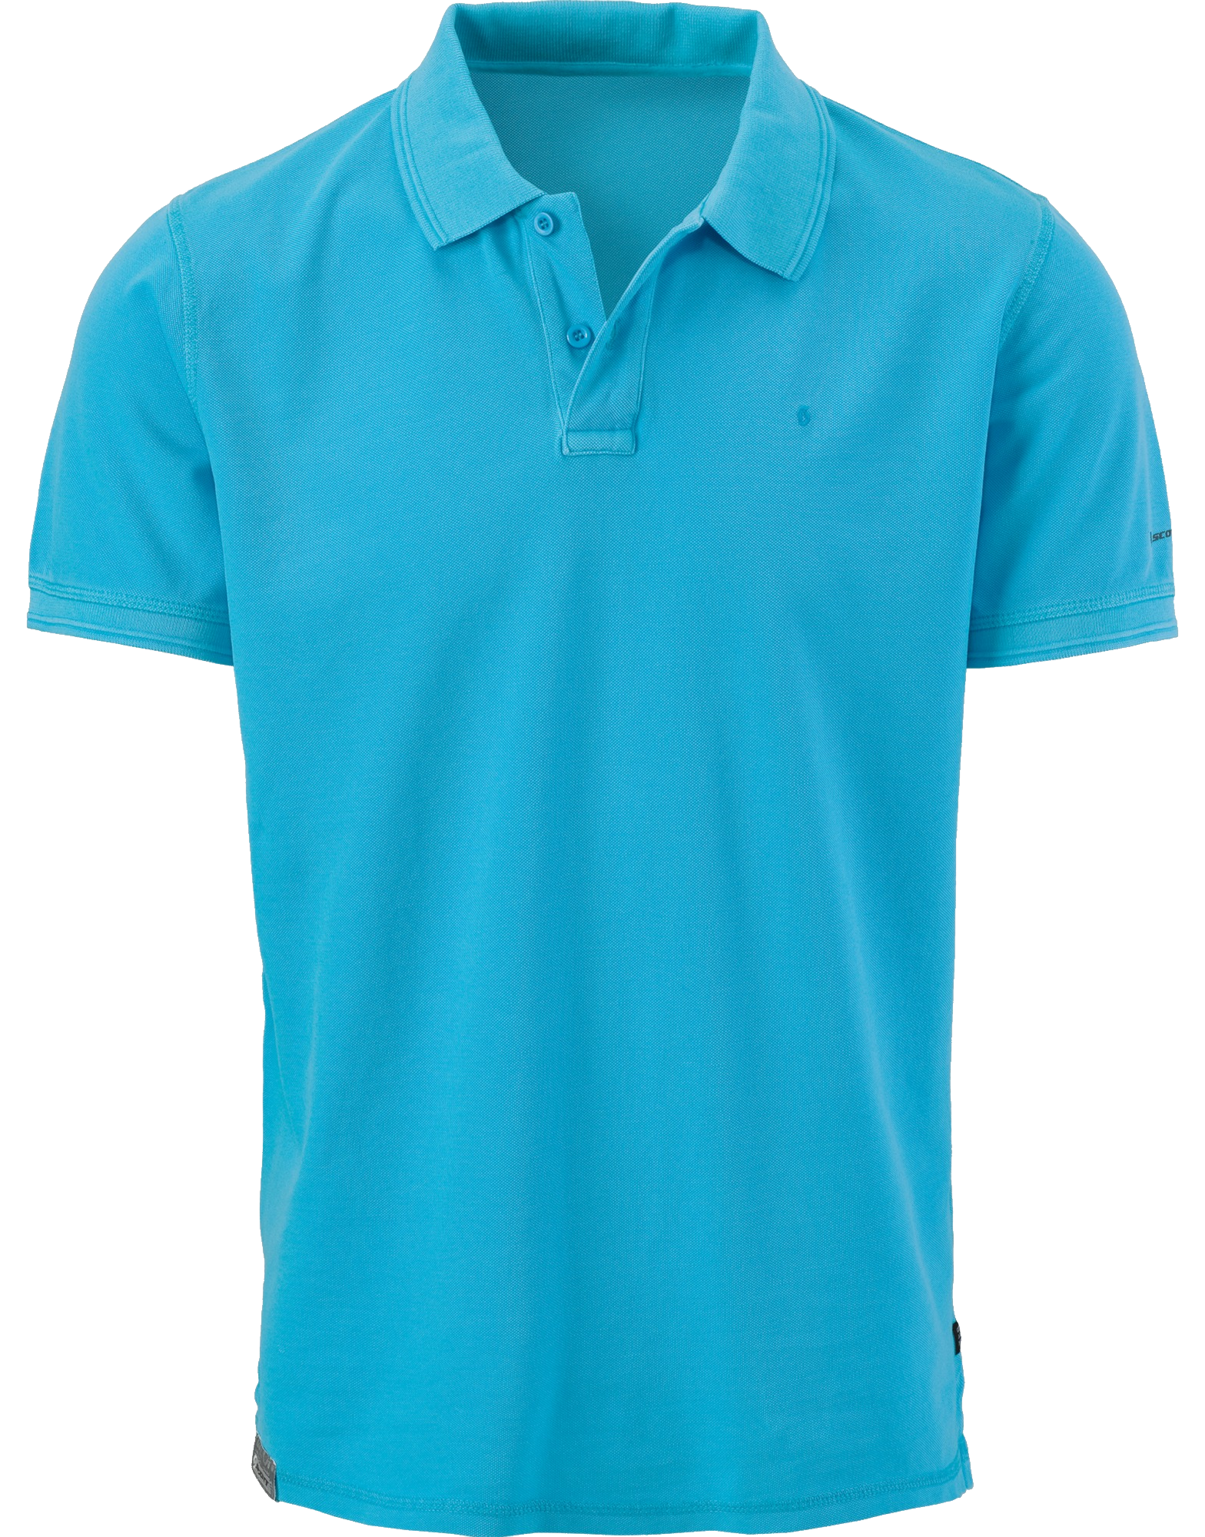
POLO FOR MEN
100% Cotton
Color: Blue
$50
More product on site iseduceonlineshop.com

Slide 3
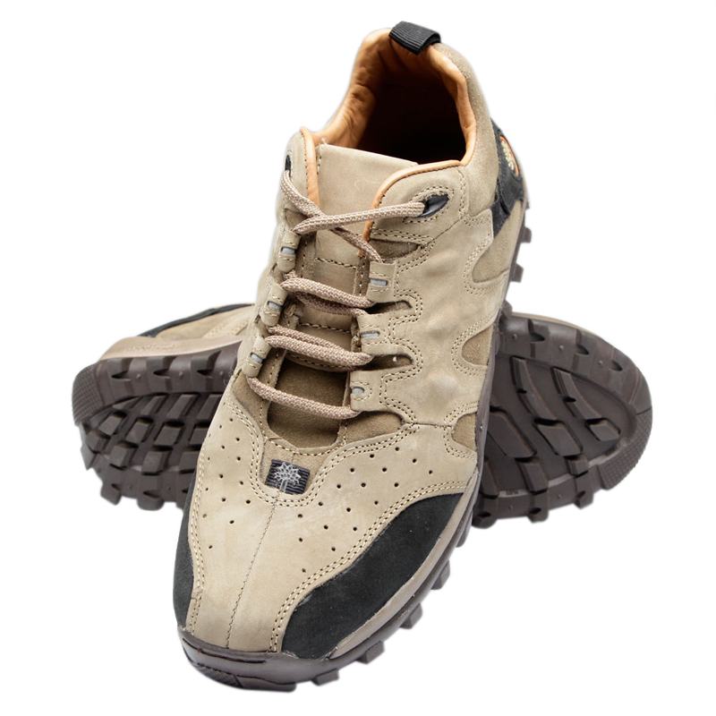
MEN SHOES
Korean Style Men Rubber Shoes
Sizes: 35 – 39
Color: Light Brown
$80
More product on site iseduceonlineshop.com

Slide 4
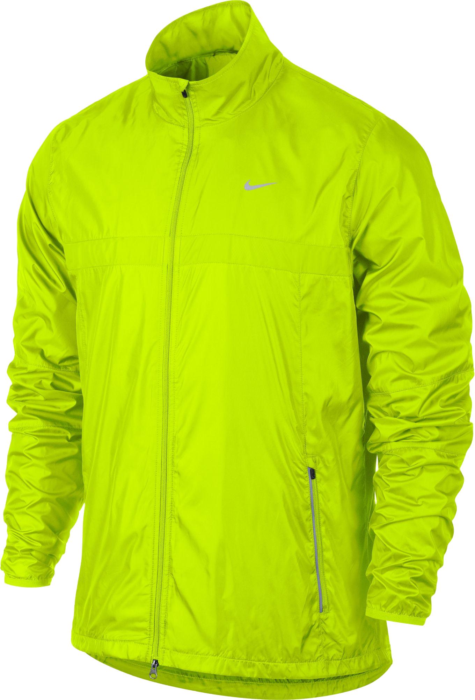
WINDBREAKER
Korean Style Windbreaker
Color: Yellow Green, Black
Sizes: S, M, L, XL
$60
More product on site iseduceonlineshop.com

Slide 5
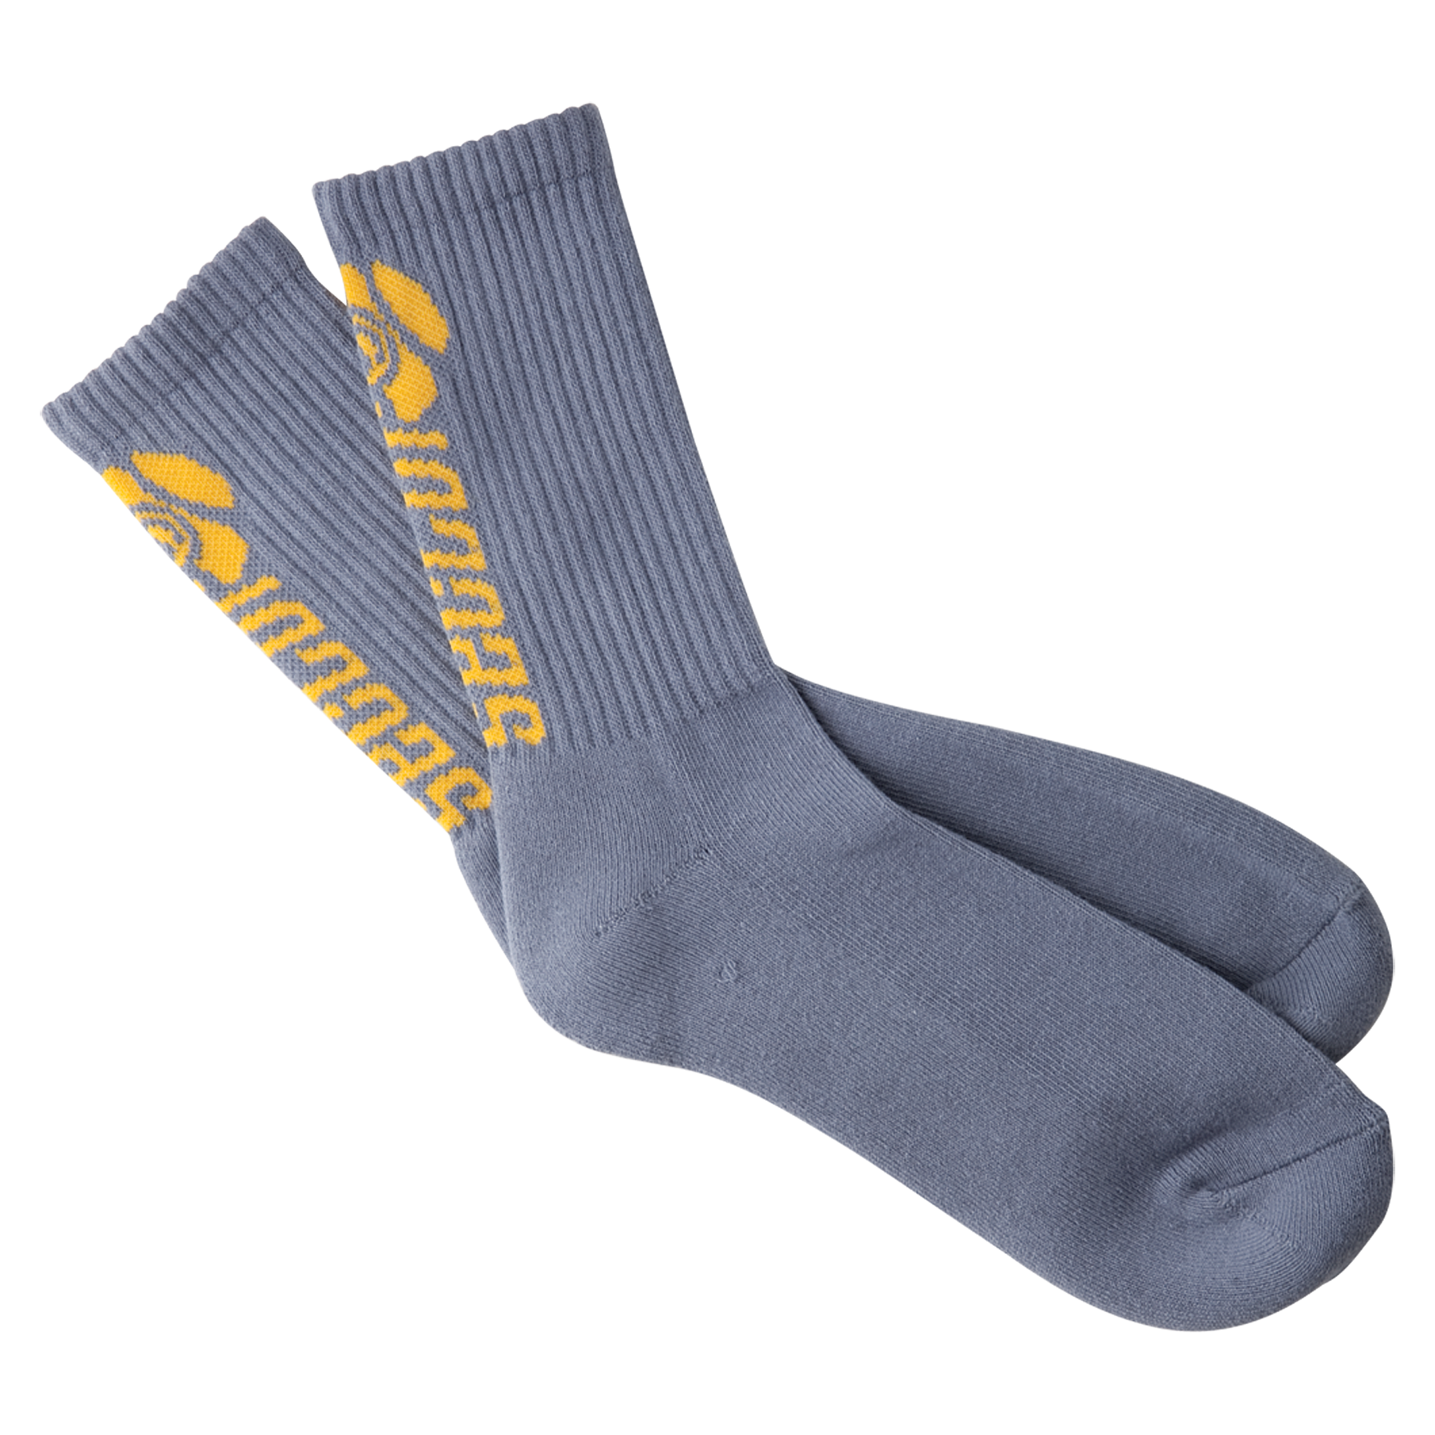
SOCKS
100& Cotton Socks
Color: Blue
$10
More product on site iseduceonlineshop.com

Slide 6
SHORTS
Silk Korean style Shorts for men
$20
More product on site iseduceonlineshop.com
Notes:
[URL=http://www.pngall.com/shorts-png/download/15004 Shorts Free PNG Image[/URL]

Slide 7
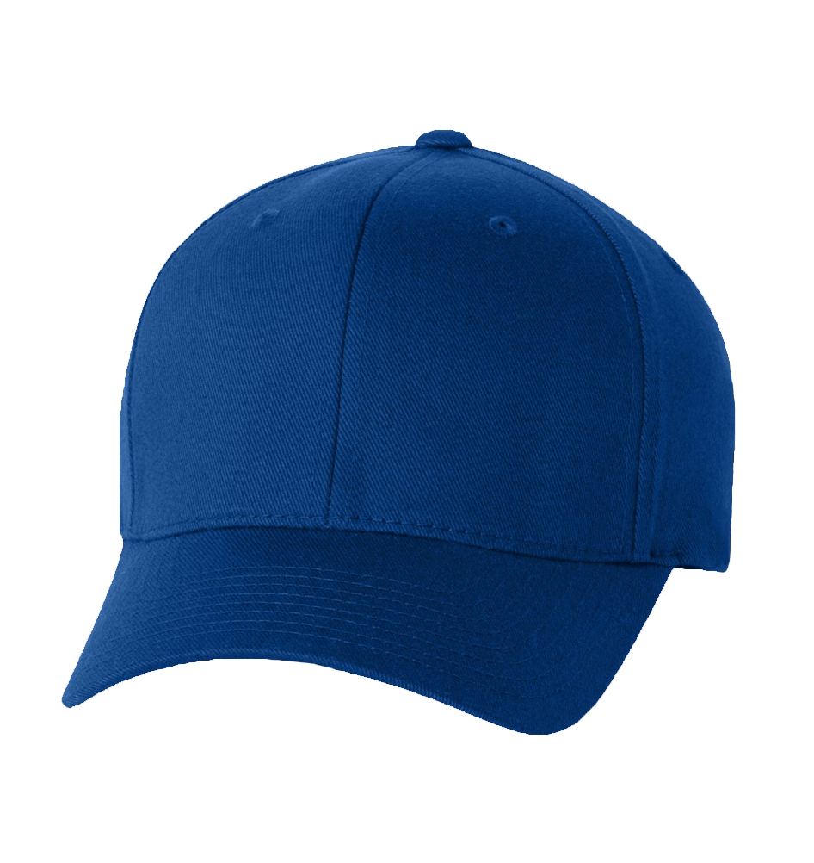
BLUE HAT
Plain Blue Baseball Cap for men
$15
More product on site iseduceonlineshop.com

Slide 8
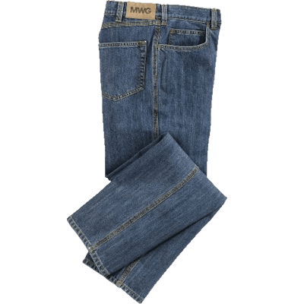
BLUE JEANS
MWG Blue Jeans for Men
Sizes: 26 - 35
$25
More product on site iseduceonlineshop.com

Slide 9
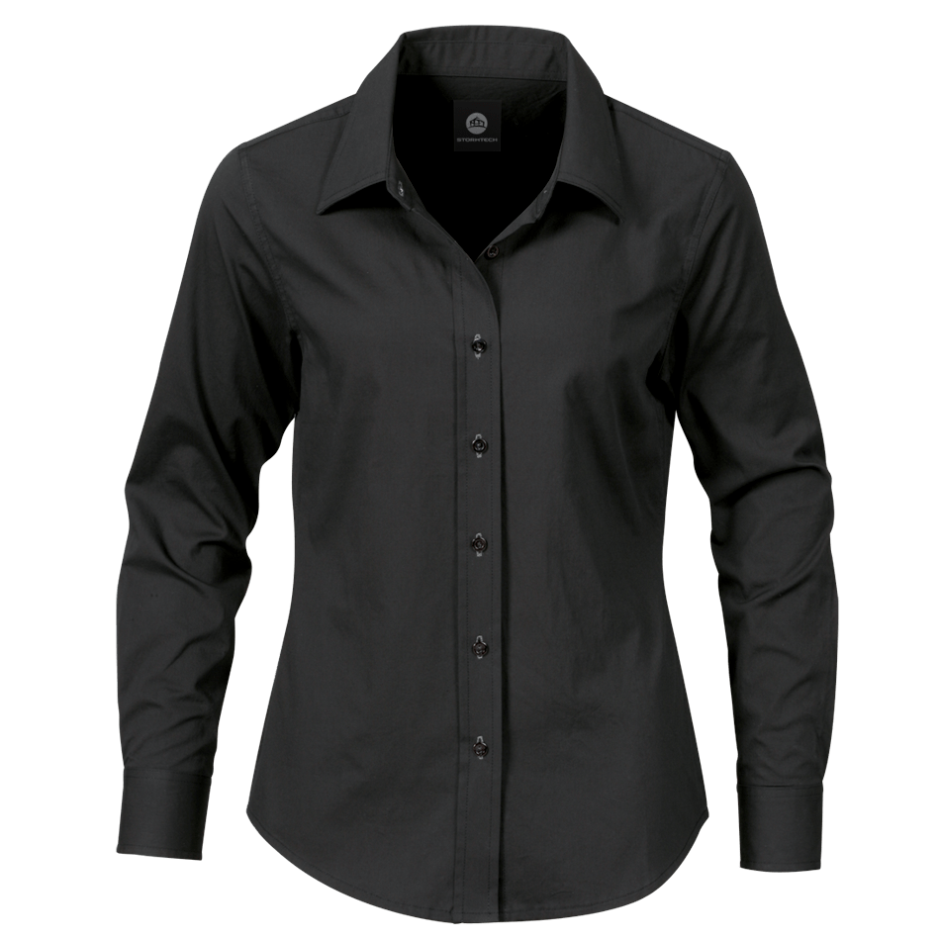
BLACK LONGSLEEVE
Black Long sleeve for Men
Color: Black
Sizes: S, M, L, XL
$70
More product on site iseduceonlineshop.com

Slide 10
BRANDED QUALITY PRODUCTS – Made in Korea
Facebook.com/iseduce
Instagram.com/iseduce
Twitter.com/iseduce
Youtube.com/iseduce

