Slide 1
CPC PARTS COMPUTER WAREHOUSE
50% Discount for all items.

Slide 2
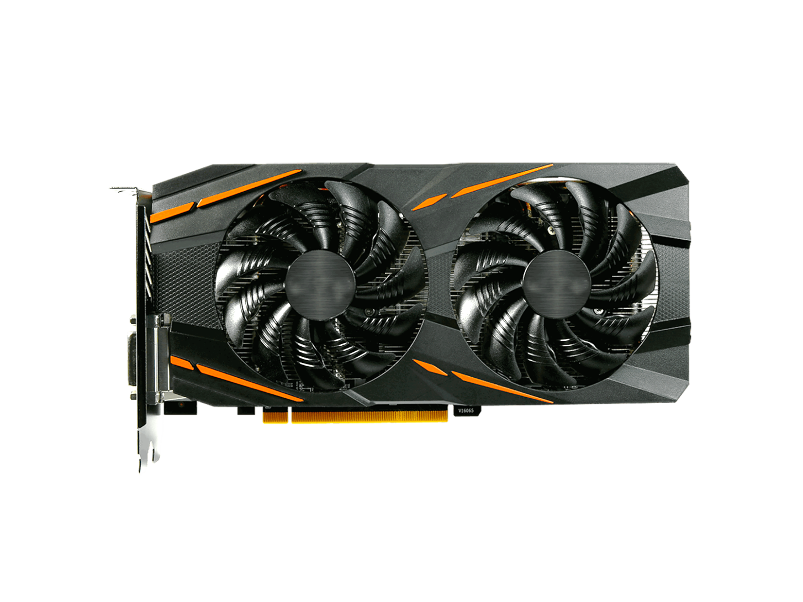
SKYFORCE RX 2000
ULTIMATE PERFORMANCE
The SKYFORCE RX 2000 is new flagship gaming CPU based on the VIDEOCARD architecture. The latest addition to the ultimate gaming platform , this card is packed with extreme gaming horsepower, next-gen 11 Gbps GDDR5X memory and a massive 11GB frame buffer.
$100.
00
Notes:
https://www.pngfly.com/png-n2y9t8/download.html

Slide 3
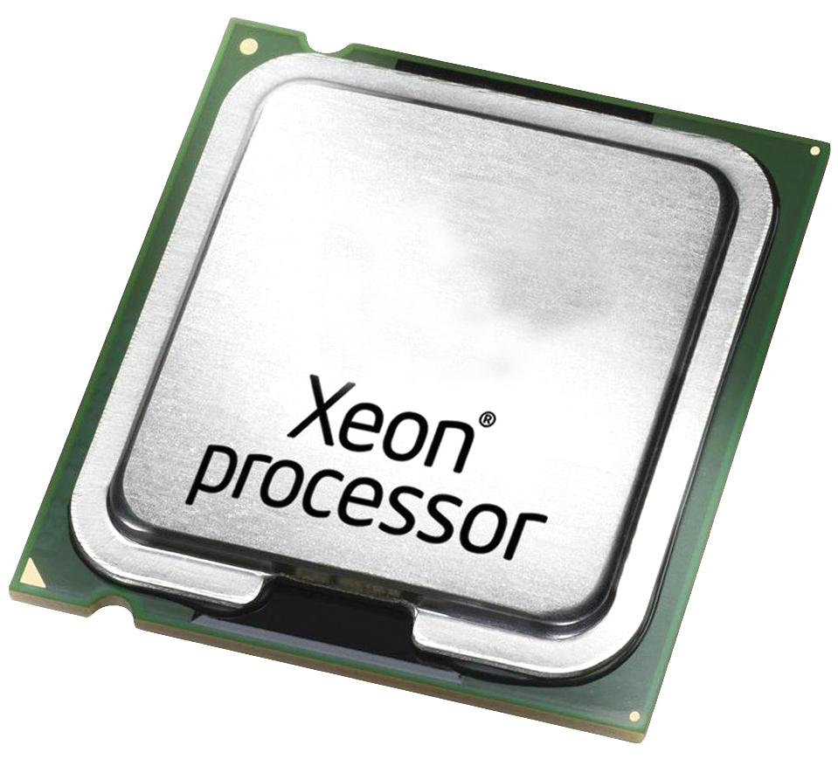
6th CORE JX 5600
NEXT GEN PROCESSOR
6TH CORE JX 5600, a seventh-generation CPU from JX, based on the new next gen architecture, with six cores, 4.2 GHz maximum clock. Cache 8 MB and Smart Cache
Bus Speed 8 GT/s DMI3 with of QPI Links, and TDP 65 W
$300.
00
EASY COLOR CONTROL
Notes:
https://www.pngfly.com/png-j48pvq/download.html

Slide 4
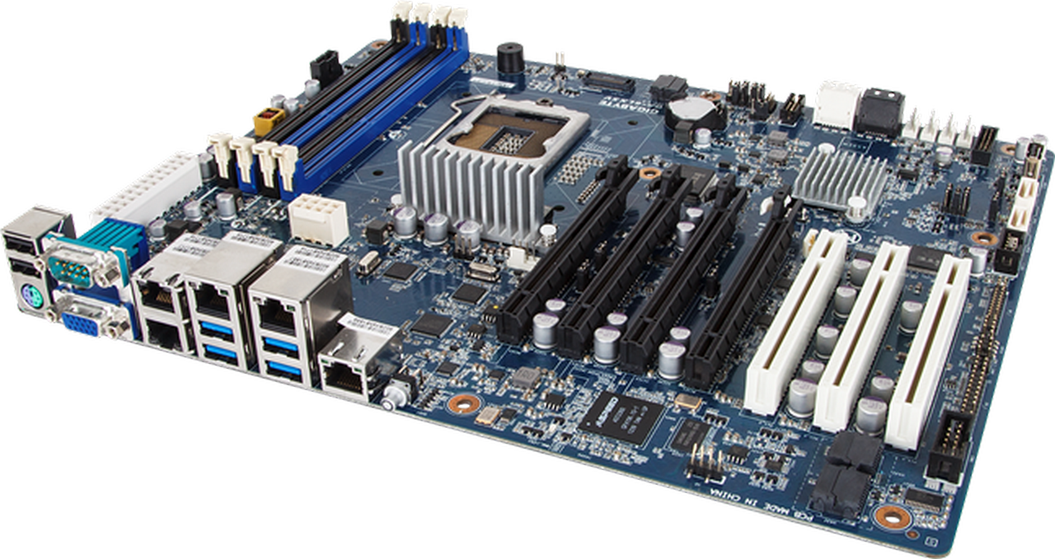
7270BM MOTHERBOARD
CLEVER HARDWARE & SOFTWARE TOOLS
Customize and set up your own scheme with RGB Mystic light Sync. Select any of the colors from the palette using your smartphone or the MSI Gaming App to match your system style.
Bored of the same color?
$200.
00
Notes:
https://www.pngfly.com/png-6byty1/download.html

Slide 5
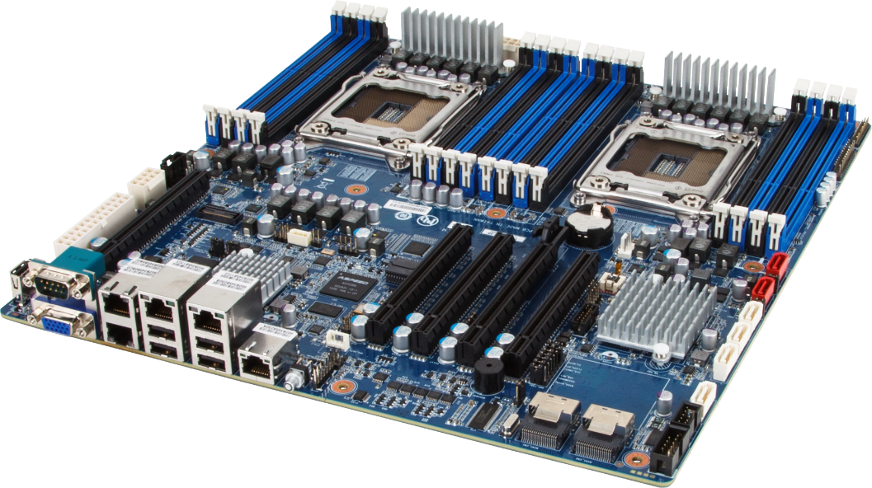
M79 MOTHERBOARD
OFFICE STABILITY PRODUCT
MSI motherboard maintains the commitment to product stability by introducing Military class III components! In addition to the use of Hi-c CAP, SFC and Solid CAP, MSI now incorporates DrMOS II, the next generation DrMOS that provides an integrated Double Thermal Protection to maximize the lifespan of components.
$150.
00
Notes:
https://www.pngfly.com/png-knmuvp/download.html

Slide 6
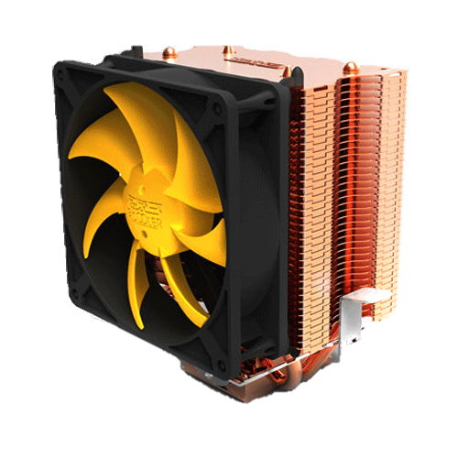
LD-16S CPU FAN
LD-16S CPU FAN
The LD-16S CPU FAN is the latest 12cm model of classic LD-series single tower CPU coolers, which have received more than 400 awards and recommendations from the international press. The S-version 45mm slim shape guarantees 100% compatibility with tall RAM modules and at the same time.
$70.
00
Notes:
https://www.pngfly.com/png-5dgsi5/

Slide 7
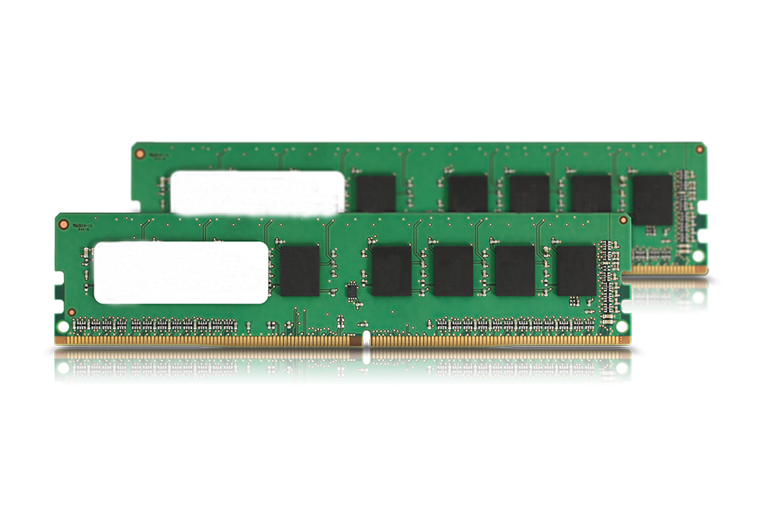
FLYFORM DDR4
HIGH PERFORMANCE
FLYFOR, DDR4 memory is designed for high-performance overclocking. The heat spreader is made of pure aluminum for faster heat dissipation, and the performance PCB helps manage heat and provides superior overlocking headroom.
$50.
00
Notes:
https://www.pngfly.com/png-zjyuvn/download.html

Slide 8
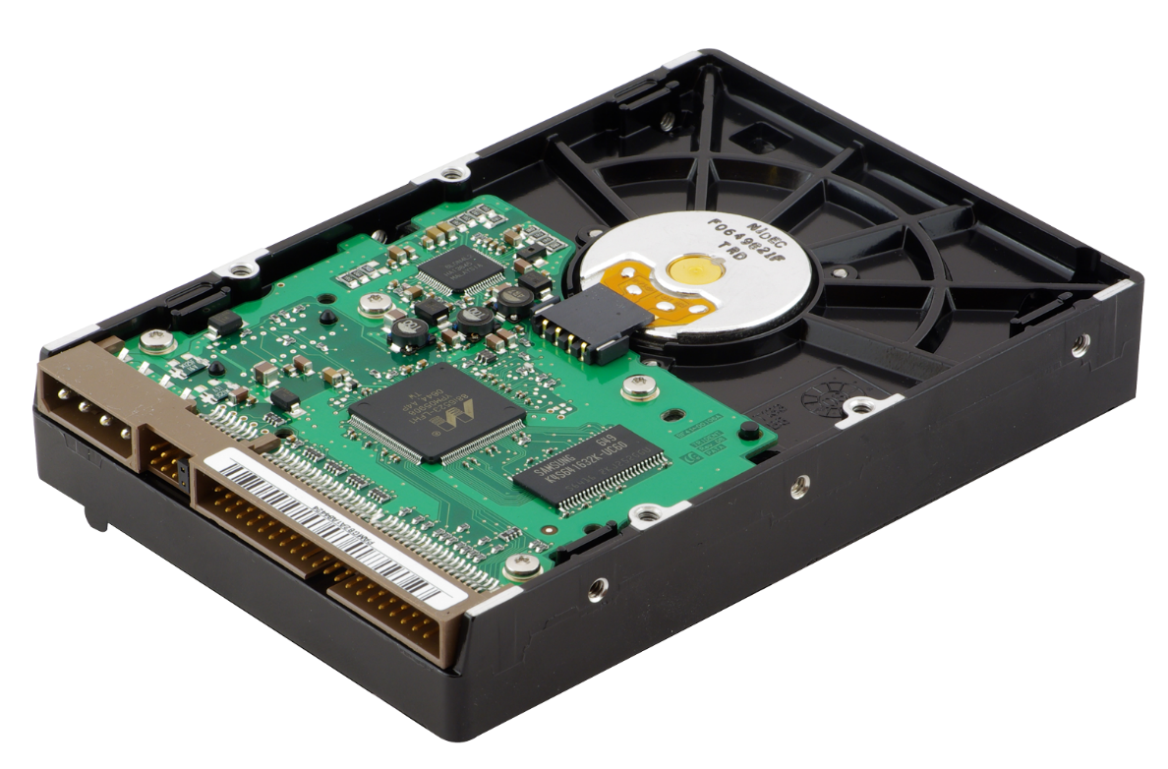
HARD DISK DRIVE
PERFORMANCE MOBILE HDD
Sophisticated performance-enhancing features deliver the speed you need for demanding applications like photo and video editing and internet gaming. High performance, high capacity, high reliability and cutting-edge technology; the ideal drive for those who demand the best.
$200.
00
Notes:
https://www.pngfly.com/png-d7zhte/download.html

Slide 9
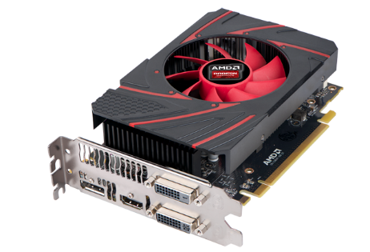
CAPTURE Xa800
LavD-16S CPU FAN
X800 Pro boasts Instant, Game view, powering your stream with superior low latency technology. The result? An unbeatable broadcasting experience that awards you absolute, real-time satisfaction. You’re live on Twitch or YouTube in a flash, and it’s never felt more natural.
$300.
00
Notes:
https://www.pngfly.com/png-tr83xh/download.html

Slide 10
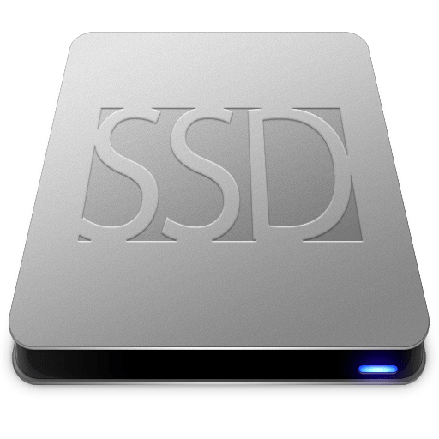
EXTERNAL SOLID-STATE DRIVE
EXTERNAL SOLID-STATE DRIVE
Ready for your high-performance computing needs, an SSD offers optimized storage which blazing speed and leading-edge reliability. Optimized for multitasking, SSDs let you simultaneously run several demanding applications with ease.
$100.
00
Notes:
https://www.pngfly.com/png-mlmtr7/download.html

Slide 11
MAXBOOK LAPTOP
THIN, LIGHT, YET POWERFUL
The all-new MAXBOOK combines class and power and brings it to a whole new level. Featuring a Full HD display with 1920 x 1080 resolution, the UX303UA delivers stunning visuals in amazing detail. At just 0.7-inch thin, the UX303UA is also power-packed with an SKYFORCE RX and 6th CORE JX 5600 processor for a silky-smooth performance.
$900.
00
Notes:
https://www.pngfly.com/png-3synux/download.html

Slide 12
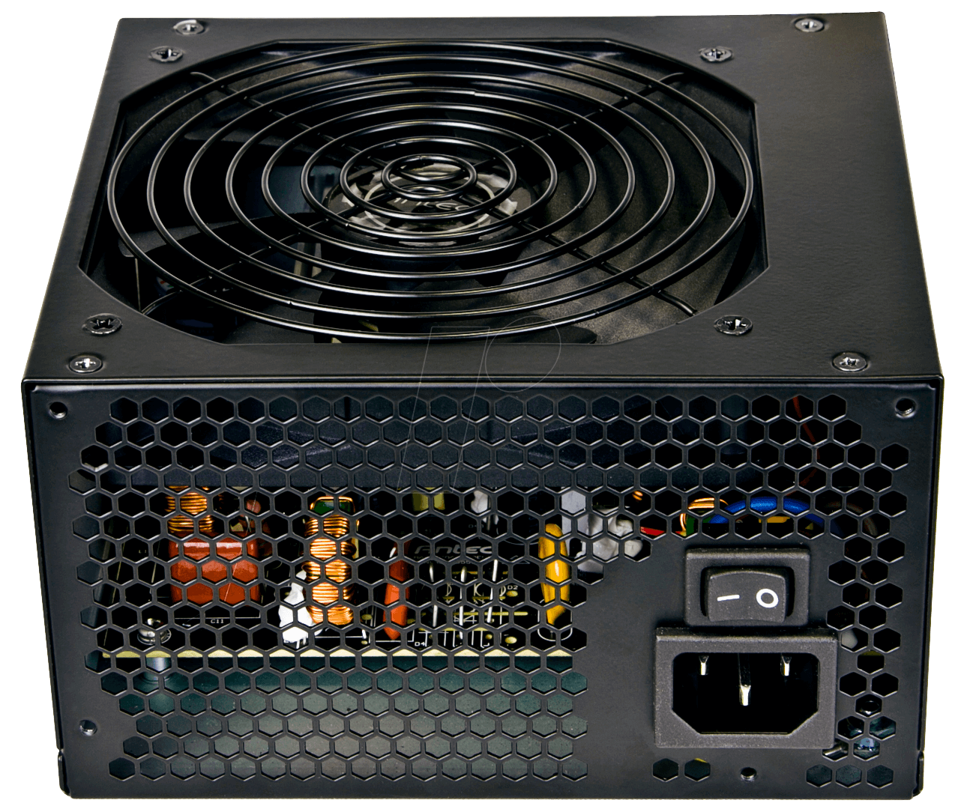
TD1a200 POWER
SOUNDLESS PERFORMANCE
Our flagship power supply comes with an award-winning design, an efficiency rating few have managed to reach, and the control perks of high-end digital signal processor. All of this combines into a whopping 1200 watts of continuous power that can run safely over a conventional household outlet.
$95.
00
Notes:
https://www.pngfly.com/png-gy7yst/download.html

Slide 13
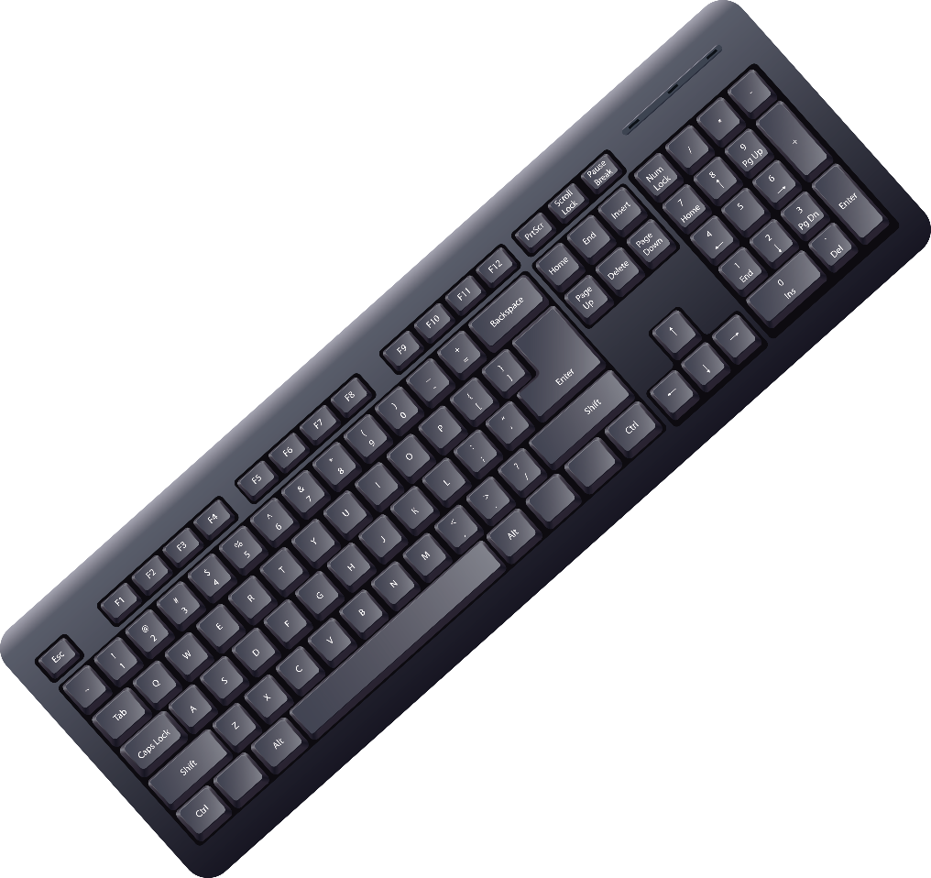
X120 KEYBOARD PRO
MECHANICAL GAMING KEYBOARD
The mechanical keys on x120 deliver gaming grade responsiveness and tactile feedback superior to rubber-domed keys. With an actuation force and distance of 45 g and 2 mm respectively, the keys are optimized for rapid command entry..
$109.
00
Notes:
https://www.pngfly.com/png-6suznf/download.html

Slide 14
CPC PARTS COMPUTER WAREHOUSE
50% Discount for all items.

