Slide 1
25 NOVEMBER
BLACK FRIDAY
SUPER SALE
DISCOUNT UP TO 80%

Slide 2
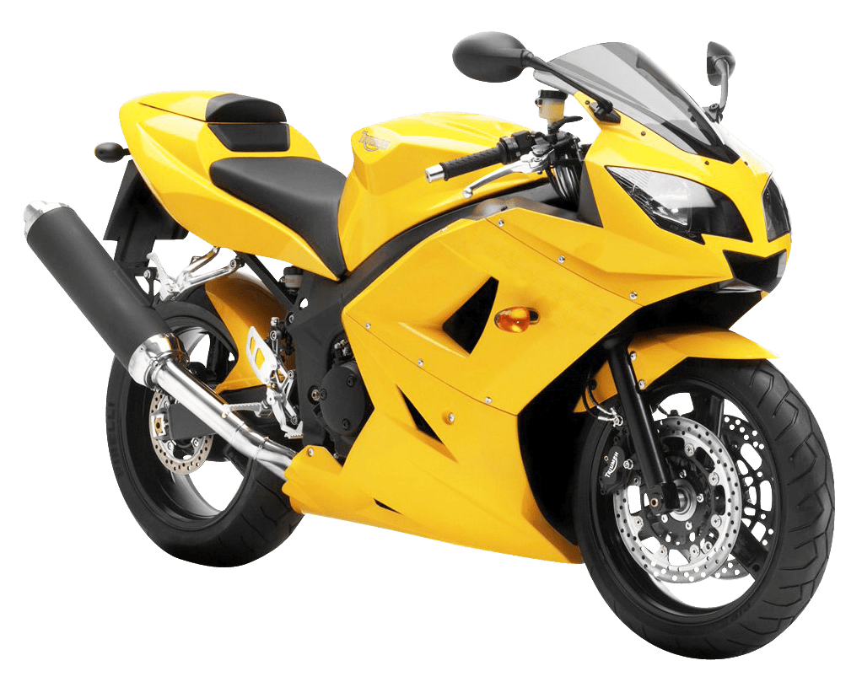
Rubber Tire
Color: Yellow
Material: Metal + Plastic
Manufacturer: Kawasaki
Kawasaki H3R Motorcycle Model
$7500
THIS WEEK ONLY
$5500
BEST OFFER
Notes:
https://www.pngfly.com/png-zz3gdd/download.html

Slide 3
Core i7 Gaming PC
Intel Core i7-4790 4Ghz 8M (4 core)
4nd GenMemory : 8GB (PC3-1600)
Hard disk of 500GB
$1000
THIS WEEK ONLY
$850
BEST OFFER
Notes:
https://www.pngfly.com/png-2izilz/

Slide 4
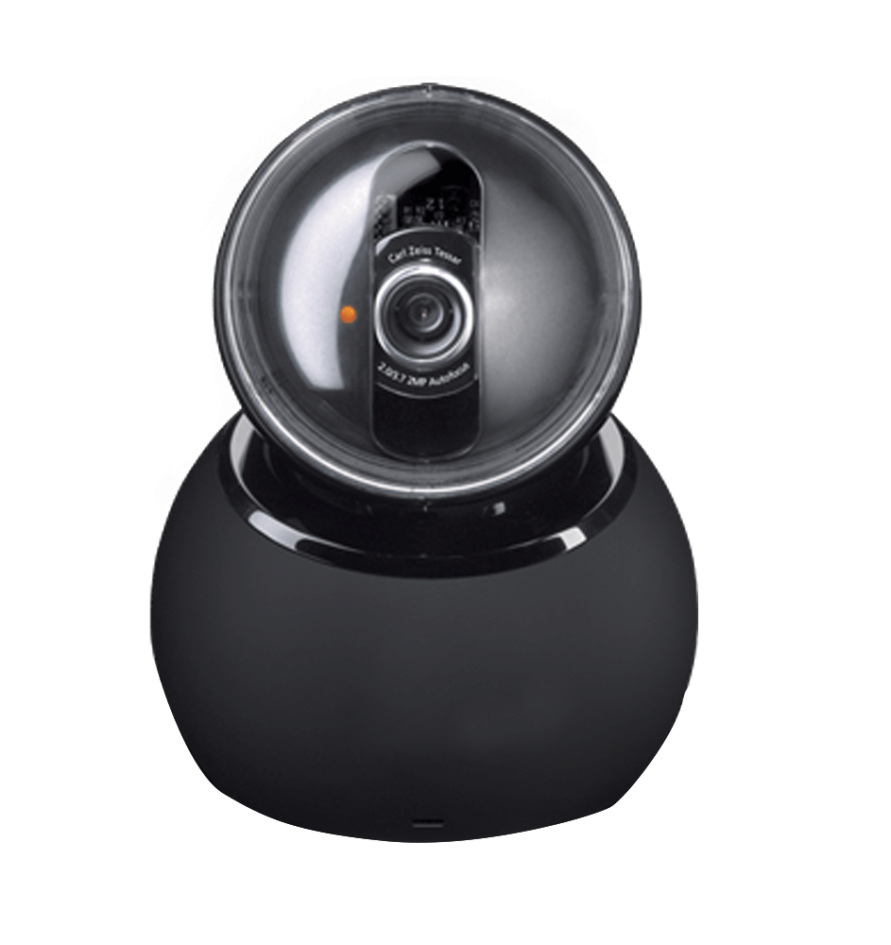
SPY CAMERA
HD 1080P Night Vision Camcorder Infrared Video Recorder
$300
THIS WEEK ONLY
$150
BEST OFFER
Notes:
https://www.kisspng.com/png-webcam-logitech-quickcam-camera-usb-video-device-c-503391/download-png.html

Slide 5
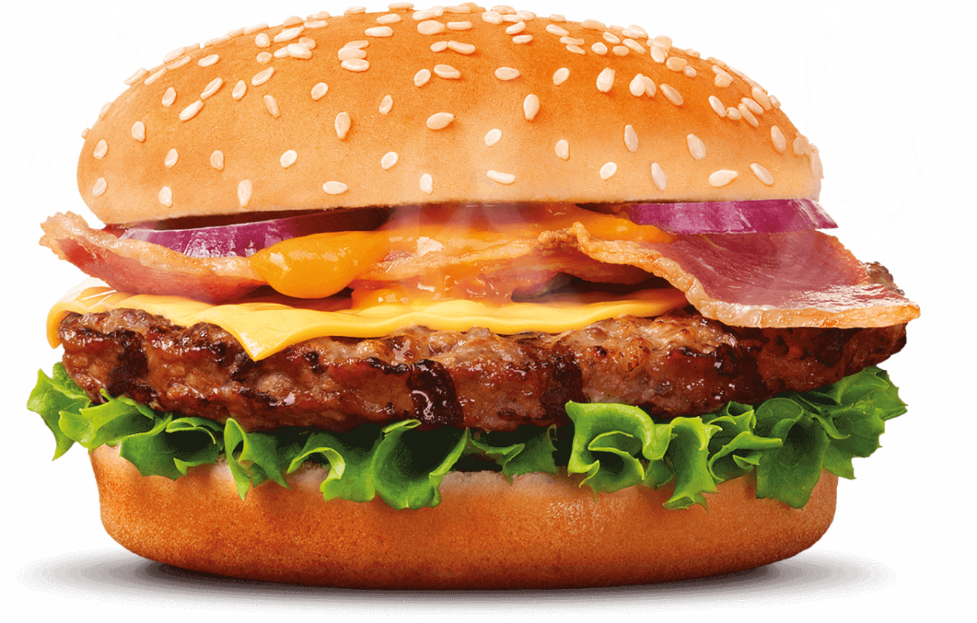
BURGER BUDGET
BURGER with Cheese, Lettuce and Onions
$12
THIS WEEK ONLY
$5
BEST OFFER
Notes:
https://www.pngfly.com/png-qae9j2/download.html

Slide 6
V15 with Gaming Powerbank
Elevating Front Camera 12Mp + 8MP + 5MP
Triple Rear Camera 6GB
Ram + 128Gb
$500
THIS WEEK ONLY
$350
BEST OFFER
Notes:
https://www.pngfly.com/png-e0vfk4/download.html

Slide 7
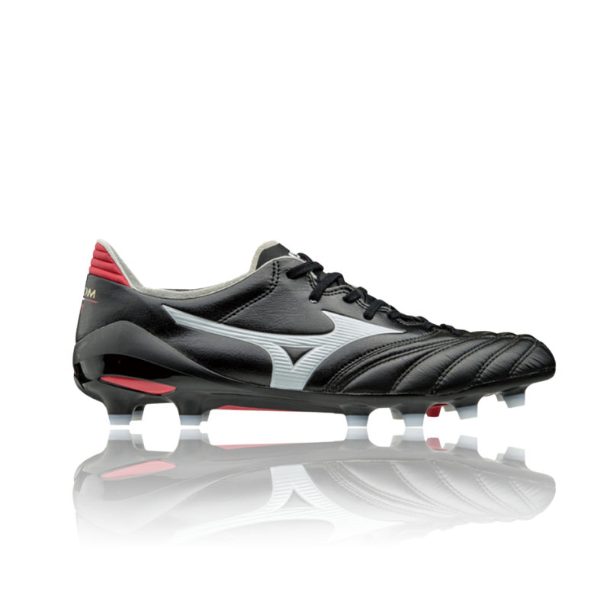
NIKE RUBBER SHOES
$300
COLOR: BLACK
FOR MEN
THIS WEEK ONLY
$150
BEST OFFER
Notes:
https://www.pngfly.com/png-cx2cqt/

Slide 8
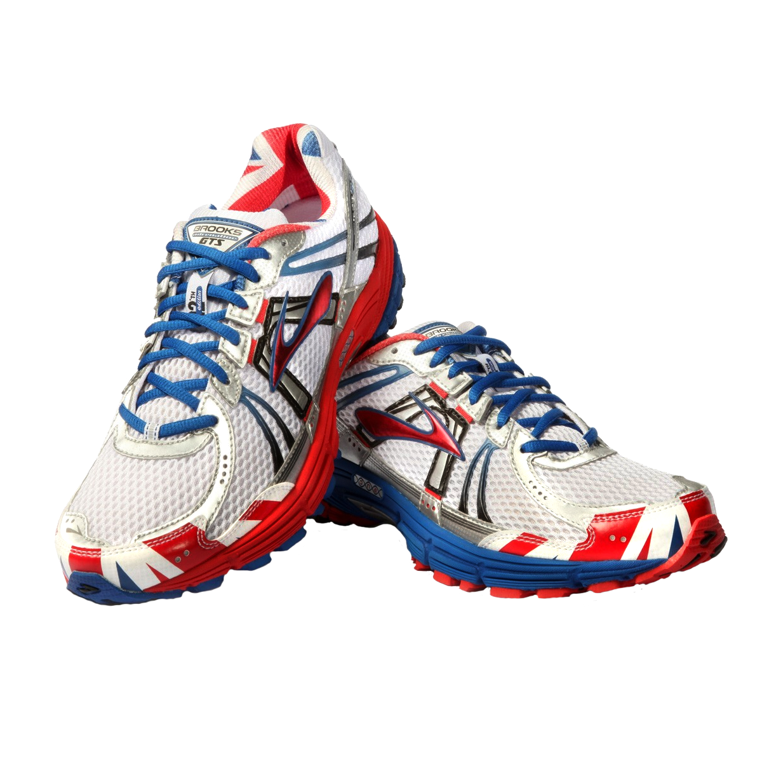
NIKE RUBBER SHOES
COLOR: WHITE
FOR WOMEN
$300
THIS WEEK ONLY
$150
BEST OFFER
Notes:
https://www.pngfly.com/png-1malns/download.html

Slide 9
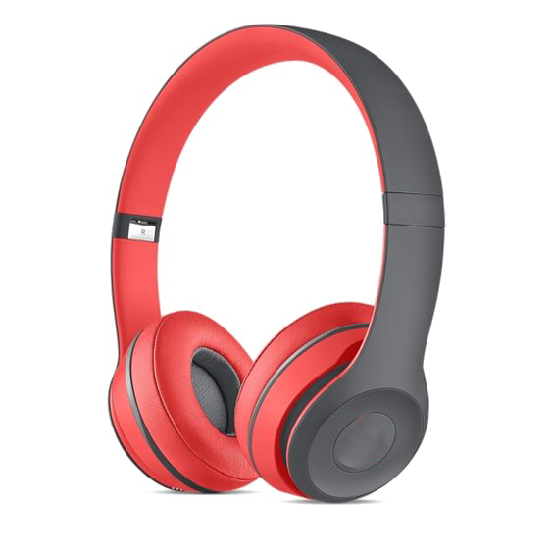
RED HEADPHONE
With NOISE CANCELLATION
$300
THIS WEEK ONLY
$150
BEST OFFER
Notes:
https://www.pngfly.com/png-5pb3b5/download.html

Slide 10
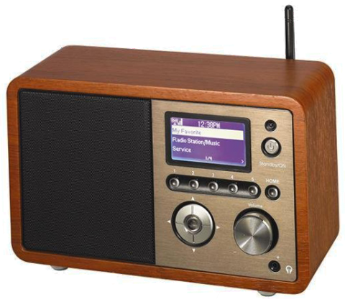
PRODUCT
PRODUCT INFO
$300
THIS WEEK ONLY
$150
BEST OFFER
Notes:
https://www.pngfly.com/png-2utp19/download.html

