Slide 1
CIRCULAR MOTION STORE

Slide 2
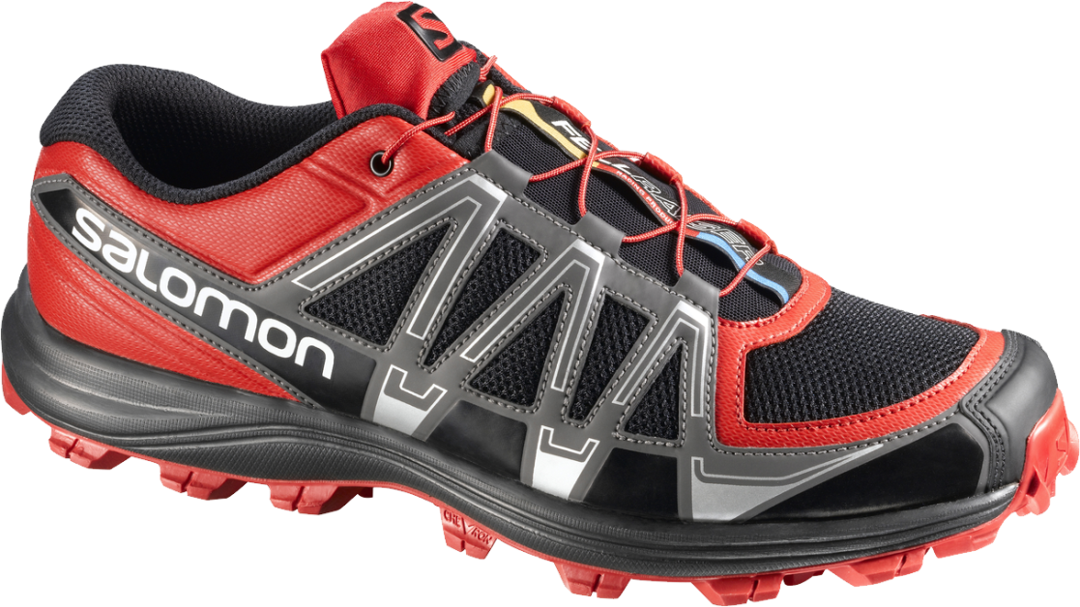
GET AMAZING PRODUCTS EXPERIENCE
EVENING SHOES
Soft, High Quality Rubber
$299

Slide 3
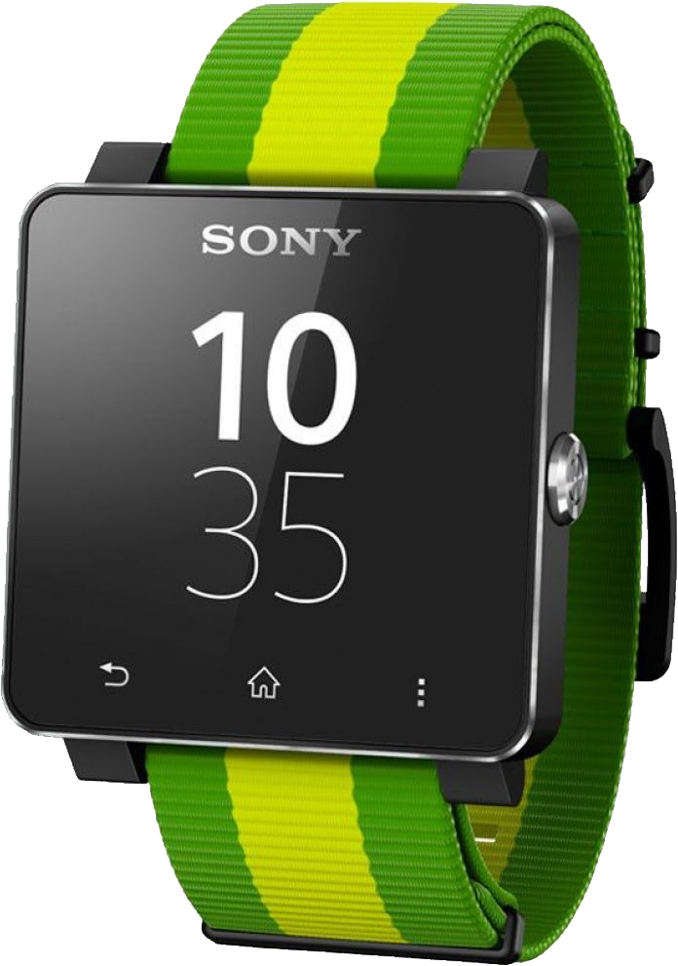
GET AMAZING PRODUCTS EXPERIENCE
SONY WATCH
Allows you to track your route and distance so you can see just how far you’ve come.
$25

Slide 4
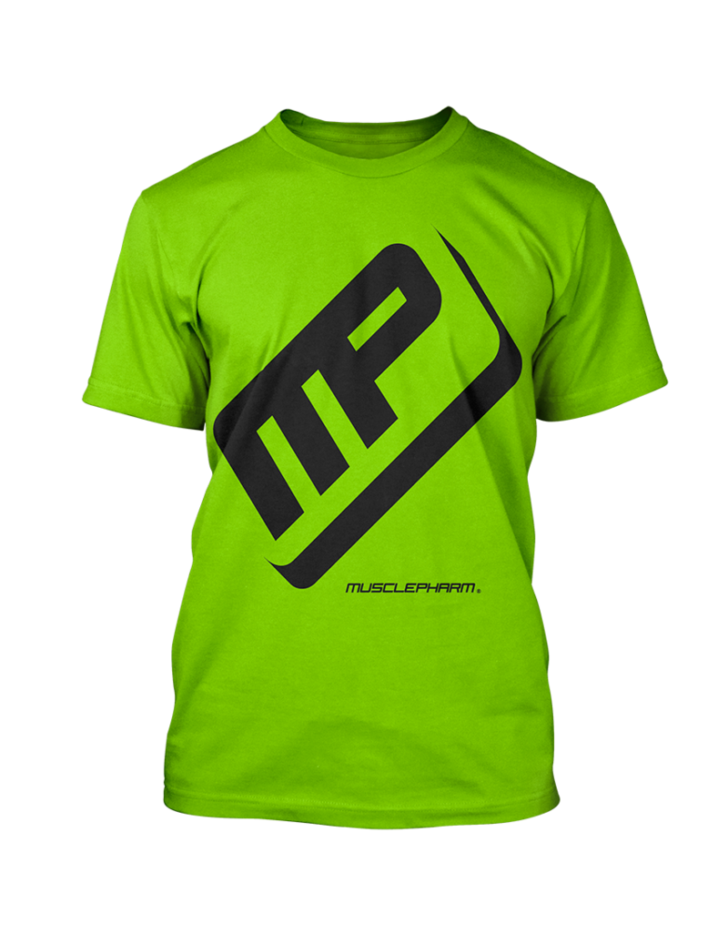
GET AMAZING PRODUCTS EXPERIENCE
GYM TSHIRT
Muscle Yellow Green Fitted Tee
$30

Slide 5
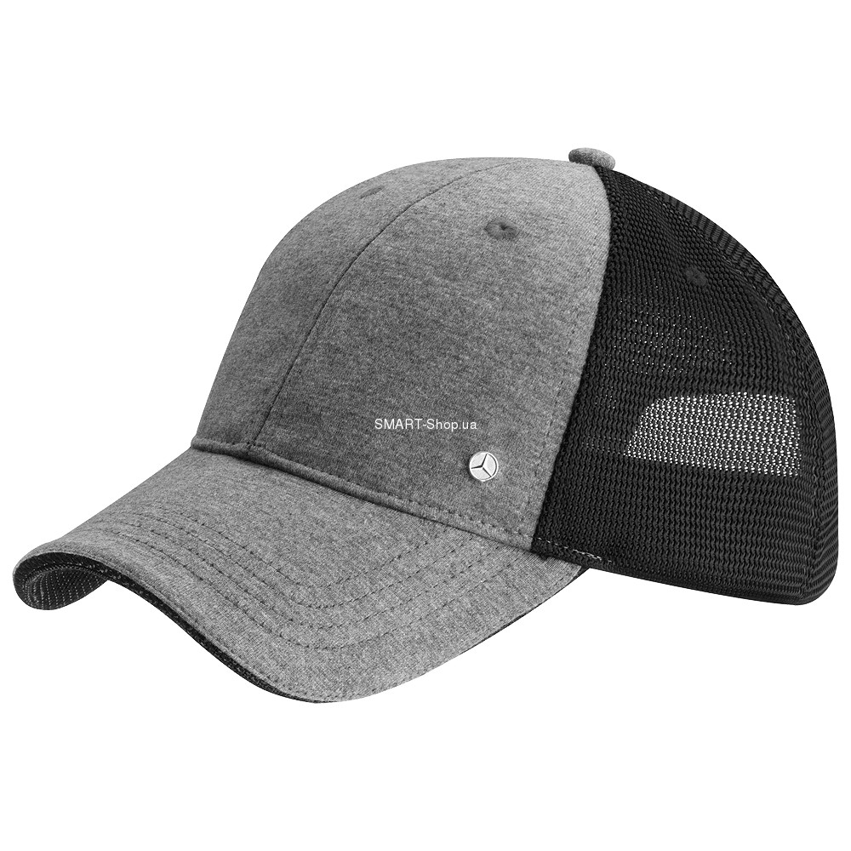
GET AMAZING PRODUCTS EXPERIENCE
BASEBALL CAPS
Black Grey Baseball Caps
$9

Slide 6
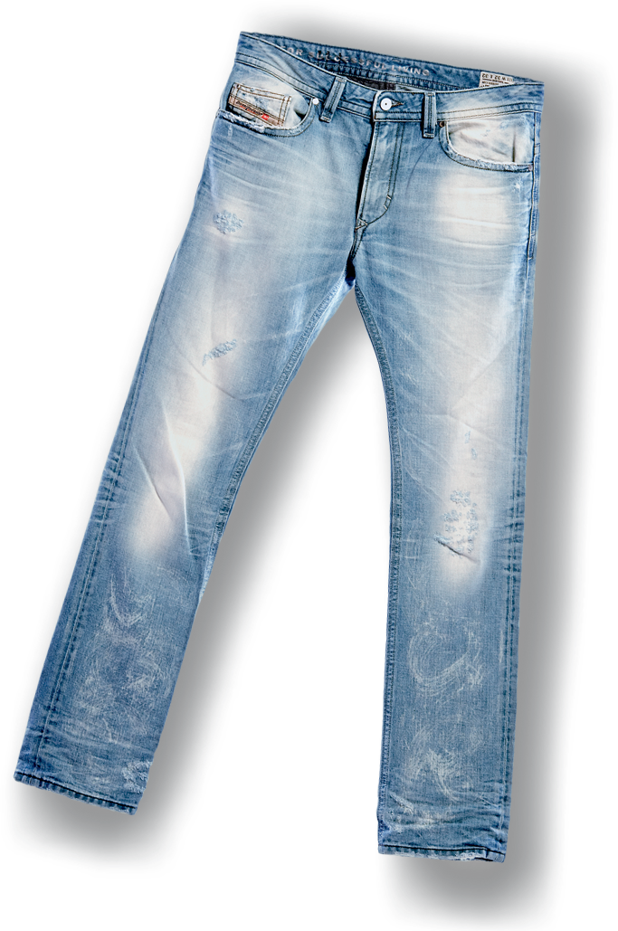
GET AMAZING PRODUCTS EXPERIENCE
ARMANI JEANS
Straight Leg Jeans - 100% Cotton
$79

Slide 7
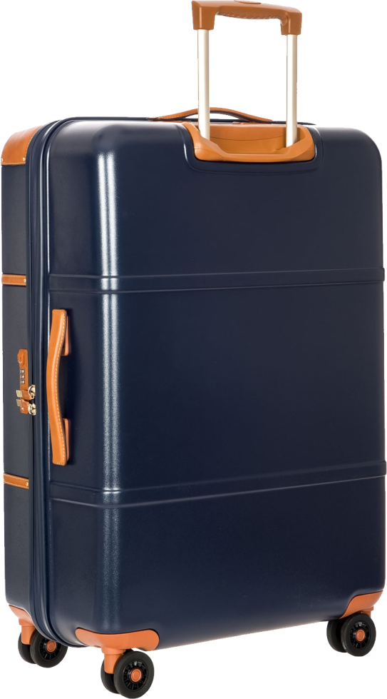
GET AMAZING PRODUCTS EXPERIENCE
LEATHER BAGS
Authentic Leather Bags for Men and Women. Very Affordable.
$300

Slide 8
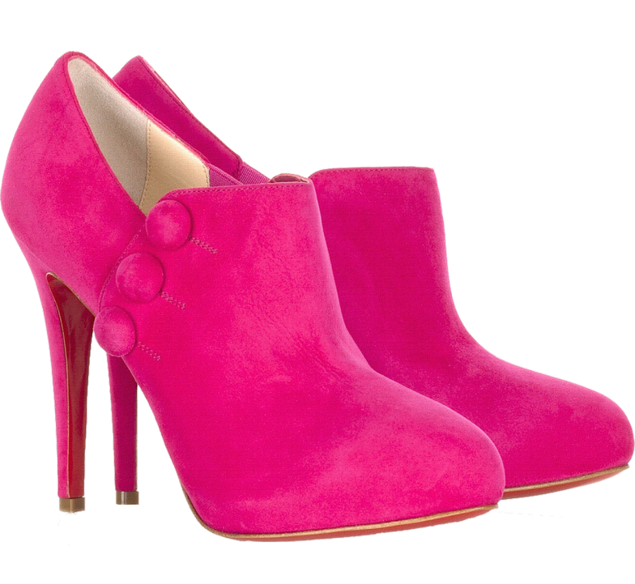
GET AMAZING PRODUCTS EXPERIENCE
LEATHER SANDALS
Korean Style Leather Sandals good for any occasion. 50% off for every purchase.
$150

Slide 9
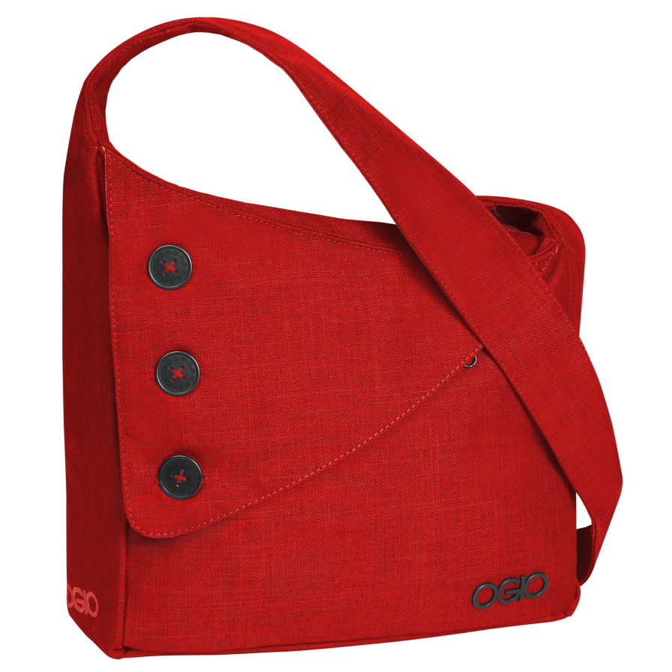
GET AMAZING PRODUCTS EXPERIENCE
DECO BAGS
Classic color Red bag for women. 50% Off for every purchase.
$50

Slide 10
CIRCULAR MOTION STORE

