Slide 1
House of the best perfumes

Slide 2
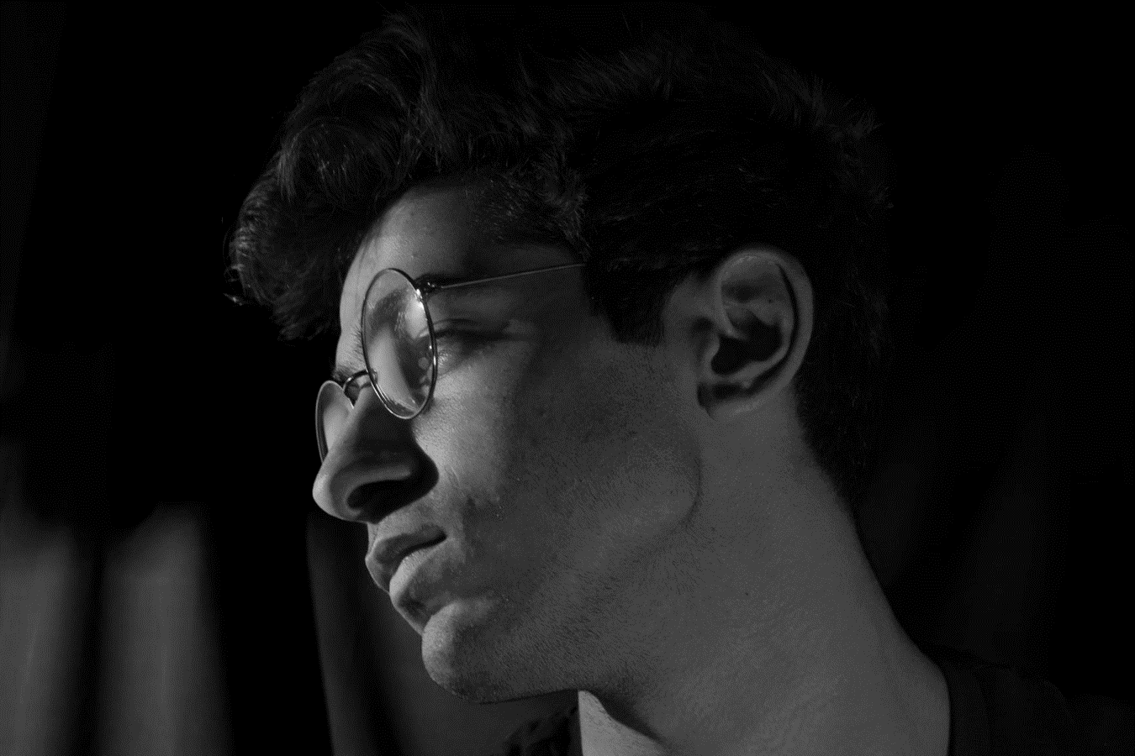
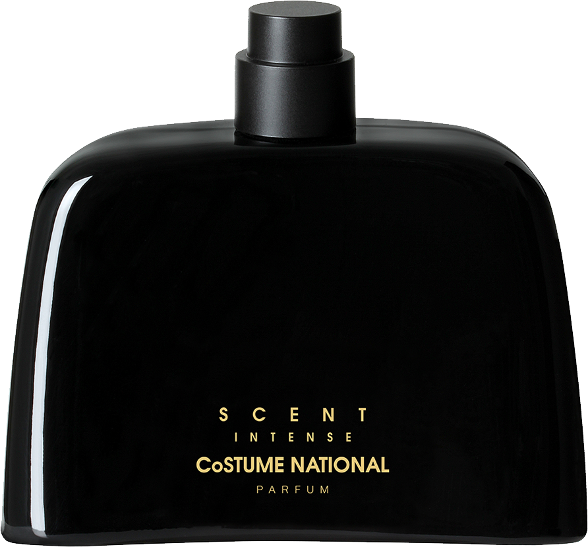
GENTS EDITIONS
SCENT INTENSE
Scent Intense is a mixture of essential oils or aroma compounds used to give the human body living-spaces an agreeable scent.
20% OFF
$110

Slide 3
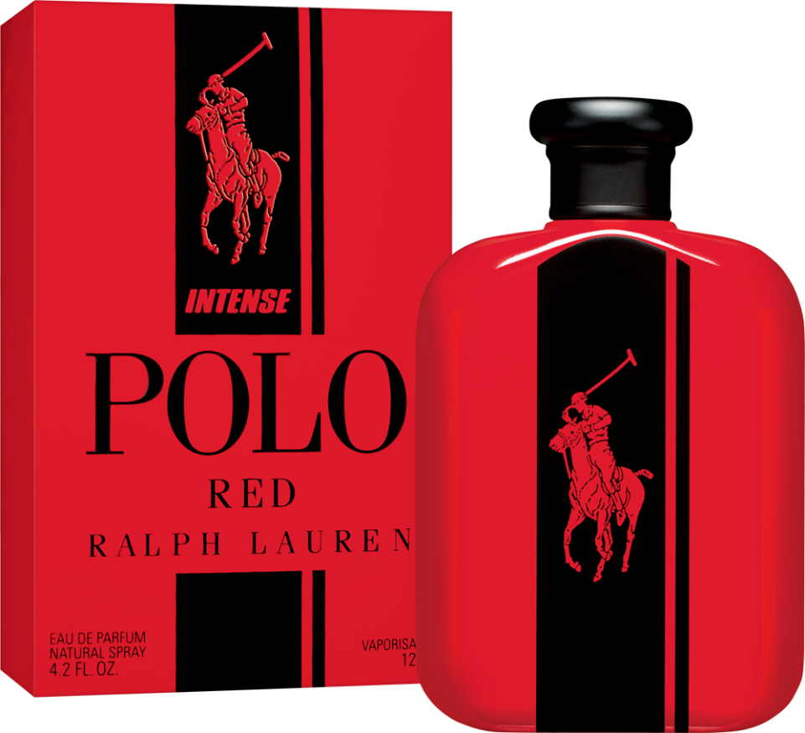
GENTS EDITIONS
RALPH LAUREN
Class - A
$200
10% OFF

Slide 4
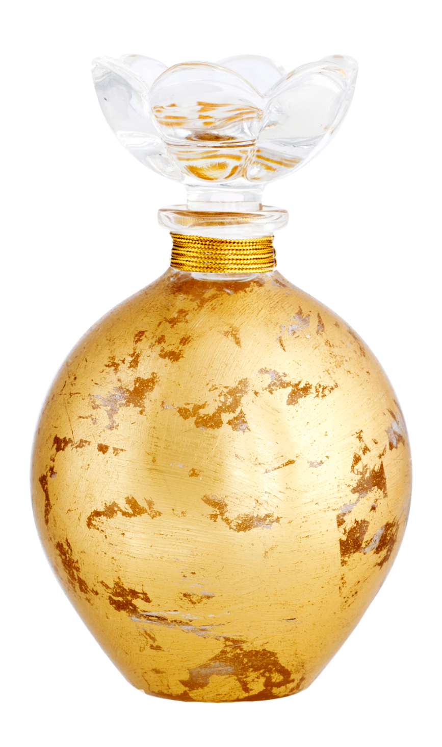
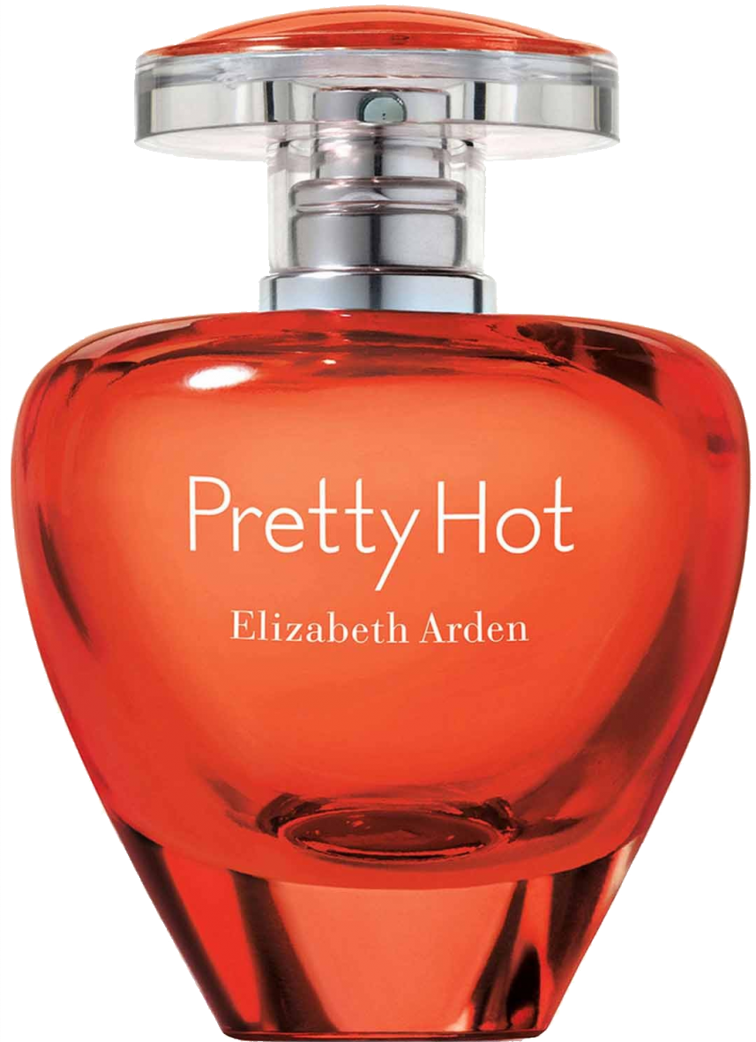
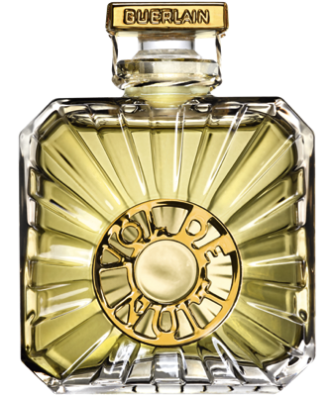
01. RALPH LAUREN
Class A
FIXED PRICE
GENTS COLLECTION
02. SCENT INTENSE
Class A
Shop original perfumes with our lowest price
03. BUBBLING
Class A
$250
04. PRETTY HOT
Class A

Slide 5
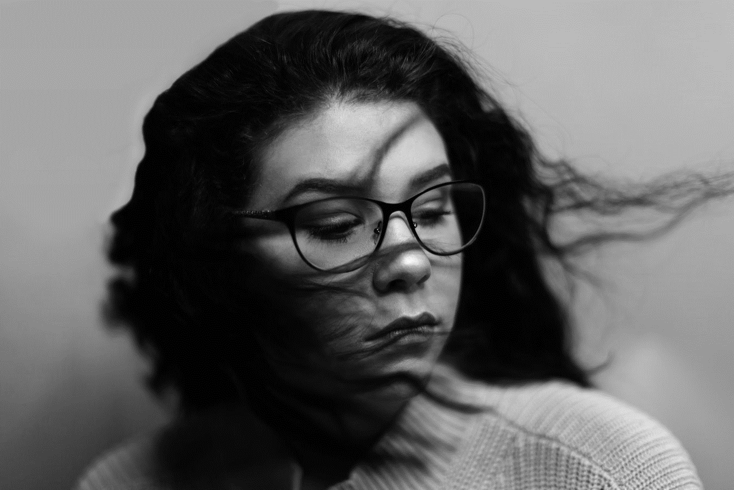
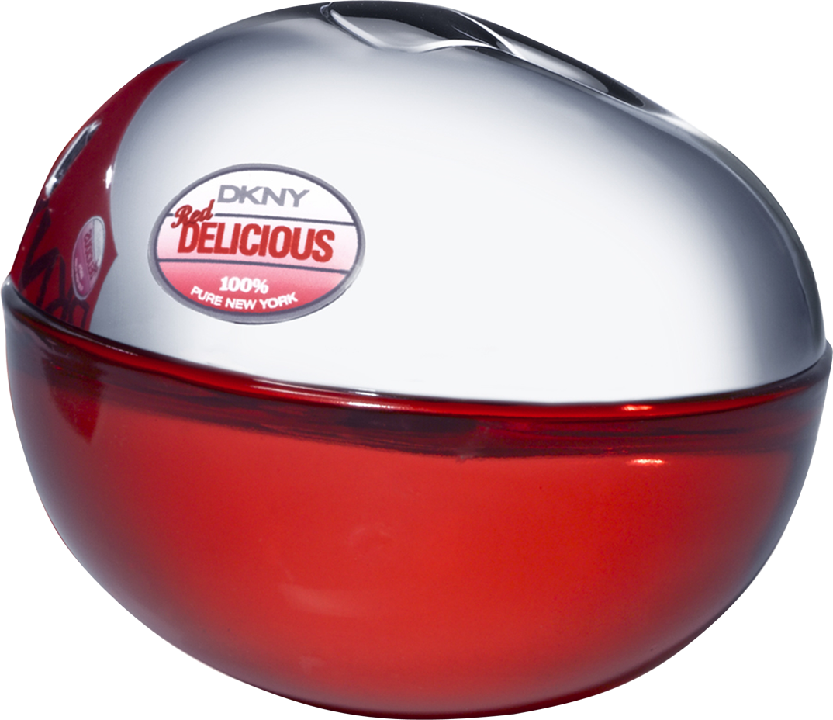
LADIES EDITIONS
DKNY DELICIOUS
DKNY Delicious Scent with the smell of fresh apple.
50% OFF
$250

Slide 6
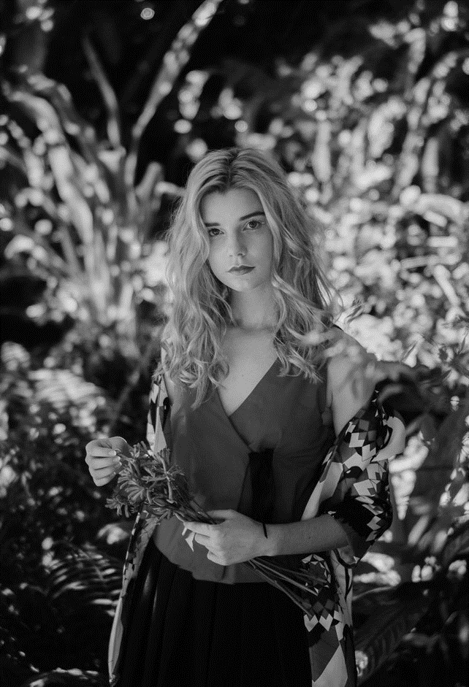
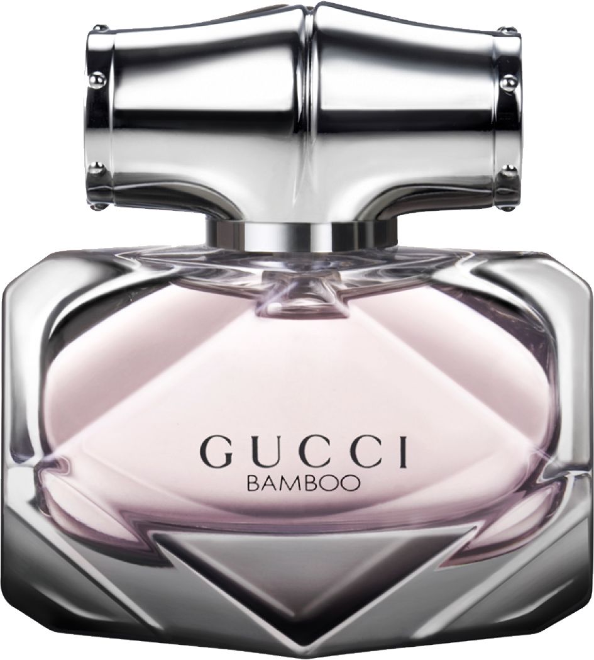
LADIES EDITIONS
GUCCI BAMBOO
Feminine smell. Long Lasting Perfume.
$300
10% OFF

Slide 7
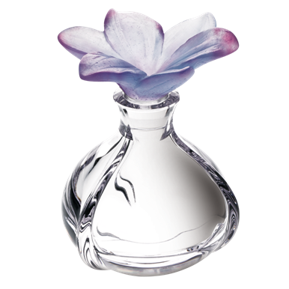
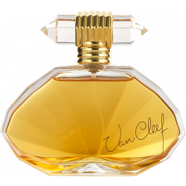
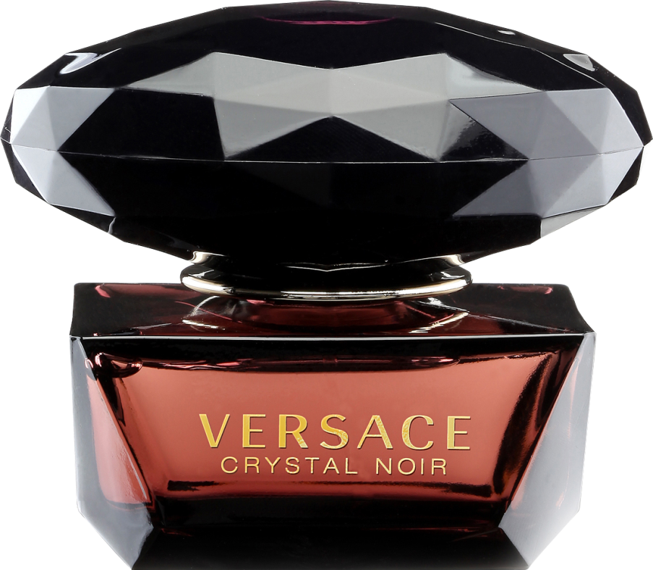
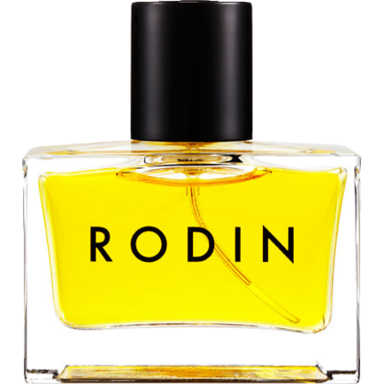
01. RODIN
Class A
FIXED PRICE
LADIES COLLECTION
02. VAN CHARLIE
Class A
Shop original perfumes with our lowest price
03. VERSACE
Class A
$250
04. PRETTY HOT
Class A

Slide 8
House of the best perfumes

