Slide 1
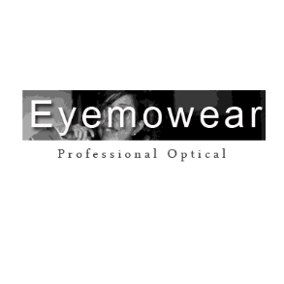
/@eyemowear
/@eyemowear
/@eyemowear
/@eyemowear
Fashion Eyemowear Eyewear. Try it!

Slide 2
CLASSIC EDITION
Style: Rectangle
Frame Material: Plastic
Gender: Men
Lens Height: 43MM
Lens Width: 53MM
Model Number:A1019
Eyewear Type: Sunglasses
LIMITED STOCK
$50.25 only
MORE PRODUCTS

Slide 3
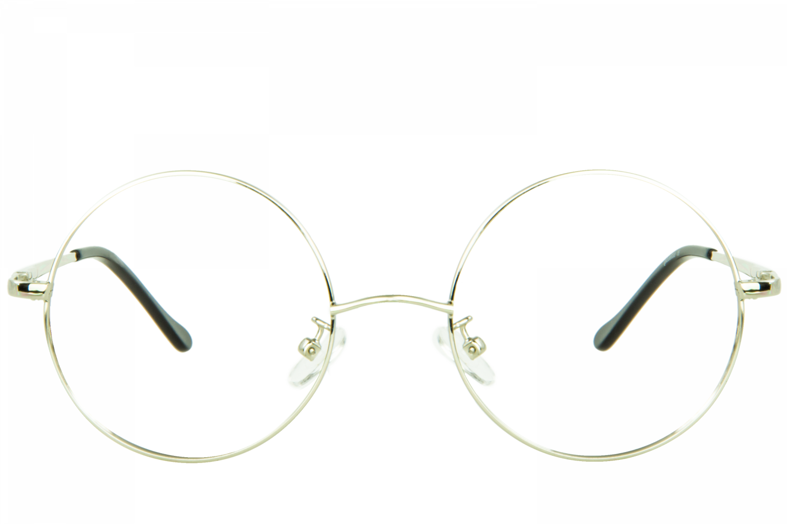
CLASSIC EDITION
Style: Rectangle
Frame Material: Metal
Gender: Women
Lens Height: 43MM
Lens Width: 53MM
Model Number: A1020
Eyewear Type: Sunglasses
LIMITED STOCK
$200 only
MORE PRODUCTS

Slide 4
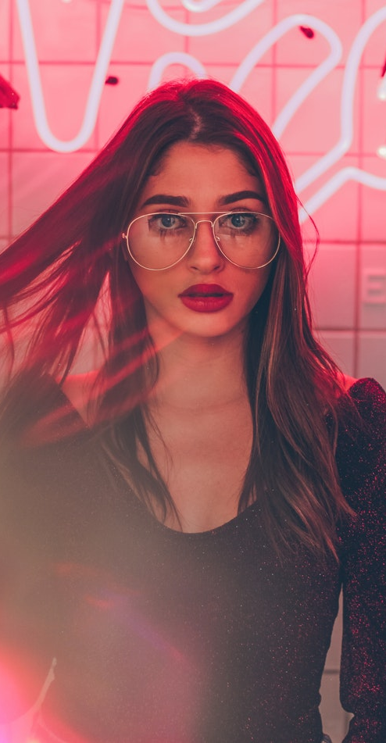
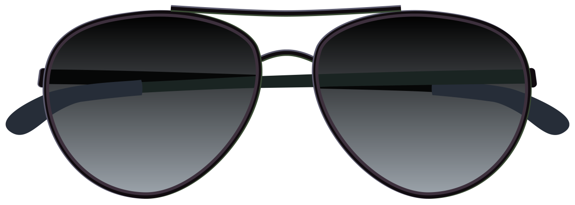
CASUAL WEAR
Style: Rectangle
Frame Material: Plastic
Gender: Women
Lens Height: 42MM
Lens Width: 50MM
Model Number:A1021
Eyewear Type: Sunglasses
LIMITED STOCK
$39.55 only
MORE PRODUCTS

Slide 5
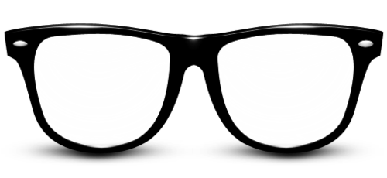
CASUAL WEAR
Style: Rectangle
Frame Material: Plastic
Gender: Women/ Men
Lens Height: 43MM
Lens Width: 53MM
Model Number: A1022
Eyewear Type: Sunglasses
LIMITED STOCK
$39.55 only
MORE PRODUCTS

Slide 6
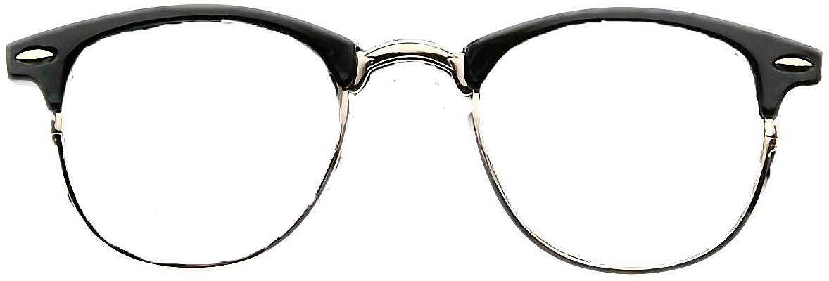
3 PEACE FRAME
Style: Rectangle
Frame Material: Metal
Gender: Women
Lens Height: 43MM
Lens Width: 53MM
Model Number: A1023
Eyewear Type: Sunglasses
LIMITED STOCK
$109.55 only
MORE PRODUCTS

Slide 7
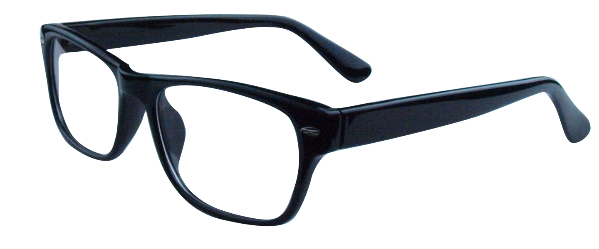
3 PEACE FRAME
Style: Rectangle
Frame Material: Metal
Gender: Men
Lens Height: 40MM
Lens Width: 51MM
Model Number: A1024
Eyewear Type: Sunglasses
$150.33 only
MORE PRODUCTS

Slide 8
MODERN WEAR
Style: Rectangle
Frame Material: Metal
Gender: Men
Lens Height: 43MM
Lens Width: 51MM
Model Number: A1025
Eyewear Type: Sunglasses
$110.55 only

Slide 9
MODERN WEAR
Style: Rectangle
Frame Material: Metal
Gender: Wonen
Lens Height: 43MM
Lens Width: 51MM
Model Number: A1026
Eyewear Type: Sunglasses
$99.99 only

Slide 10
/@eyemowear
/@eyemowear
/@eyemowear
/@eyemowear
THANKYOU FOR VISITNG US

