Slide 1
+123456789
www.pacificseatravelandtours.com
A-2, Anaheim, USA

Slide 2
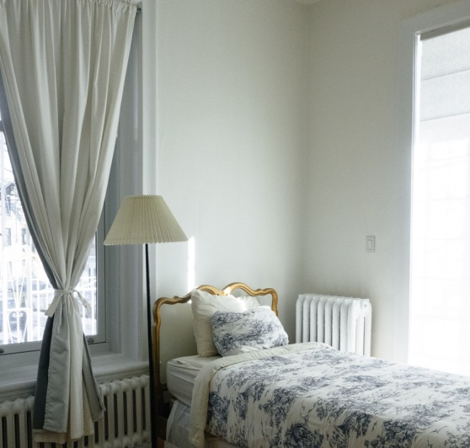
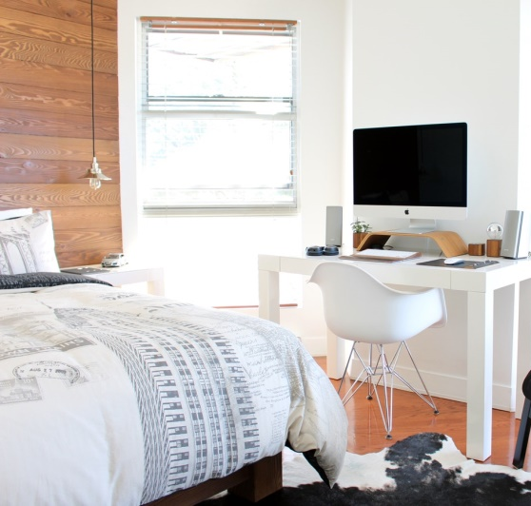
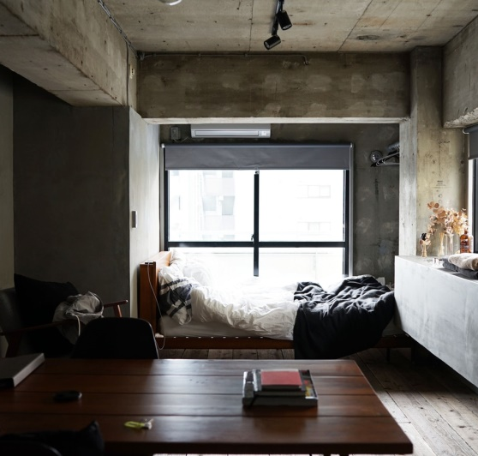
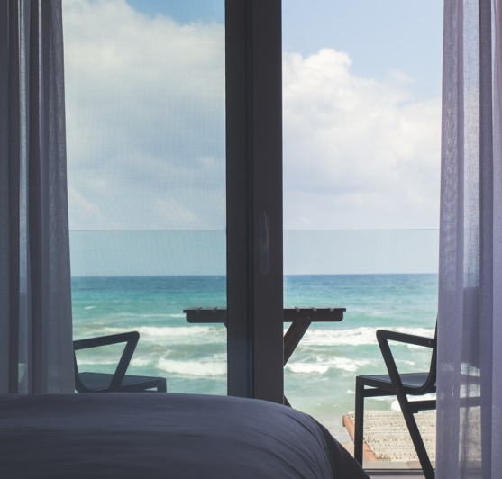
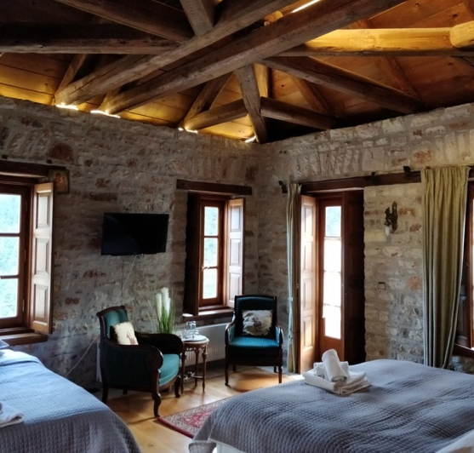
CHOOSE
YOUR ROOM
SINGLE ROOM
DOUBLE ROOM
DOUBLE-DOUBLE ROOM
A room for one person.
A room for two people. May have one or more beds.
A room with two double beds.
Save up to 25% off of the Standard Rate with breakfast per day. For a limited time period, Very special offer.
LIMITED TIME OFFER
STUDIO TYPE ROOM
EXECUTIVE ROOM
LUXURY ROOM
A room with a studio bed.
A living room with to one or more bedrooms.
A living room with to one or more bedrooms.

Slide 3
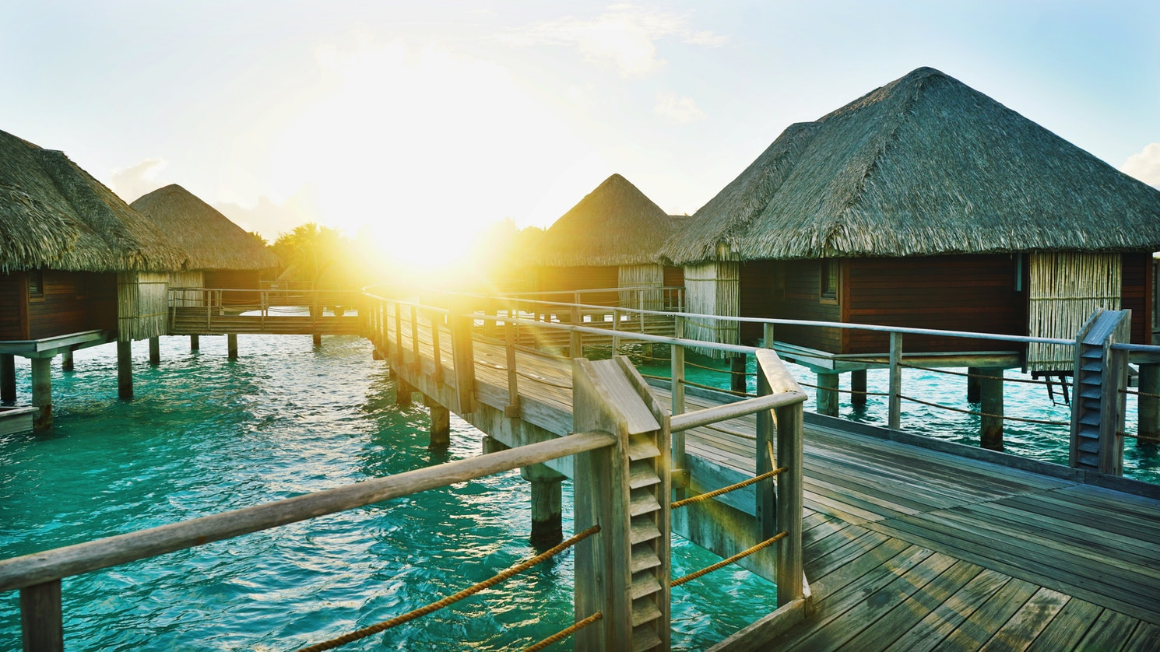
BORA BORA
FRENCH POLYNESIA
$449 PP
Early bird offer: Book your holiday now and save 50 %!

Slide 4
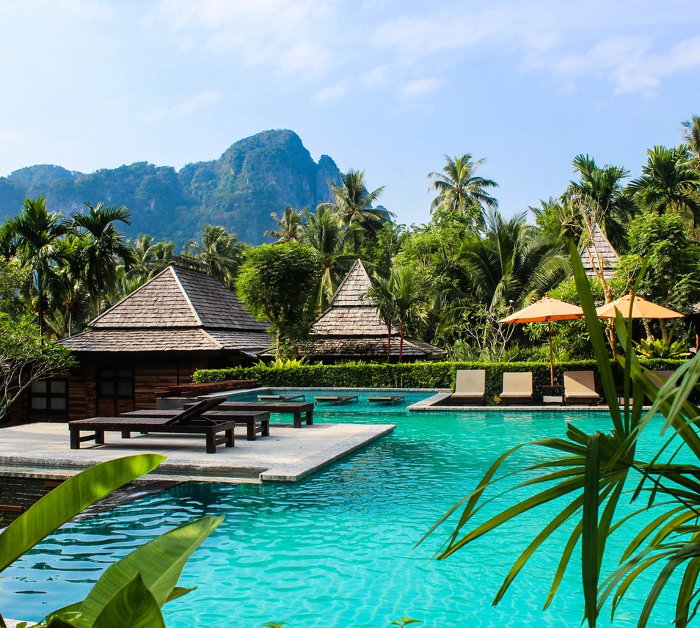
MAAFUSHI
MALDIVES
$699 PP
Early bird offer: Book your holiday now and save 50 %!

Slide 5
LET’S TRAVEL
WITH FRIENDS
Don’t wait any longer and book your holiday now! You’ll benefit from a 50% discount on the best available travel rate.
3 Days Maldives Tour
Includes: Full board meals (breakfast, lunch, dinner), Round trip
Egypt Tour
Includes: Full board meals (breakfast, lunch, dinner), Round trip transfer by speed boat
BOOK NOW

Slide 6
LET’S TRAVEL
WITH FRIENDS
Don’t wait any longer and book your holiday now! You’ll benefit from a 50% discount on the best available travel rate.
2 nights accommodation Daily breakfast
Underground River Tour with buffet lunch
Roundtrip airport transfers
5 Days Palawan Philippines Tour
Taiwan Tour
Roundtrip airport transfer
Hotel accommodation Daily breakfast
Whole Day Taipei City Tour
BOOK NOW

Slide 7
SPECIAL PACKAGE
Don’t wait any longer and book your holiday now! You’ll benefit from a 50% discount on the best available travel rate.
Free Breakfast / Lunch
Beautiful Overlooking Views
Swimming Pools

Slide 8
LET’S TRAVEL
WITH US TODAY
299+
1250+
899+
3 Days / 2 Nights
1 Week
5 days / 5 Nights
Save up to 25% off of the Standard Rate with breakfast per day. For a limited time period. Very special offer.

Slide 9
PRICING
SILVER
GOLDEN
PLATINUM
Early bird offer: Book your holiday now and save 50 %!
BOOK NOW
$99
$199
$299
Stonehenge Tours
Stonehenge Tours
Stonehenge Tours
Paris Day Trips
England Paradise
England Paradise
Warner Bros. Studio Tour

Slide 10
WHERE DO YOU WANT TO GO?
South East Asia
Travel to South East Asia Countries
Trip to see the wonders of the world.
Africa
The Middle East
Middle East Tours
Safari Tours

Slide 11
2018
EVERY DAY A NEW ADVENTURE
Best of Asian Countries
2019
Worldwide Tour
EVERYDAY NEW PLACE
We believe that it's the small things that make the difference between a good bonding. We always want to assure that your vacation is perfect and fun.
BOOK NOW

Slide 12
EVERY DAY A
NEW PLACE
Save up to 20% off of the Standard Rate with breakfast per day. For a limited time period. Very special offer.
Asia Countries
European Countries
TRAVEL
FEATURES
SAVE 10% plus $200 Bonus Saving
SAVE 10% plus $300 Bonus Saving

Slide 13
FIND A PERFECT HOLIDAY PLAN
BOOK NOW
We love it when our special offers help make your dream travel into reality.

Slide 14
+123456789
www.pacificseatravelandtours.com
A-2, Anaheim, USA

