Slide 1
YOUR GATEWAY TO A PERFECT LIFE
1-800-123-4567
New York, NY
www.yourfantasyrealestate.com

Slide 2
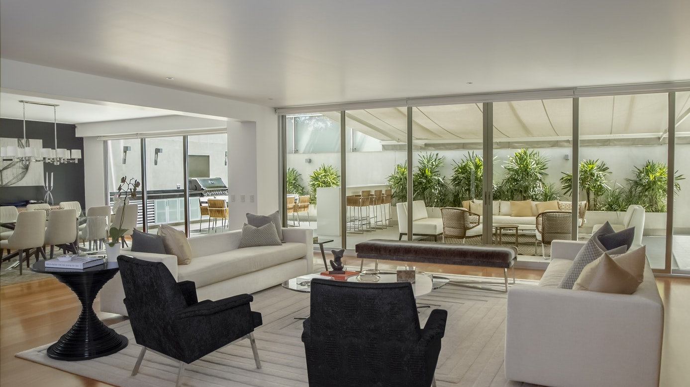
WE OFFER BEST HOUSE FOR YOUR FAMILY UNDER YOUR BUDGET

Slide 3
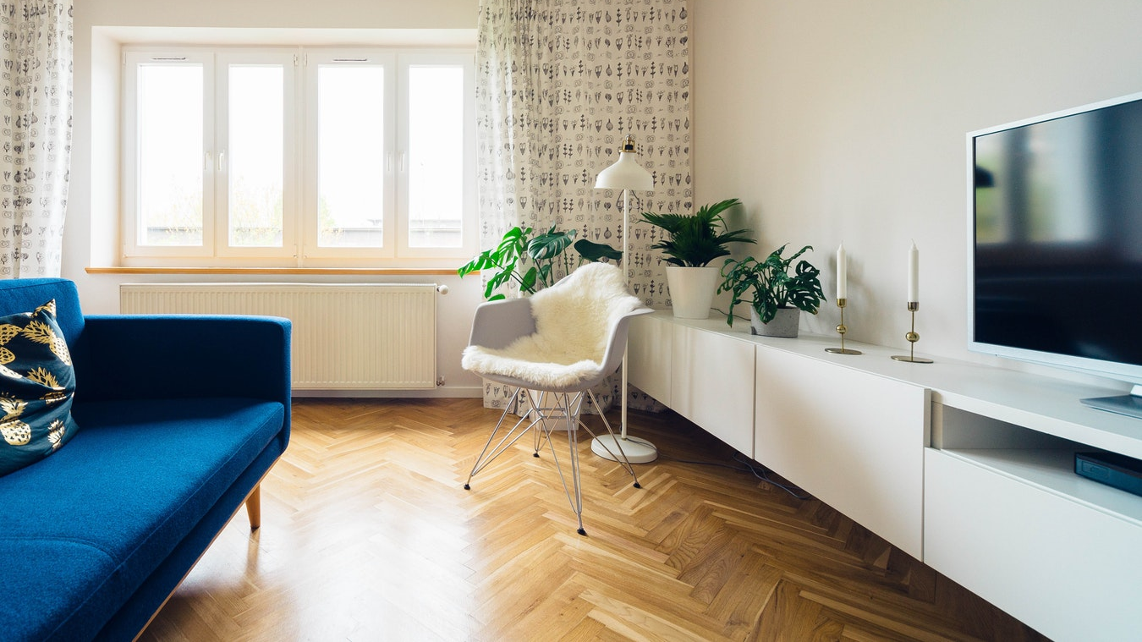
WHAT WE OFFER
We believe that buying and selling real estate should be less complicated and more enjoyable. We are a group of people who are helping people obtain the American dream of homeownership.

Slide 4
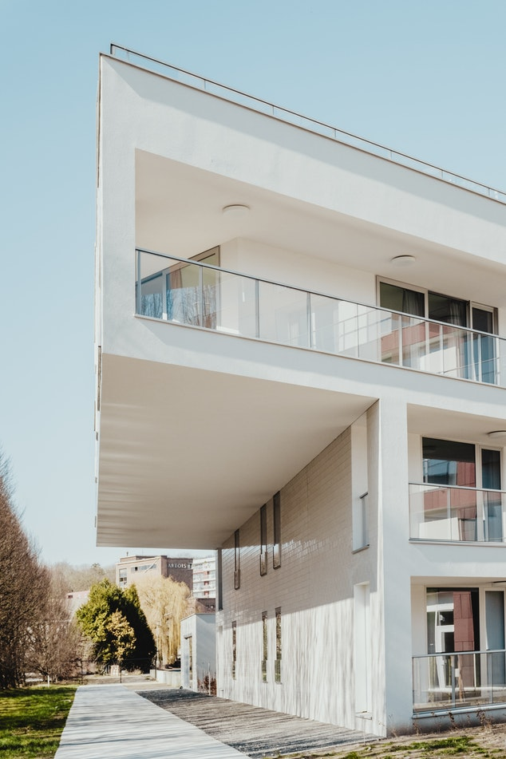
DREAM HOUSE SOLUTION #01
The DREAM HOUSE Solution #01 Village is surrounded by hotels and an array of leisure selections.
$1,699,000
GET BEST DEAL

Slide 5
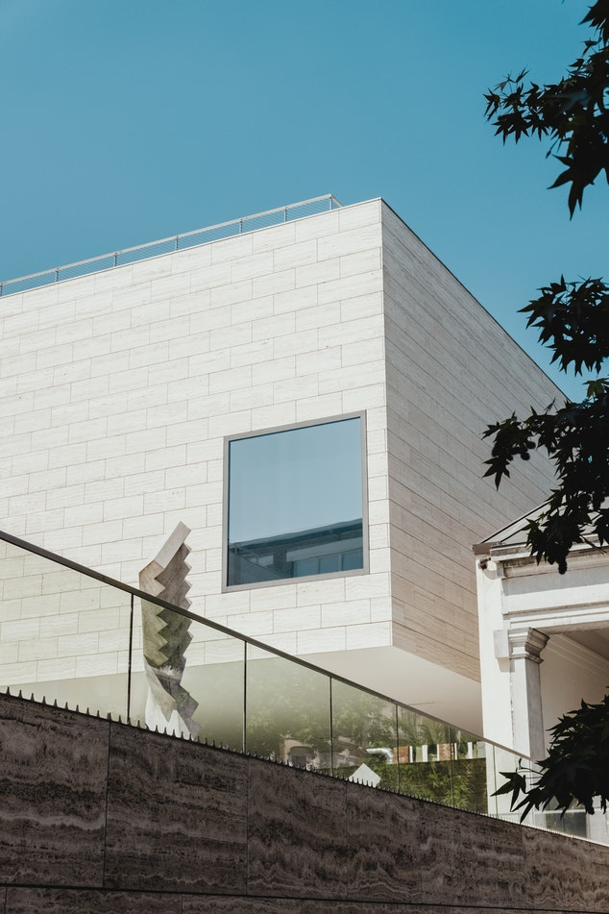
DREAM HOUSE SOLUTION #02
The DREAM HOUSE Solution #02 Village is one of the most admired place in this village.
$2,875,000
GET BEST DEAL

Slide 6
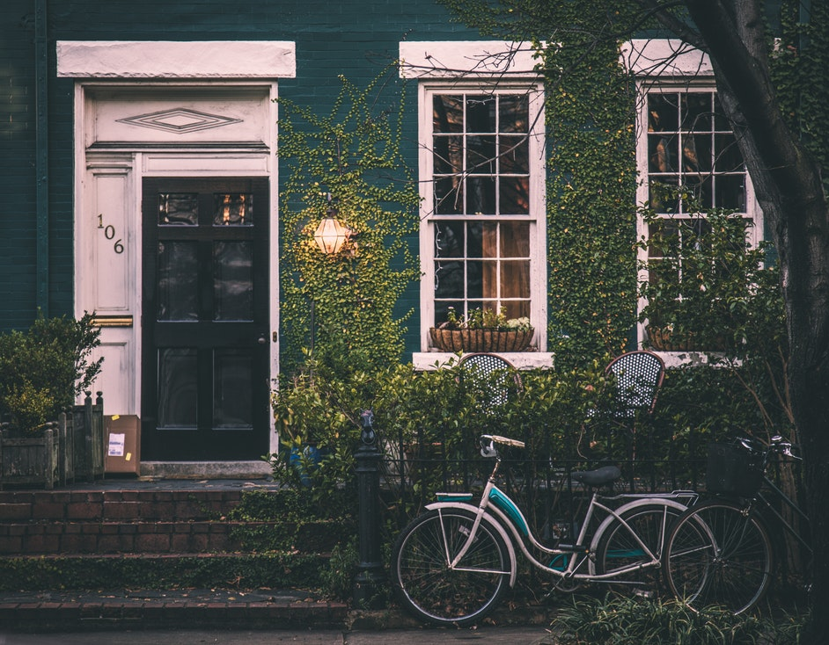
DREAM HOUSE SPECIAL #01
The DREAM HOUSE Special #01 Village is surrounded by special leisure selections.
$1,299,000
GET BEST DEAL

Slide 7
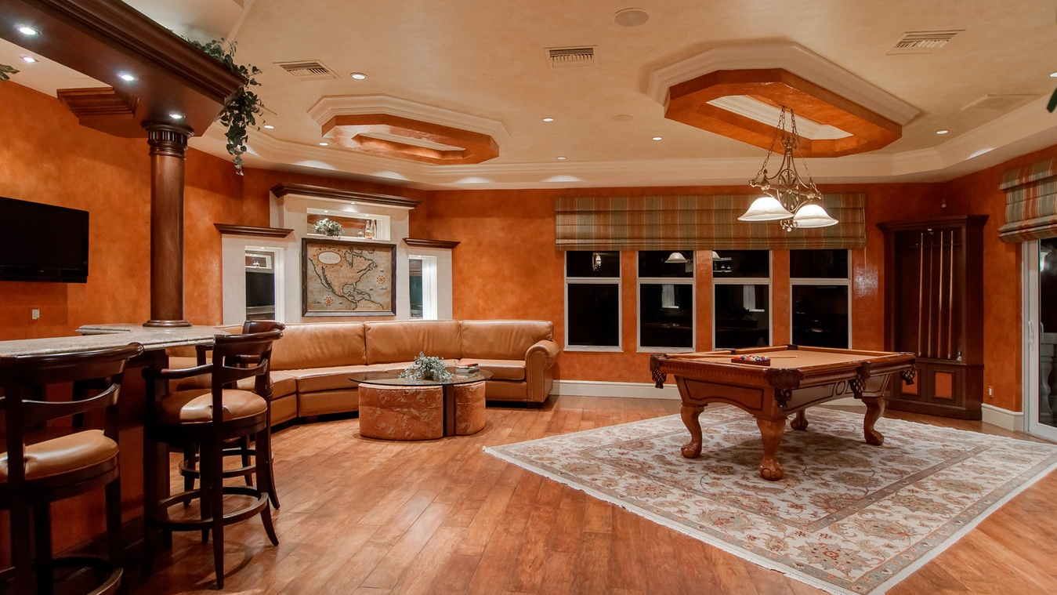
SOME LUXURY OFFERS

Slide 8
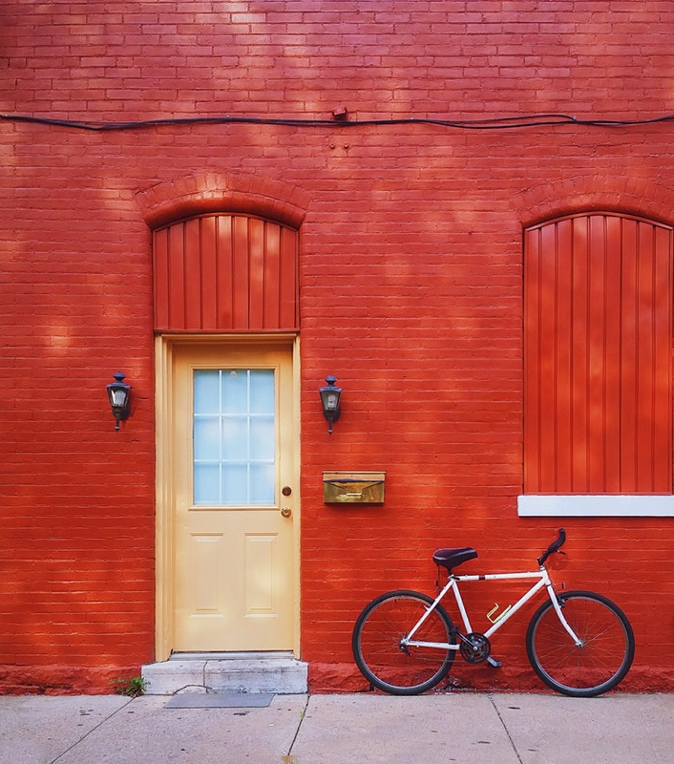
DREAM HOUSE SPECIAL
The DREAM HOUSE Special is surrounded by special luxury leisure selections who seeks comfort in nature.
$995,000
GET BEST DEAL

Slide 9
DREAM HOUSE EXCLUSIVES
The DREAM HOUSE exclusive is a luxurious residential development offering a sustaining lifestyle to it’s residents.

Slide 10
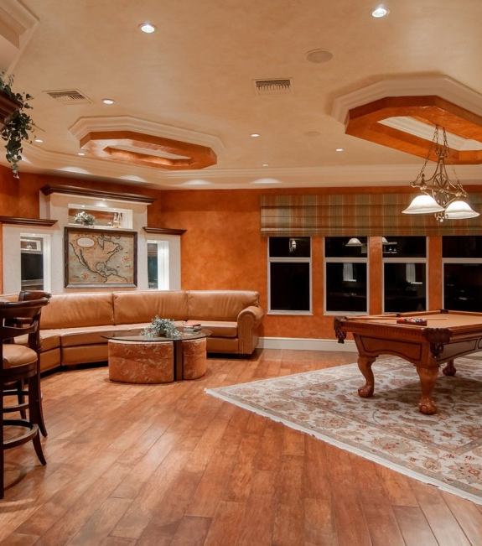
OFFER
4 BEDROOM
2 KITCHEN 3 BATHROOM
1 CAR PORCH 1 SWIMMING POOL 2 DINNING AREA
DREAM HOUSE EXCLUSIVES
Nature rich setting.
EXCLUSIVES
The DREAM HOUSE exclusive is a luxurious residential development offering a sustaining lifestyle to it’s residents.
$2,000,000

Slide 11
DREAM HOUSE EXCLUSIVES
Residents will enjoy full access to the existing amenities. Other features and amenities will include a swimming pool, a multi-purpose function area, children’s playground and a gym.
$1,500,000

Slide 12
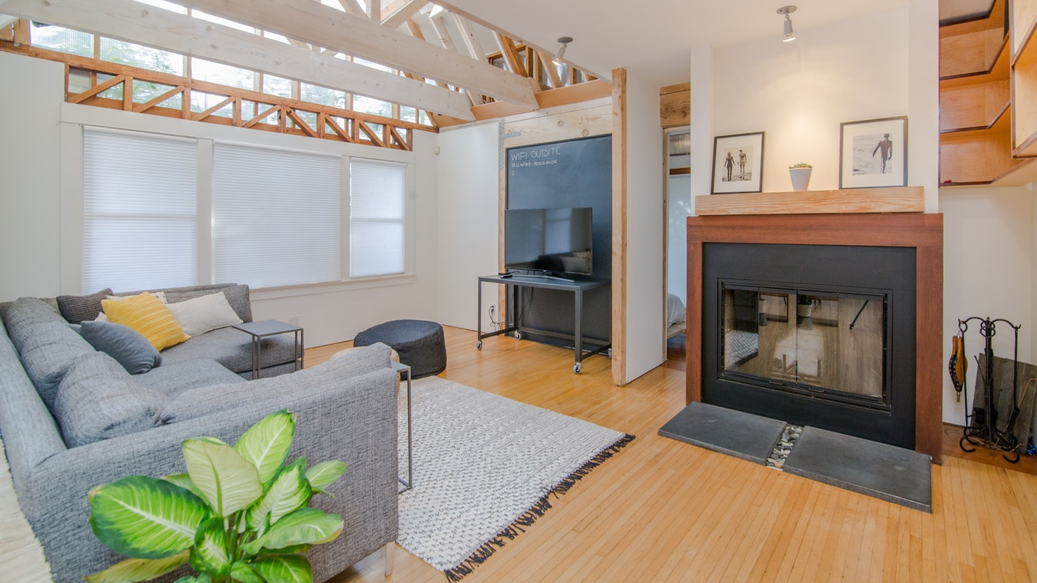
DREAM HOUSE EXCLUSIVES
Modern conveniences such as underground utilities will also be available for the residents.
$1,200,000

Slide 13
New York, NY
www.yourfantasyrealestate.com
1-800-123-4567

