Slide 1
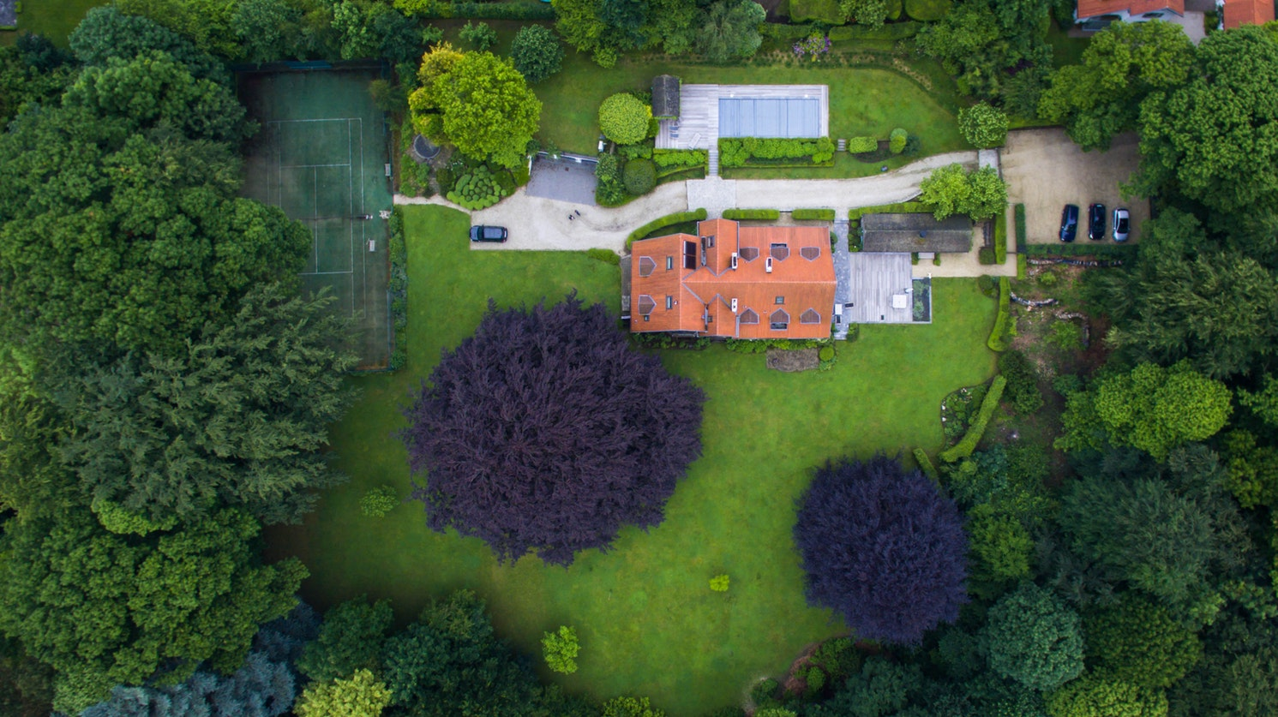
Looking For a
Looking For a
DREAM HOME?
DREAM HOME?

Slide 2
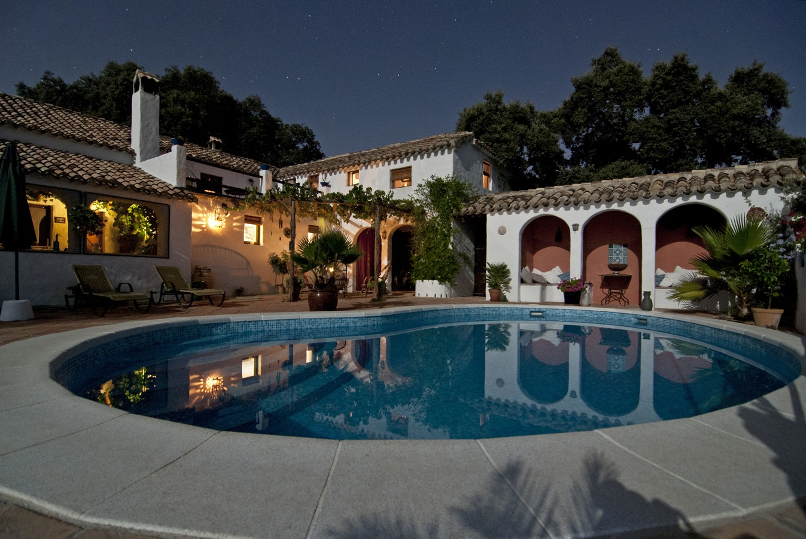
Looking For a
We Have a
DREAM HOME?
Deal for Your Life

Slide 3
Looking For a
Luxury
DREAM HOME?
PENT HOUSE
1160 Gulf Blvd, Clearwater Beach, FL 33767, USA

Slide 4
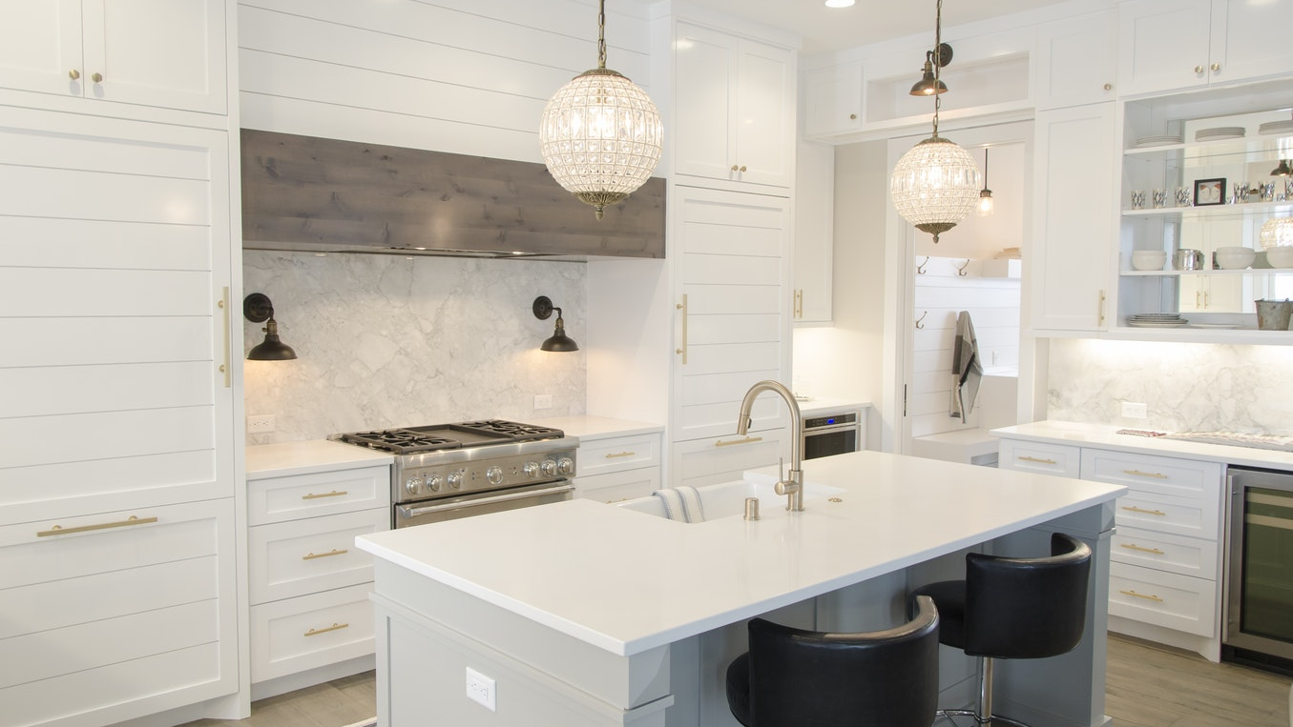
Style
European
European
European
European
European
Furniture Pattern Equipment Vase Door Tile
1-800-123-4567
www.gianthomere.com
1 Living Room
4 Bedroom
3 Bathroom
1 Gurage
3 Dinning Room
2 Kitchen
1 Gym / Spa
1 Swimming pool

Slide 5
Area
Hall
Bedroom
Tiolet
Bathroom
Pool
5x5 FT2
3x3 FT2
2x2 FT2
2x3 FT2
5x7 FT2
1-800-123-4567
www.gianthomere.com
1 Living Room
4 Bedroom
3 Bathroom
1 Gurage
3 Dinning Room
2 Kitchen
1 Gym / Spa
1 Swimming pool

Slide 6
1-800-123-4567
www.gianthomere.com
1 Living Room
4 Bedroom
3 Bathroom
1 Gurage
3 Dinning Room
2 Kitchen
1 Gym / Spa
1 Swimming pool

Slide 7
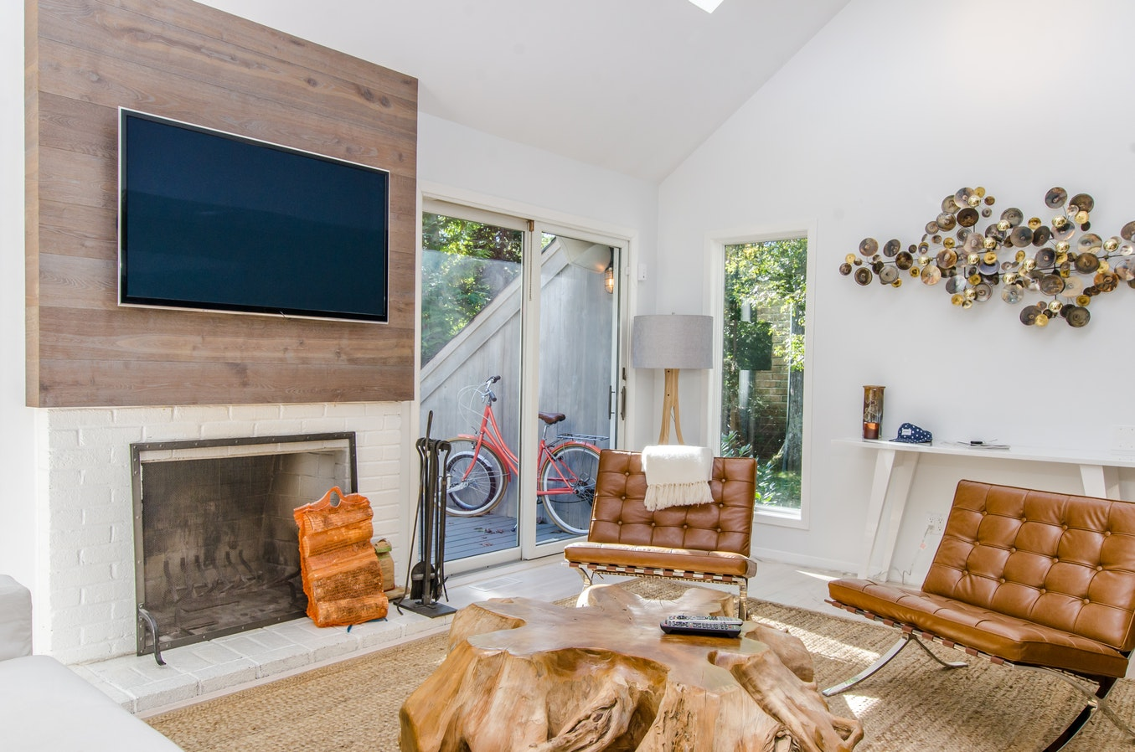
Condition
Repair Walls Flooring Furniture Equipment
New Wallpaper Wood New New
New
1-800-123-4567
www.gianthomere.com
1 Living Room
4 Bedroom
3 Bathroom
1 Gurage
3 Dinning Room
2 Kitchen
1 Gym / Spa
1 Swimming pool

Slide 8
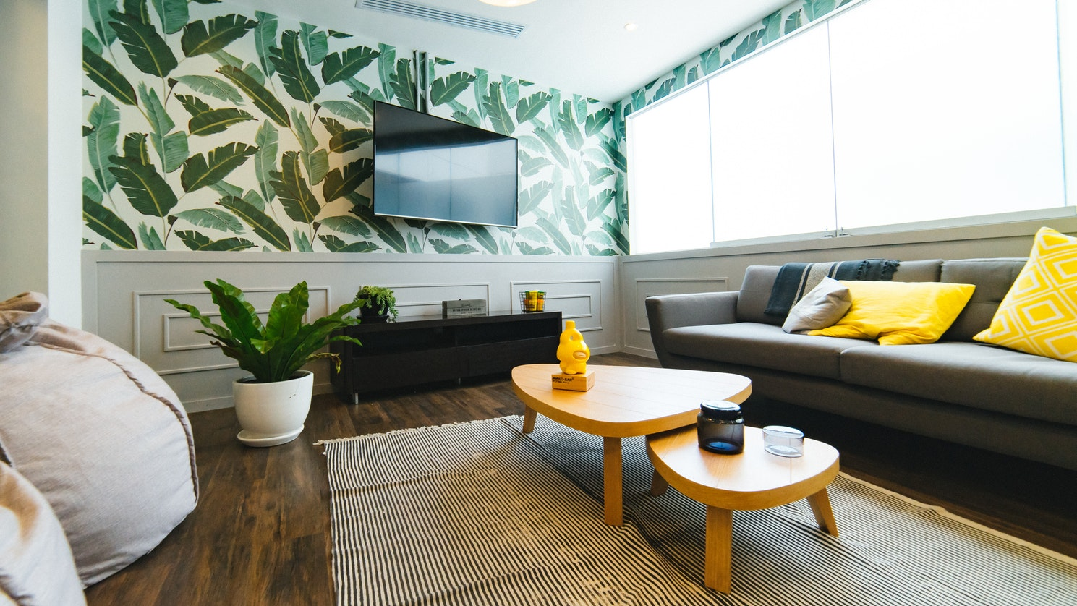
1-800-123-4567
www.gianthomere.com
1 Living Room
4 Bedroom
3 Bathroom
1 Gurage
3 Dinning Room
2 Kitchen
1 Gym / Spa
1 Swimming pool

Slide 9
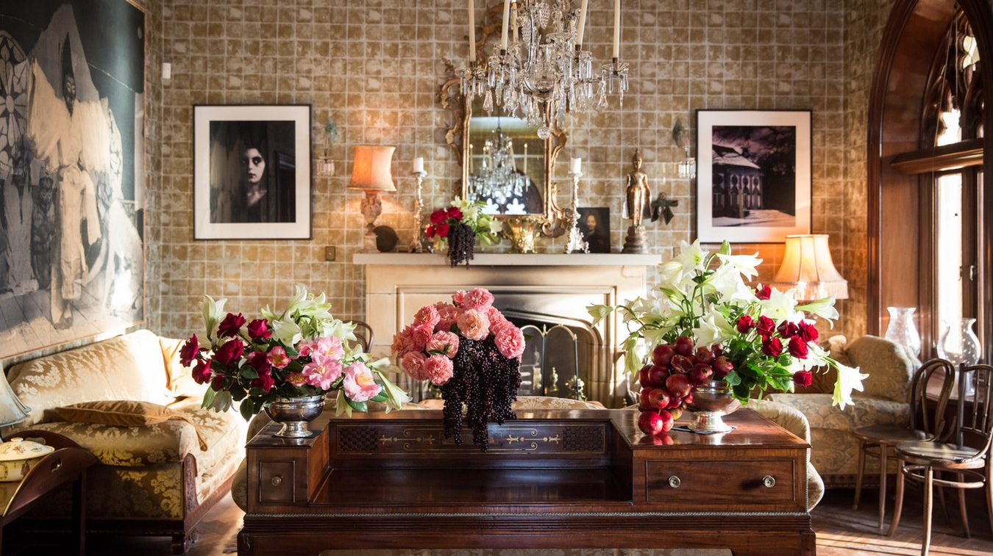
Area Kitchen
Hall
Bedroom
Tiolet
Bathroom
Pool
5x5 FT2
3x3 FT2
2x2 FT2
2x3 FT2
5x7 FT2
1-800-123-4567
www.gianthomere.com
1 Living Room
4 Bedroom
3 Bathroom
1 Gurage
3 Dinning Room
2 Kitchen
1 Gym / Spa
1 Swimming pool

Slide 10
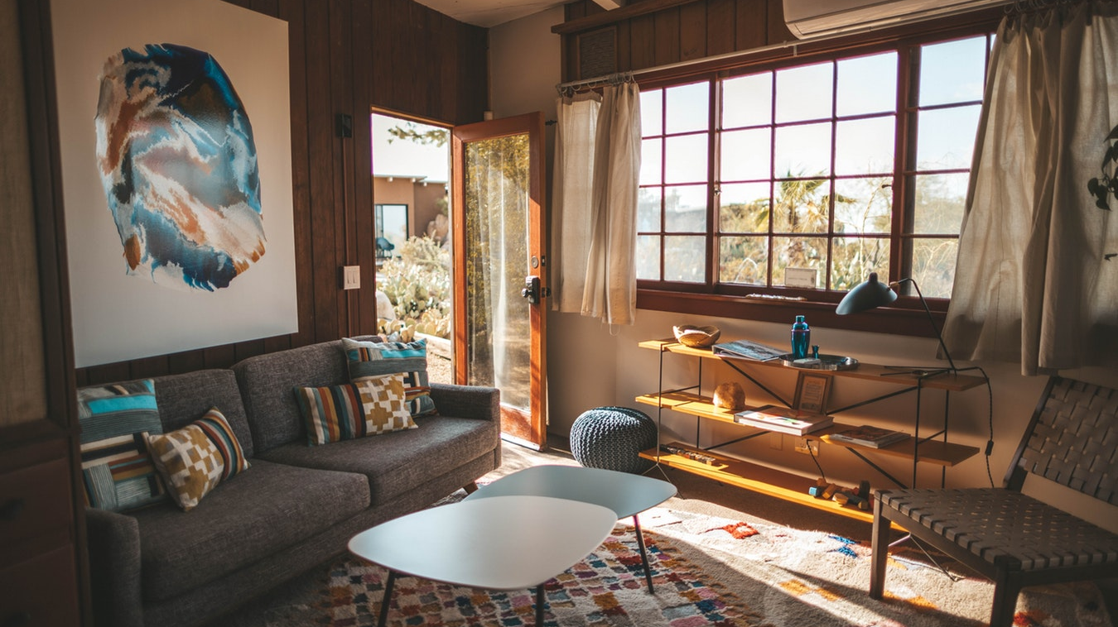
1-800-123-4567
www.gianthomere.com
1 Living Room
4 Bedroom
3 Bathroom
1 Gurage
3 Dinning Room
2 Kitchen
1 Gym / Spa
1 Swimming pool

Slide 11
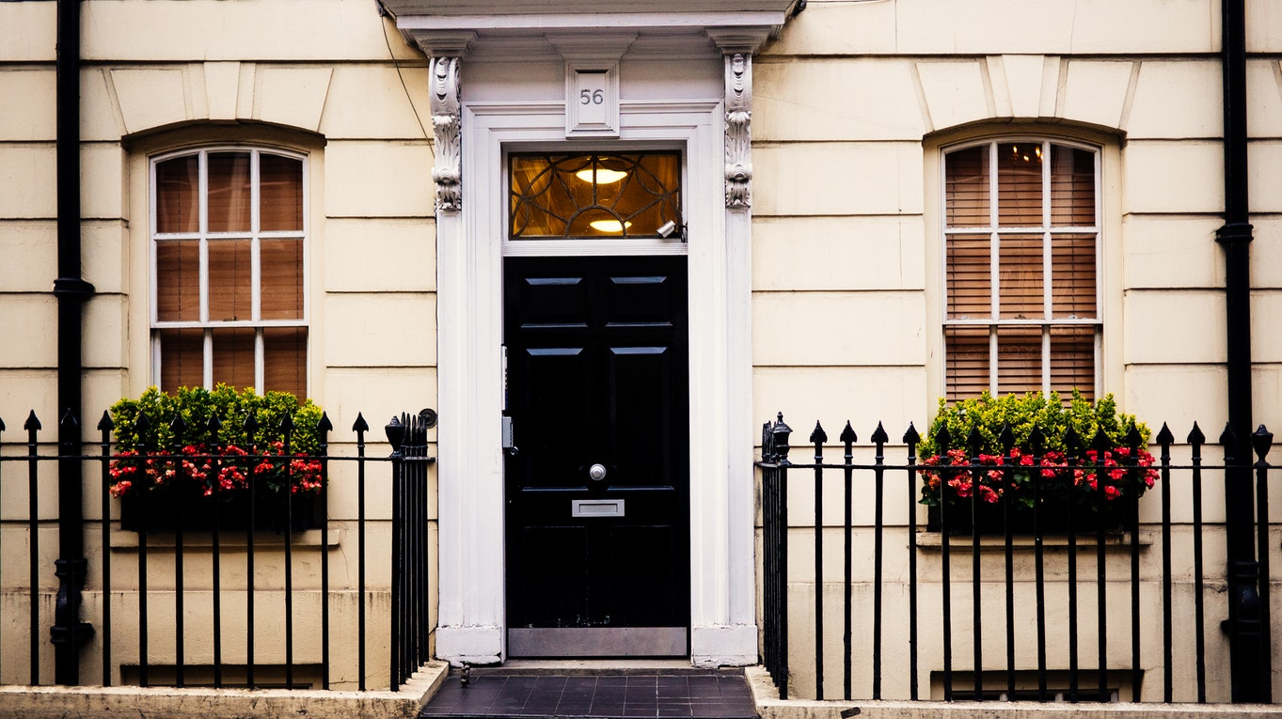
Price
AN INCREDIBLE PRICE
$500.000
1-800-123-4567
www.gianthomere.com
1 Living Room
4 Bedroom
3 Bathroom
1 Gurage
3 Dinning Room
2 Kitchen
1 Gym / Spa
1 Swimming pool

Slide 12
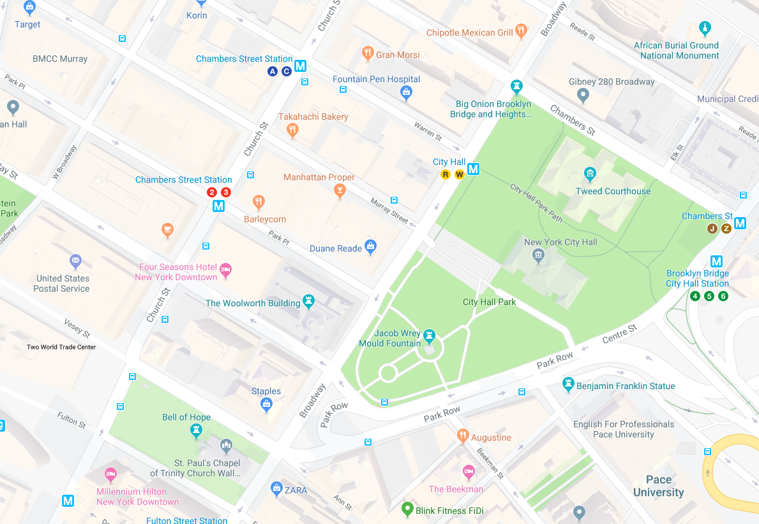
Address
221 GIANTHOME, NEWYORK CITY

Slide 13
1-800-123-4567
www.gianthomere.com

