Slide 1
+123456789
www.silverjewelnatics.com
A-525, Silverjewelnatics, USA

Slide 2
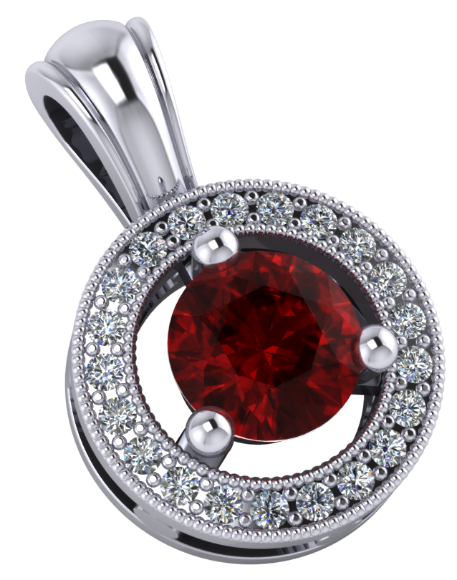
NEW ARRIVAL
$599
$399
RED DIAMOND NECKLACE PENDANT
Red diamond necklace pendant with silver plated round design
Model RS00-001

Slide 3
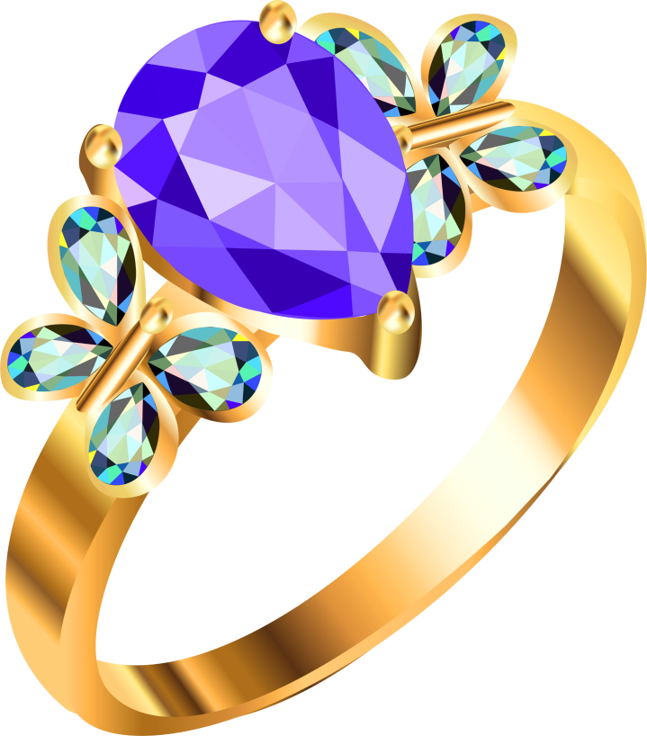
NEW ARRIVAL
$499
$299
WEDDING RINGS
6cm wedding gold ring with blue diamond stone
Model RS00-002

Slide 4
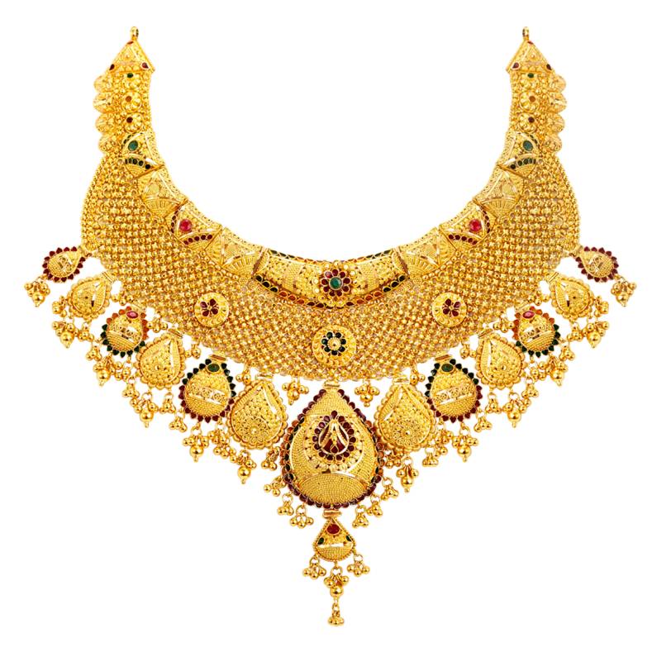
FLAT SALE
$599
$399
INDIAN GOLD NECKLACE
Ladies necklace chain by gold plated pendants
Model RS00-003

Slide 5
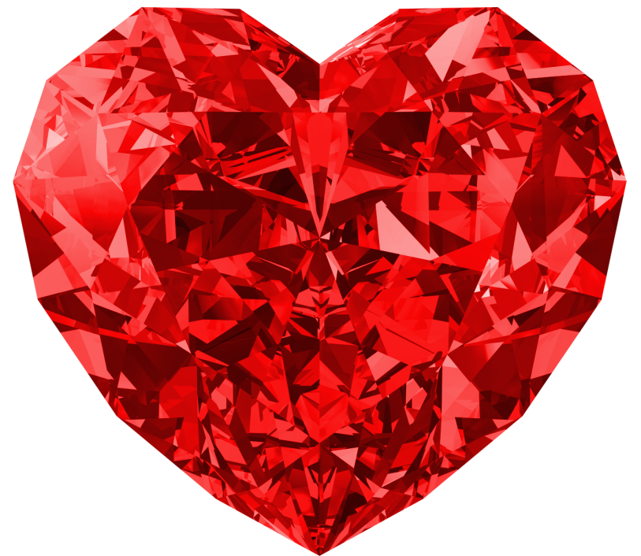
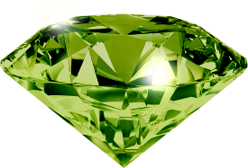
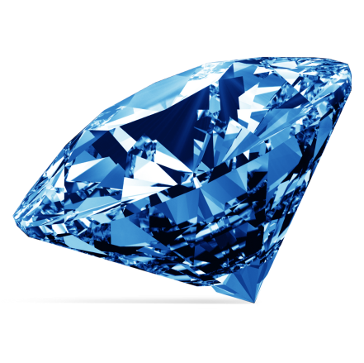
SALE
GREEN SAPPHIRE
HEART STONE
5cm red heart sapphire stone, 5cm green sapphire stone, 5cm blue sapphire stone
BLUE SAPPHIRE
Model RS00-004, RS00-005, RS00-006

Slide 6
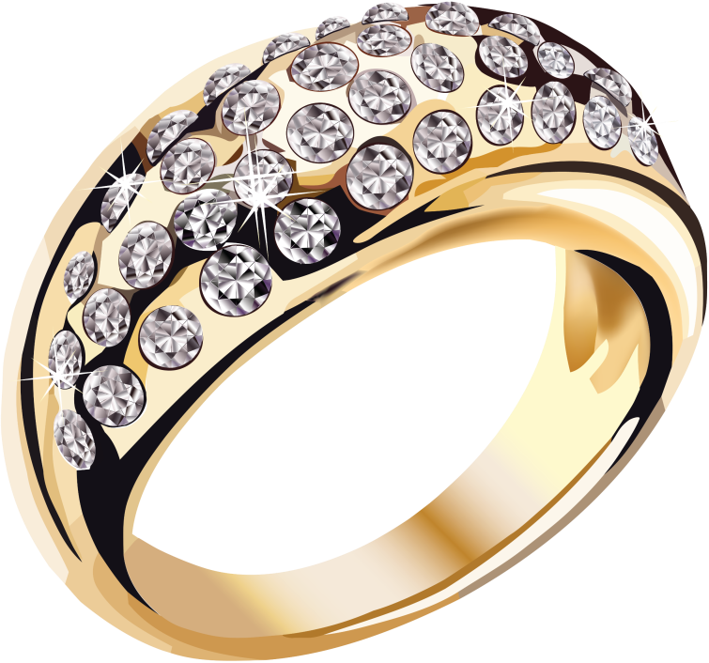
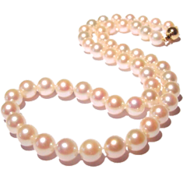
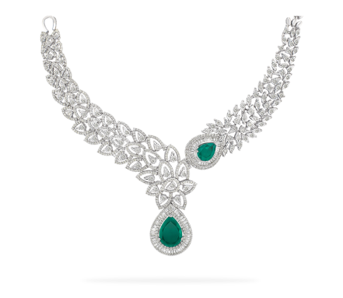
SALE
DIOMAND NECKLACE
DIAMOND RING
6cm wedding gold ring with diamond stone, Pink diamond pearl necklace and Silver sapphire necklace
SAPPHIRE NECKLACE
Model RS00-007, RS00-008, RS00-009

Slide 7
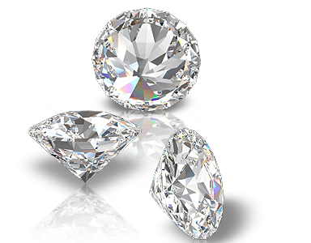
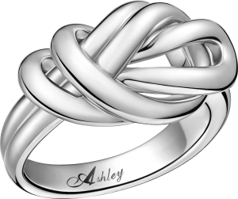
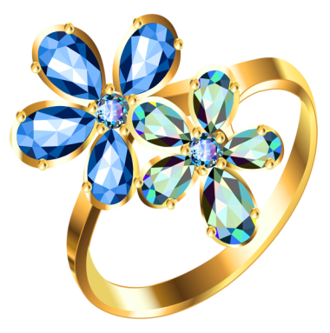
SALE
SILVER RING
DIAMOND STONE
5cm diamond stone, Silver Ring and Gold Ring
GOLD RING
Model RS00-010, RS00-011, RS00-012

Slide 8
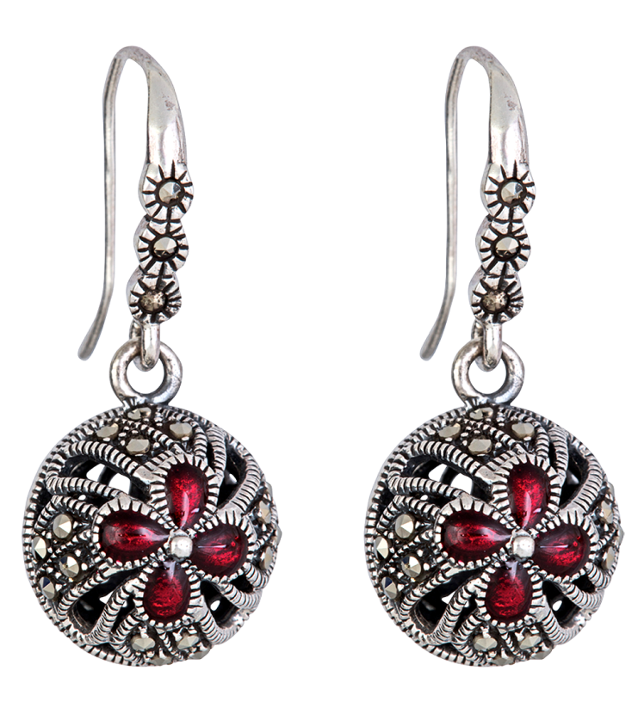
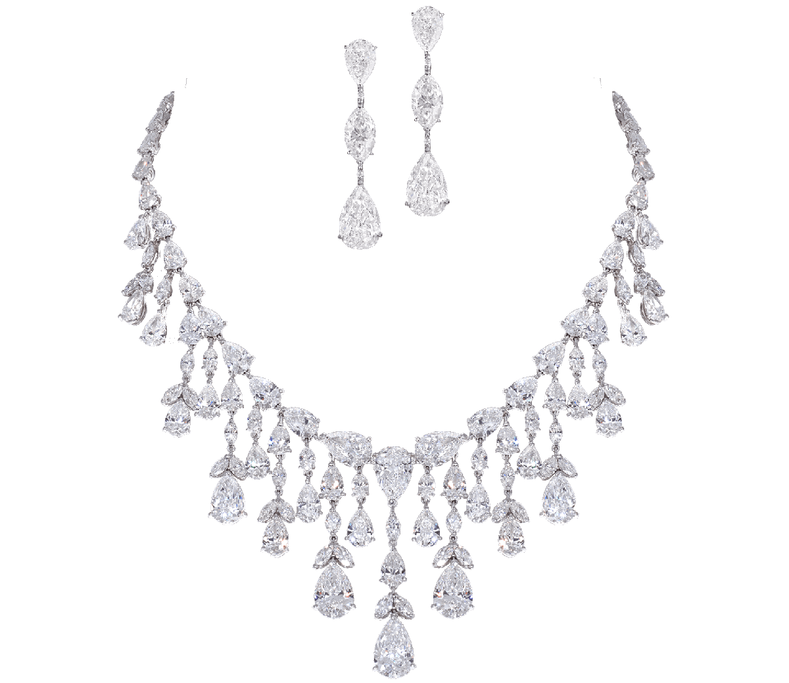
50% OFF
DIAMOND NECKLACE
SILVER EARRINGS
Ladies necklace chain by silver flowers
Ladies silver earrings
Model RS00-013, RS00-014, RS00-015

Slide 9
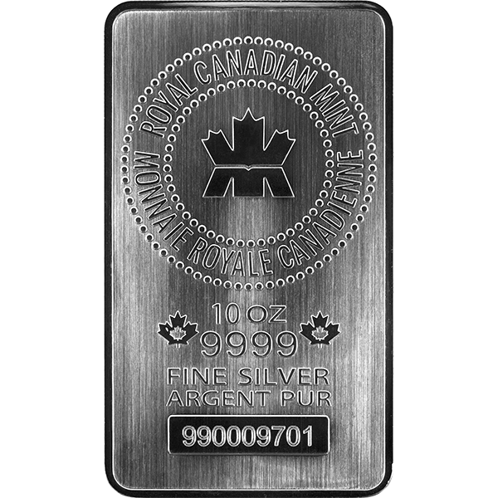
50% OFF
CUSTOM SILVER TROPHIE
CUSTOM SILVER PLATE
Customizable Silver 17-1/4 Inch, Includes Personalization, Shipping Weight: = 14 Pounds
Customizable Silver 10-1/4 Inch, Includes Personalization, Shipping Weight: = 10Pounds
Model RS00-016, RS00-017, RS00-018

Slide 10
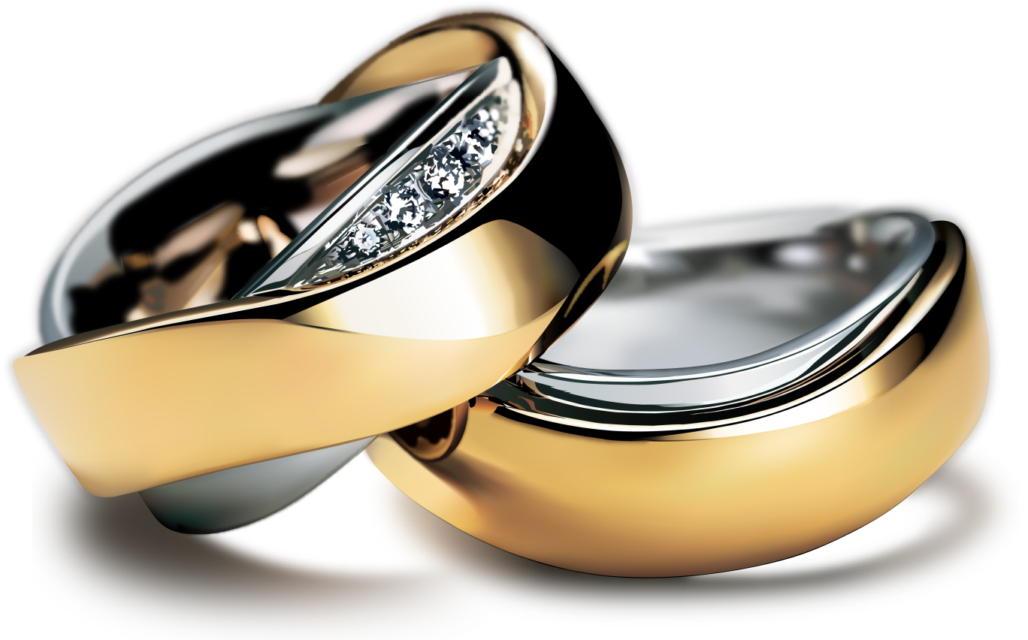
FLAT SALE
$599
$399
WEDDING RINGS
6cm and 10cm couple wedding gold ring with diamond stone
Model RS00-019

Slide 11
+123456789
www.silverjewelnatics.com
A-525, Silverjewelnatics, USA

