Slide 1
+123456789
www.lateststyleworld.com
A-15, LatestStyle, USA

Slide 2
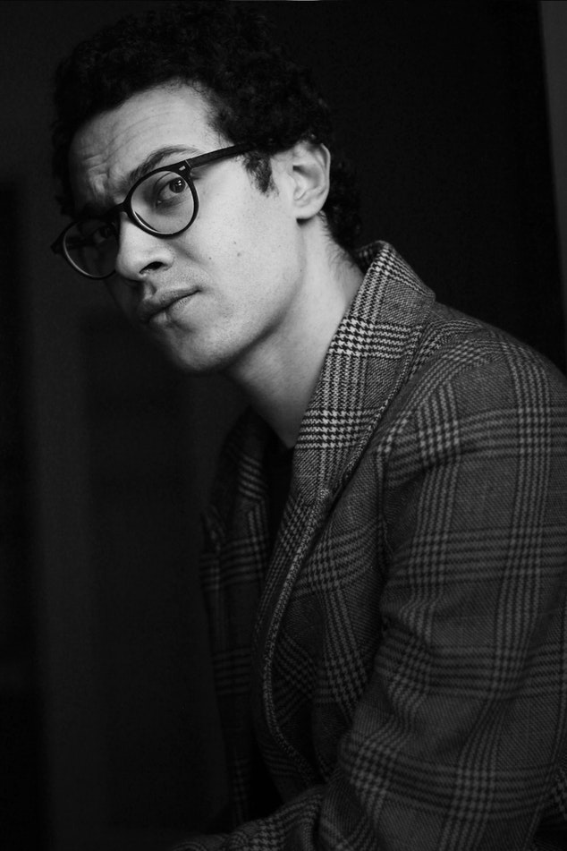
ABOUT
SERVICE
ADDRESS
ABOUT
US
Latest Style is the number-one online shopping and selling destination in the world – present in Asian Countries, USA and Europe. Latest Style has 1 million sellers and 2,000 brands serving 800 million consumers in the region through its marketplace platform, supported by a wide range of tailored marketing, data and service solutions. Focused on delivering an excellent customer experience, it offers multiple payment methods including cash-on-delivery, comprehensive customer care and hassle-free returns.

Slide 3
ABOUT
SERVICE
ADDRESS
SERVICES & FEATURES
24 X 7 SERVICES
DAILY DISCOUNT
DEBIT CARD
INTERNATIONAL COURIER
COUPONS
GIFTS

Slide 4
ABOUT
SERVICE
ADDRESS
ADDRESS & CONTACT US
1177 Avenue of the America, New York, NY 10036
1-800-123-4567
www.lateststyleworld.com

Slide 5
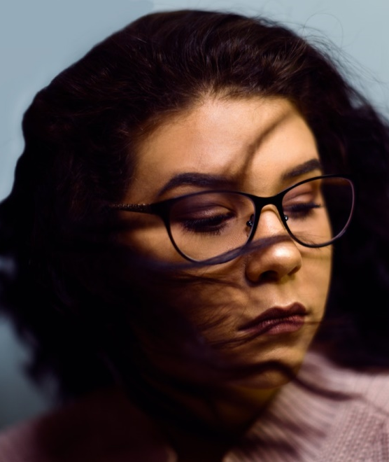
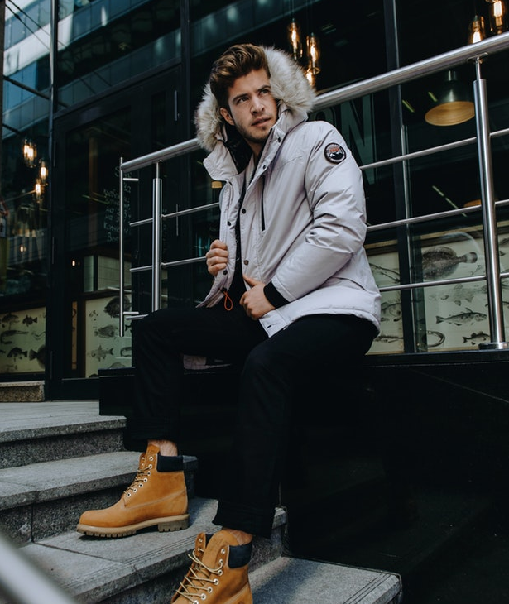
PRODUCTS
NEW ARRIVAL
DISCOUNT
PRODUCTS
Outfits
$49.00
$29.00
$69.00
FASHION EYE GLASS
LADIES SWEATER
WOOL JACKET

Slide 6
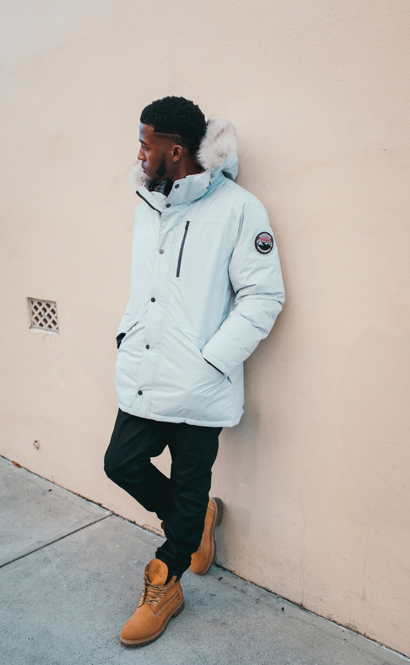
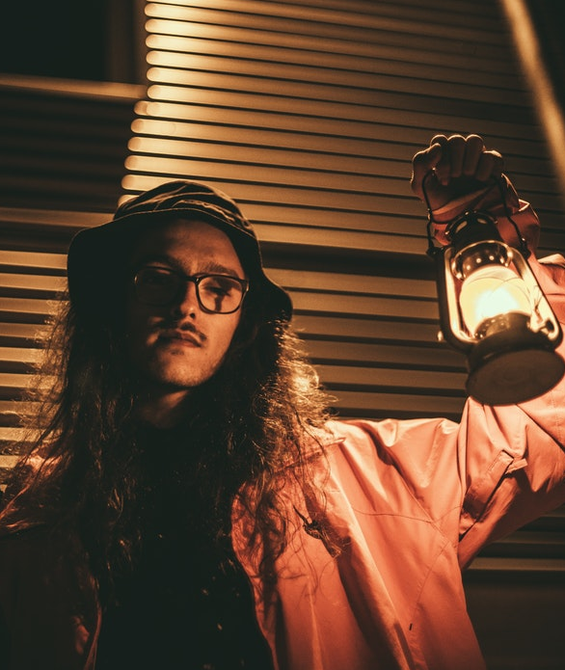
PRODUCTS
NEW ARRIVAL
DISCOUNT
PRODUCTS
Apparel
$119
$139
$49
TRANSPARENT EYE GLASS
MALE FASHION JACKET
SKY BLUE LONG SLEEVE

Slide 7
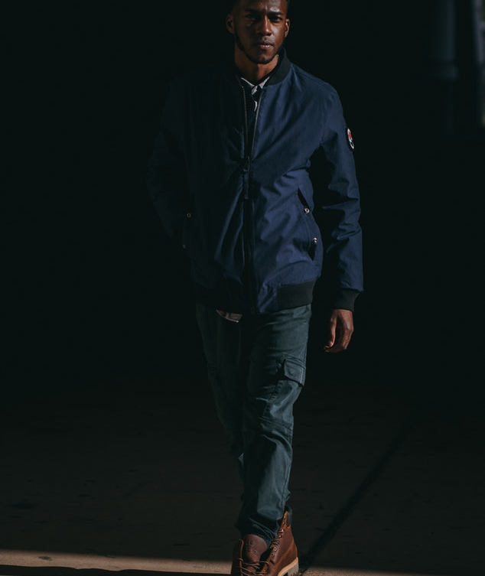
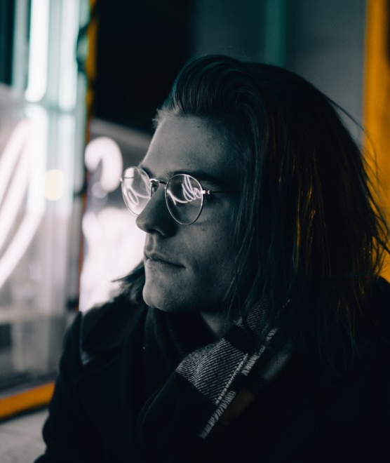
PRODUCTS
NEW ARRIVAL
DISCOUNT
NEW ARRIVAL
Men
$199
$99
$59
MEN’S JACKET
ROUND EYE GLASS
FASHION JACKET FOR MEN

Slide 8
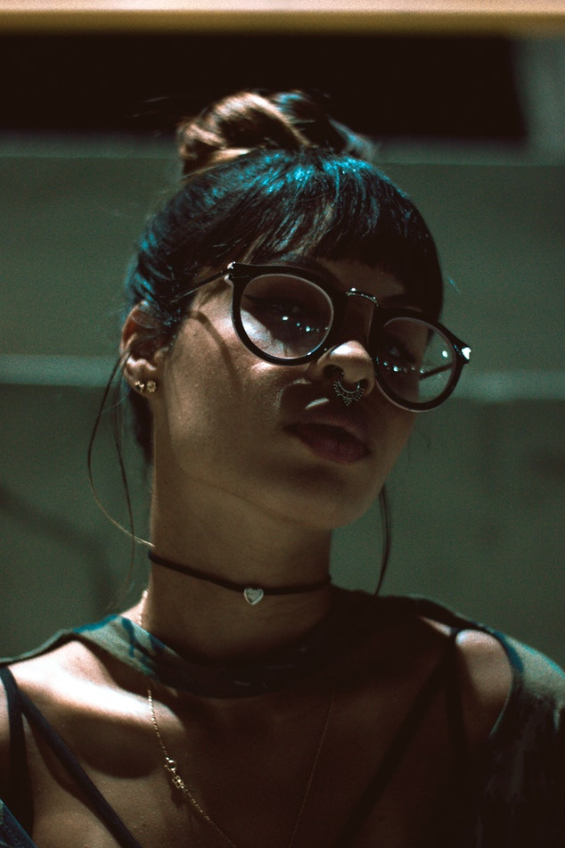
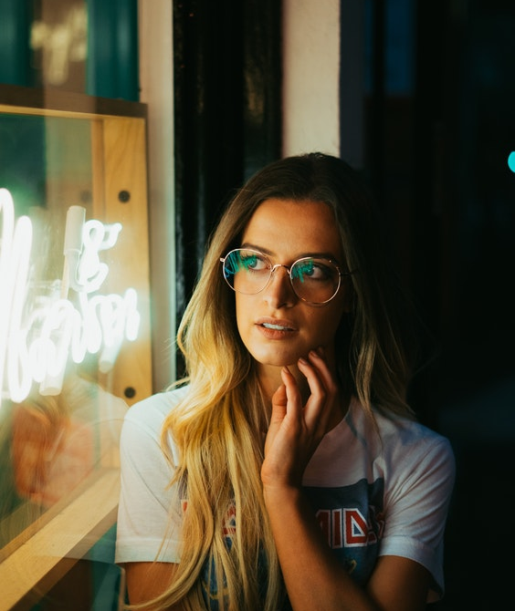
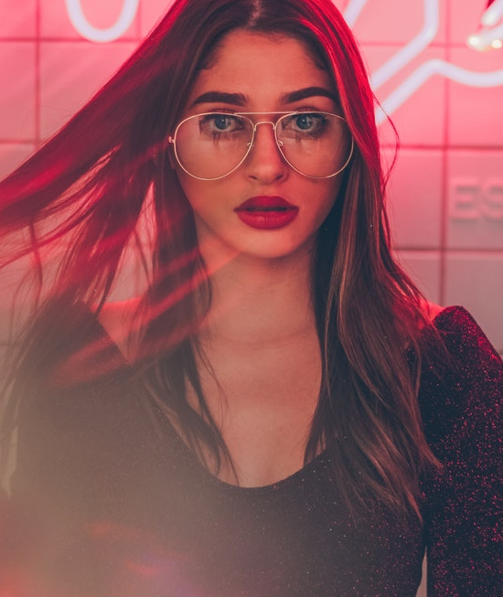
PRODUCTS
NEW ARRIVAL
DISCOUNT
NEW ARRIVAL
Ladies
$79
$79
$59
LIGHT PINK EYE WEAR
EYE WEAR FOR LADIES
FASHION JACKET FOR LADIES

Slide 9
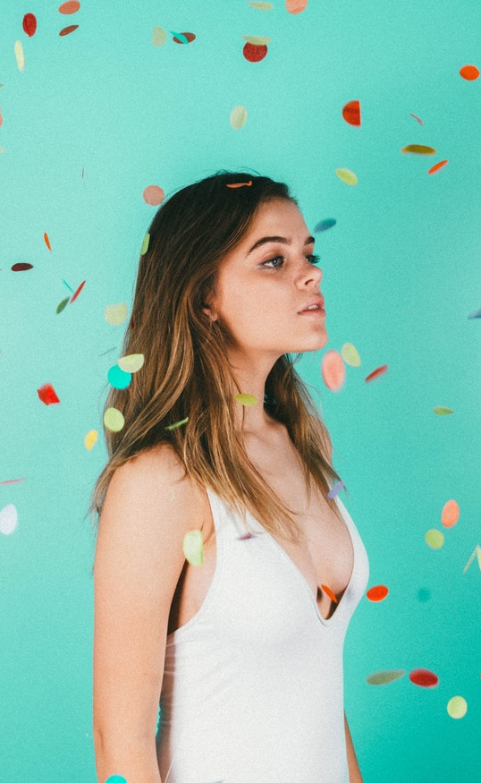
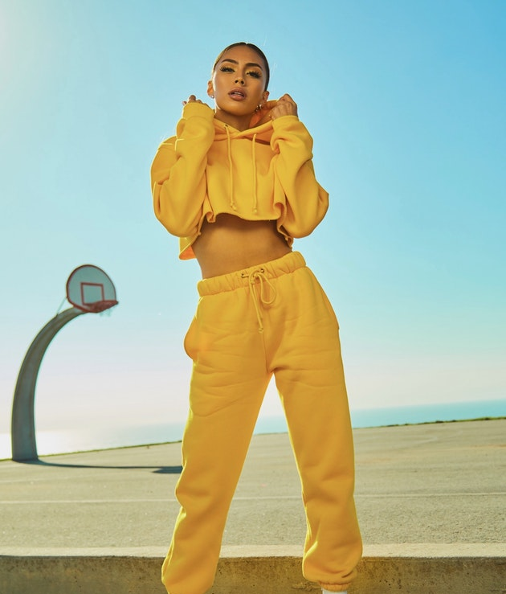
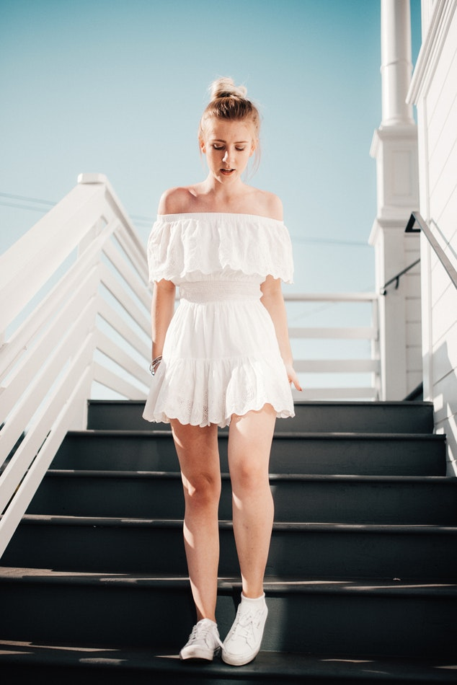
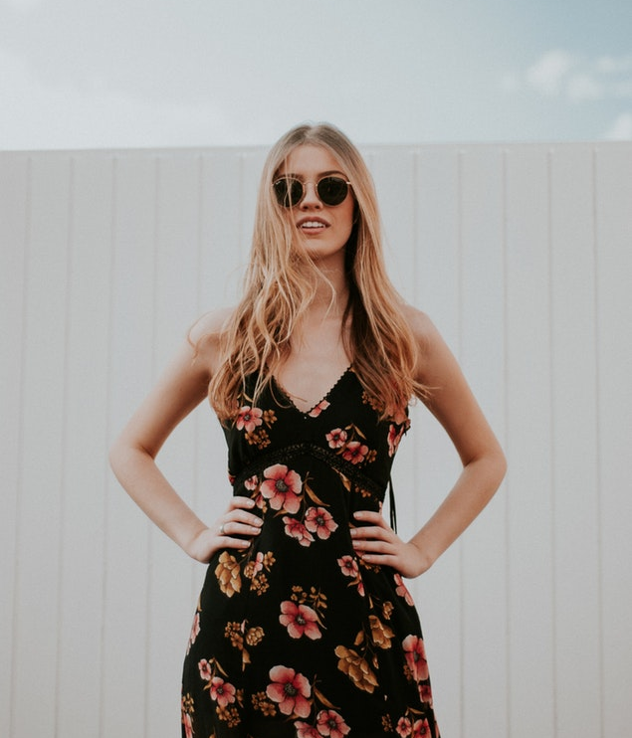
PRODUCTS
NEW ARRIVAL
DISCOUNT
DISCOUNT
Flat 50%
$89
$39
$49
FASHION BODY FIT SEXY OUTFIT
OFF-SHOULDER DRESS
SEXY BLACK DRESS

Slide 10
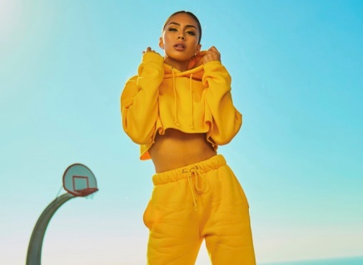
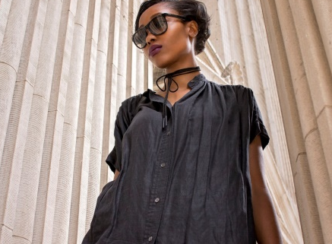
PINK FRAME SUNGLASS
$119 / $199
Colors: Black, Pink
YELLOW SEXY OUTFIT
$49 / $99
FLASH DEALS
Colors: Yellow
PINK LONGSLEEVE
$199 / $299
Colors: Pink
BLACK DRESS
$99 / $149
Colors: Black

Slide 11
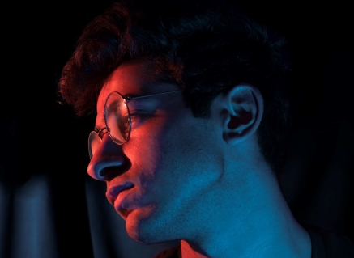
OVERSIZED EYEGLASS
$119 / $199
Colors: Transparent
LADIES EYE WEAR
$69 / $159
FLASH DEALS
Colors: Transparent
FASHION EYE WEAR
$119 / $229
Colors: Transparent
AMERICAN STYLE
$99 / $199
Colors: Transparent

Slide 12
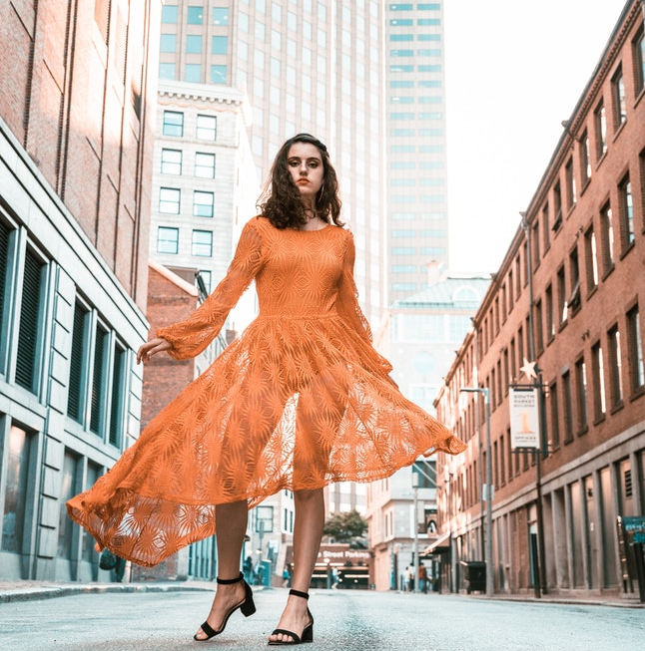
PREMIUM
STYLISH SEXY DRESS
USD $99
Japanese style cotton sexy dress good to wear for any occasion.
AVAILABLE COLORS:

Slide 13
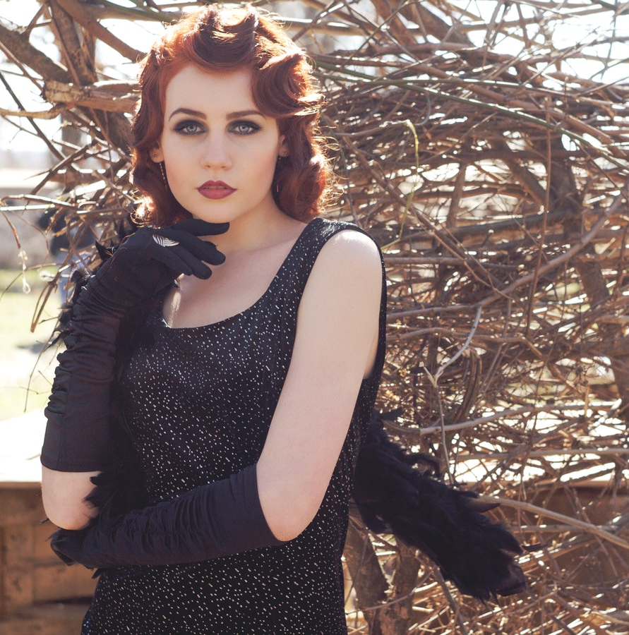
PREMIUM
ELEGANT SEXY DRESS
USD $59
Italian style cotton sexy dress good to wear for any occasion.
AVAILABLE COLORS:

Slide 14
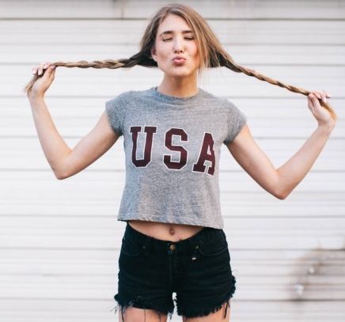
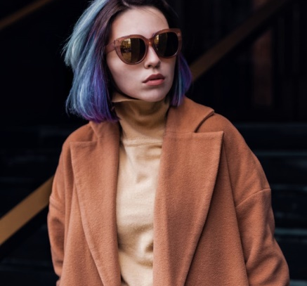
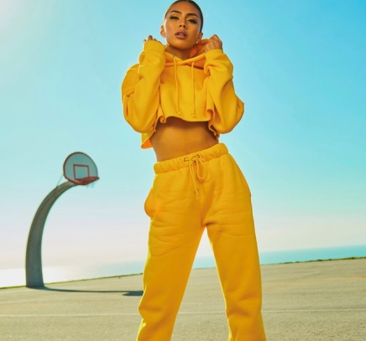
01
02
03
04
05
NEW ARRIVAL
06
07

Slide 15
01
02
04
LIMITED STOCK
03
05

Slide 16
+123456789
www.lateststyleworld.com
A-15, LatestStyle, USA

