Slide 1
I AM MORE
THAN WHAT
YOU SEE

Slide 2
WE CARE YOUR VISION
1-800-123-4567
www.asianvisionfashion.com
1177 Avenue of the Americas, New York, NY 10036

Slide 6
I AM

Slide 7
MORE

Slide 8
THAN

Slide 9
WHAT YOU

Slide 10
SEE!

Slide 11
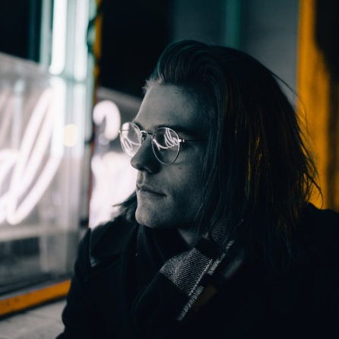
BROWLINE
REGULAR
EXCLUSIVE OFFERS
Oversized Classic Vintage Retro Style Clear Lens Frame Rose
50% off
30% off
10% off
$200
$179

Slide 12
EXCLUSIVE OFFERS
Fashion Metal Frame Optical Glasses Classic Eyeglasses
AVIATOR ROUND
50% off
20% off
10% off
$200
$199

Slide 13
EXCLUSIVE OFFERS
50% off NOW, If you share our product to your Facebook, we will offer you 50% off discount code!
BROWLINE
Colours: Transparent, Black, Blue, Leopard
$149
LIMITED TIME OFFER

Slide 14
EXCLUSIVE OFFERS
20% off NOW, If you share our product to your Facebook, we will offer you 20% off discount code!
UNISEX
Colours: Transparent, Black, Blue, Leopard
$119
LIMITED TIME OFFER

Slide 15
EXCLUSIVE OFFERS
10% off NOW, If you share our product to your Facebook, we will offer you 10% off discount code!
VINTAGE
Colours: Transparent, Black, Blue, Leopard
$99
LIMITED TIME OFFER

Slide 16
HOT COLLECTION
100% Protection Against Harmful UVA/UVB Rays
CLASSIC
CLASSIC
Glasses frame width: 142 mm
Glasses frame high: 53 mm
Glasses leg length: 143 mm
Glasses frame width: 142 mm
Glasses frame high: 53 mm
Glasses leg length: 143 mm
All original designs from AVF
$200
$139

Slide 17
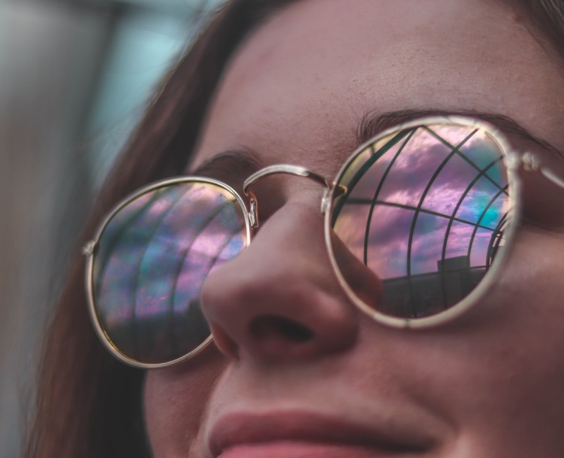
CLASSIC
HOT COLLECTION
Glasses frame width: 142 mm
Glasses frame high: 53 mm
Glasses leg length: 143 mm
50% off NOW, If you share our product to your Facebook, we will offer you 50% off discount code!
CLASSIC
Glasses frame width: 142 mm
Glasses frame high: 53 mm
Glasses leg length: 143 mm
Anti-Radiation/Blue light eyewear High quality acetate optical frame Metal
$200
$79

Slide 18
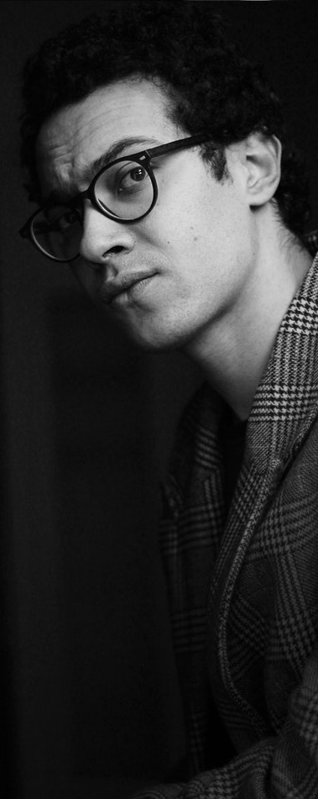
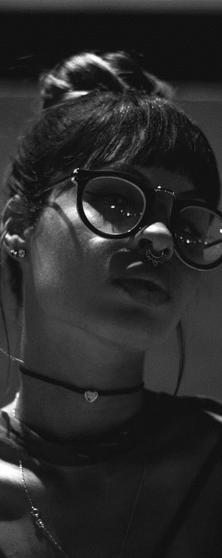
LIMITED
STOCK

Slide 19
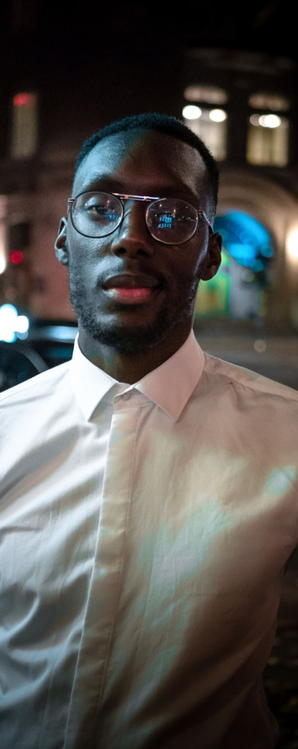
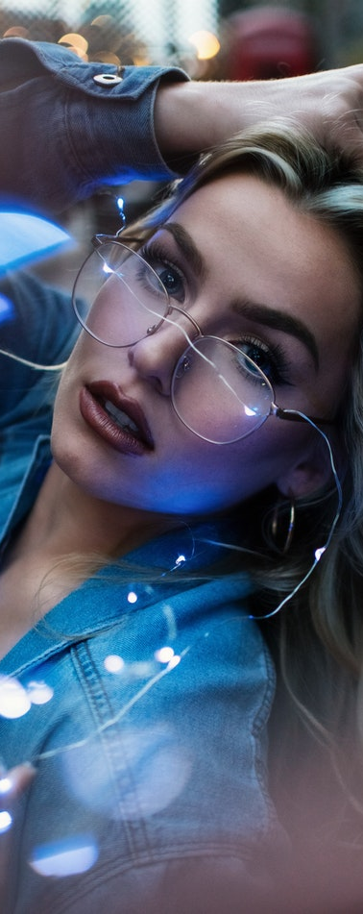
LIMITED
STOCK

Slide 20
WE CARE YOUR VISION
1-800-123-4567
www.asianvisionfashion.com
1177 Avenue of the Americas, New York, NY 10036

