Slide 1
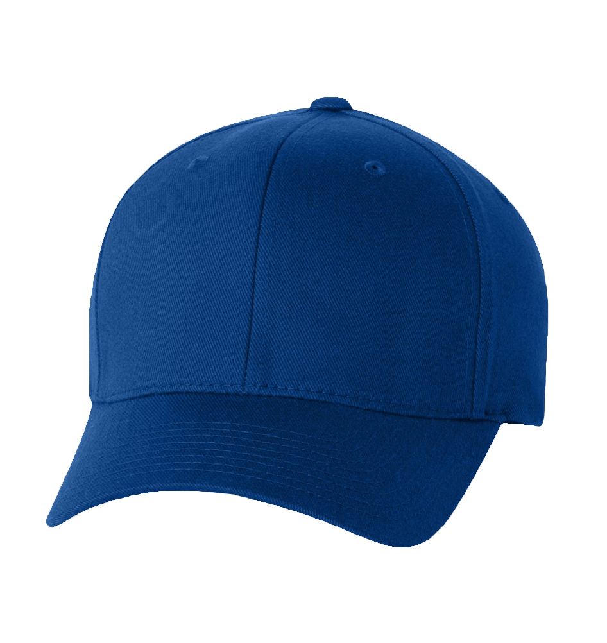
WWW.SEXYMEJEANS.COM
blue cap
$12
99
American style casual blue cap
-40% OFF
Notes:
<a href="https://www.freepngimg.com/png/1144-baseball-cap-png-image">Baseball Cap Png Image FreePNGImg.com</a>

Slide 2
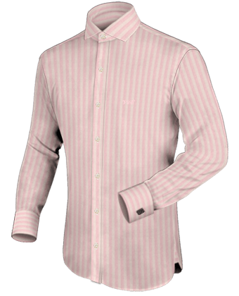
WWW.SEXYMEJEANS.COM
Long sleeve for men
$14
99
Body Fit stripe long sleeve
-50% OFF
Notes:
<a href="https://www.freepngimg.com/png/2115-dress-shirt-png-image">Dress Shirt Png Image FreePNGImg.com</a>

Slide 3
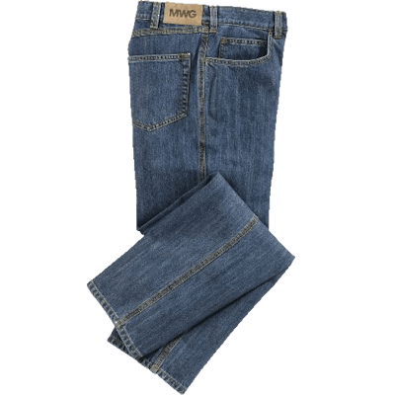
WWW.SEXYMEJEANS.COM
Blue jeans
$39
99
Simple design blue jeans
-50% OFF
Notes:
<a href="https://www.freepngimg.com/png/6777-jeans-png-image">Jeans Png Image FreePNGImg.com</a>

