Slide 1
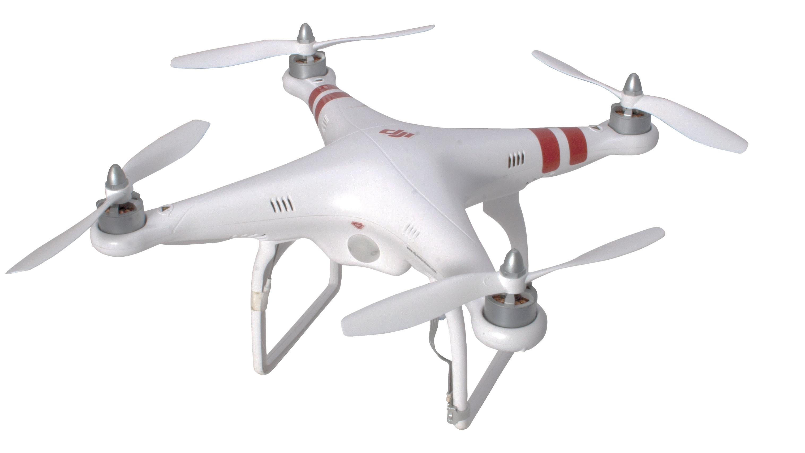
Drone
$ 199.00
-10%
www.buymenow.com
28 minutes maximum flight time, maximum control range of 31mi
Maximum speed of 44mph
Integrated gimbal for greater camera stability and smoother footage
Optimized Vision Positioning System raises positioning altitude up to 10 meters
Notes:
<a href="https://www.freepngimg.com/png/21908-drone-file">Drone File FreePNGImg.com</a>

Slide 2
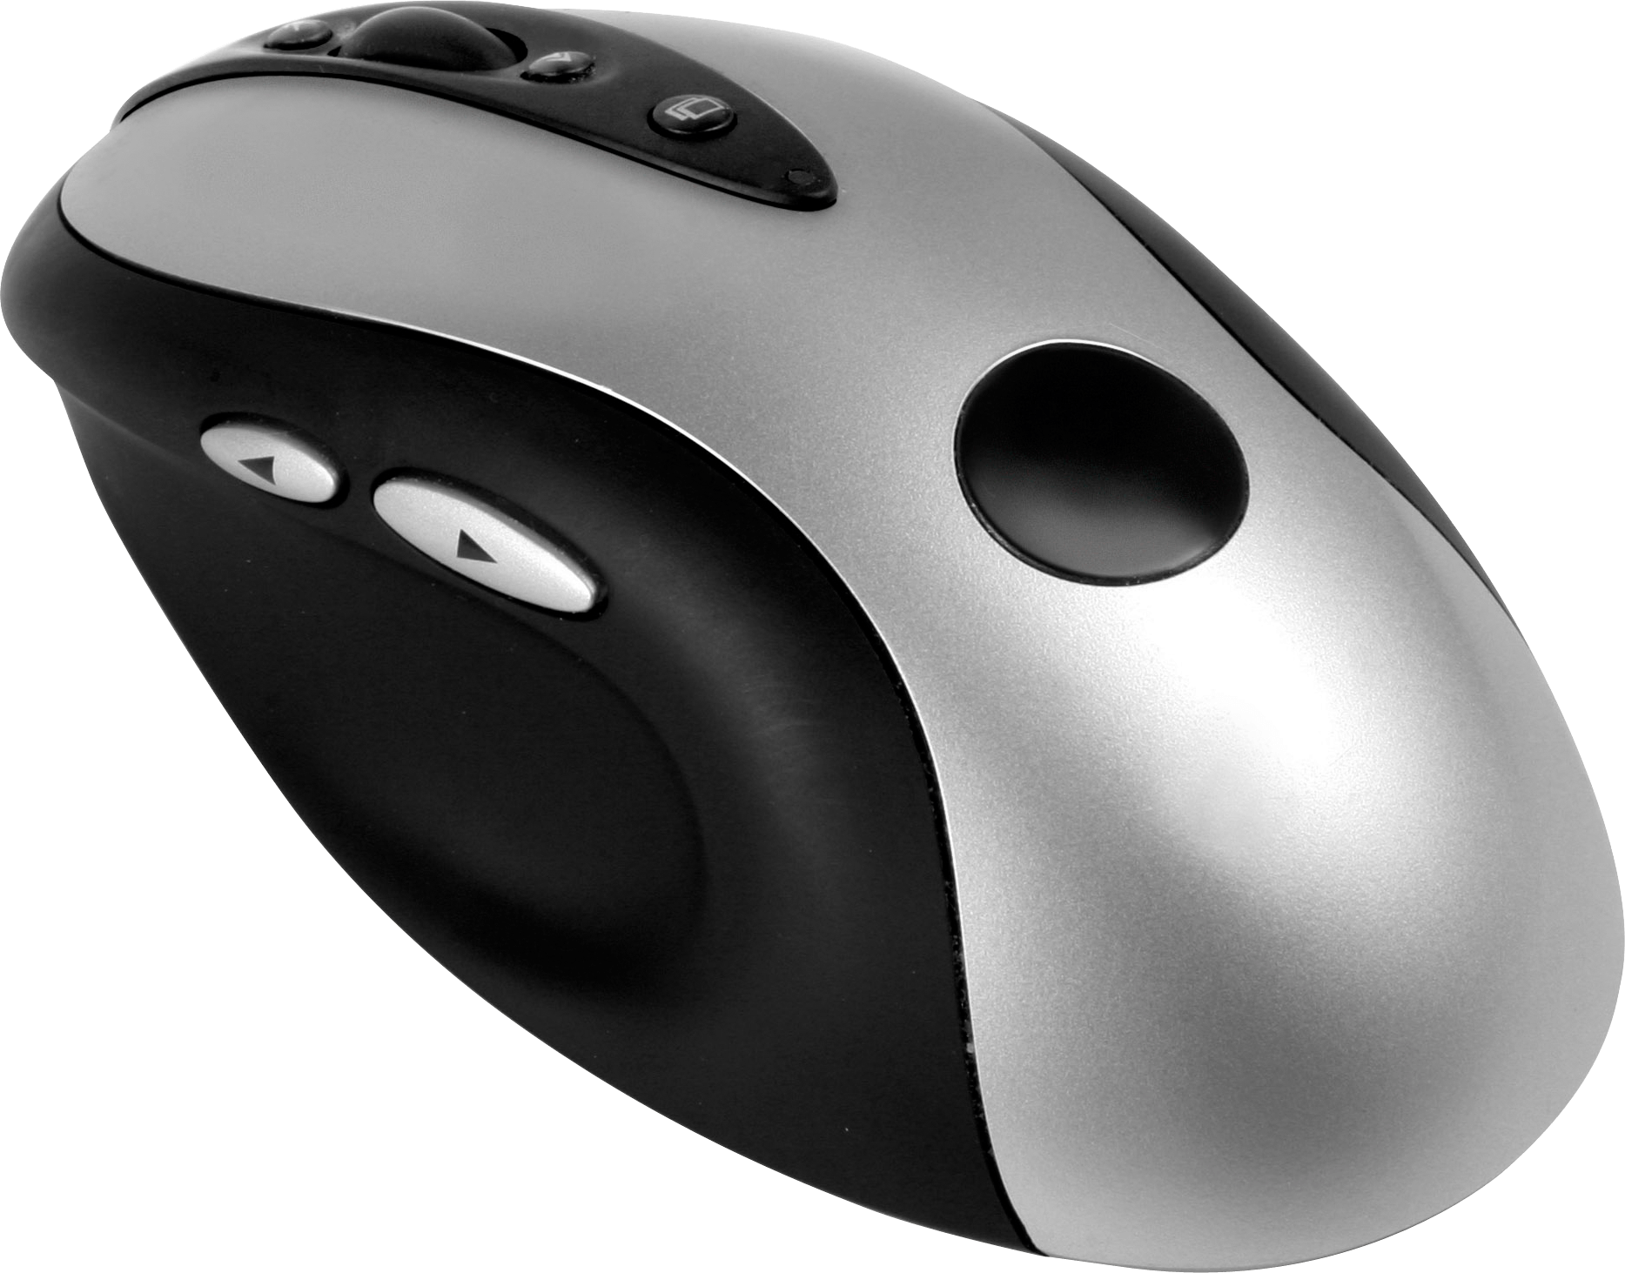
Gaming mouse
$20.00
-20%
www.buymenow.com
Optical Mouse for your computer. Ideal for Gaming. Fast reaction times.
Notes:
<a href="https://www.freepngimg.com/png/5883-pc-mouse-png-image">Pc Mouse Png Image FreePNGImg.com</a>

Slide 3
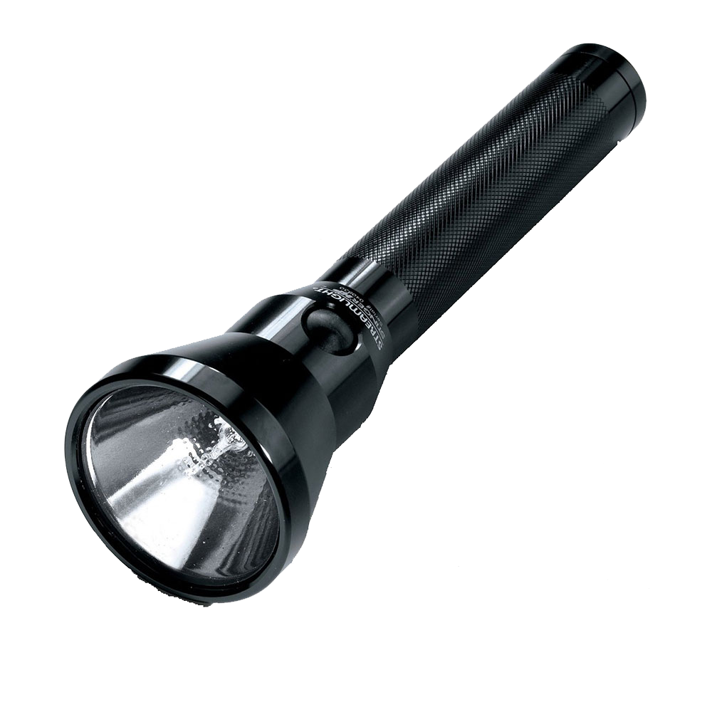
Flashlight
$15.00
-50%
www.buymenow.com
MorganStar Ultra Bright CREE XML T6 LED 5 Mode Bright Zoom Flashlight Splashproof Torch
Notes:
<a href="https://www.freepngimg.com/png/22681-flashlight-transparent-background">Flashlight Transparent Background FreePNGImg.com</a>

Slide 4
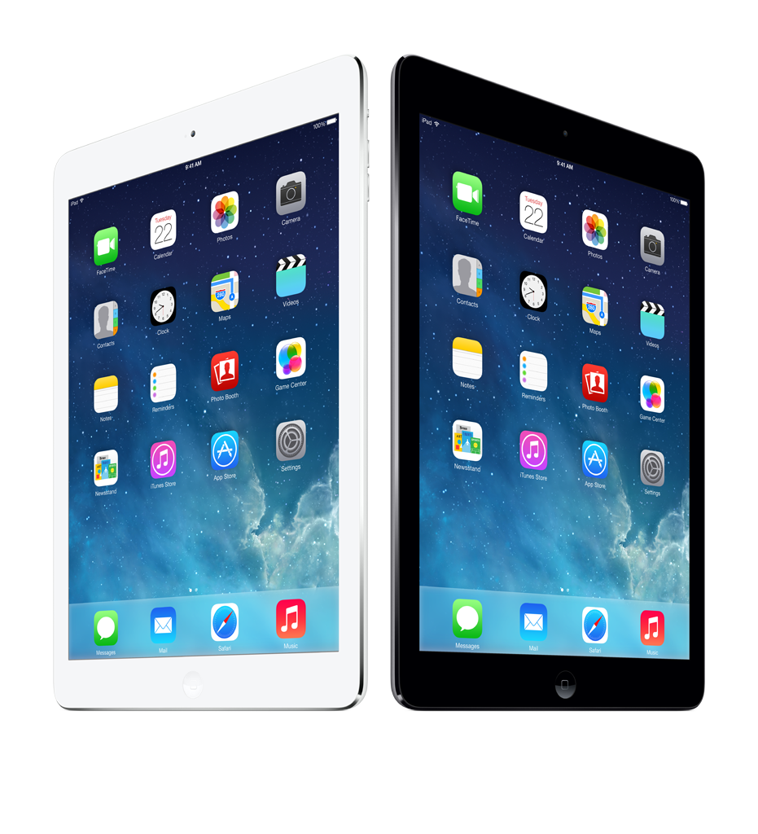
iPad
$600.00
-20%
www.buymenow.com
If the computer were invented today, what would it look like? It would be powerful enough for any task. So mobile you could take it everywhere. And so intuitive you could use it any way you wanted — with touch, a keyboard, or even a pencil.1 In other words, it wouldn’t really be a “computer.” It would be iPad.
Notes:
<a href="https://www.freepngimg.com/png/30300-ipad-transparent-picture">Ipad Transparent Picture FreePNGImg.com</a>

