Slide 1
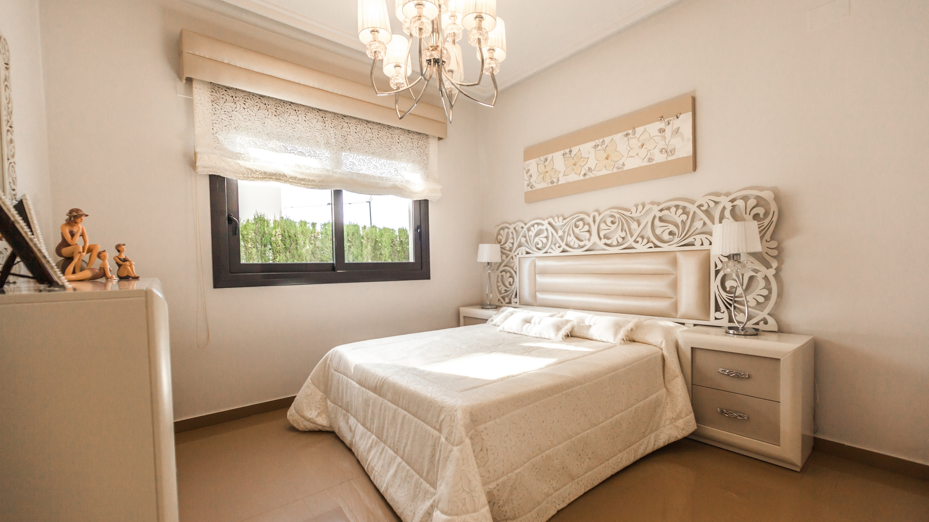
WWW.PADILLAMOUNTAINRESORT.COM
HOTEL FACT SHEET SHOWCASE
Follow us online
We are based in
1160 Gulf Blvd,
Clearwater Beach,
FL 33767, USA
Booking & Reservation
1-800-123-4567
info@padillamountainresort.com

Slide 2
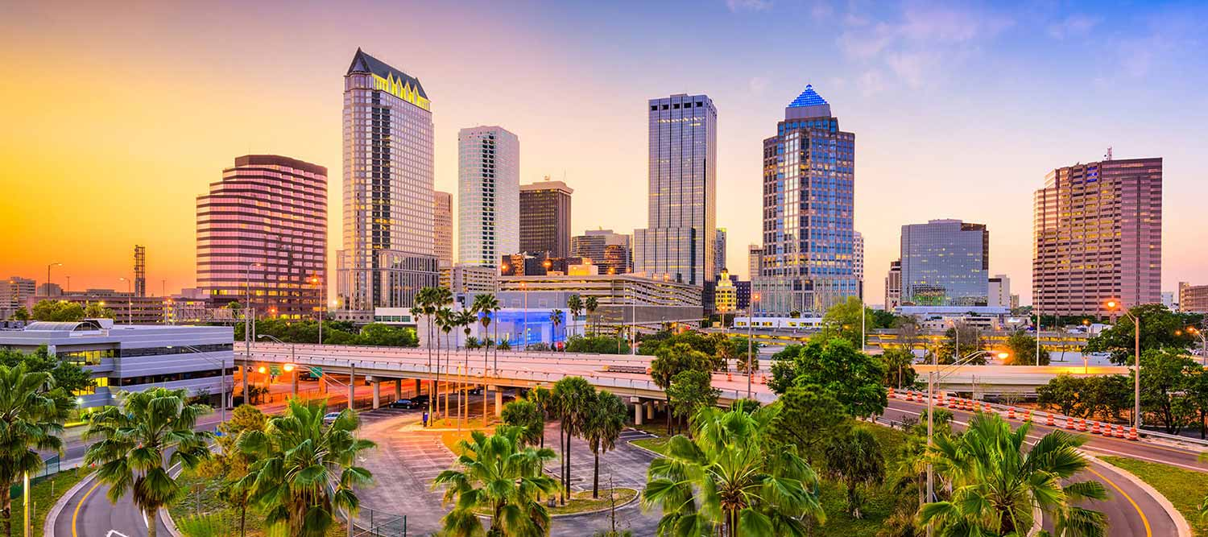
The Perfect Spot
for your Next Travel in
TAMPA

Slide 3
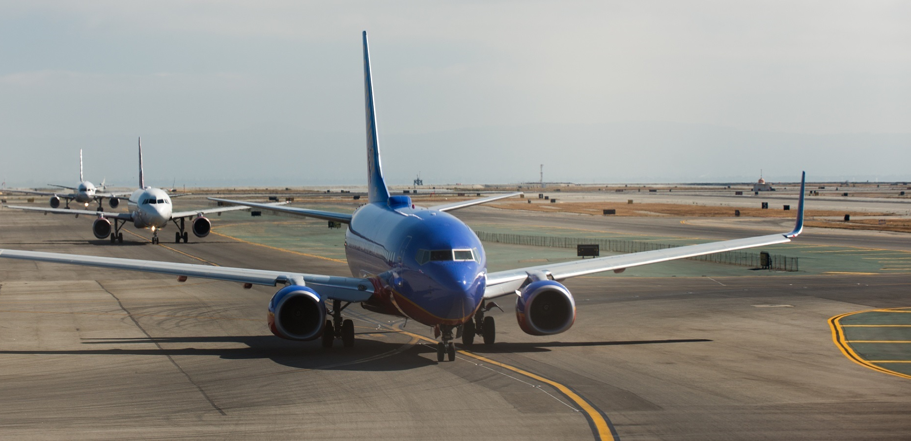
Only 20min from
Tampa international
Airport

Slide 4
5mn Walk from
Downtown City
Center

Slide 5
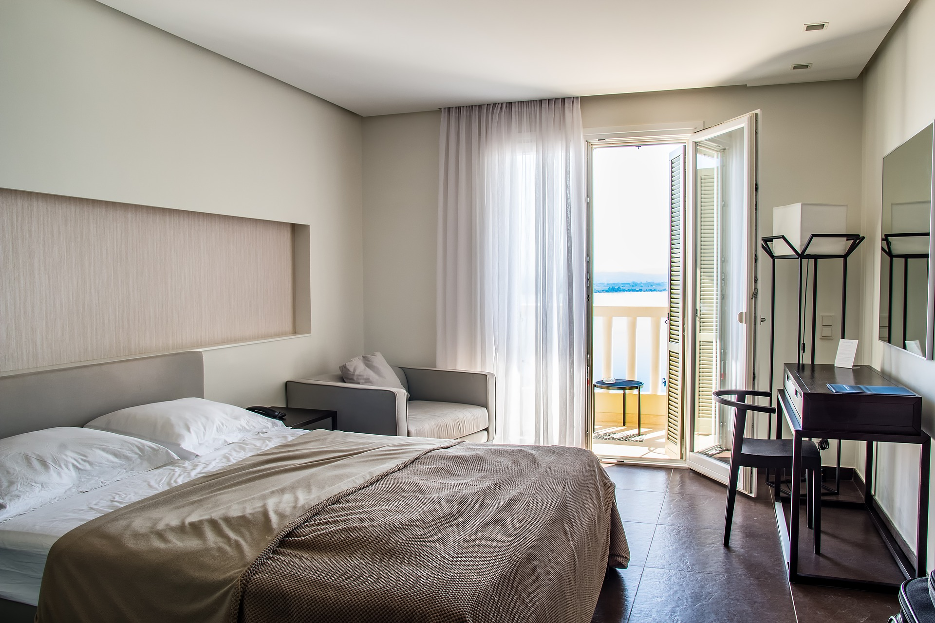
OUR HOTEL FEATURES
Room type
cv
35
Standard 25$m^{2}$
Single & double bed available
ROOMS
Located on the 4th floor & 6th Floor
FROM STANDARD TO V.I.P SUITE

Slide 6
Room type
Deluxe 35$m^{2}$
King size bed
With free SPA Access
Located on the 4th floor & 6th Floor

Slide 7
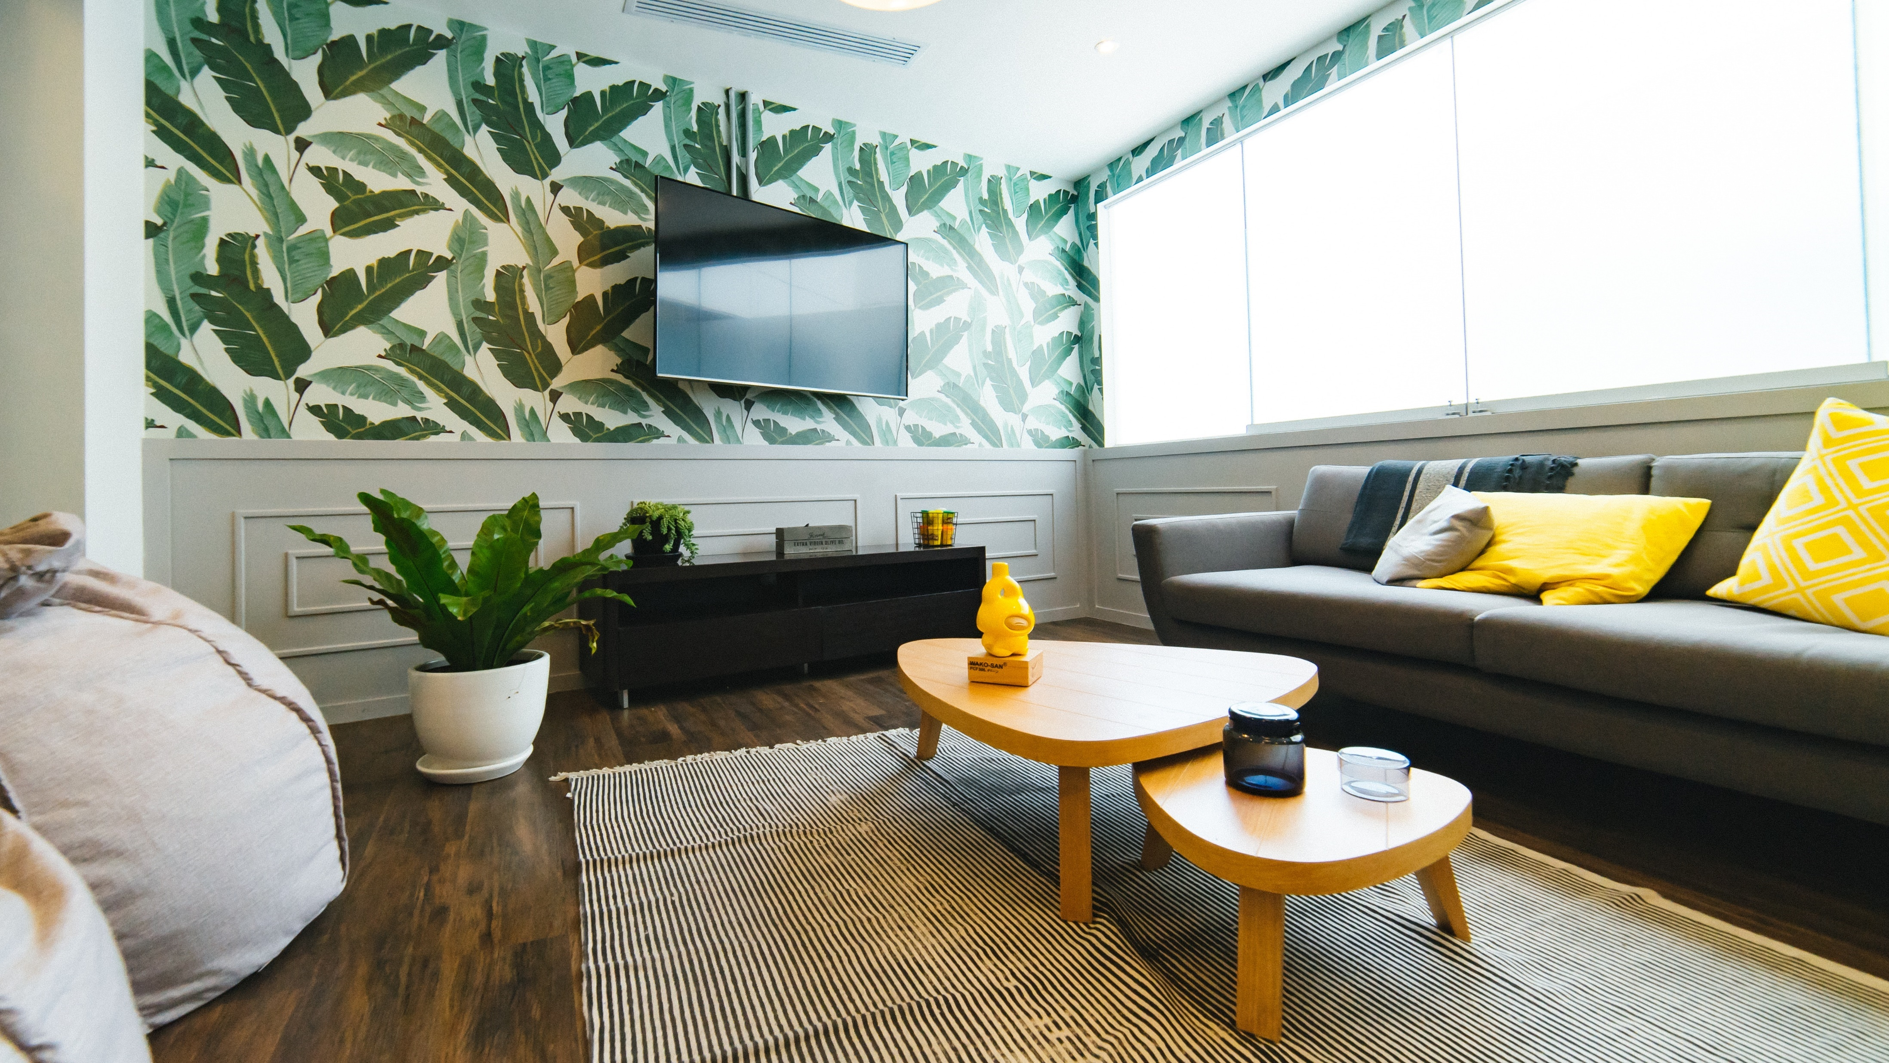
Room type
Junior suite
65$m^{2}$
Simple exceptional,
Your private Jacuzzi
Located on the 3rd floor & 7th Floor

Slide 8
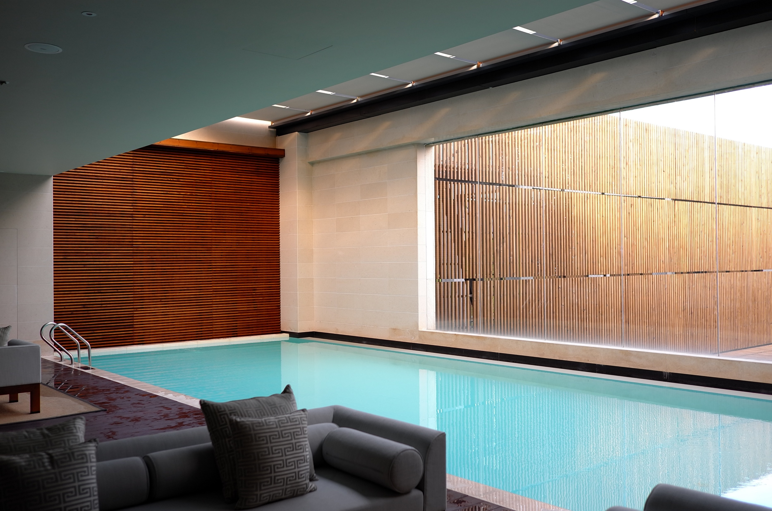
Room type
VIP suite
125$m^{2}$
Roof top Apartment with private pool & City View
Located on last floors

Slide 9
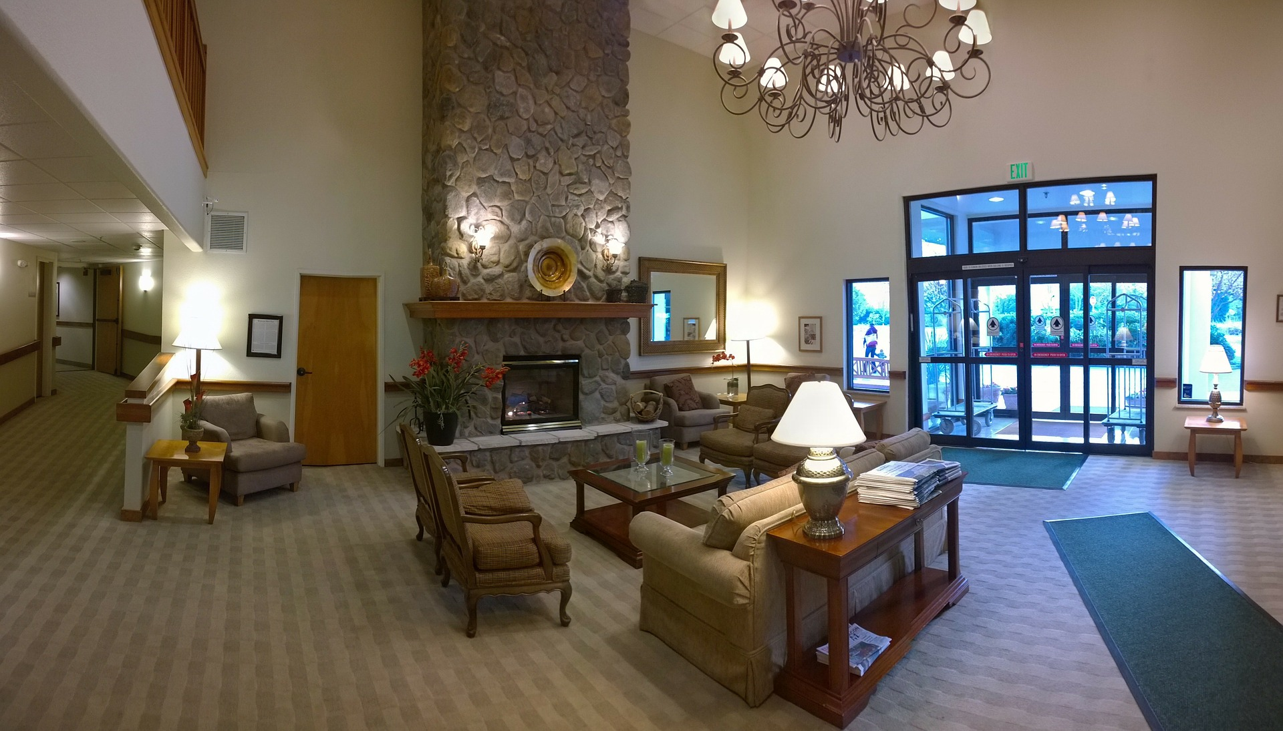
All furnished with Top Quality
Equipments & Services
BAGAGE
24H CONCIERGE
ROOM SERVICE
KING SIZE BED
AIR CONDITIONED
SHOWER
PRIVATE JACUZZI
LAUNDRY CLEANING
4K CABLE TV
FREE WIFI

Slide 10
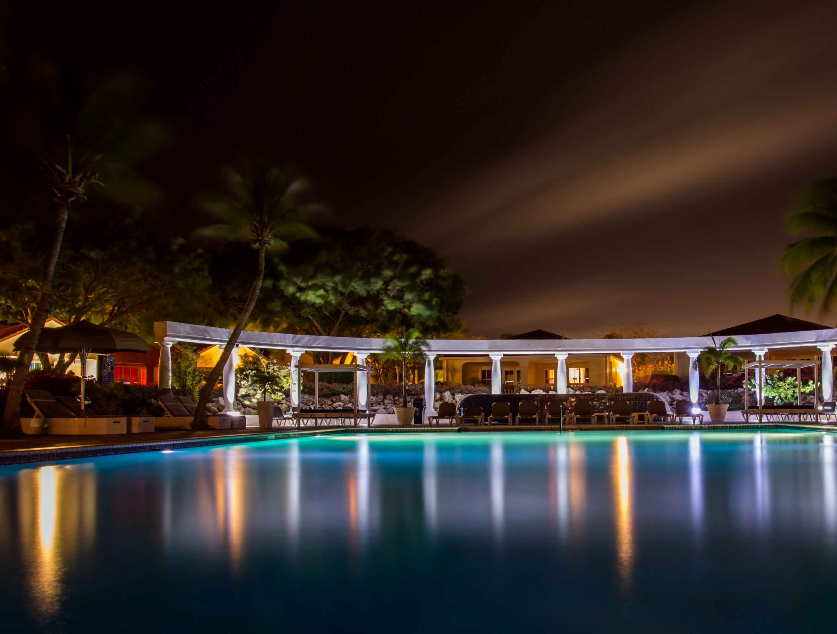
Relax Yourself
in our luxury
SPA CENTER

Slide 11
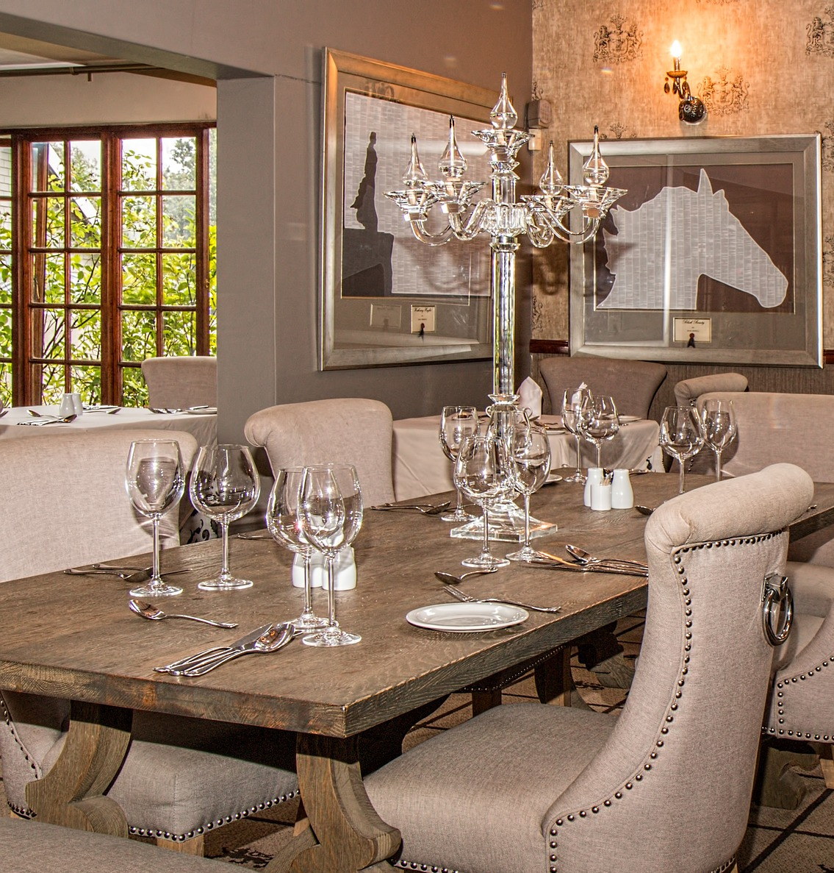
ENJOY
A fine dinning
IN OUR AWARD
RESTAURANTS
Experience

Slide 12
incentive
Business Facilities
At your Service
CONFERENCE.SEMINARIES

Slide 13
And Practice
PREMIUM
ACTIVITIES

Slide 14
Follow us online
HOTEL FACT SHEET SHOWCASE
We are based in
1160 Gulf Blvd,
Clearwater Beach,
FL 33767, USA
Booking & Reservation
1-800-123-4567
info@padillamountainresort.com
WWW.PADILLAMOUNTAINRESORT.COM

