Slide 1
TASTE THE DIFFERENCE
Delicious Food And Drinks
Bon Gpetit

Slide 2
STARTERS
SOUPS
LOBSTER RAVIOLI
GAZPACHO
€9.50
LONION, CUCUMBER, BELL PEPPER, YELLOW BELL PEPPER,
CELERY, TOMATOES, TOMATO JUICE, OLIVE OIL AND GARLIC
PLATO DI STATATA
€11.50
GINGER SOUP WITH ASPARAGUS
€11.50
GINGER SOUP WITH ASPARAGUS MIXED WITH PEPPER AND SOY SAICE
GRILLED SALMON WITH LEMON
€12.50
€14.50
LOBSTER SOUP
SMOKED MAKREL
LOBSTER RAVIOLO WITH SAUTEED ASPAGARUS IN A LEMON TARRAGON BUTTER
€14.50
€9.50
Enjoy!
Bon Gpetit

Slide 3
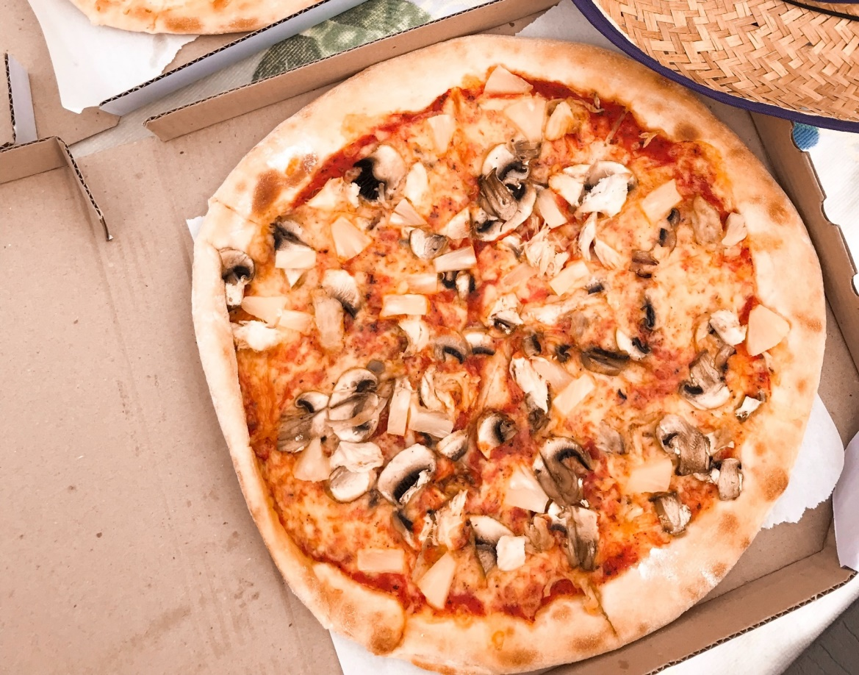
OFFER OF THE DAY
Honey Fresh
STONE BAKED PIZZA
PIZZA WITH MUSHROOM, TOMATO SAUCE AND FLOODED WITH MOZERELLA CHEESE
small €11.50
medium €14.50
large €17.50

Slide 4
STARTERS
MAIN
STEAK TARTARE
GRILLED MACKEREL
€11.50
€11.50
MEAT WITH ONIONS, SOY SAUCE, PEPPERS AND TOMATOES
MACKEREL, SOY SAUCE, SALT AND RADDISH
GRILLED RUMP STEAK
CHICKEN KEBABS
€12.50
€12.50
GRILLED SLICED BEEF WITH ONIONS AND GARLIC
YOGURT, OLIVE OIL, LEMON JUICE, GARLIC, PEPPER AND 2 CUTS OF CHICKEN
SLOW COOCKED BRISKET
PIZZA NAPOLI
€19.50
€19.50
COOKED BRISKET MEAT FROM BEEF OR VEAL
PIZZA FILLED WITH MOZARELLA CHEESE AND TOMTOES
ORIGINAL STEW
PULLED PORK
€19.50
€19.50
BEEF STEW, SOY SAUCE, ONION, GARLIC, BEANS
CHILI POWDER, BROWN SUGAR, GARLIC POWDER, BLACK PEPPER, MIXED ALL OVER THE PORK SHOULDER
Bon Gpetit
Bon Gpetit

Slide 5
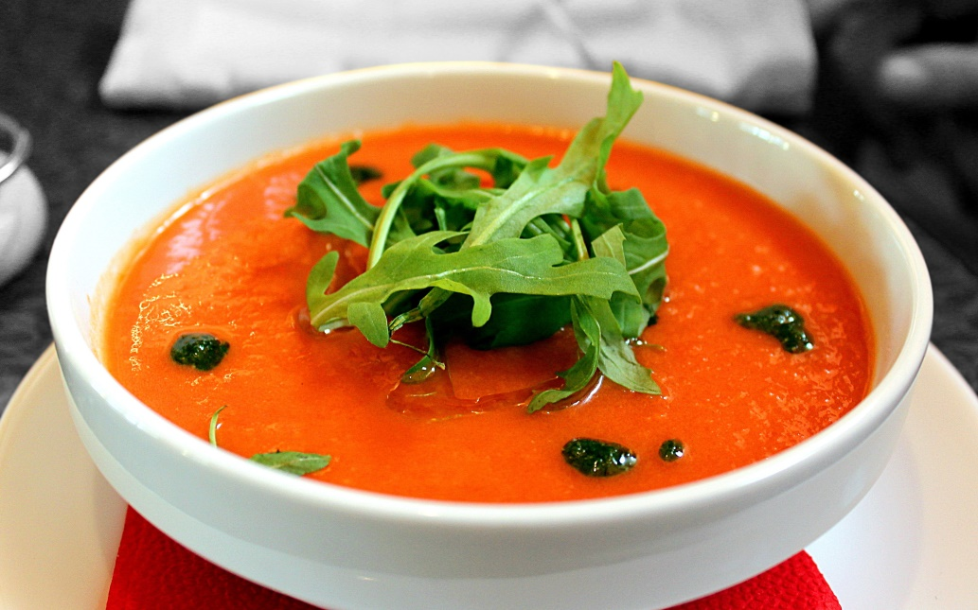
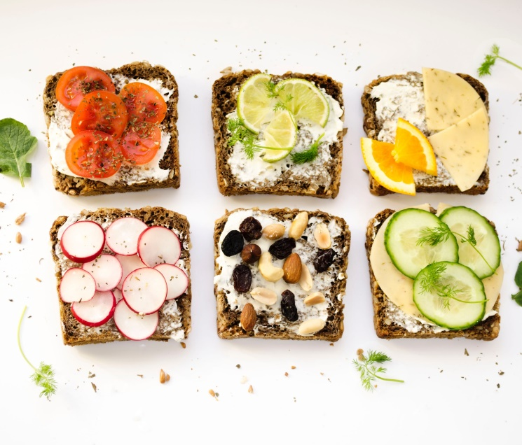
VEG DISH
ON THE WAY
GAZPACHO
SANDWICH DISH
ORIGINAL STEW
ONION, CUCUMBER, BELL PEPPER, YELLOW BELL PEPPER,
CELERY, TOMATOES, TOMATO JUICE, OLIVE OIL AND GARLIC
GRILLED VEGI PESTO SANDWICH, HOMEMADE CHICKEN SANDWICH, EGG AND CHEDDAR CHEESE SANDWICH
€11.50
€11.50

Slide 6
STARTERS
BREWERY
RISTRETTO
€2.00
PALE ALE
€4.50
EXPRESSO
€1.50
DARK ALE
€5.50
DOUBLE EXPRESSO
€2.50
CZECH LAGER
€6.50
CAPPUCCINO
€3.50
MEXICAN BEER
€4.50
CAFFE LATTE
€2.50
GINGER BEER
€3.50
HOT CHOCOLATE
€1.50
SMOOTH MOTH
€1.50
GRAY TEA
€2.50
GRAY TEA
€2.50
Fresh Coffee Beans
Home Made

Slide 7
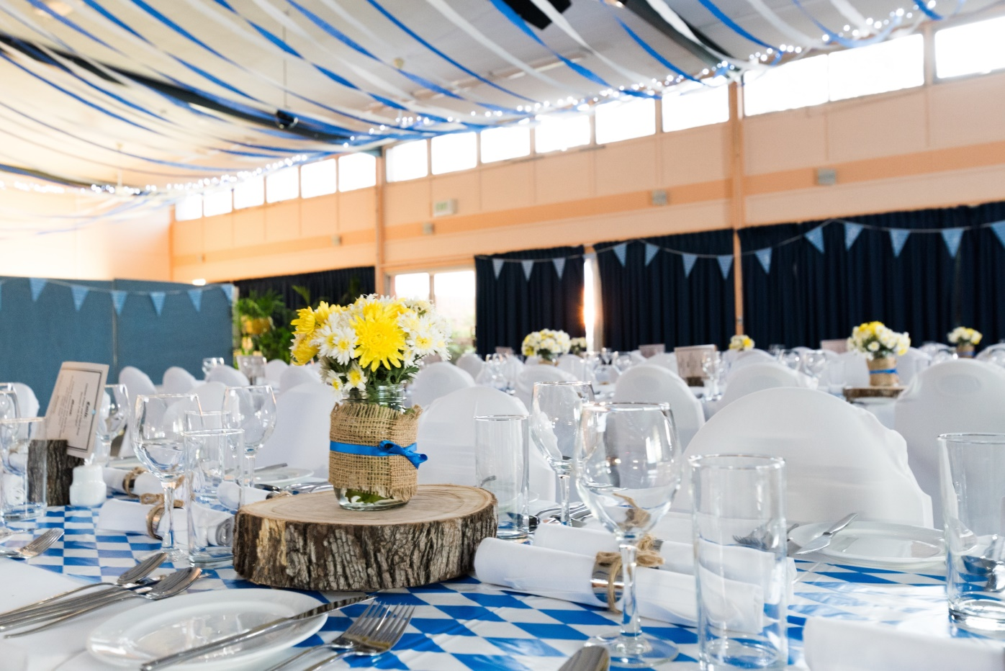
ENOY OUR SERVICE
Honesty Fresh
SPECIAL EVENT
WEDDING • BIRTHDAY PARTY
KARAOKE • QUIZ NIGHT
MUSIC EVENTS • CATERING
1-800-123-4567
www.pizzachospizzaparlor.com

Slide 8
TASTE THE DIFFERENT
Delicious Food And Drinks
info@pizzachospizzaparlor.com
1-800-123-4567
www.pizzachospizzaparlor.com
Bon Gpetit

