Slide 2
Anastasia
Gevorge
YOUR PERSONAL REALTOR
1-800-123-4567
info@simpleplantower.com
www.simpleplantowerrealestate.net

Slide 3
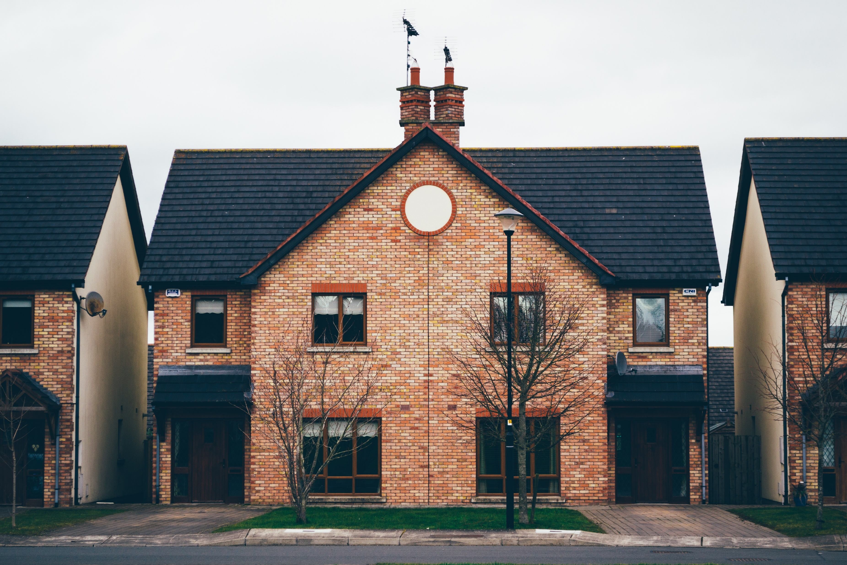
www.simpleplantowerrealstate.com
FOR SELL
$980,000
3 bathrooms
3 bedrooms
3 car places
NEW SOUTH WALES 2320,
AUSTRALIA

Slide 4
BOX FACTORY , GREAT 2014 STREET LONDON
3 car places
345$M^{2}$
On credit
$940,000
FOR SELL
www.simpleplantowerrealstate.com

Slide 5
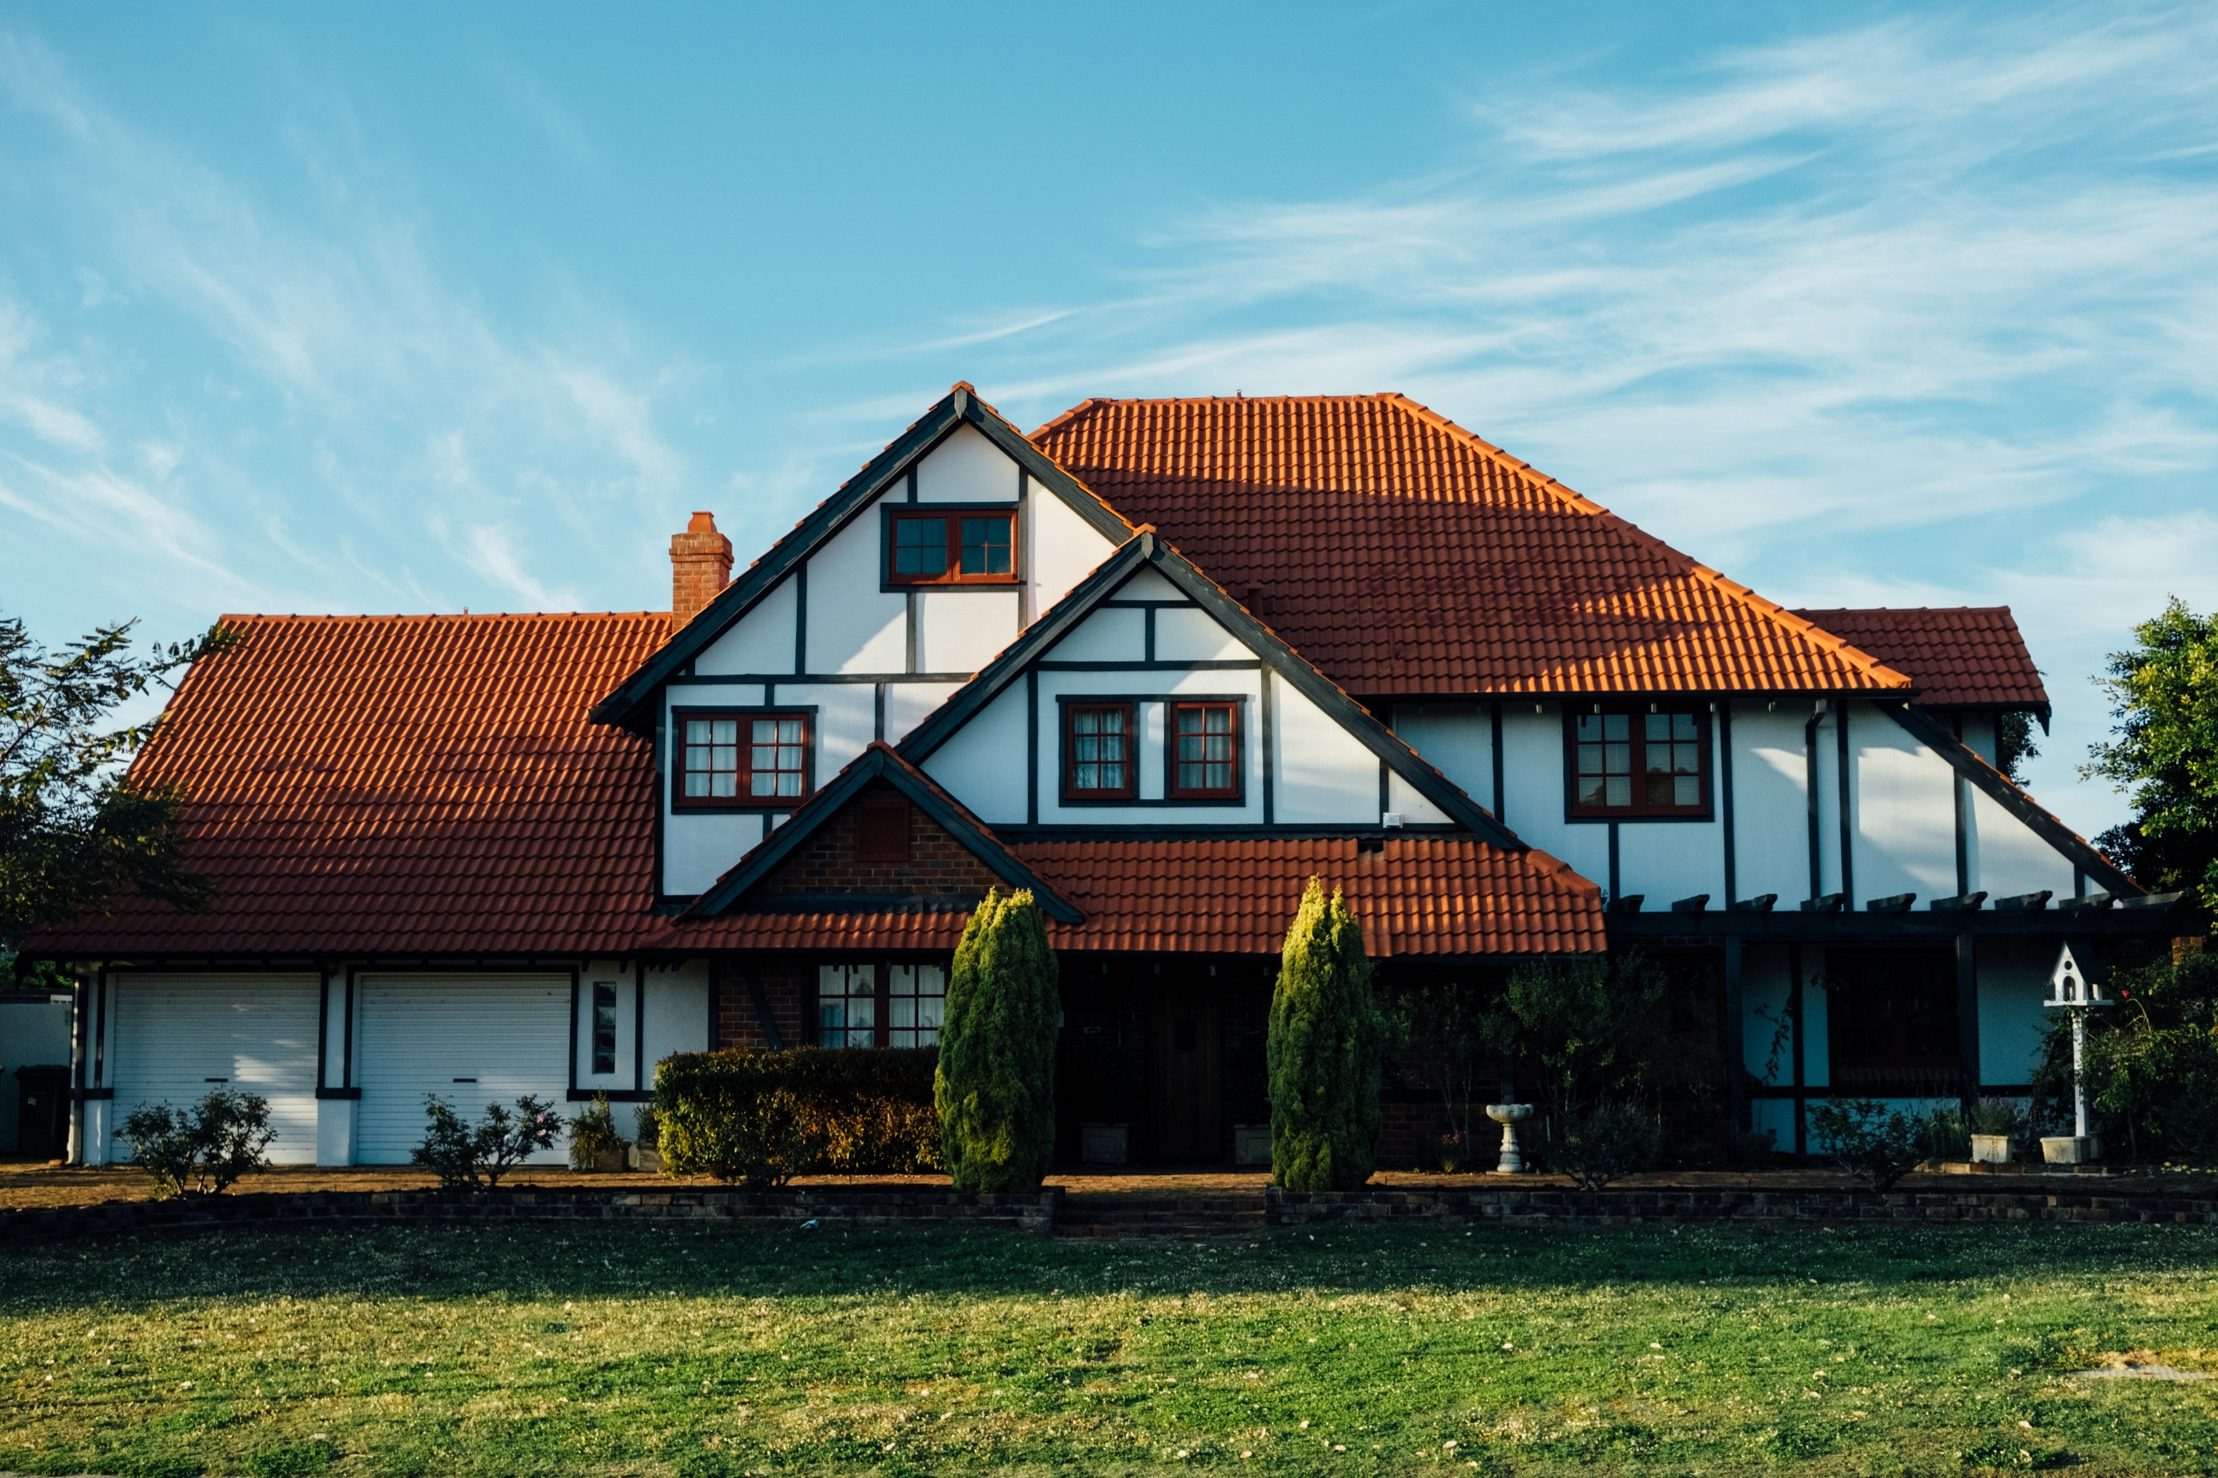
www.simpleplantowerrealstate.com
FOR SELL
3 car places
345$M^{2}$
Subway
$640,000
STATES STREET #312
UNITED ST PAUL, MN 443

Slide 6
www.simpleplantowerrealstate.com
FOR SELL
3 car places
345$M^{2}$
Subway
$964,000
STATES STREET #312
UNITED ST PAUL, MN 443

Slide 7
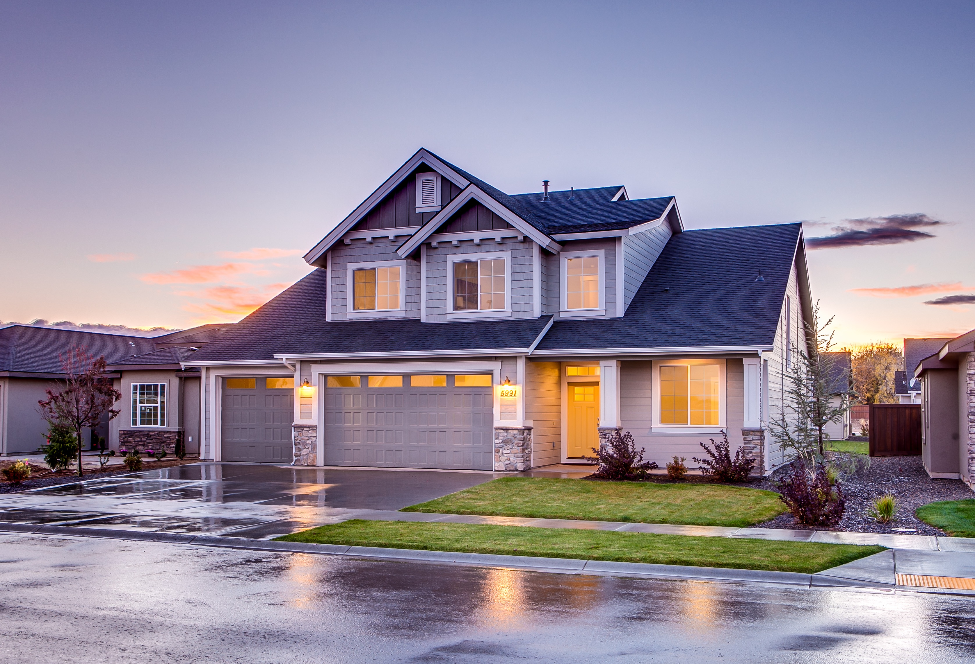
FOR RENT
www.simpleplantowerrealstate.com
$2,400
4 bedrooms
3 bedrooms
3 car places
STEVAN BERNSON
1556 BROADWAY, SUIT41

Slide 8
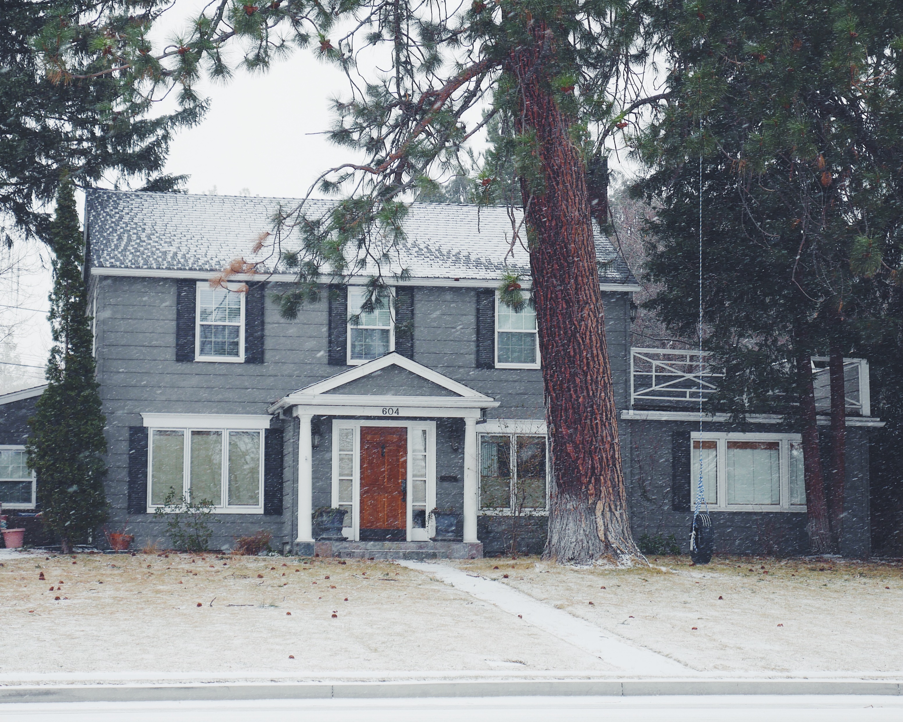
$610,000
BIRD STREET. LM 342 SUIT 243 AUSTRALIA
FOR SELL
3 car places
289$M^{2}$
Your
www.simpleplantowerrealstate.com

Slide 9
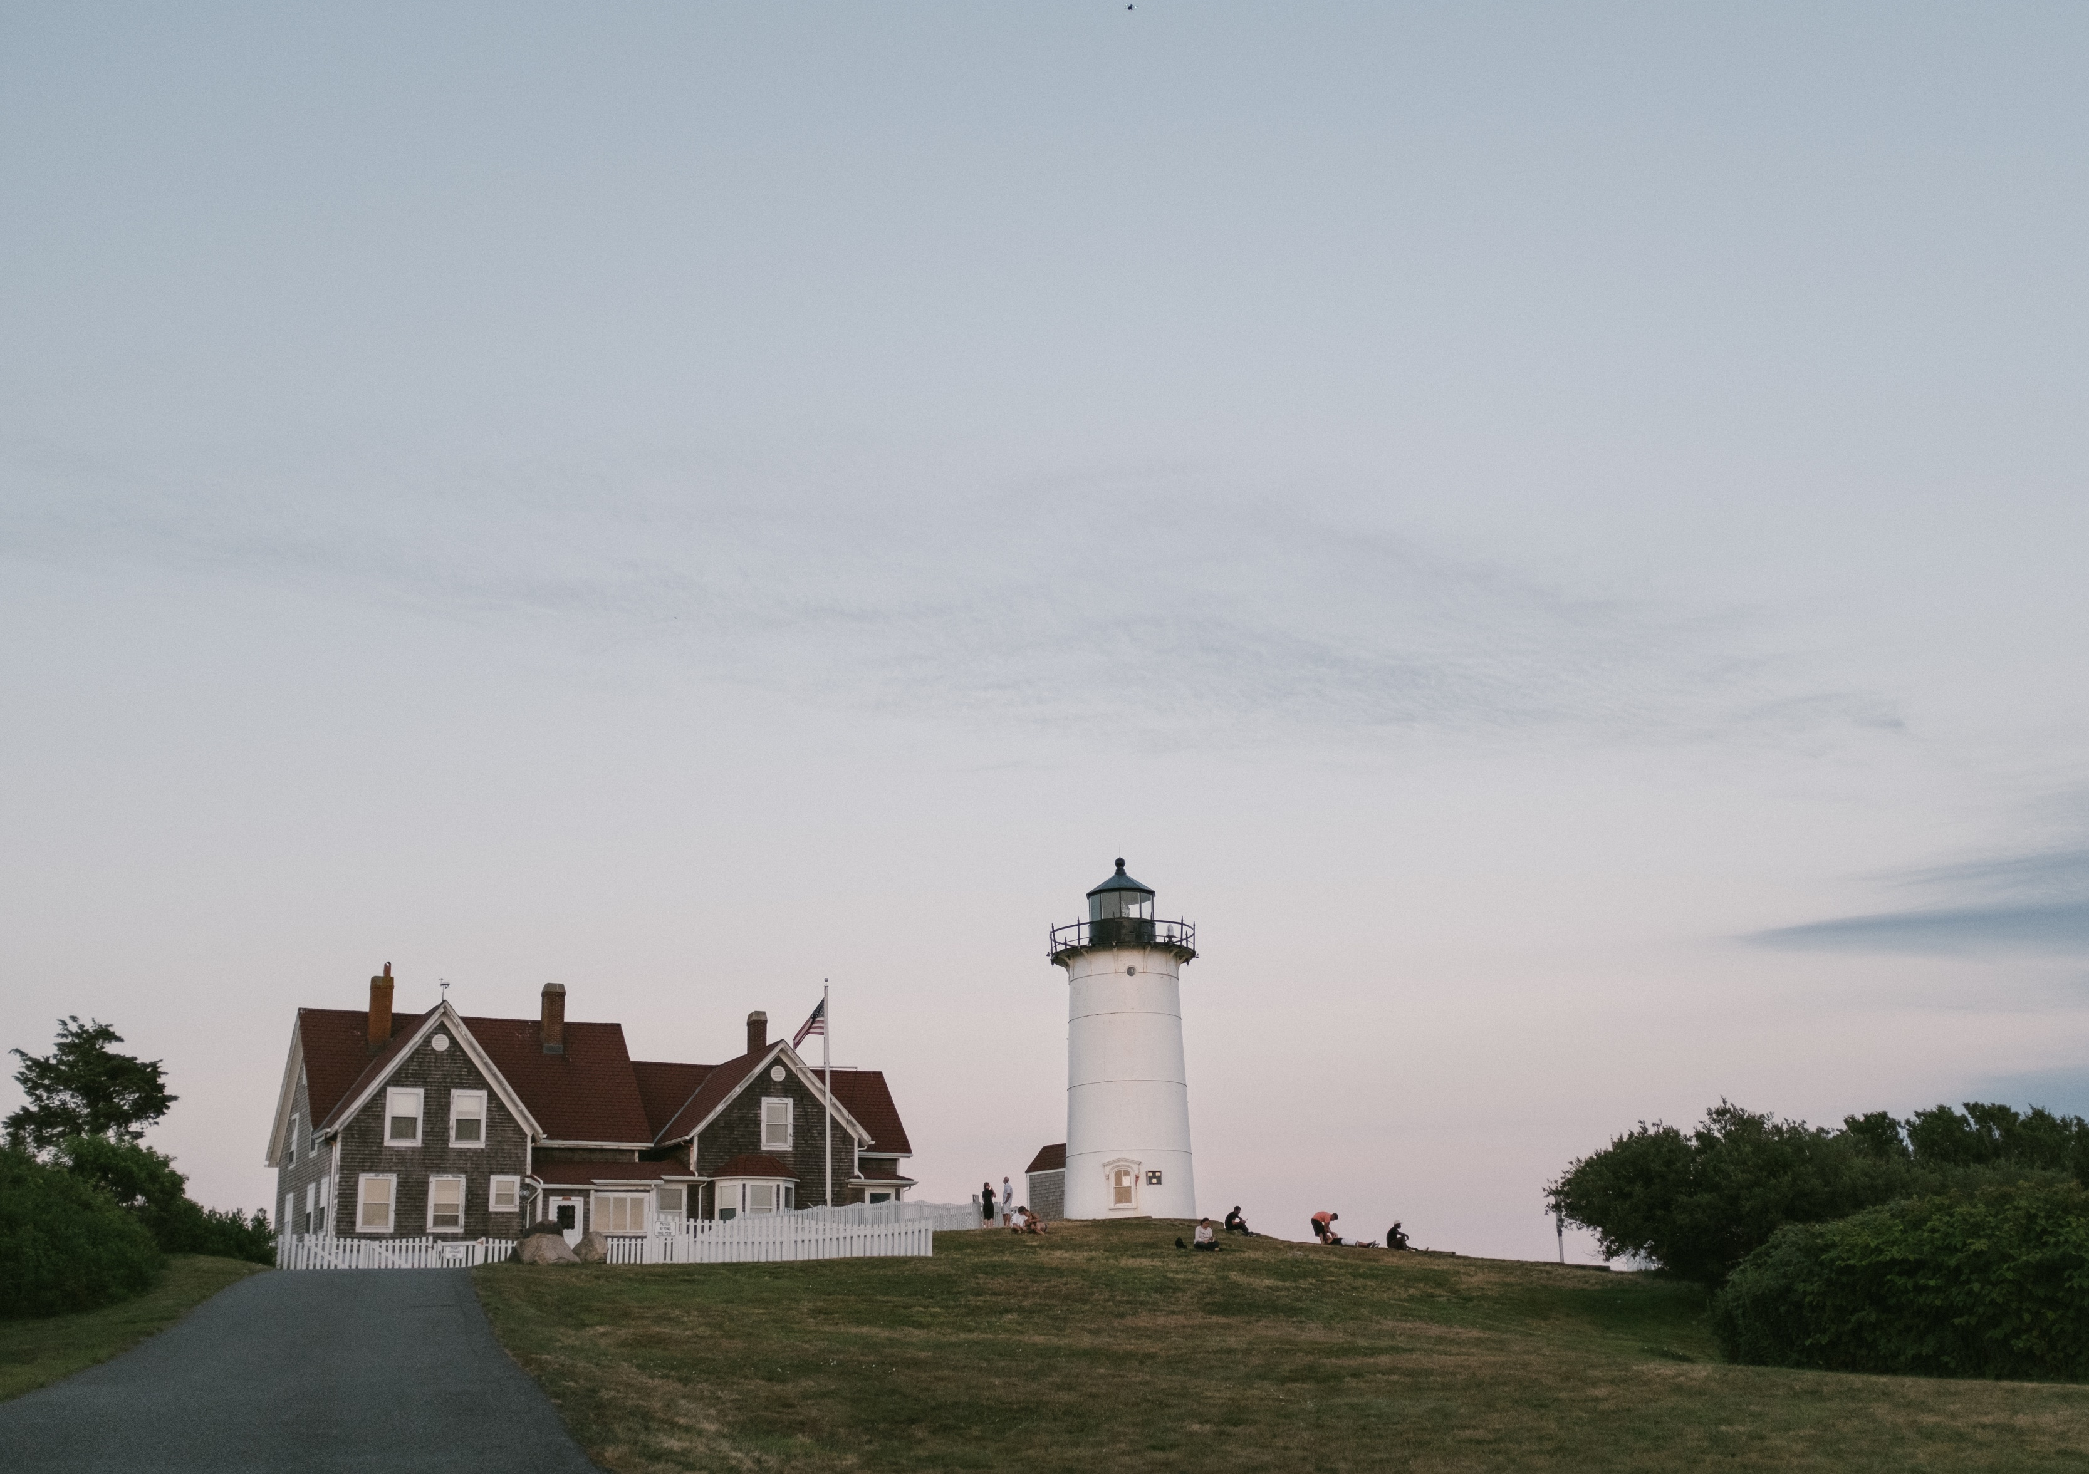
FOR SELL
www.simpleplantowerrealstate.com
$140,000
3 bathrooms
3 bedrooms
3 car places
LOC DENIAL STREET, MS 234 , SUIT 23

Slide 10
$3,000
STATE STREETS # 321
UNITED ST PAUL, MN 553
FOR RENT
3 car places
3 bedrooms
On credit
www.simpleplantowerrealstate.com

Slide 11
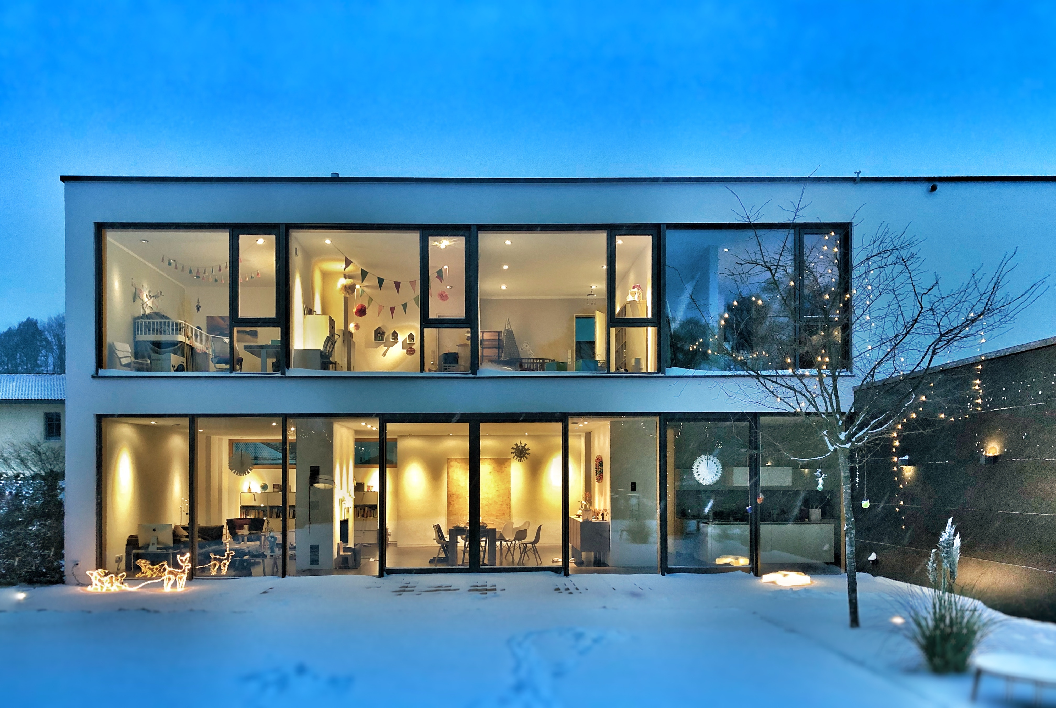
LINCLON ROAD, LM 2342
AUSTRALIA
3 car places
345$M^{2}$
On credit
$950,000
FOR SELL
www.simpleplantowerrealstate.com

Slide 12
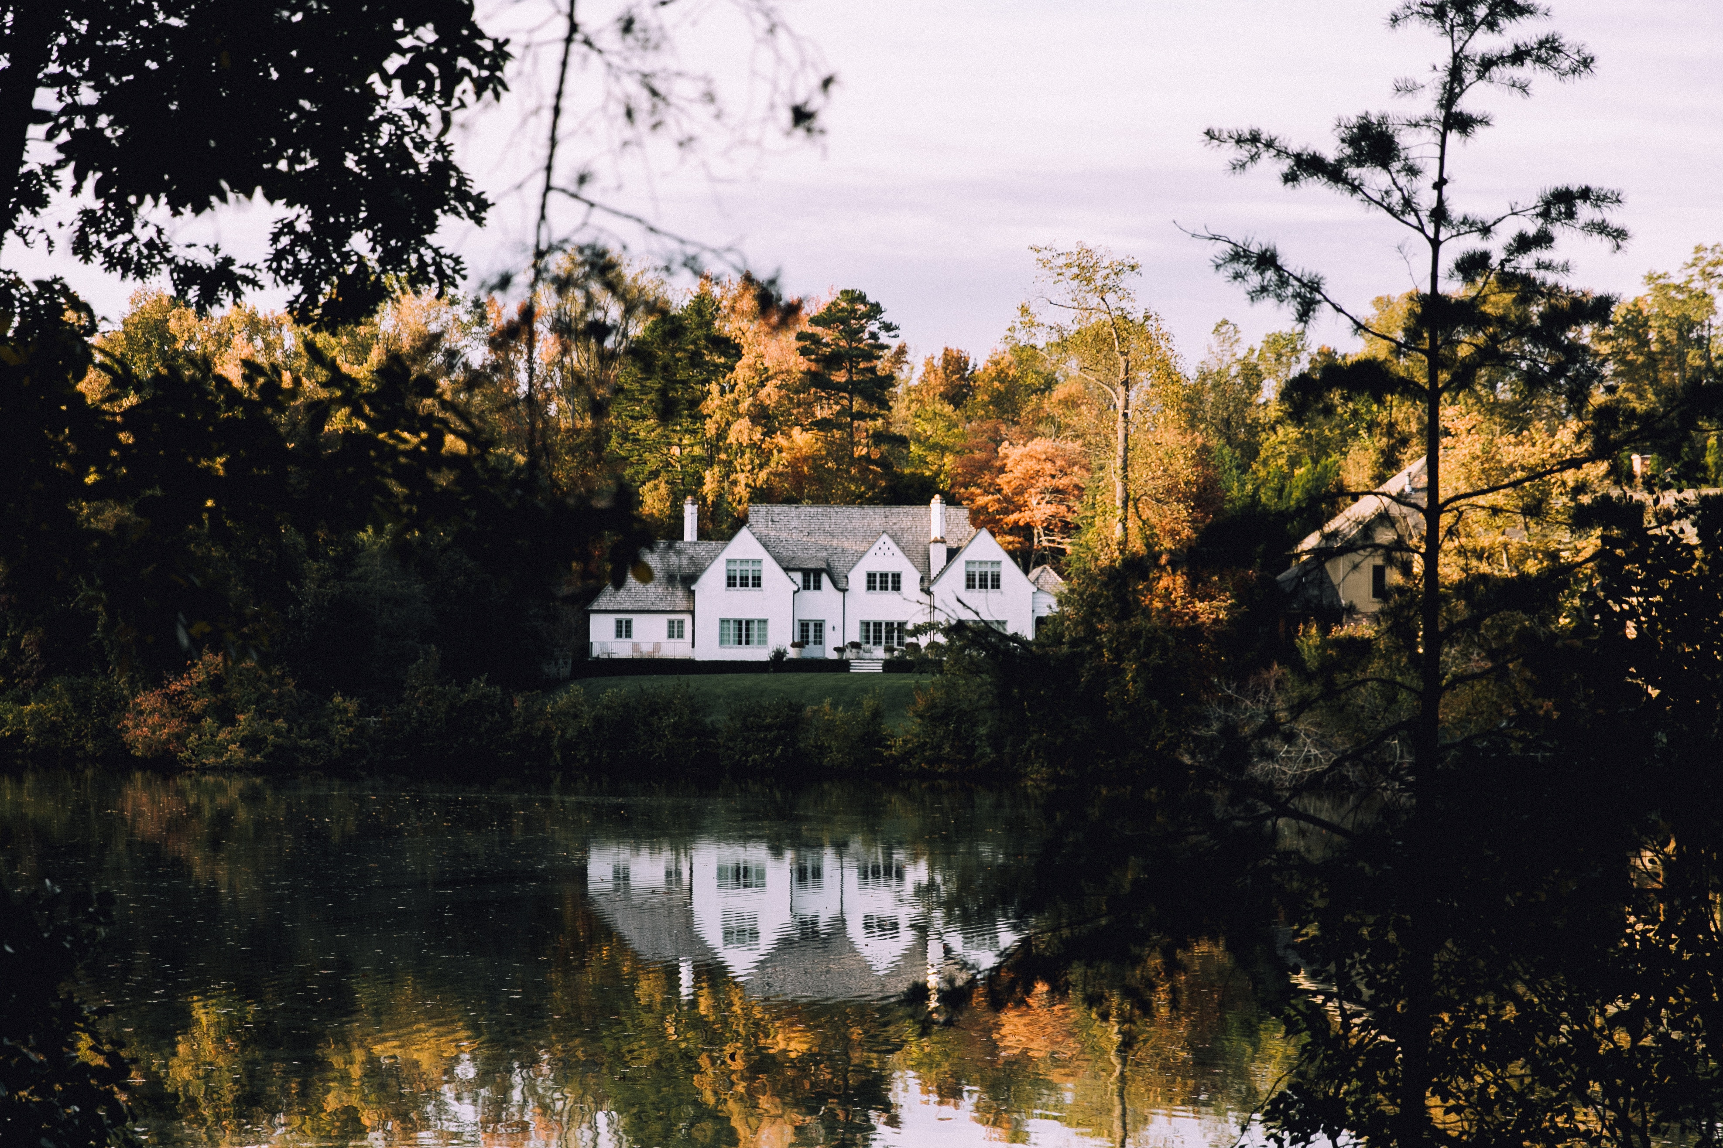
www.simpleplantowerrealstate.com
FOR SELL
3 car places
345$M^{2}$
Subway
$270,000
STATES STREET #312
UNITED ST PAUL, MN 443

Slide 13
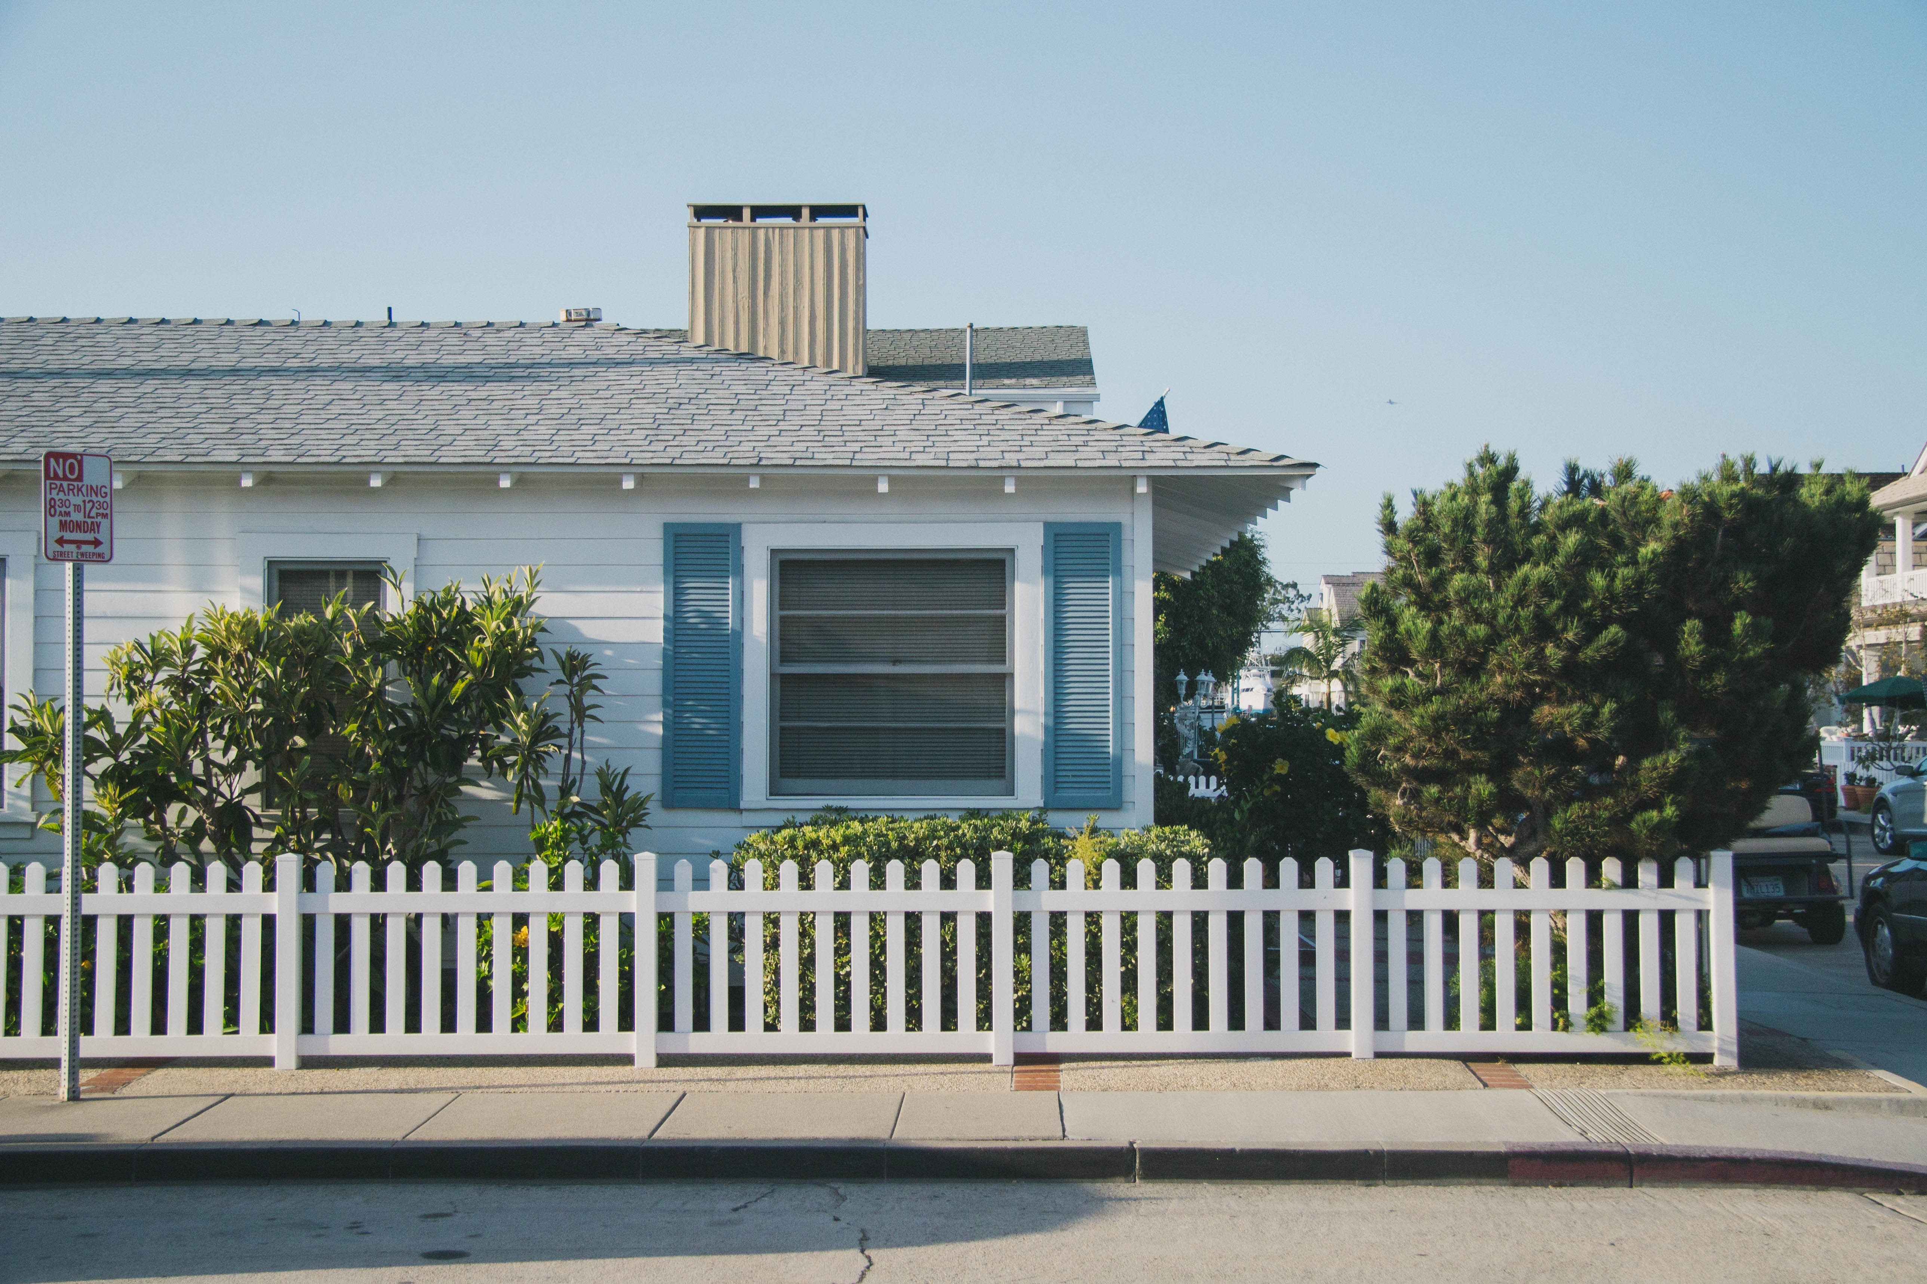
$610,000
PERTER WATNER AND BIRCH ROAD WATERFO
FOR SELL
3 car places
289$M^{2}$
Your info
www.simpleplantowerrealstate.com

Slide 14
$780,000
BIRD STREET. LM 342 SUIT 243 AUSTRALIA
FOR SELL
3 car places
289$M^{2}$
Easy access
www.simpleplantowerrealstate.com

Slide 15
1-800-123-4567
info@simpleplantower.com
www.simpleplantowerrealestate.net

Slide 16
ICONS

