Slide 1
FACEBOOOK/ COMPANYNAME
TWITTER/ COMPANYNAME
YOUTUBE/ COMPANYNAME
YOUR LUXURY RESORT
START RELAXING YOUR SOUL
AND ENJOY YOUR STAY
WWW.ROYALINDIGOHOTEL.COM

Slide 2
THE PERFECT RETREAT FROM THE CITY
WWW.ROYALINDIGOHOTEL.COM

Slide 3
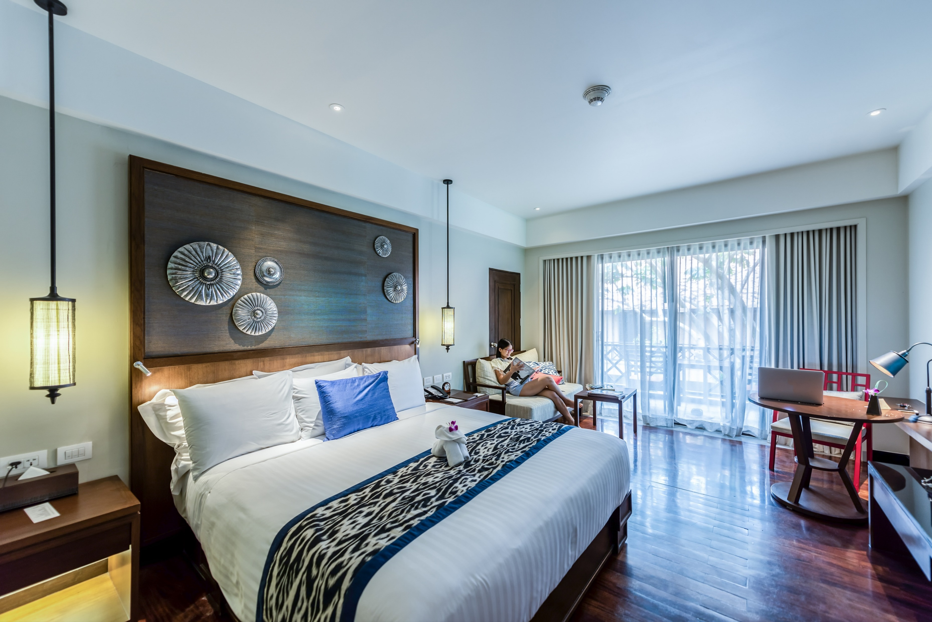
A FAMILY BED & BREAKFAST ESTABLISHMENT
WWW.ROYALINDIGOHOTEL.COM

Slide 4
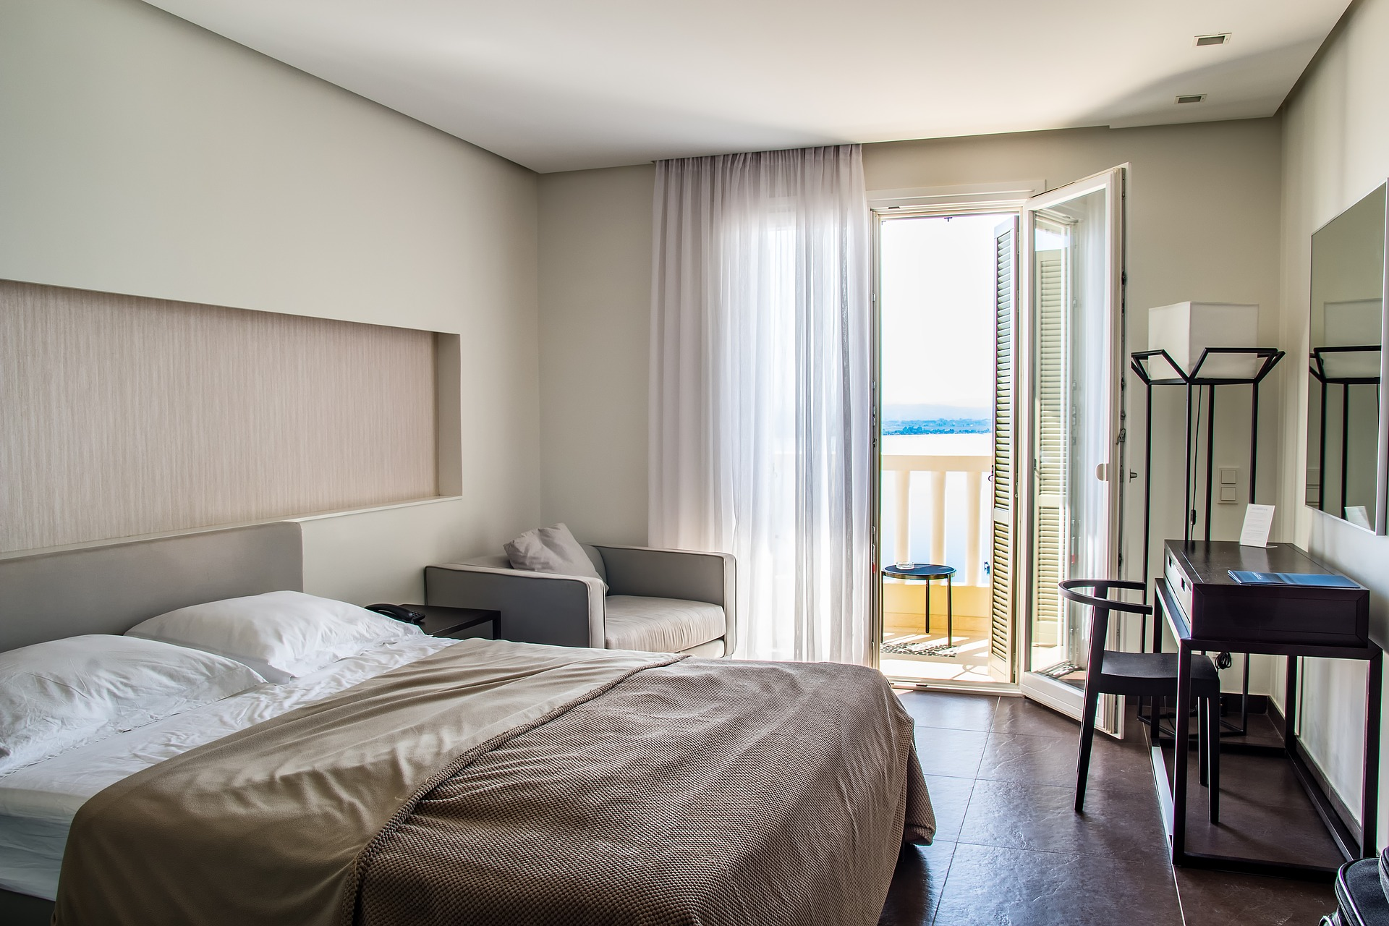
FEELS JUST LIKE
SWEET HOME
WWW.ROYALINDIGOHOTEL.COM

Slide 5
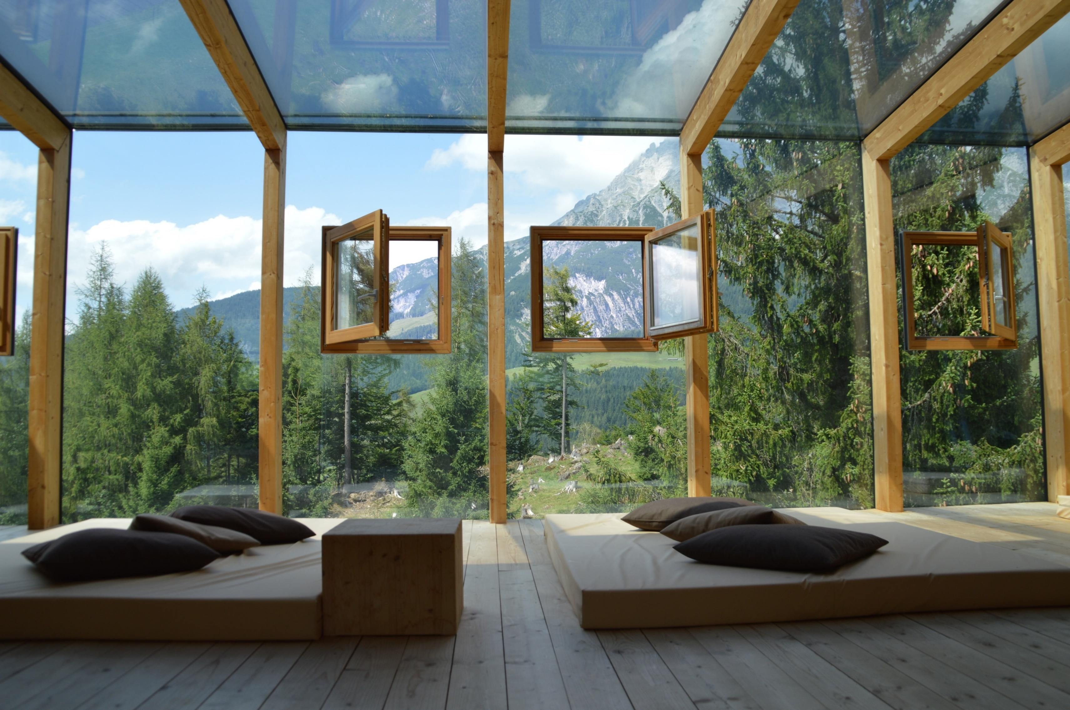
SURROUNDED BY
A GREEN ENVIRONMENT
WWW.ROYALINDIGOHOTEL.COM

Slide 6
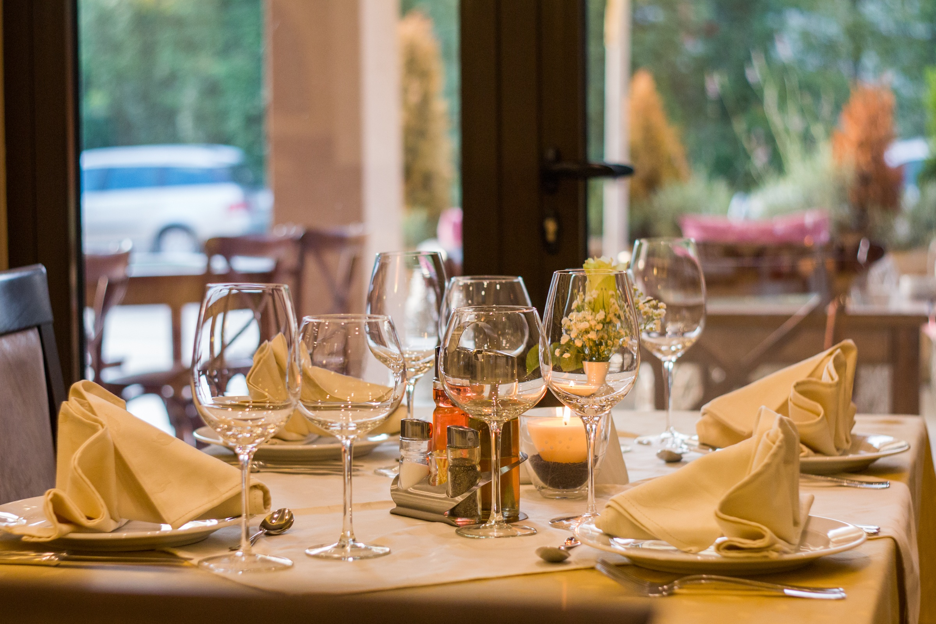
FRESH AND DELICIOUS
LOCAL PRODUCTS
WWW.ROYALINDIGOHOTEL.COM

Slide 7
Award Winning
RESORT
Providing Quality Services
Since ‘90.
WWW.ROYALINDIGOHOTEL.COM

Slide 8
Hope For The Best,
But Prepare For The Worst
Bad Things Might Happen, So Be Prepared
WWW.ROYALINDIGOHOTEL.COM

Slide 9
PUT YOUR STATISTIC CHART HERE
85
80
77
70
60
BED SIZE
RESTAURANT
SERVICES
GYM/SPA
FREE
PARKING
WWW.ROYALINDIGOHOTEL.COM

Slide 10
A FAMILY
BED AND BREAKFAST
ESTABLISHMENT
DESCRIPTION
Wake up in the morning to complete your Royal Indigo experience and avail our Best Available Rates, inclusive of Breakfast for four..
89% COMMENTS
WWW.ROYALINDIGOHOTEL.COM

Slide 11
FORTUNE FAVORS
the bold
People who bravely go after what they want are more successful than people who try to live safely.
WWW.ROYALINDIGOHOTEL.COM

Slide 12
55% COMMENTS
99% COMMENTS
78% COMMENTS
SHOW YOUR CHART HERE
OUR STATISTICS SAYS BETTER
DESCRIPTION
99% of the customers gave “very satisfied” positive comments.
78% of the customers gave “very good” positive comments.
55% of the customers gave “satisfied” positive comments.
WWW.ROYALINDIGOHOTEL.COM

Slide 13
We Offer
The Best Prices
Our Quality Is The Highest
In The Country
PRICE RANGE :
$
$$$
WWW.ROYALINDIGOHOTEL.COM

Slide 14
PUT YOUR STATISTIC CHART HERE
90
85
77
56
24H
SUPPORT
AIR
CONDITIONING
SAFE BOX
BEST
WELLNESS
WWW.ROYALINDIGOHOTEL.COM

Slide 15
Royal Hotel
Five Stars
Resorts & Service
Trying To Convince People With Ideas And Words Is More Effective
WWW.ROYALINDIGOHOTEL.COM

Slide 16
A squeaky wheel
gets the grease
If you can’t wait patiently, no one’s going to
help you
CHILDREN
FACILITIES
LANGUAGE
SPOKEN
FREE
PARKING
LAUNDRY
RESTAURANT
& DINNING
FREE WIFI
PROFESSIONAL
GYM/SPA
AIR
CONDITIONING
OUTDOOR
POOL
YOUTUBE/ COMPANYNAME
WWW.ROYALINDIGOHOTEL.COM

Slide 17
Hope For The Best,
But Prepare For The Worst
Bad Things Might Happen, So Be Prepared
24H
SUPPORT
BOAT
ACCESS
HIGHWAY
ACCESS
FREE
PARKING
EASY TO FIND US
AIRPORT
ACCESS
1 WILLINGTON STREET 8878 BALI, GINYAHAR
LOCATIONS
WWW.ROYALINDIGOHOTEL.COM

Slide 18
FACEBOOOK/ COMPANYNAME
TWITTER/ COMPANYNAME
YOUTUBE/ COMPANYNAME
R
oyal
HOTEL
YOUR LUXURY RESORT
START RELAXING YOUR SOUL
AND ENJOY YOUR STAY
WWW.ROYALINDIGOHOTEL.COM

