Slide 1
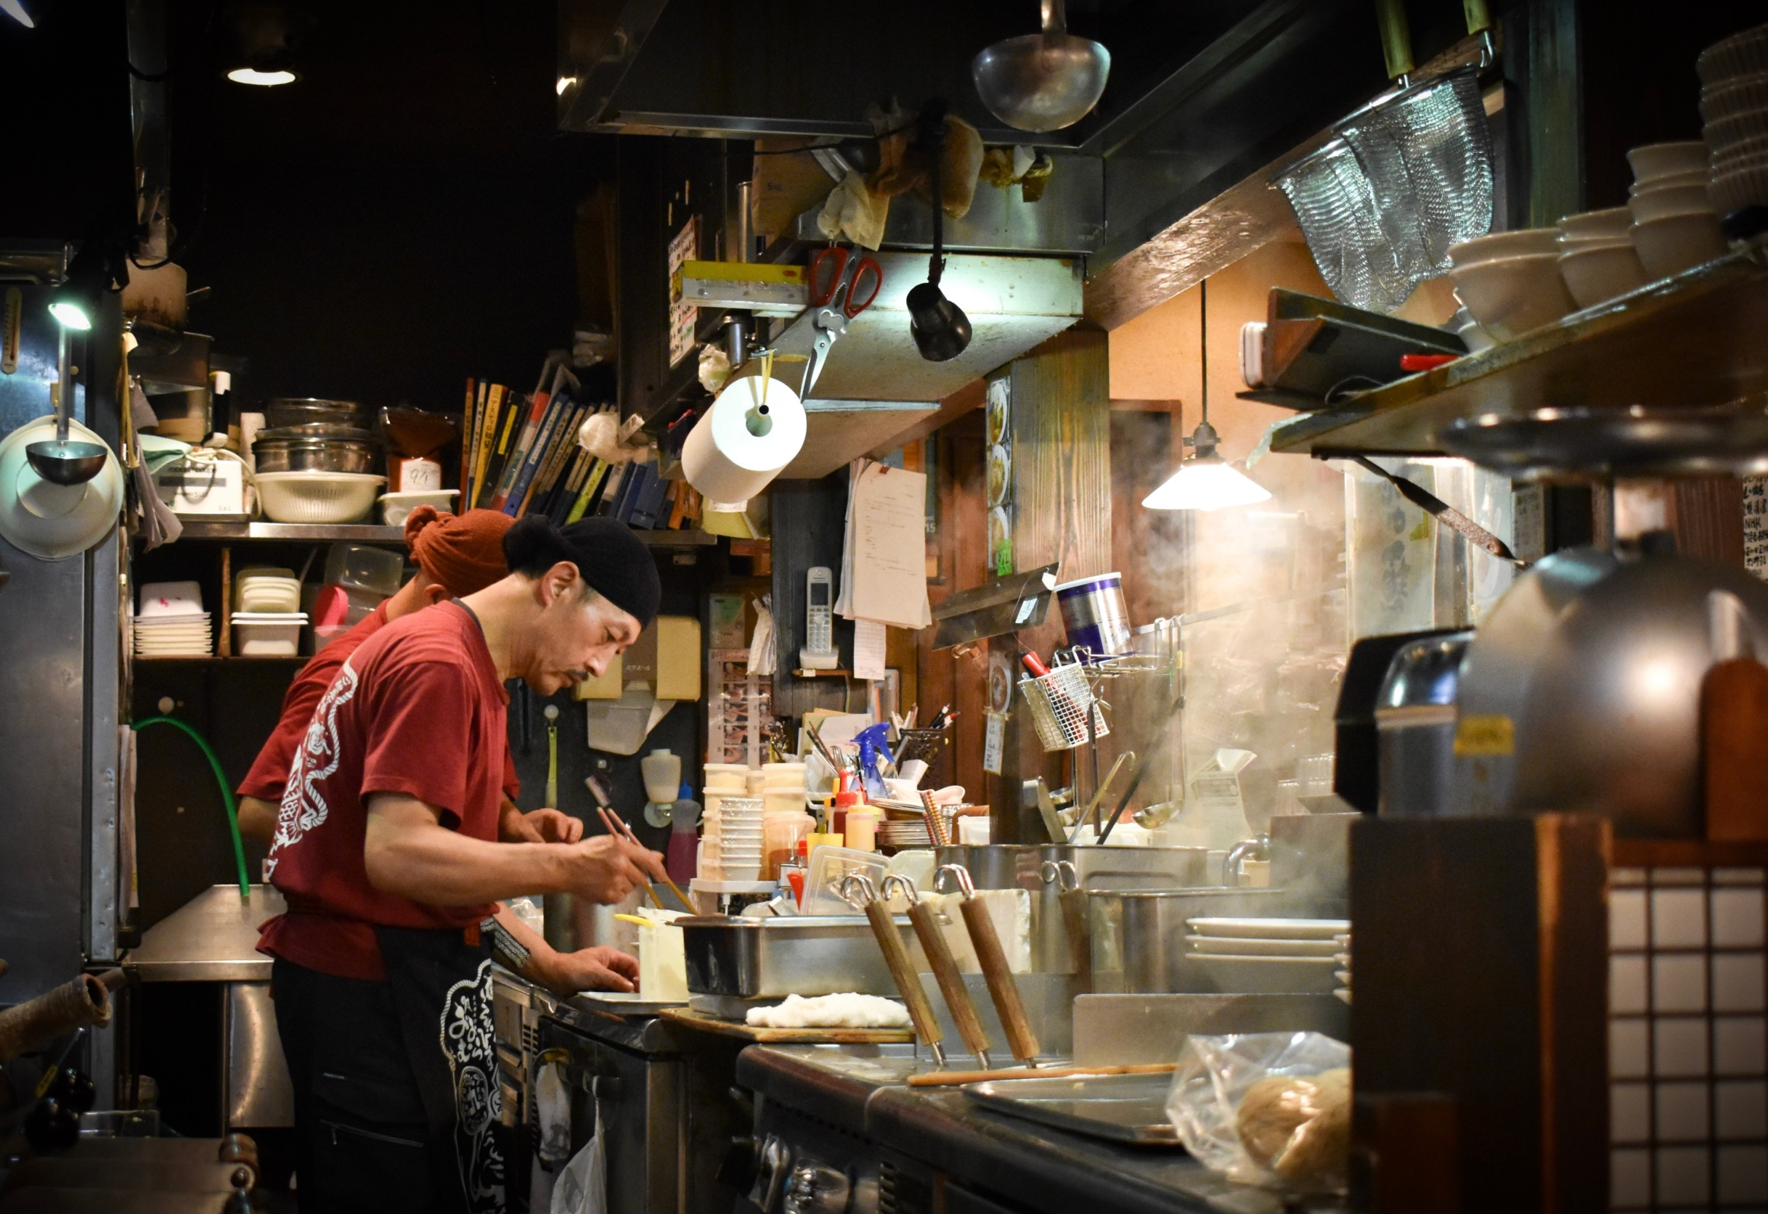

Slide 2
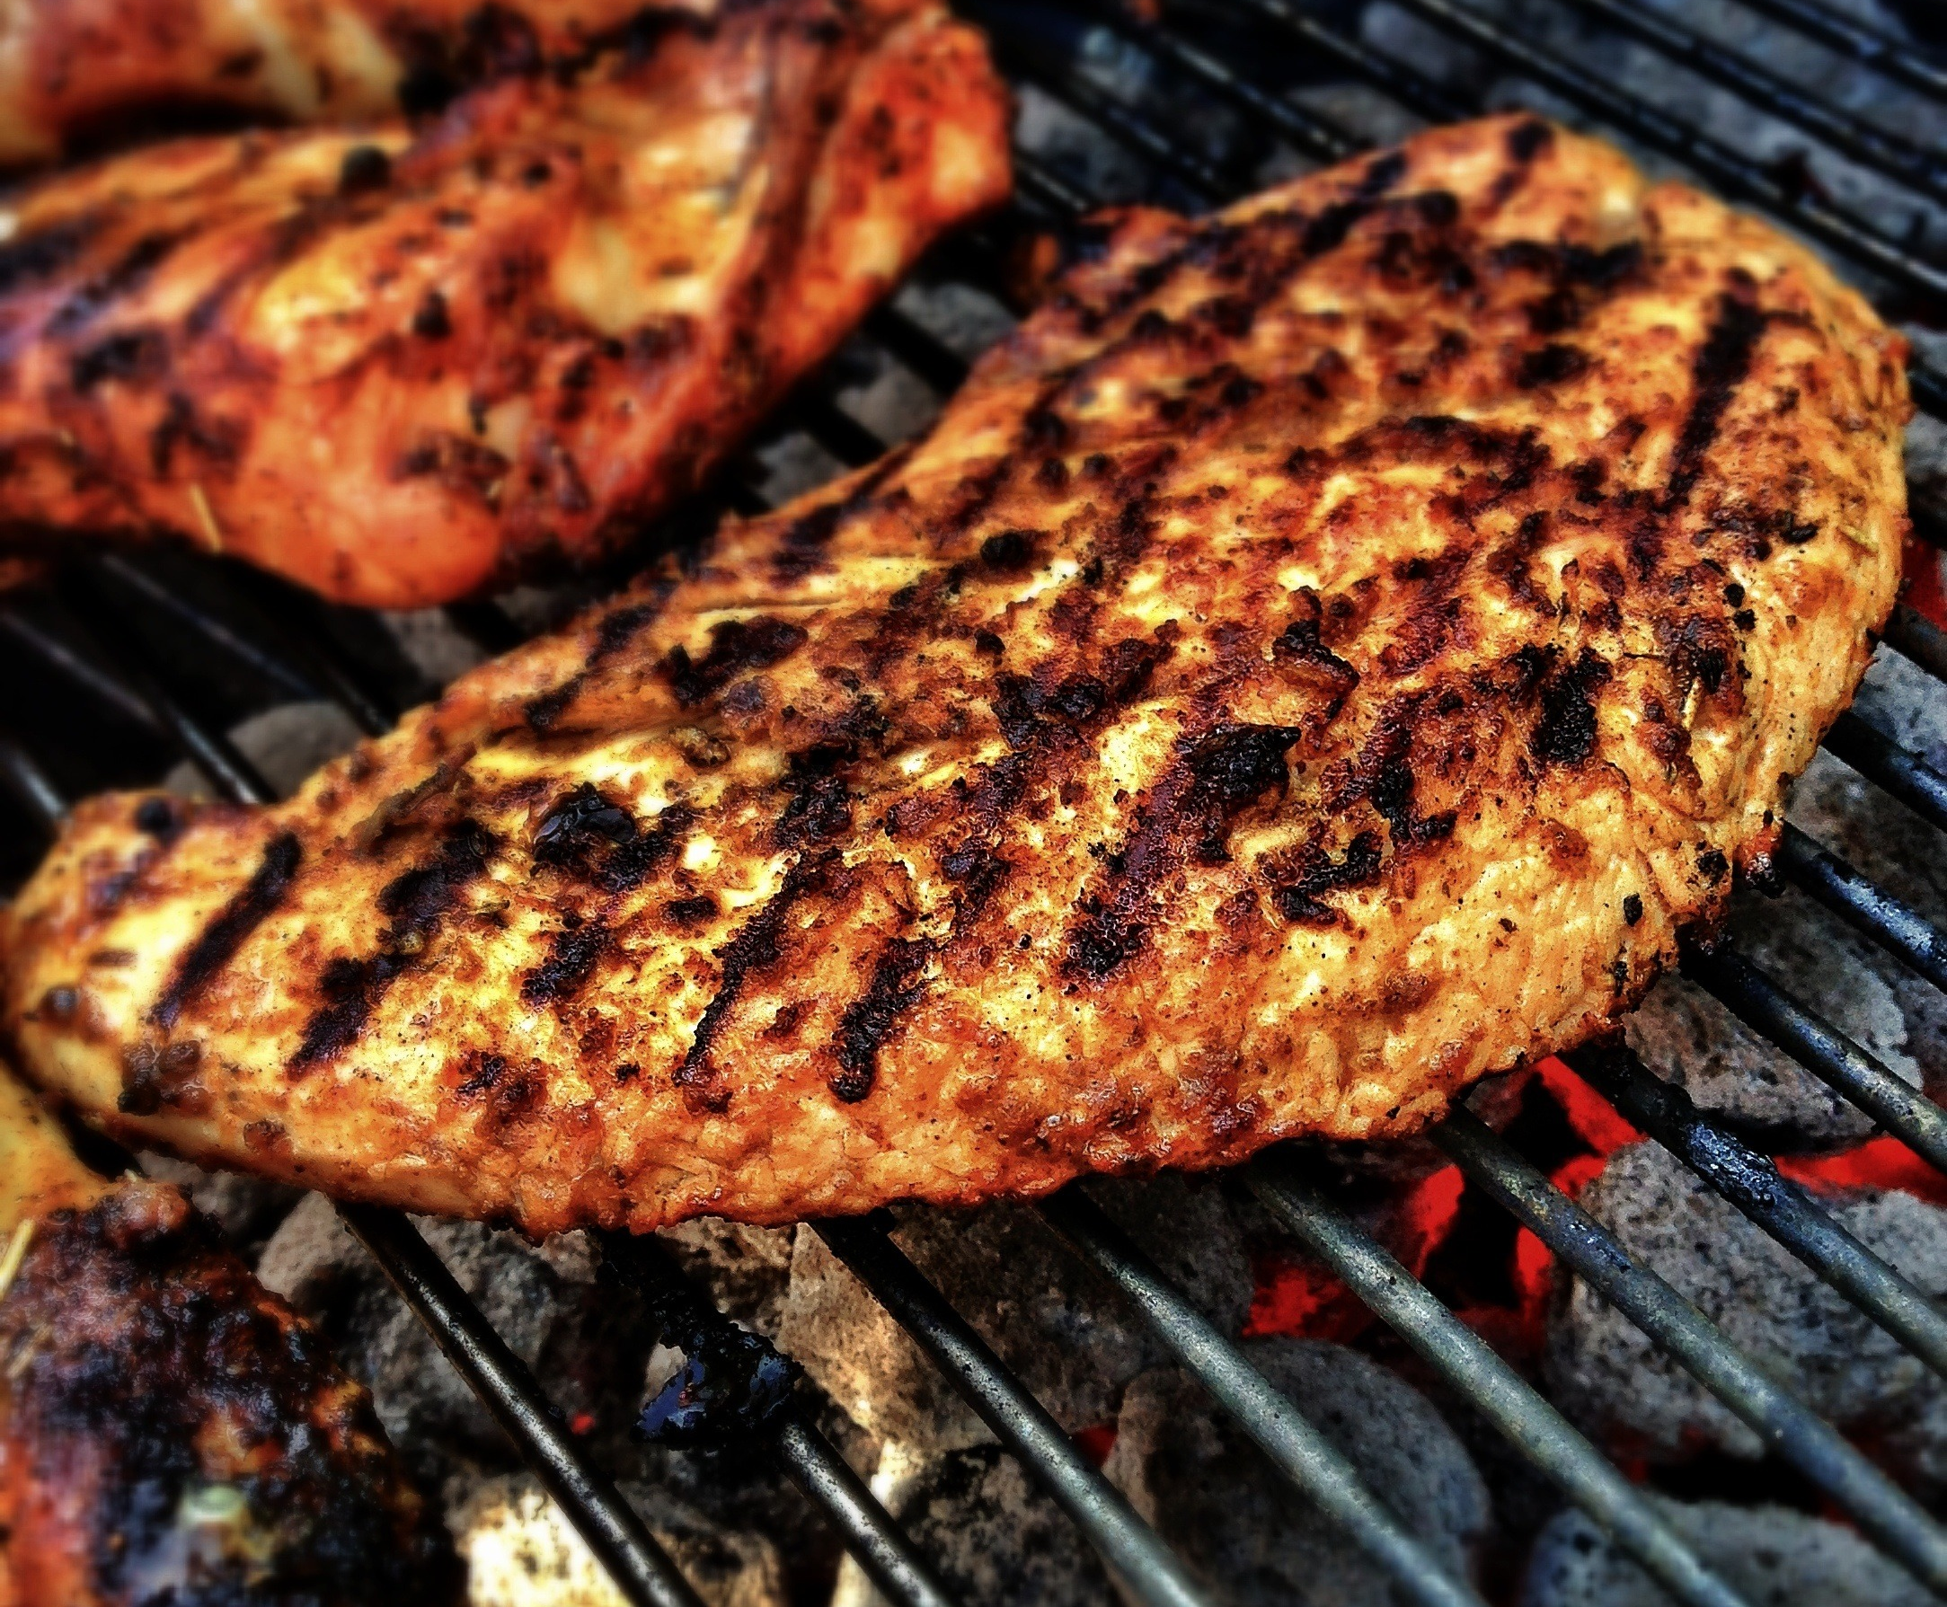
UNCLE BOY
BEST
CHOICE
.STEAK.
DRY AGED BEEF
$36.00
20OZ

Slide 3
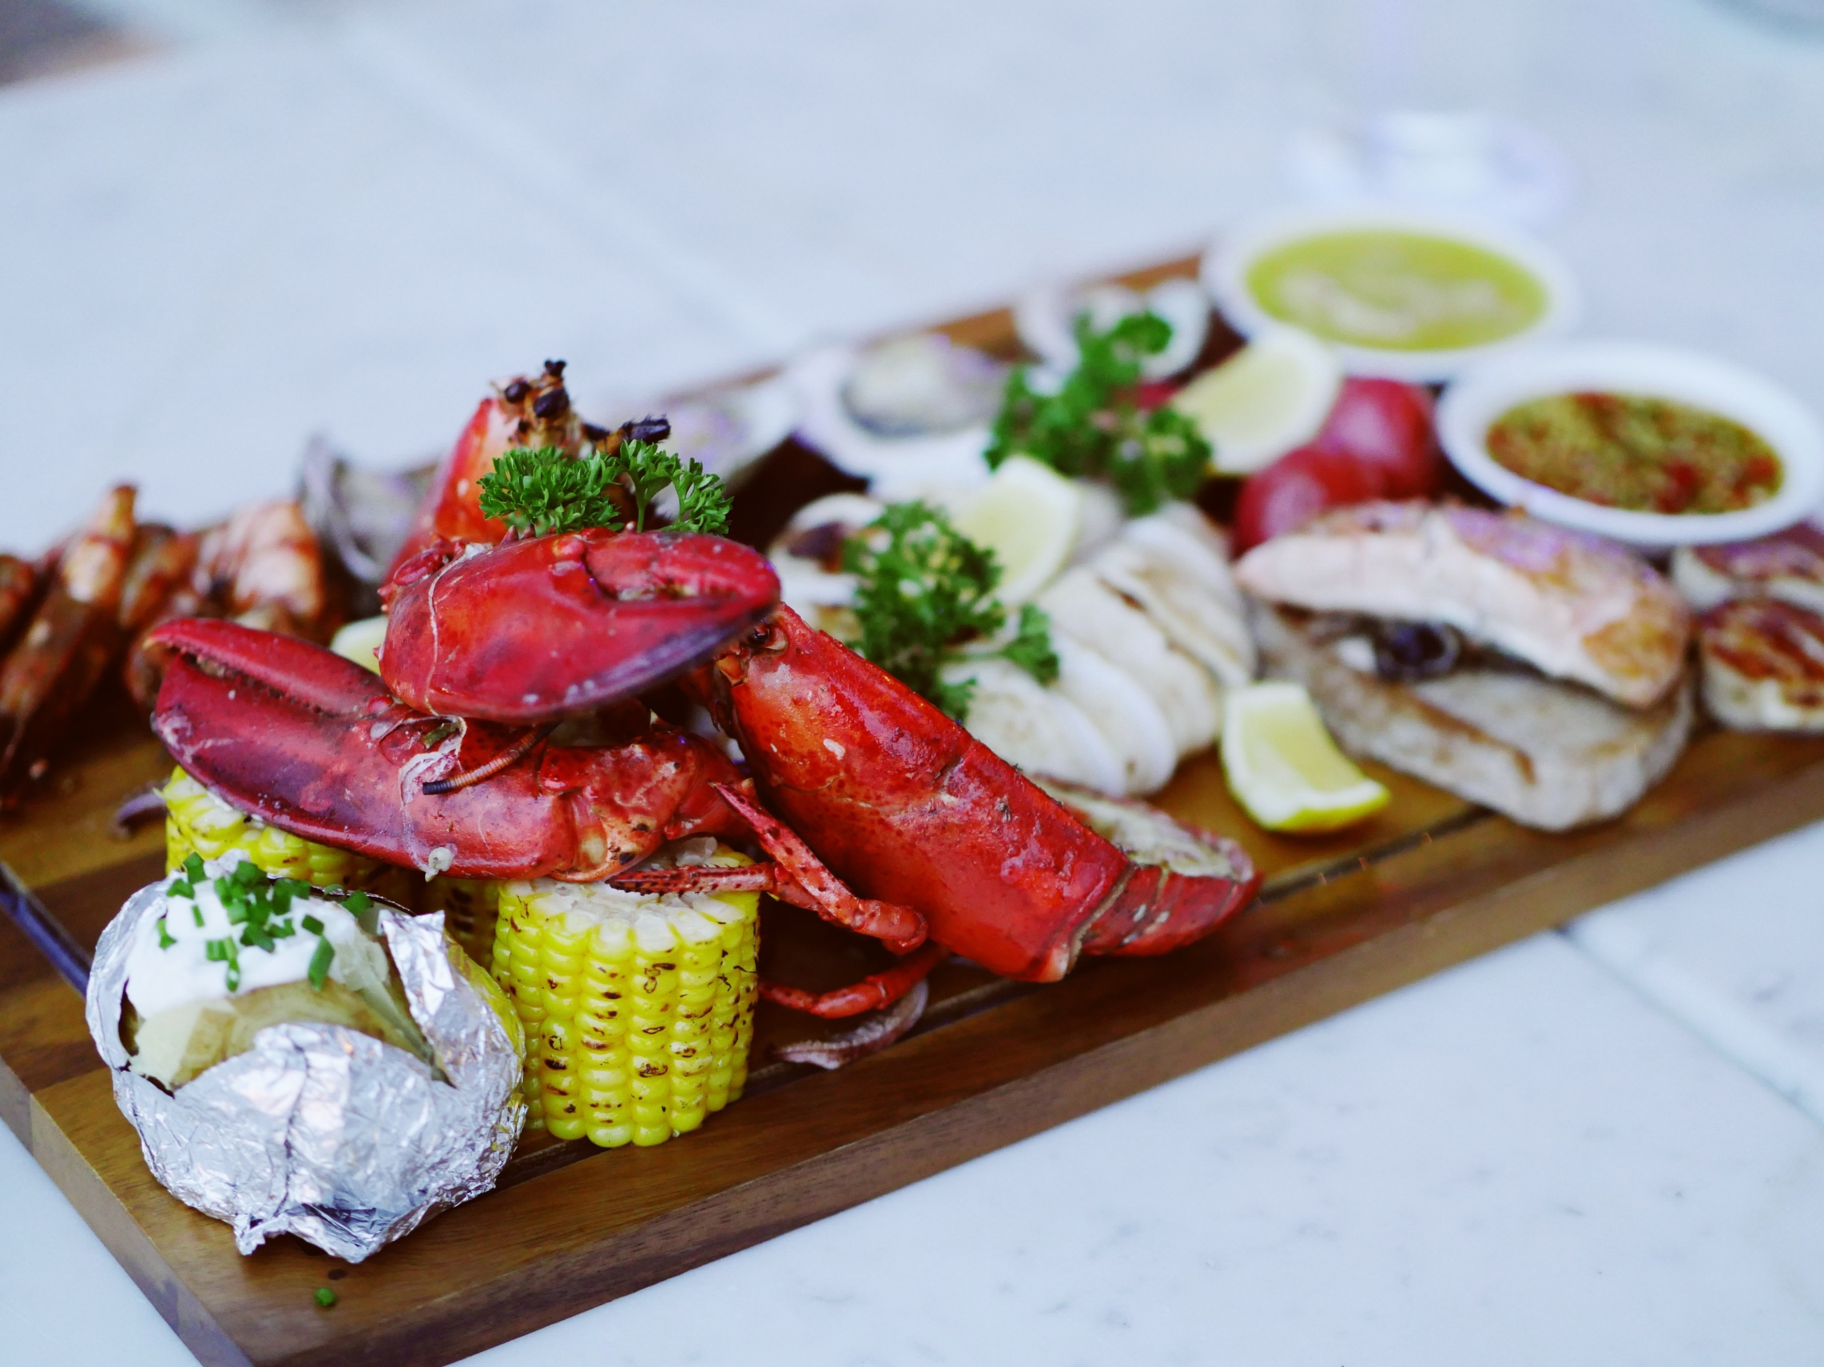
EXOTIC seafood
HOME
LOBSTER
STEAM with BUTTER
$30.00
1.5LB.

Slide 4
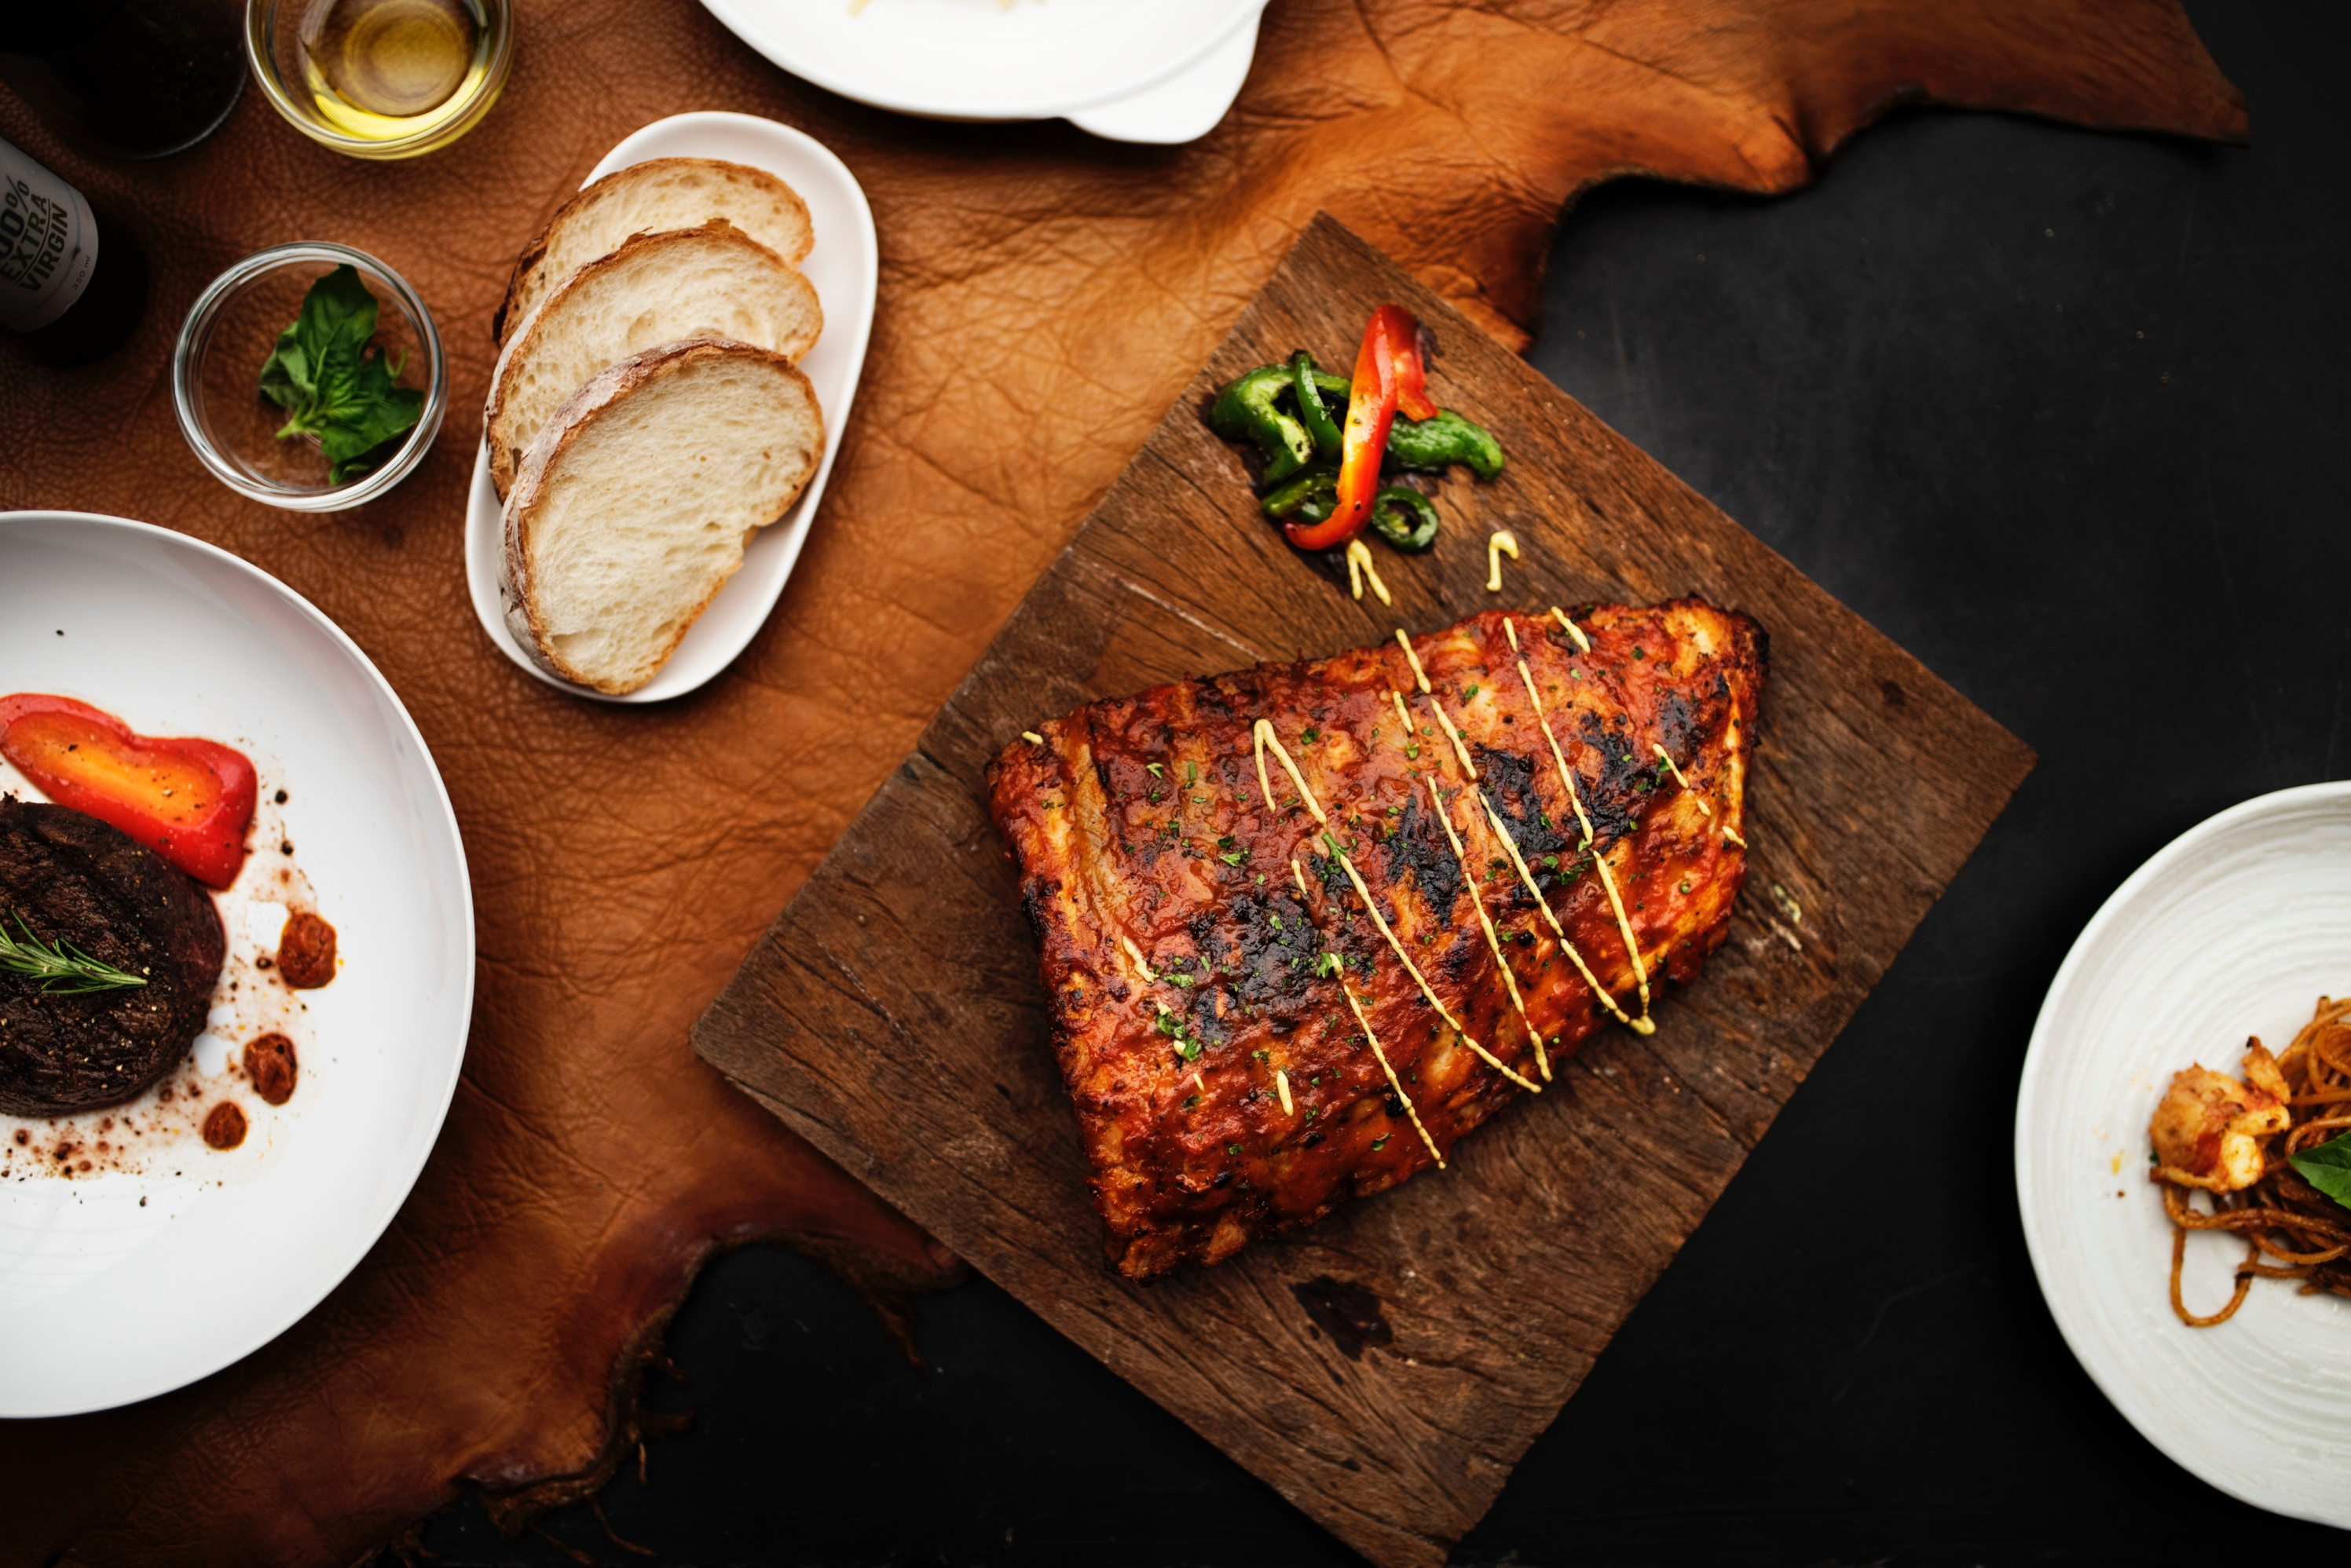
.DISHES OF THE WEEK.
$40.00
STREAMED CLAMS
$15.00
PERFECT DUCK STEAK
30OZ.
FOUR JUMBO CRAB SAUTED IN BUTTER
1LB.
THREE SPICES, ORANGE
$30.00
DOVER SOLE
$30.00
SALMON WITH CORN
25OZ.
With LEMON & BUTTER
28OZ.
CAULIFLOWER, LEMON
ENJOY THE TASTE

Slide 5
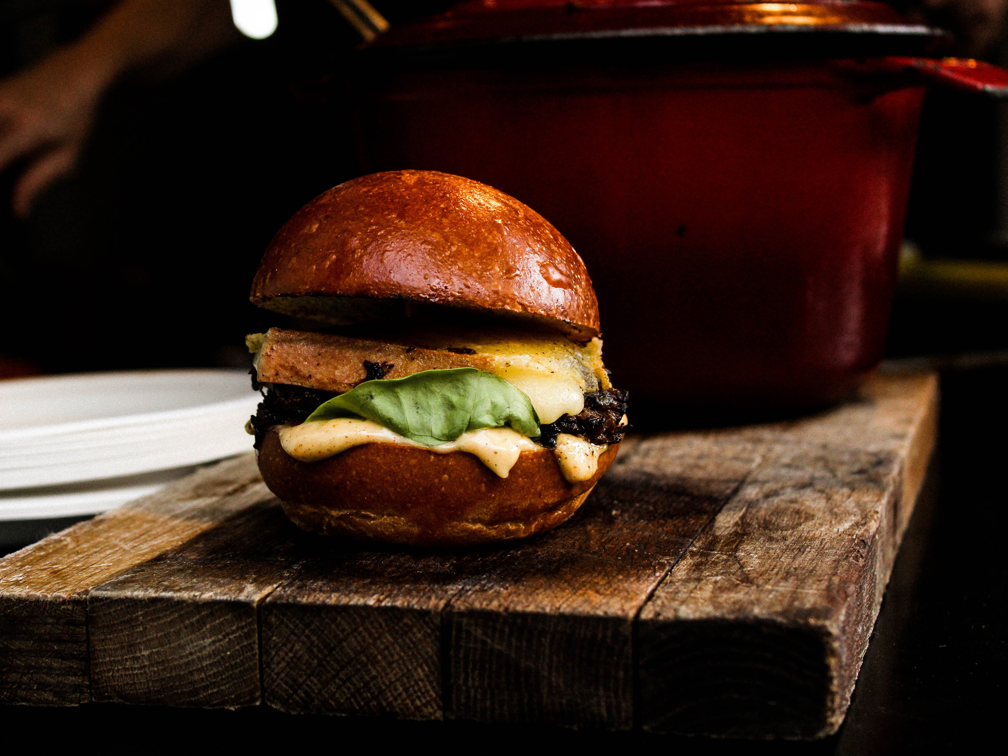
MADE WITH LOVE
CHEESY
. BURGERS .
DOUBLE CHEESEBURGER
$11.00
With LETTUCE AND HAM
6OZ.
$15.00
UNCLE BOY BURGER
WITH CHEESE, GRILLEAD ONION AND TOMATO
8OZ.
SPECIAL LOBSTER BURGER
$20.00
WITH CHEESE
7OZ.
SPECIAL CHICKEN BURGER
$10.00
WITH CHEESE
6OZ.

Slide 6
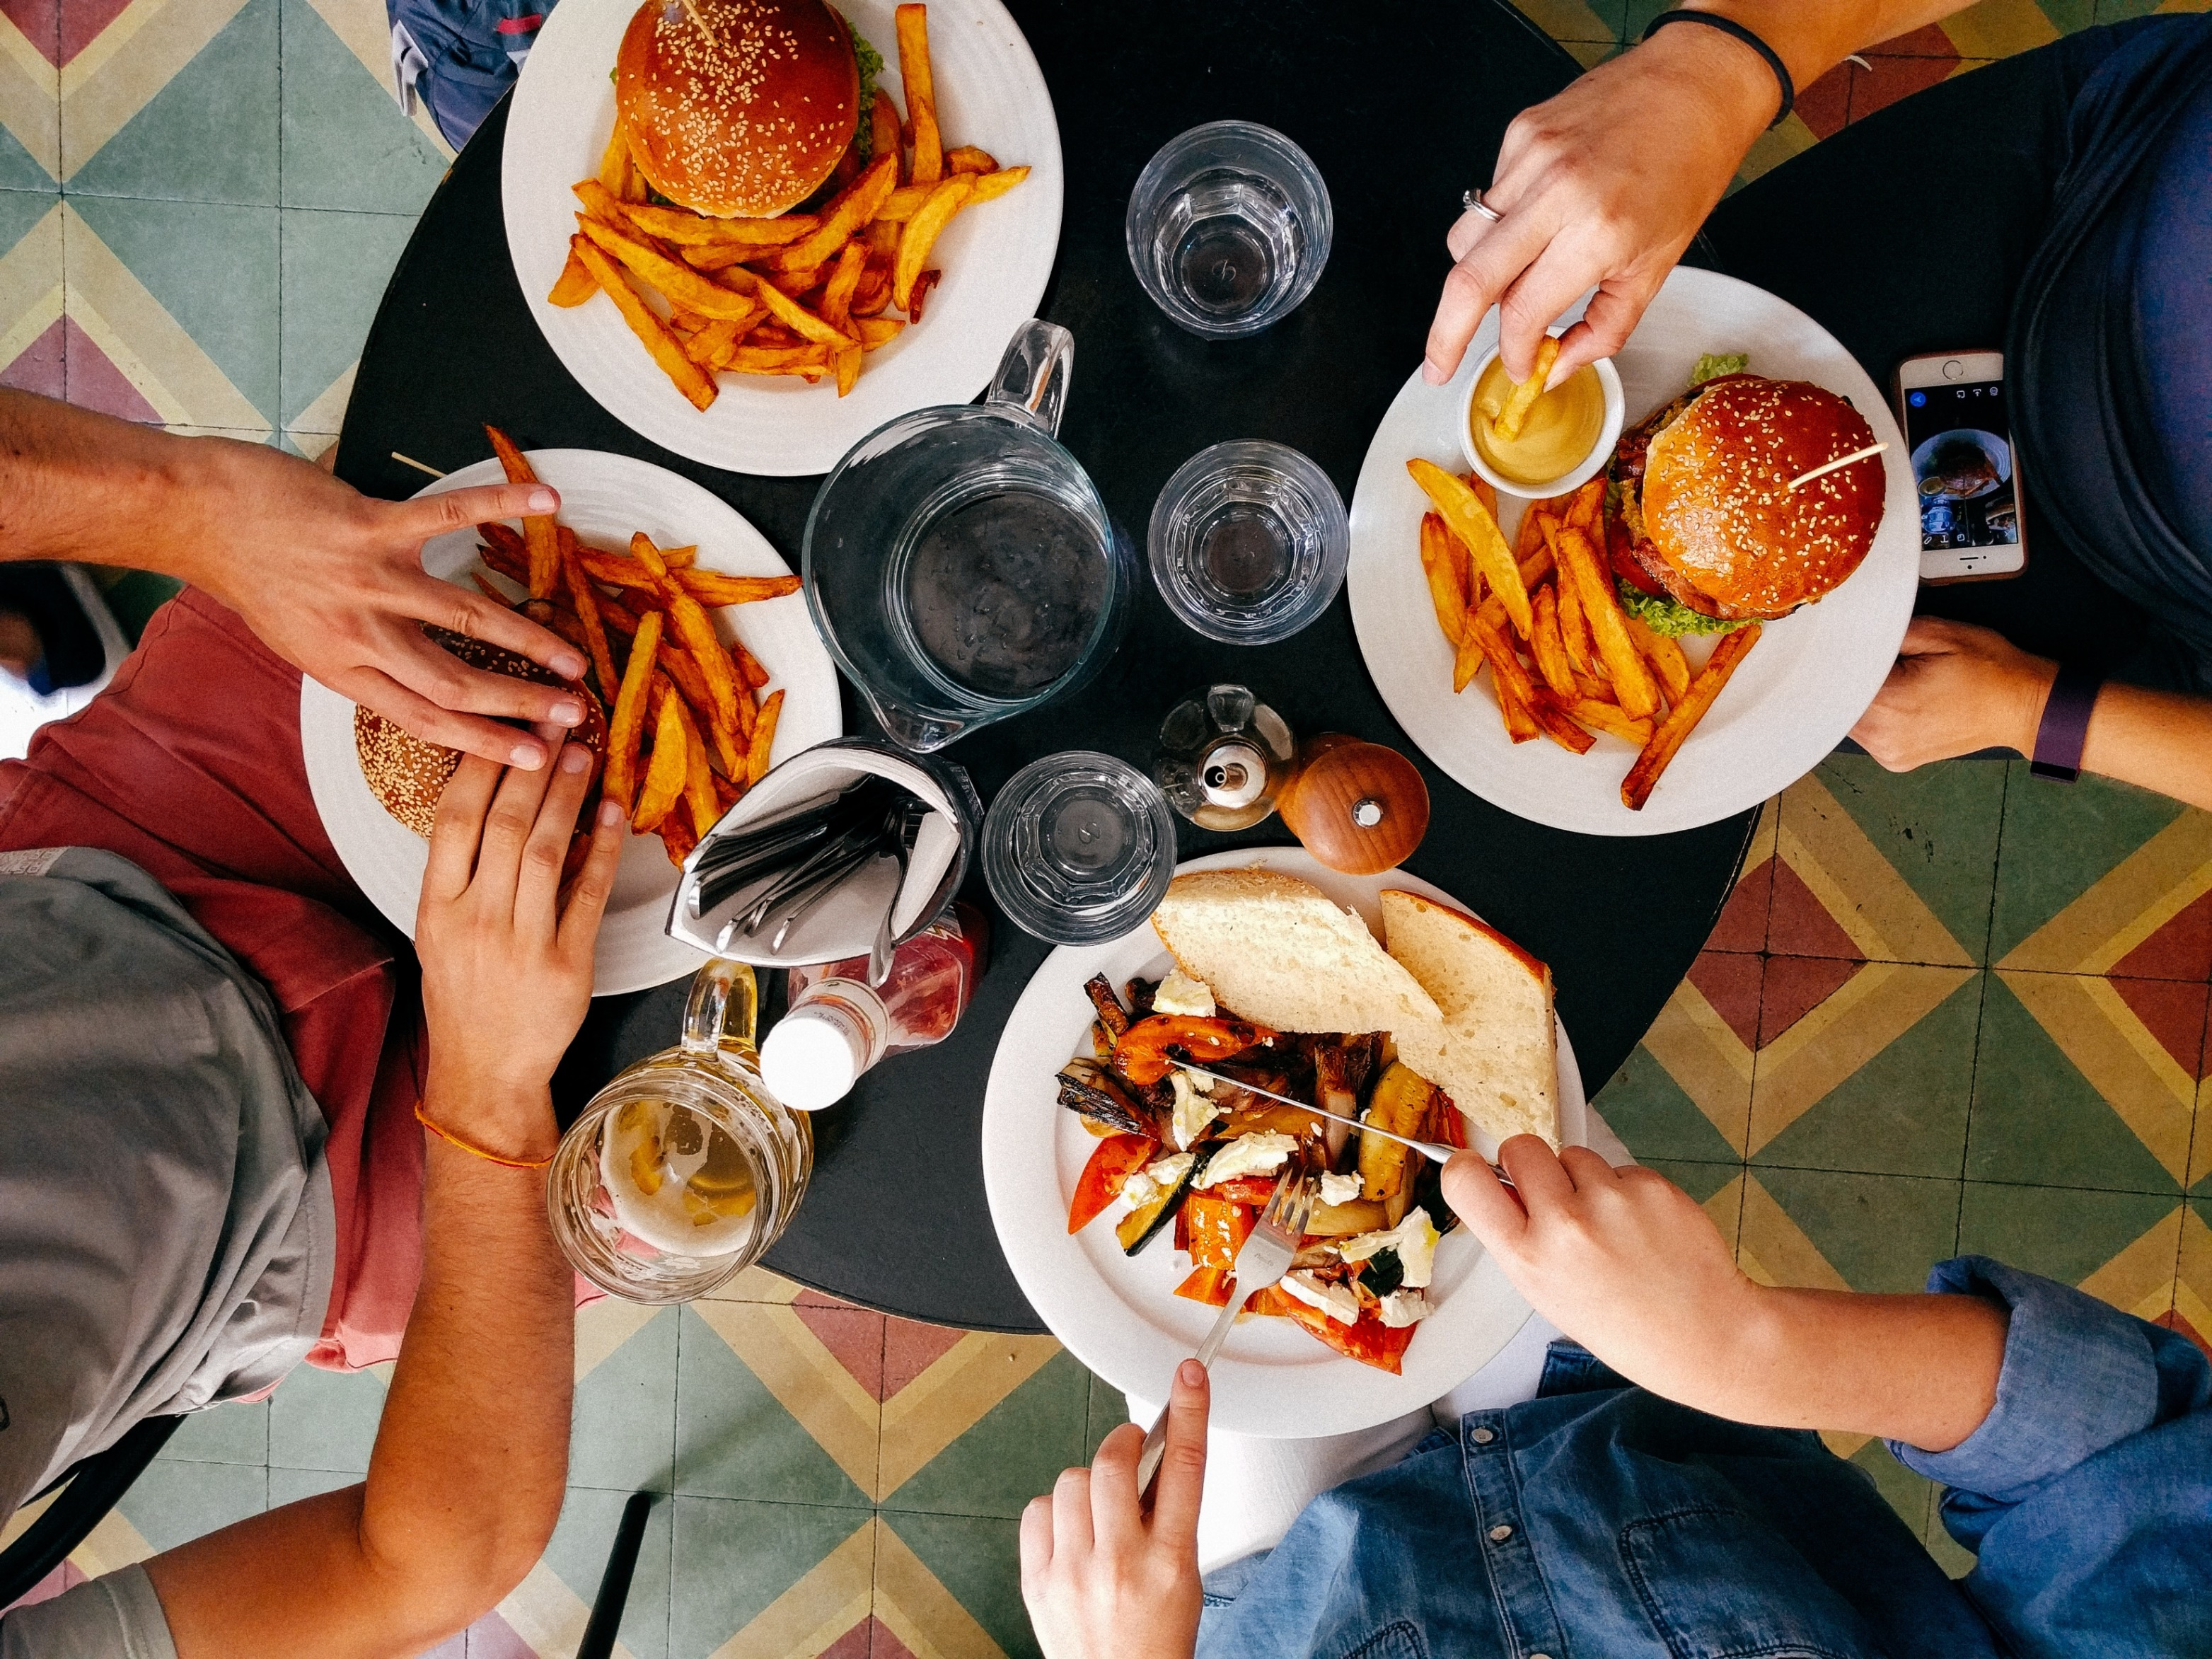
COME WITH
FRIENDS
. LUNCH .
. BRUNCH .
MONDAY- FRIDAY:12:00PM-2:30PM
SATURDAY- SUNDAY:11:30PM-3:30PM
FRIES, RICE WITH SPECIAL UNCLE BOY
STEAK
$10.00
DOUBLE CHEESEBURGER WITH FRIES
WITH UNCLE BOY STEAK
$14.00

Slide 7
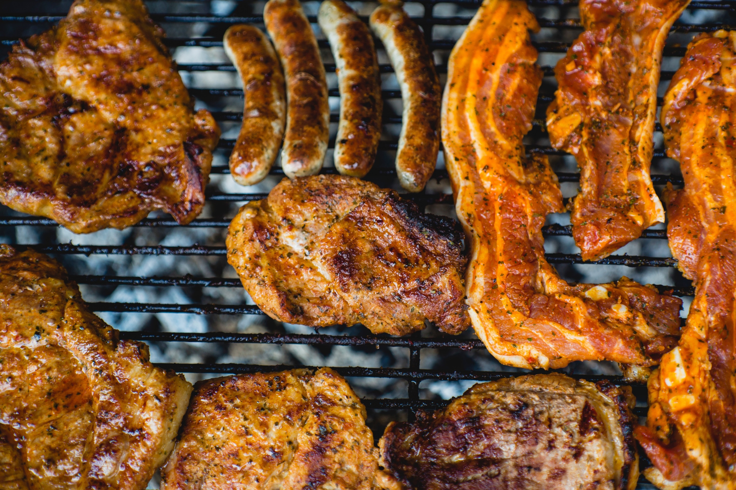
CHEF
MENU
.STEAKS.
& CHOPS
OVEN ROASTED
$20.00
14OZ.
NEW YORK STRIP
$30.00
24OZ.
STEAK FILLET
$35.00
34OZ.
GRILLED BEEF
$20.00
18OZ.

Slide 8
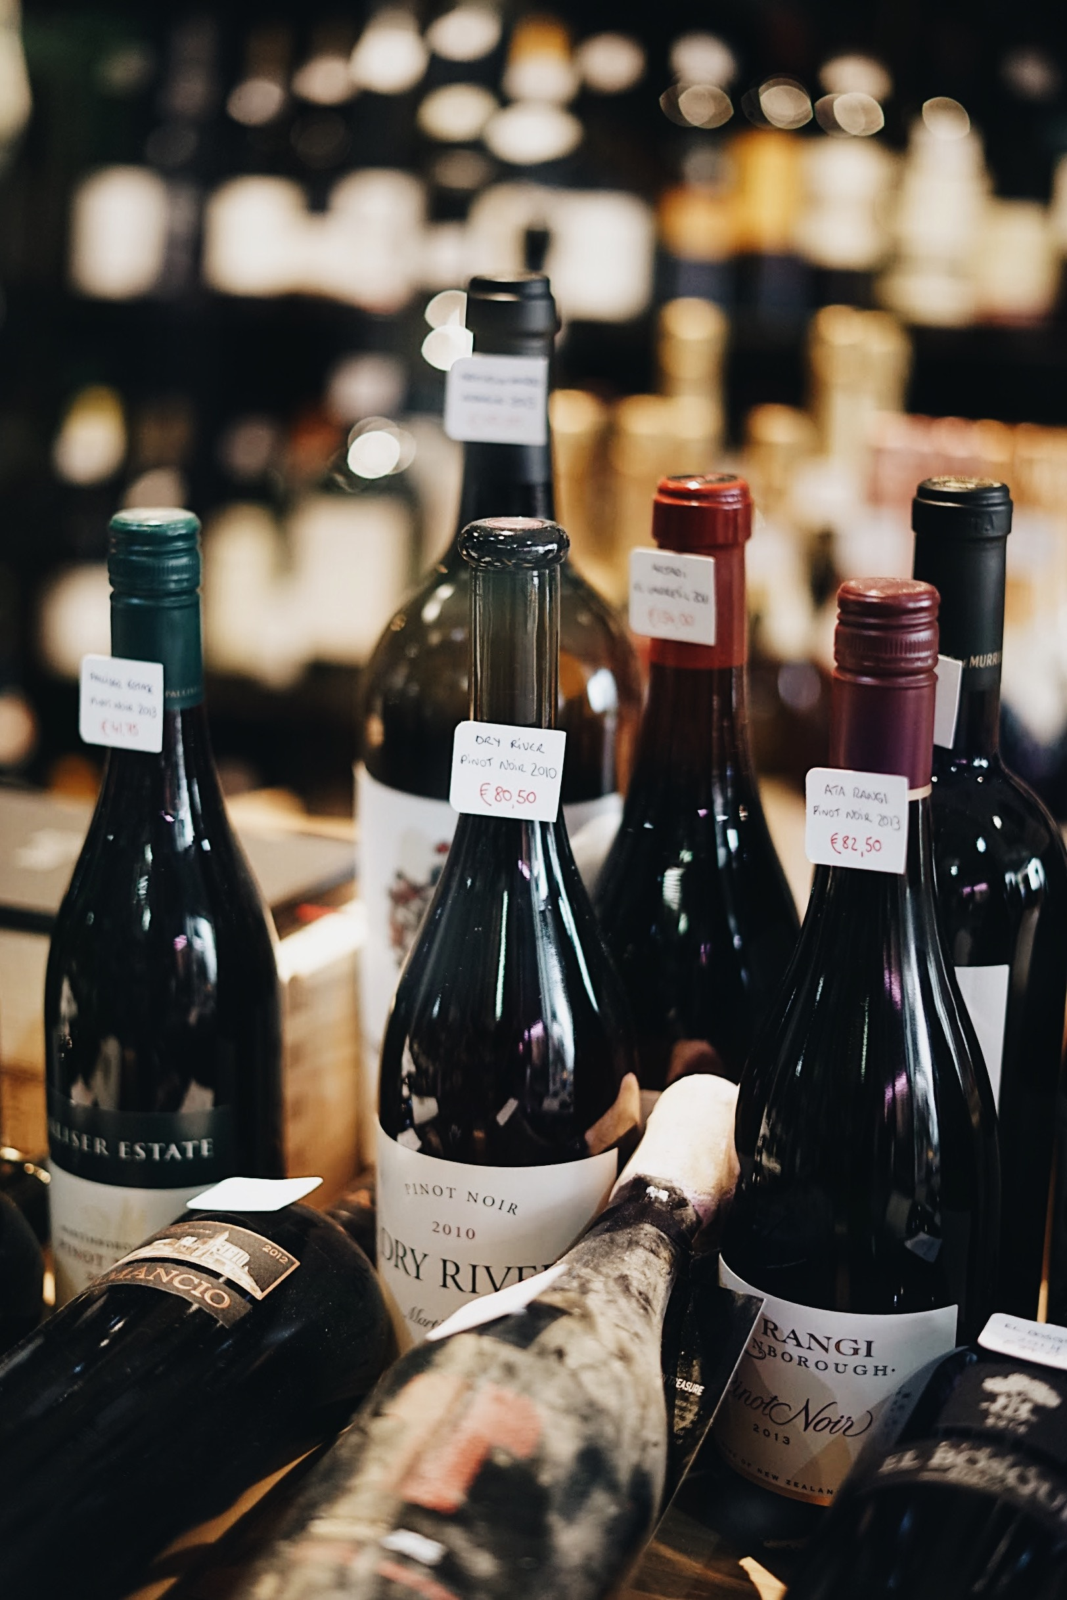
GREAT EVENING
.
BY THE
.WINE
BEER
GLASS
SAN MIGUEL
PINE APPLE WINE
$4.00
$9.00
SAN JUAN
GRAPES WINE
$5.00
$9.00
SAN PEDRO
STRAWBERRY WINE
$5.00
$10.00
SAN AGUSTIN
GUYABANO WINE
$5.00
$12.00

Slide 9
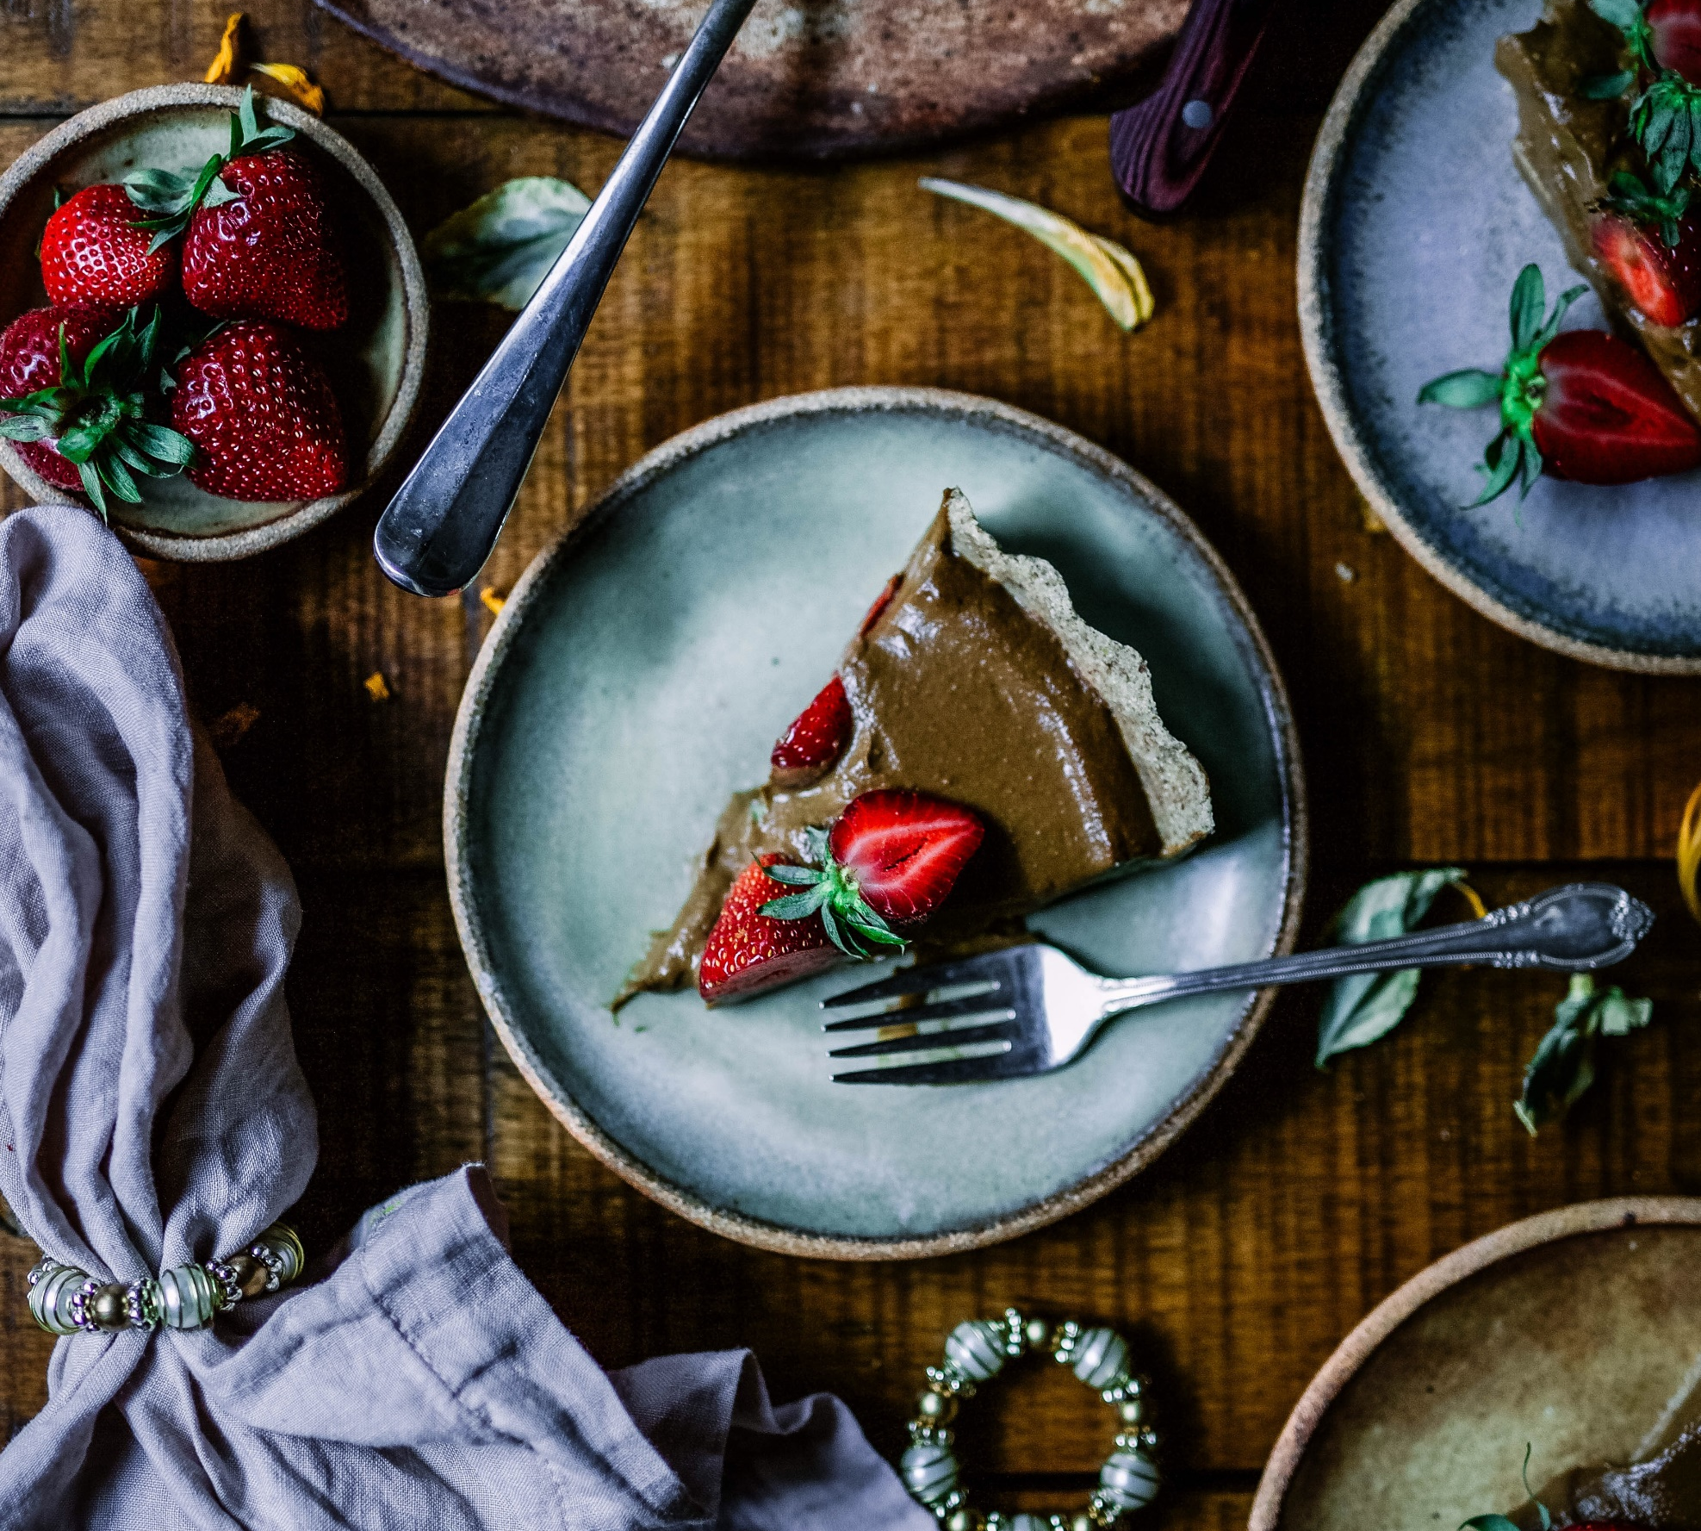
MAGICAL taste
.DESSERTS.
COFFEE JELLY
$12.00
$13.00
LECHE FLAN
CHEESE CAKE
$13.00
ICE CREAM
SUNDAE
$5.00
VANILLA GELATIN
$5.00

Slide 10
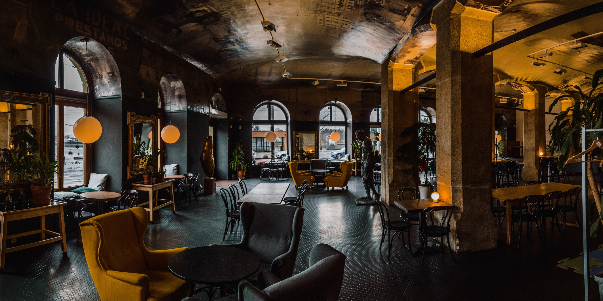
ENTERTAIN
. WITH US .
MONDAY – FRIDAY: 8AM – 8PM
SATURDAY – SUNDAY: 9AM – 11PM
.ADDRESS.
123 UNCLE BOY STEAK AVE. NEW YORK, NY 12345
.INFO & RESSERVATION.
PHONE: 1-800-123-4567
STEAKHOUSE.COM
6O.

