Slide 1
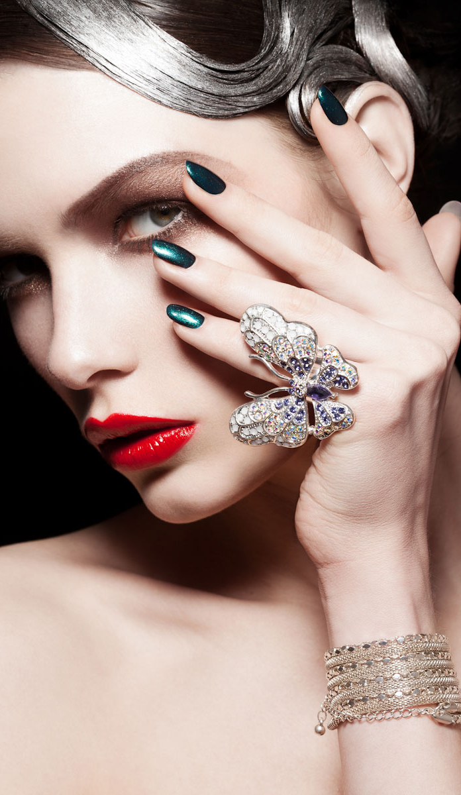
WE
Delighted
ARE

Slide 2
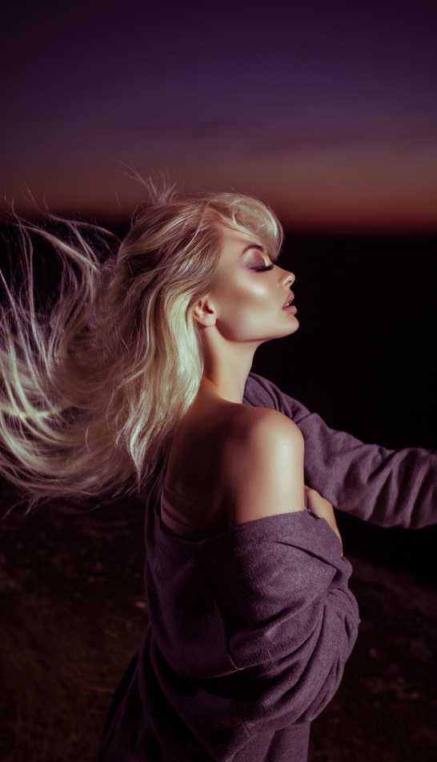
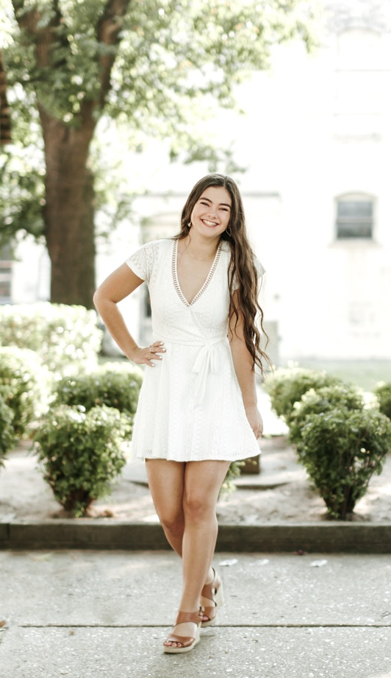
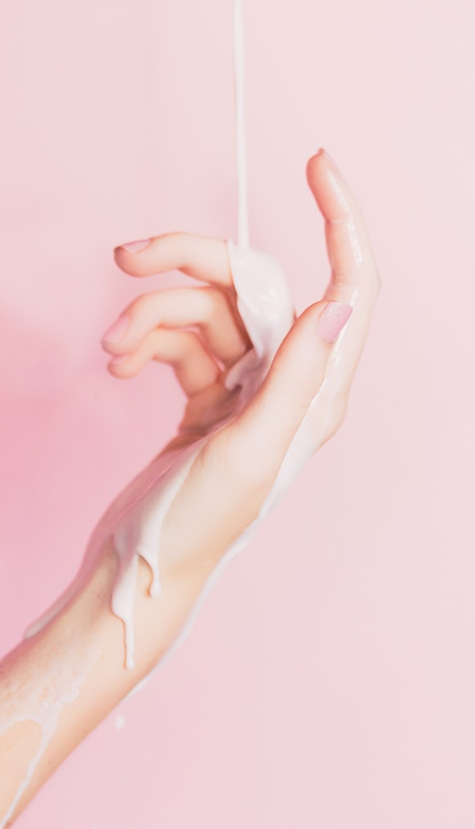
Presence at
Beautiful Magic Salon
With Your

Slide 3
About Us
WE BRING OUT THE BEST IN YOU.
Beautiful Magic Salon offers world-class salon. With the vision of bringing an Asian hairdressing to the world, We offer a wide range of hair and beauty services to a wide range of customers. It is a name that has been admired and followed by many Asian countries with 500 branches.
Beautiful Magic roster of services include Hair Styling, Hair Color, Hair and Scalp Treatments, Hot Oil, Relaxing, Rebonding, Make Up, Waxing/Threading, Nail Care, and Hand and Foot Spas.
A trusted salon brand that works with different trusted supliers for hair color, and hair care. Total customers satisfaction is the goal of Beautiful Magic’s Salon. The Beautiful Magic’s Salon gives a relaxing ambience and personal assistance by store managers and store assistants.

Slide 5
Services
Manicure

Slide 6
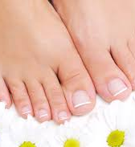
Services
Hair & Scalp Treatments, Hot Oil, Relaxing, Rebonding

Slide 7
Services
Make Up,
Waxing / Threading,
Nail Care,
Hand and Foot Spa’s

Slide 8
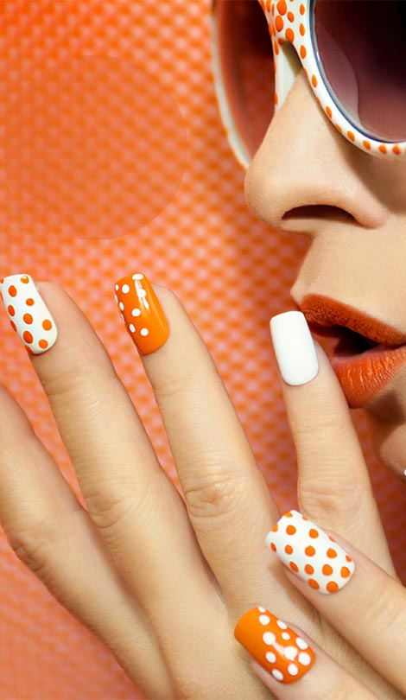
WHAT

Slide 9
MAKES THE

Slide 10
DIFFERENCE

Slide 11
WE REALLY
CARE
ABOUT YOU

Slide 12
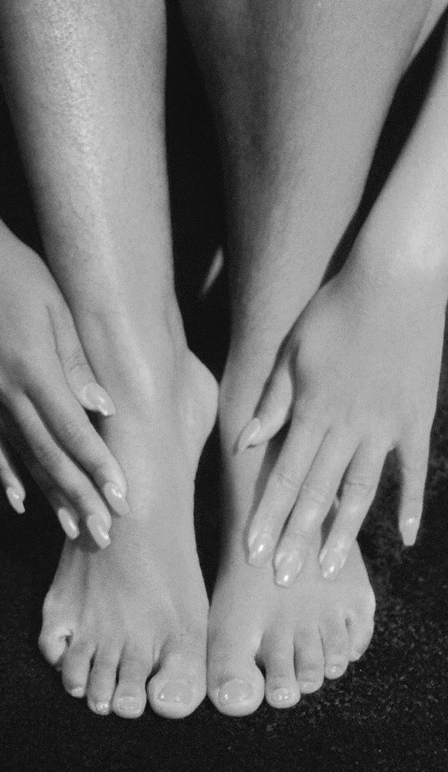
Get the BM Salon Privilege card that brings out the best in you.
Cardholders will get an amazing 10% discount on all hair services in all Beautiful Magic Salon branches every day,
any day of the year, for 1 year!
To get a discount card, fill up an application form at any Beautiful Magic Salon branch and pay a fee of $5.
Immediately, you can get your favorite hair services, like Hair Styling, Hair Color, Hair and Scalp Treatments, Hot Oil, Relaxing, Rebonding, Make Up, Waxing/Threading, Nail Care, and Hand and Foot Spas.
with a discount!
With your card, you are sure to get world-class services, at an affordable price.
What Makes
The Difference

Slide 13
HAPPY
BIRTHDAY
GET
50% DISCOUNT
For all services on your birthday

Slide 14
GET AMAZING
DISCOUNT
3
Points
3$ for 3 visits

Slide 15
GET AMAZING
DISCOUNT
6
Points
5$ for 6 visits

Slide 16
GET AMAZING
DISCOUNT
10
Points
10$ for 20 visits

Slide 17
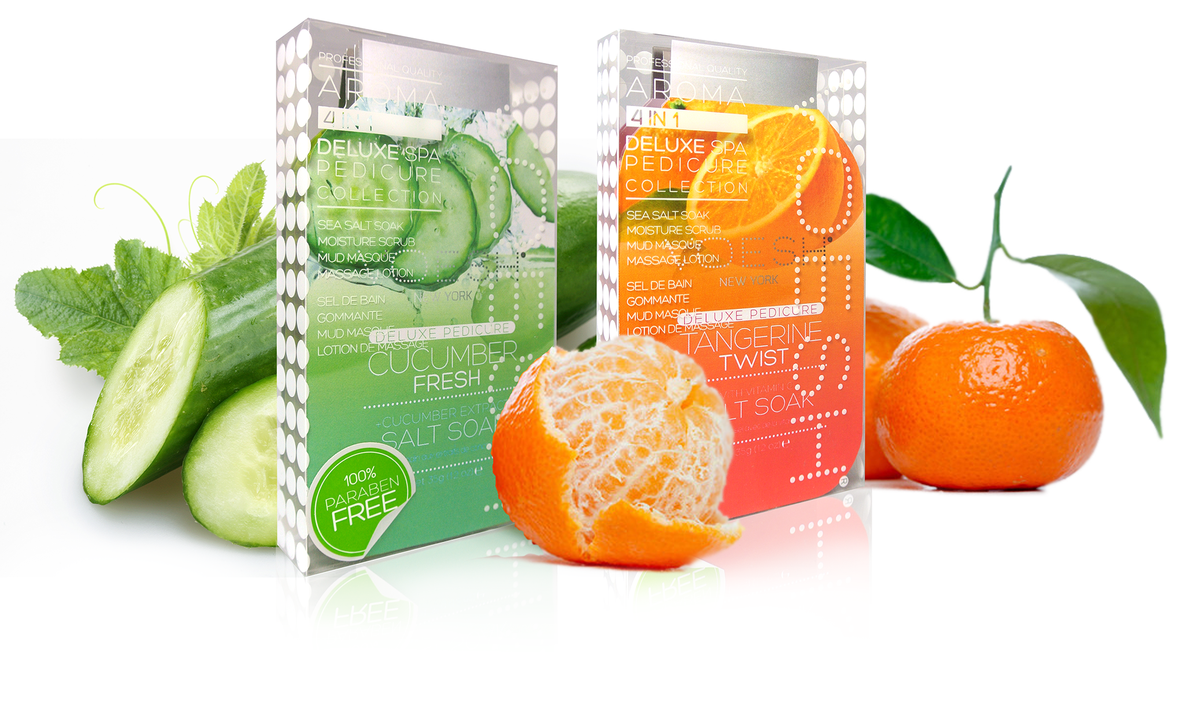
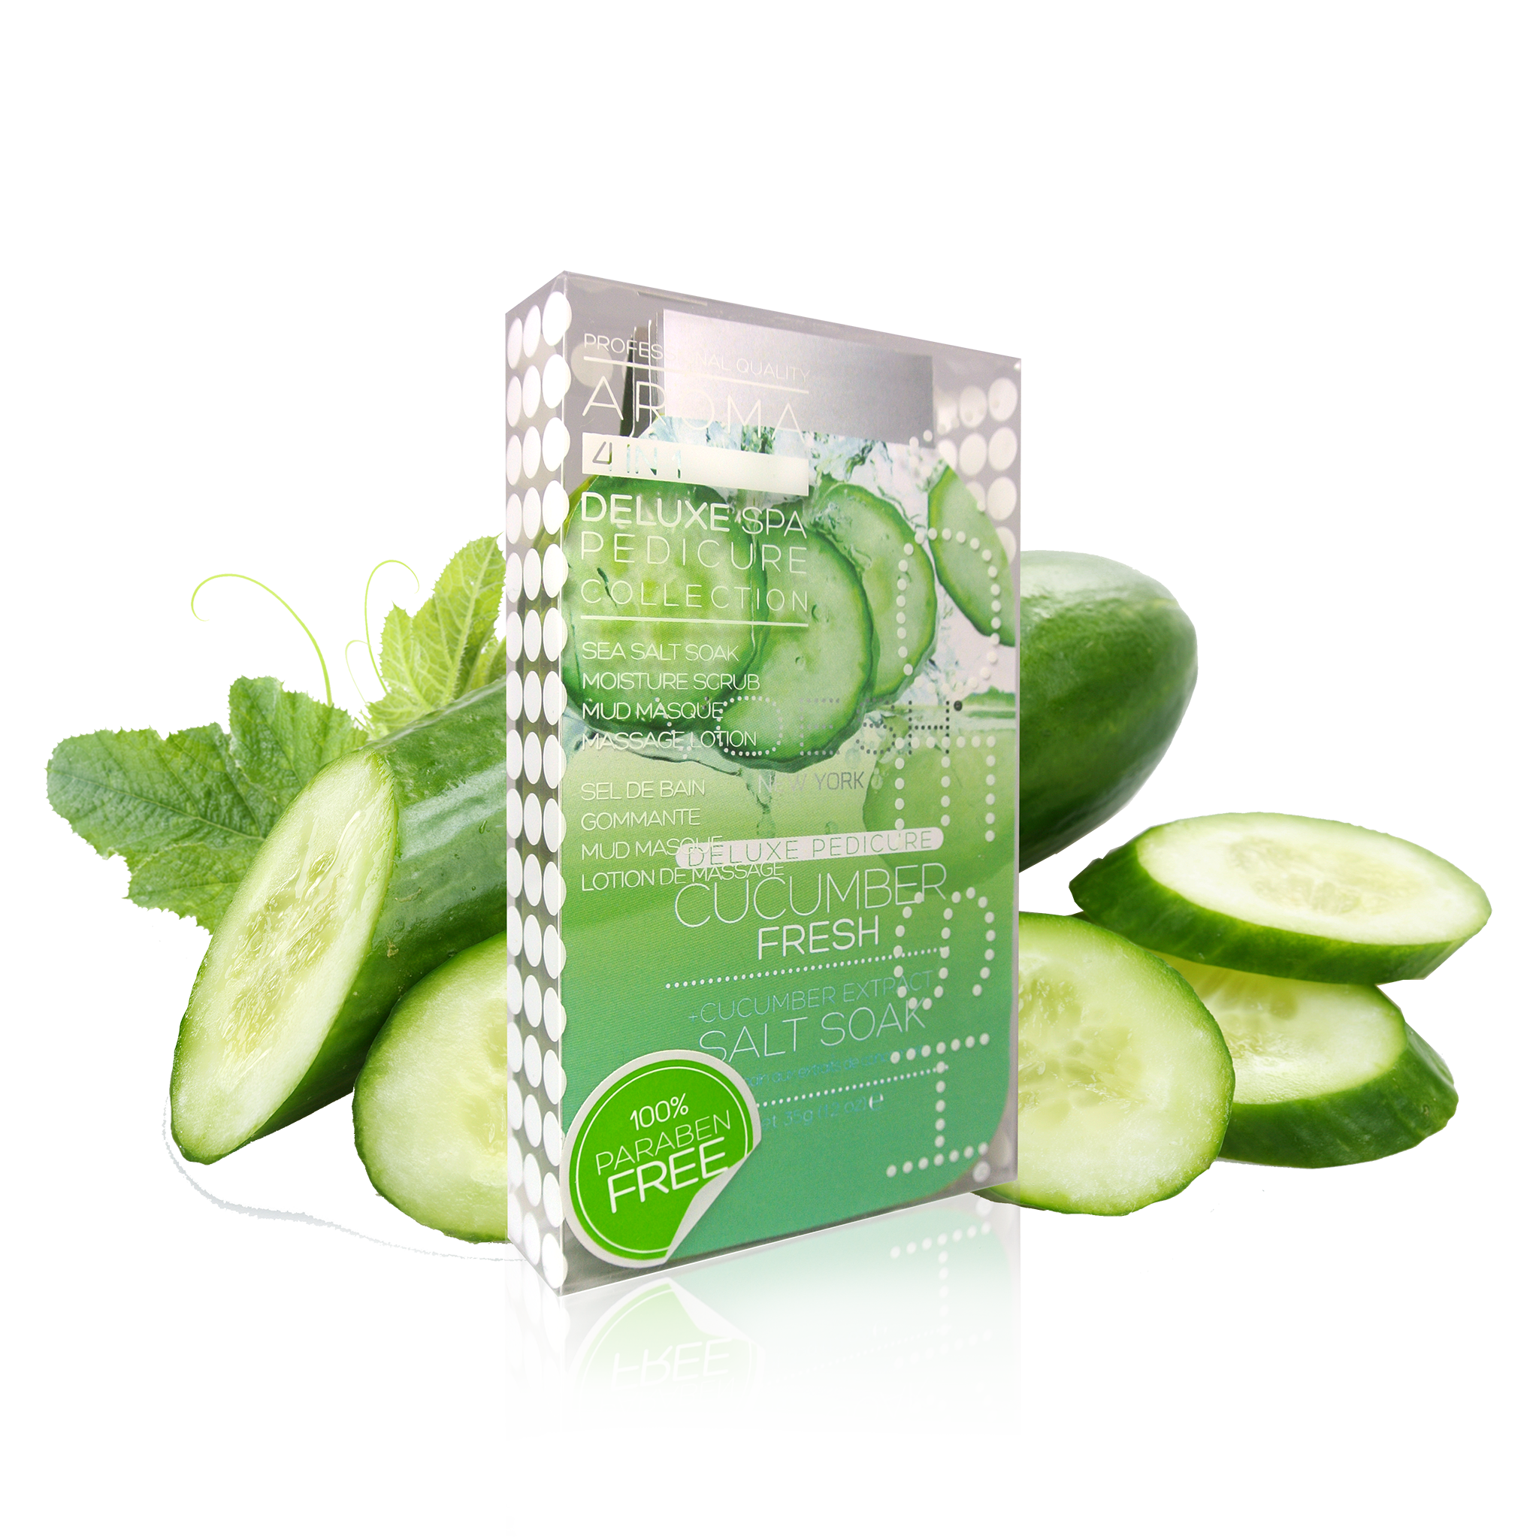
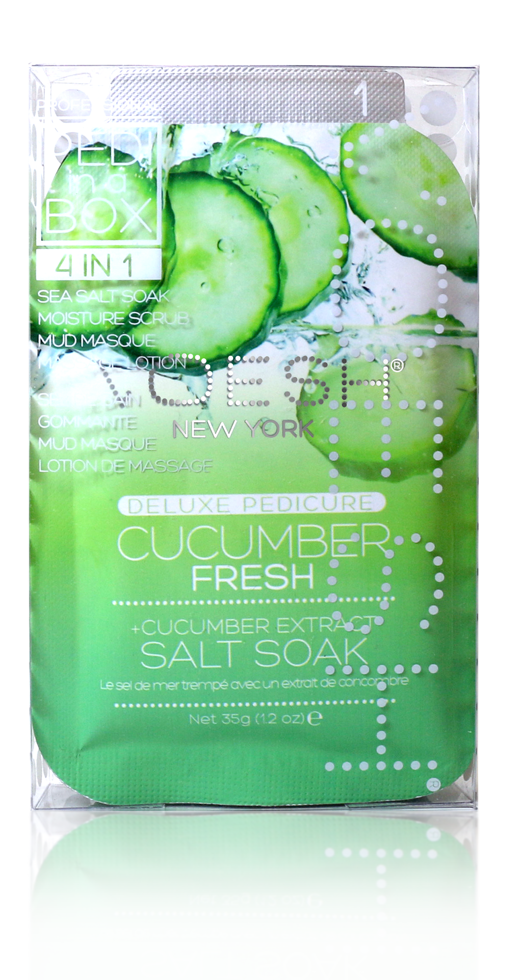
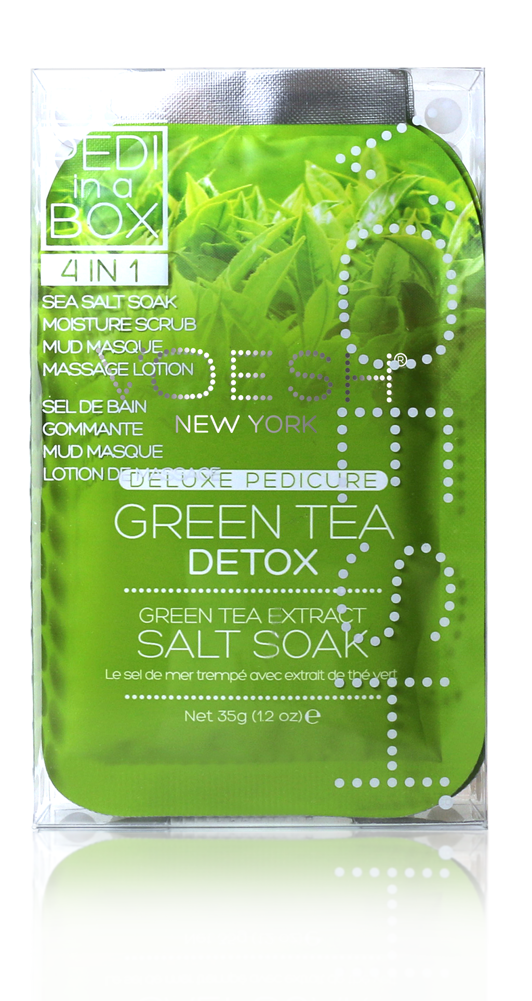
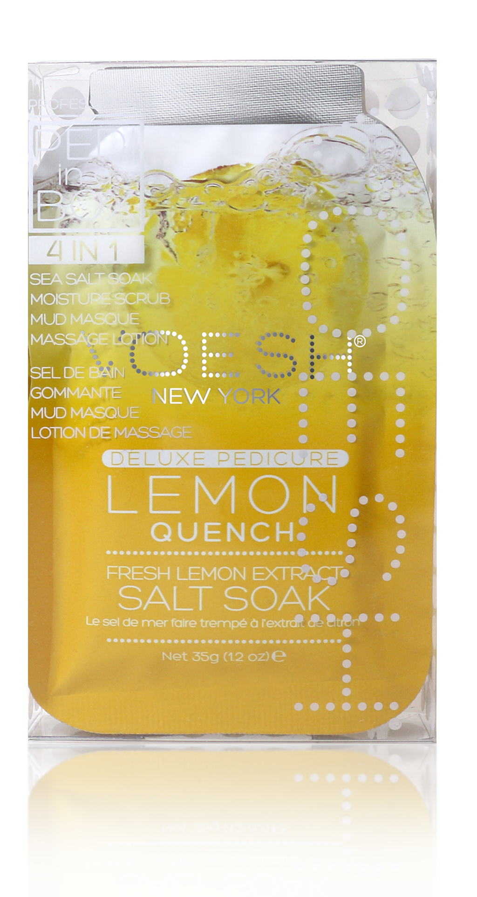
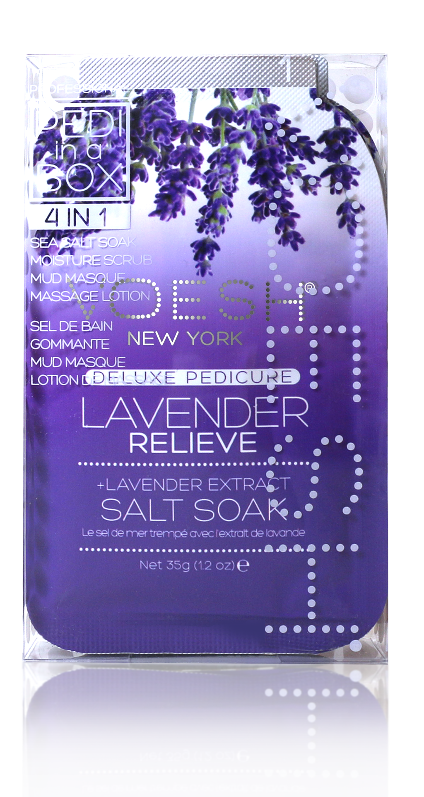
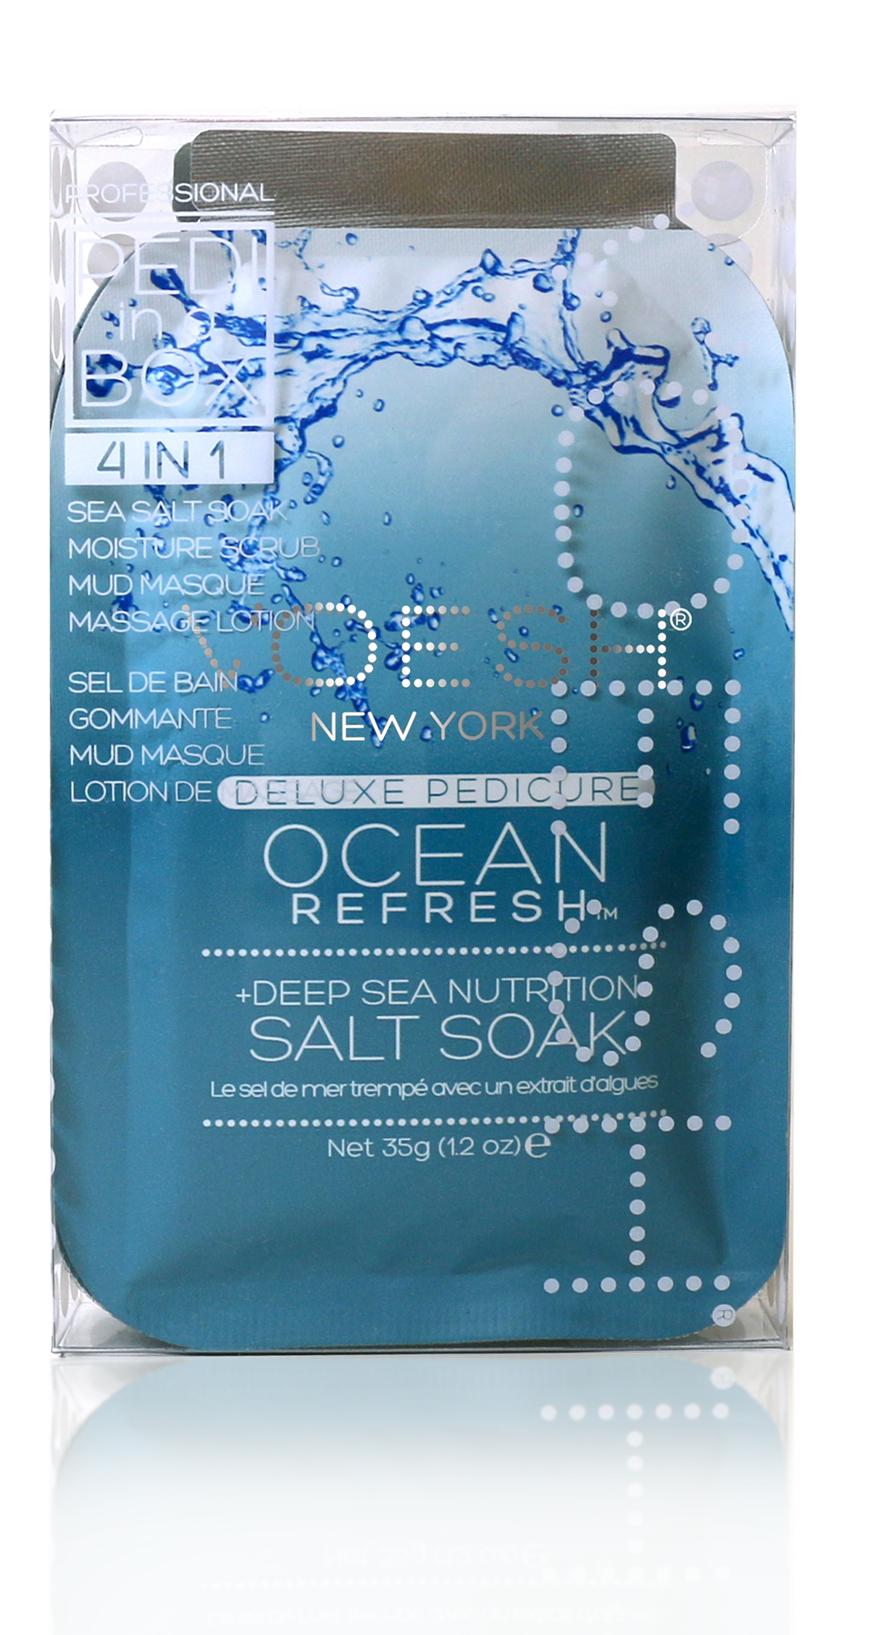
Products
SUNBLOCK SPF 60
ALOEVERA SOAP
GINGER MASK
CUCUMBER CREAM

