Slide 1
fb.com/captainp
info@captainp.com
1-800-123-4567

Slide 2
fb.com/captainp
info@captainp.com
1-800-123-4567

Slide 3
OPEN FOR FRANCHISE
For Inquiries call or text:
Or email us at:
1-800-123-4567
info@captainp.com
fb.com/captainp

Slide 4
EVENTS
Birthday
Debut
Baptismal Reception
Wedding Reception
Awards Night
Family Gatherings
Christmas Party
fb.com/captainp
info@captainp.com
1-800-123-4567

Slide 5
THE CAPTAIN BREAKFAST
Bacon, sausages, eggs, black pudding, eggy and garlic bread
A full breakfast is the breakfast meal, usually including bacon, eggs, and variety of other cooked foods, with a beverage such as coffee or tea.
$4.50

Slide 6
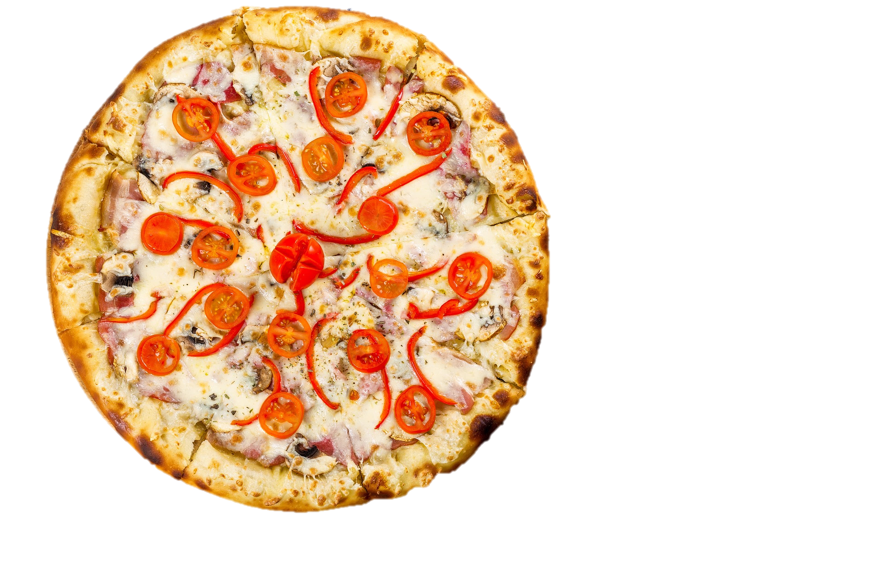
TOMATO HAM AND CHEESE PIZZA
Tomato, ham and cheese
Pizza is a flatbread generally topped with tomato, ham and cheese and baked in an oven. It is commonly topped with a selection of meats, vegetables and condiments.
$3.50

Slide 7
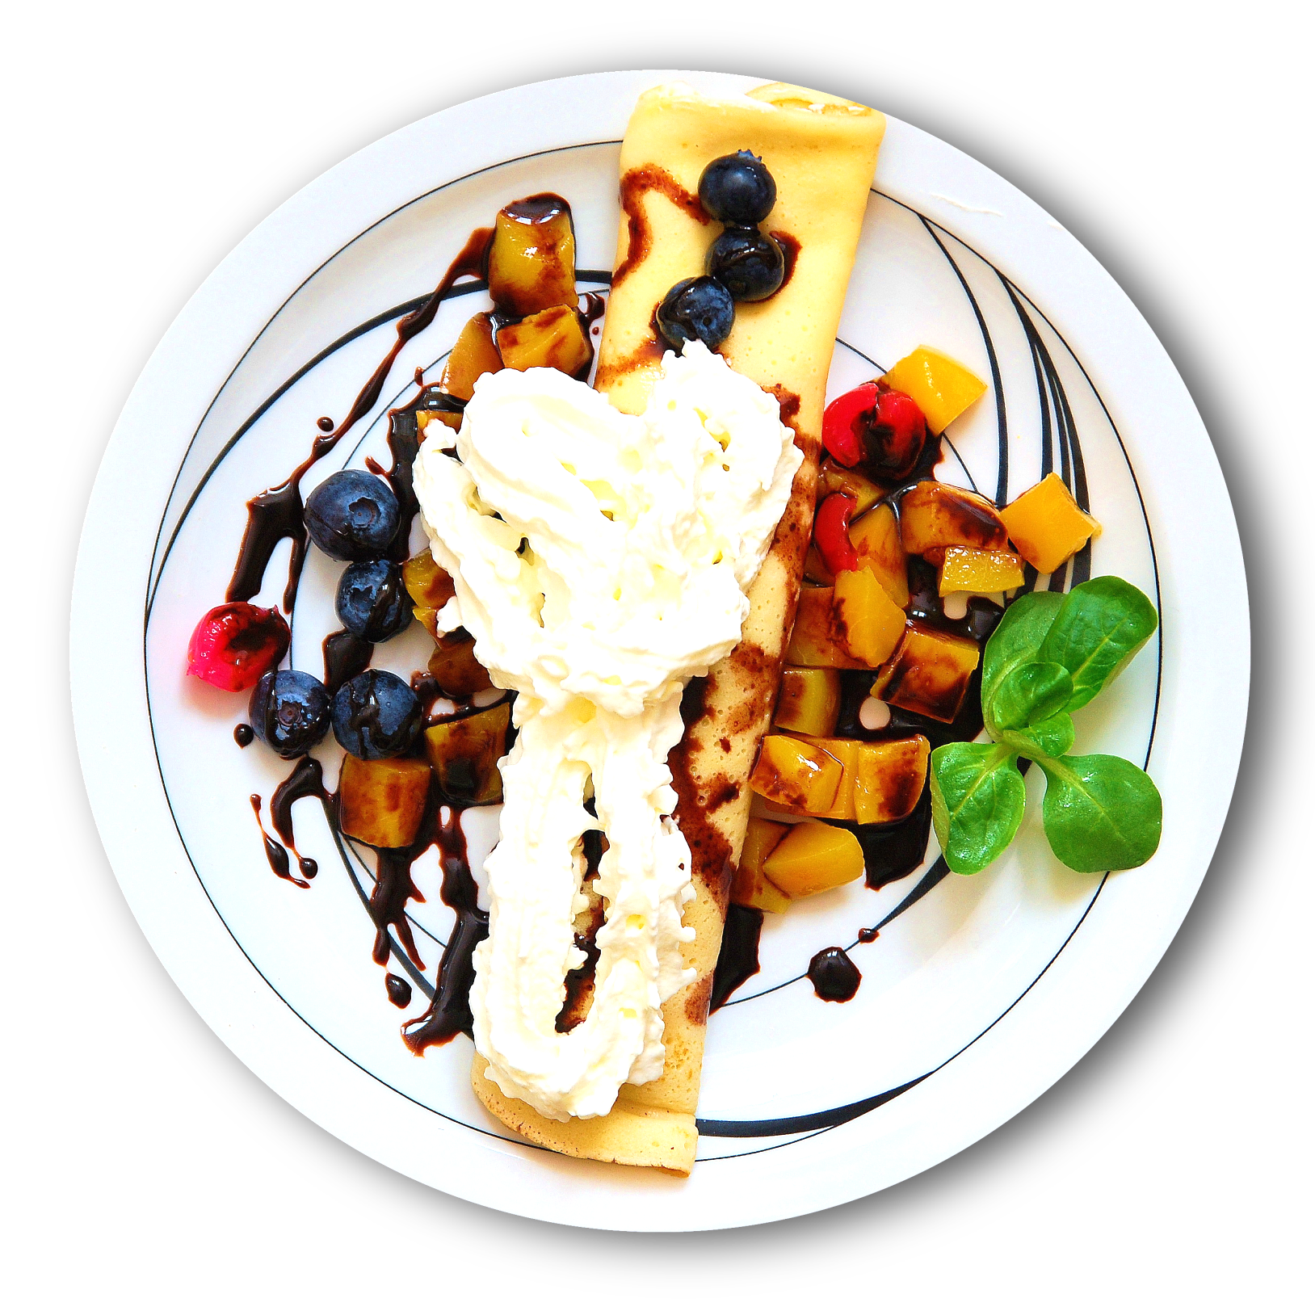
CAPTAIN P’’s ‘ PLATTER
Blueberry, cherry, mango ,
Hot cake w/ sweet icing on top
Mixed fruits: blueberry, cherry, mango, hot cake with sweet icing on top.
$2.50

Slide 8
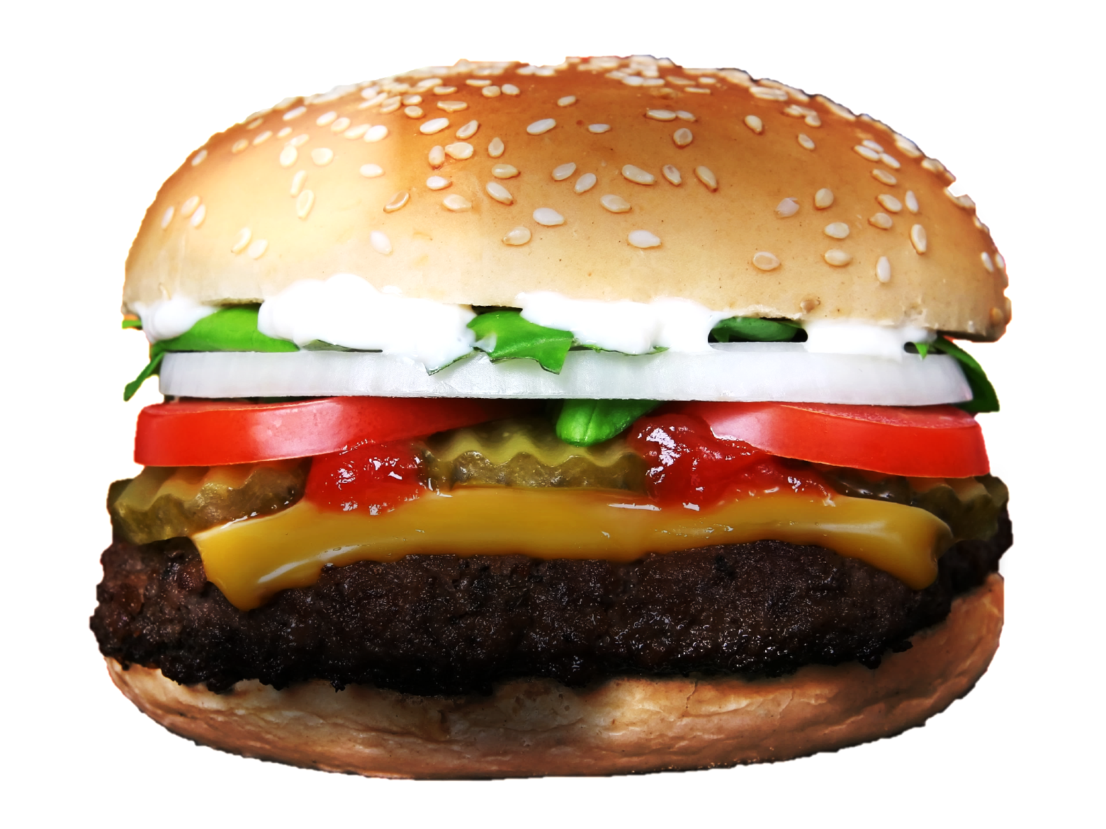
CAPTAIN P’s HAMBURGERBARBEQUE
Burger w/ Barbeque Patty, sliced tomato, lettuce, onion and special sauce
Hamburger is a sandwich consisting of one or more cooked patties of ground meat, usually of beef placed inside.
$3.00

Slide 9
SALMON STREAMED
ASPARAGUS w/
CREAMY GARLIC
DIPSAUCE
STANDARD GARNISH: iced tea or pineapple
Iced Tea or Fresh Pineapple Juice
$5.99

Slide 10
BURGER BARBEQUE
only for
$2

Slide 11
PIZZA HAM AND CHEESE
only for
$2

