Slide 1
A TASTE AND QUALITY STATION
1-800-123-4567
www.foodorganickitchenresto.com

Slide 2
Starters
Soups
LOBSTER RAVIOLI
MUSHROOM SOUP
$ 19
$ 5
CHICKEN RAVIOLI
BEEF SOUP
$ 10
$ 5
MUSHROOM PIZZA
BEEF CORN SOUP
$ 15
$ 8
FISH RAVIOLI
POTATO SOUP
$ 10
$ 9

Slide 3
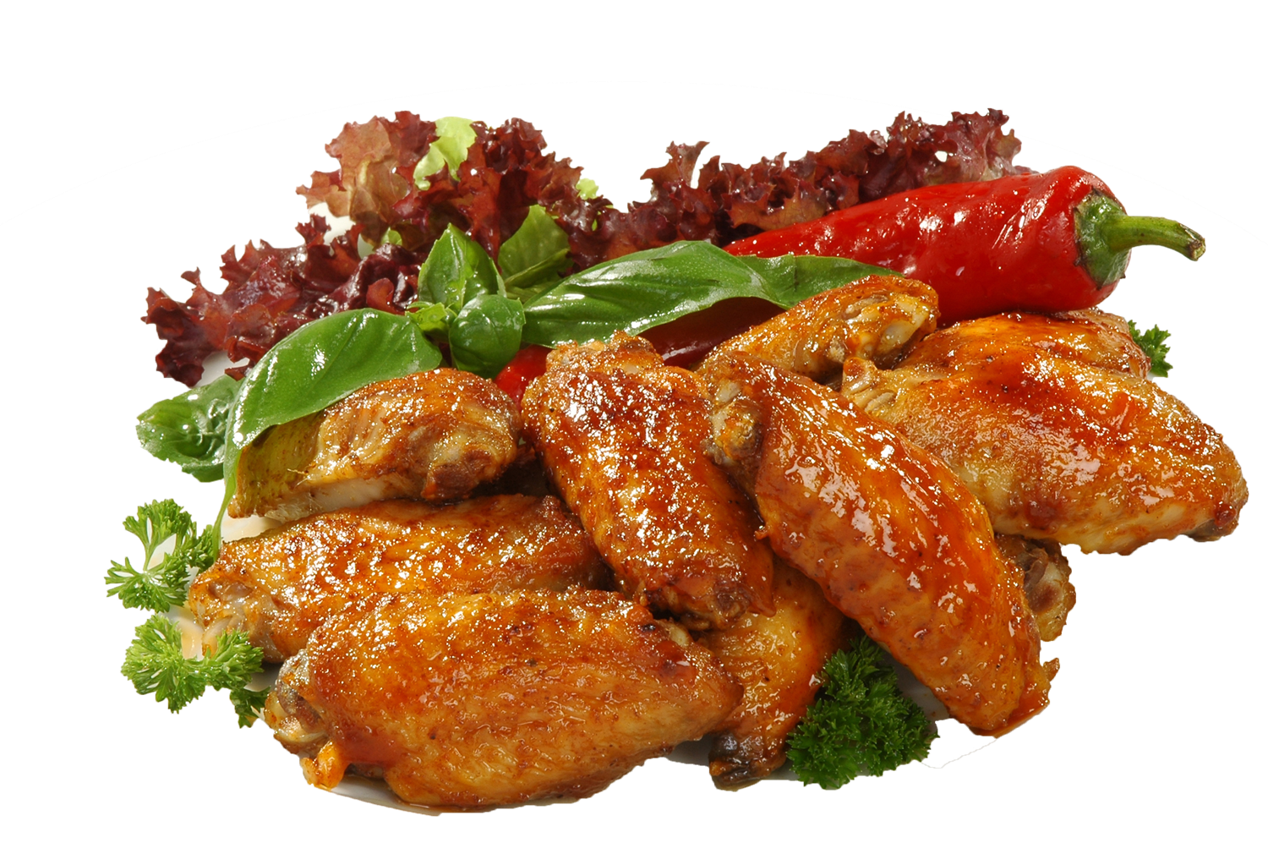
Fresh Organic
CHICKEN RAVIOLI
Pan fried with sweet and sour sauce.
SMALL
MEDIUM
LARGE
10$
15$
20$

Slide 4
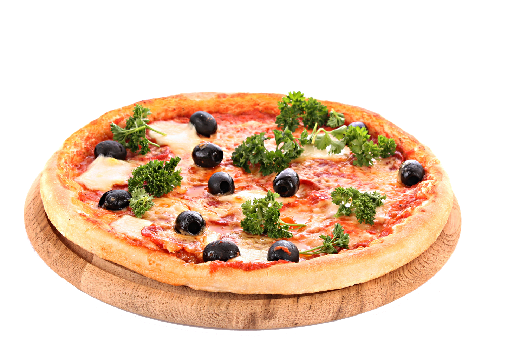
Fresh Mushroom
Mushroom Pizza
Pizza dough top with mushroom, mozzarella cheese with onion and broccoli.
SMALL
MEDIUM
LARGE
10$
15$
20$

Slide 5
Beef Dish
Chicken Dish
BEEF STEW
$10
CHICKEN MARSALA
$10
Beef stew with Rice and Iced Tea
Chicken Marsala with Rice and Iced Tea
CORNED BEEF
$15
GARLIC ROAST CHICKEN
$15
Special corned beef with Rice and Iced Tea
Garlic Roast Chicken with Rice and Iced Tea
BEEF MEATLOAF
$16
GARLIC ROAST CHICKEN
$16
Argentina beef meatloaf with Rice and Pineapple Juice
Garlic Roast Chicken with Rice and Pineapple Juice
BEEF STEAKS
$12
COCONUT CHICKEN
Beef Steaks with Rice and Pineapple Juice
Coconut chicken with Rice and Pineapple Juice
$12

Slide 6
Vegetable
Desserts
Vegetable Ravioli
Sweet Desserts
Toasted bread with tomatoes, shanghai and sweet vegetable
Hot cake with sweet cream and blur berry on top
$10
$15

Slide 7
Hot Drinks
Brewery
Espresso
Dark Ale
$5
$5
Cappuccino
El Diablo
$4
$5
Hot Chocolate
Margarita
$2
$5
Mocha
Bombshell
$5
$5

Slide 8
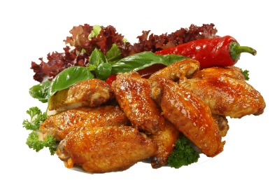
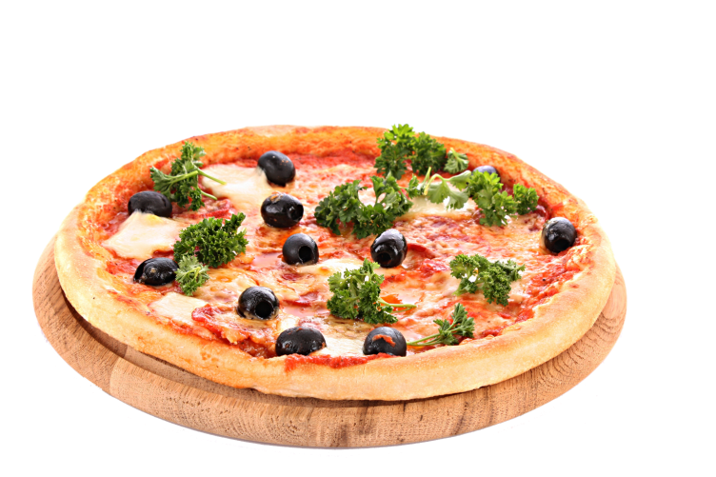
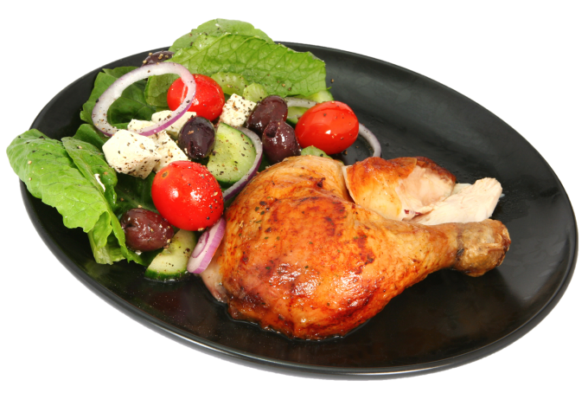
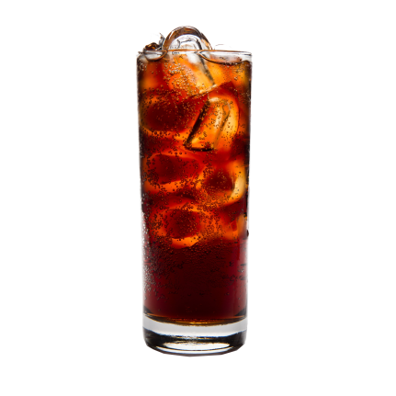
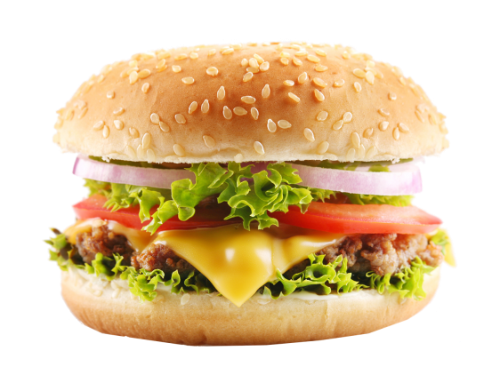
Special Events
Weddings
Birthday
Family Gathering
Music Party
Quiz Nights
Catering
1-800-123-4567
www.foodorganickitchenresto.com

Slide 9
A TASTE AND QUALITY STATION
1-800-123-4567
www.foodorganickitchenresto.com

