Slide 1
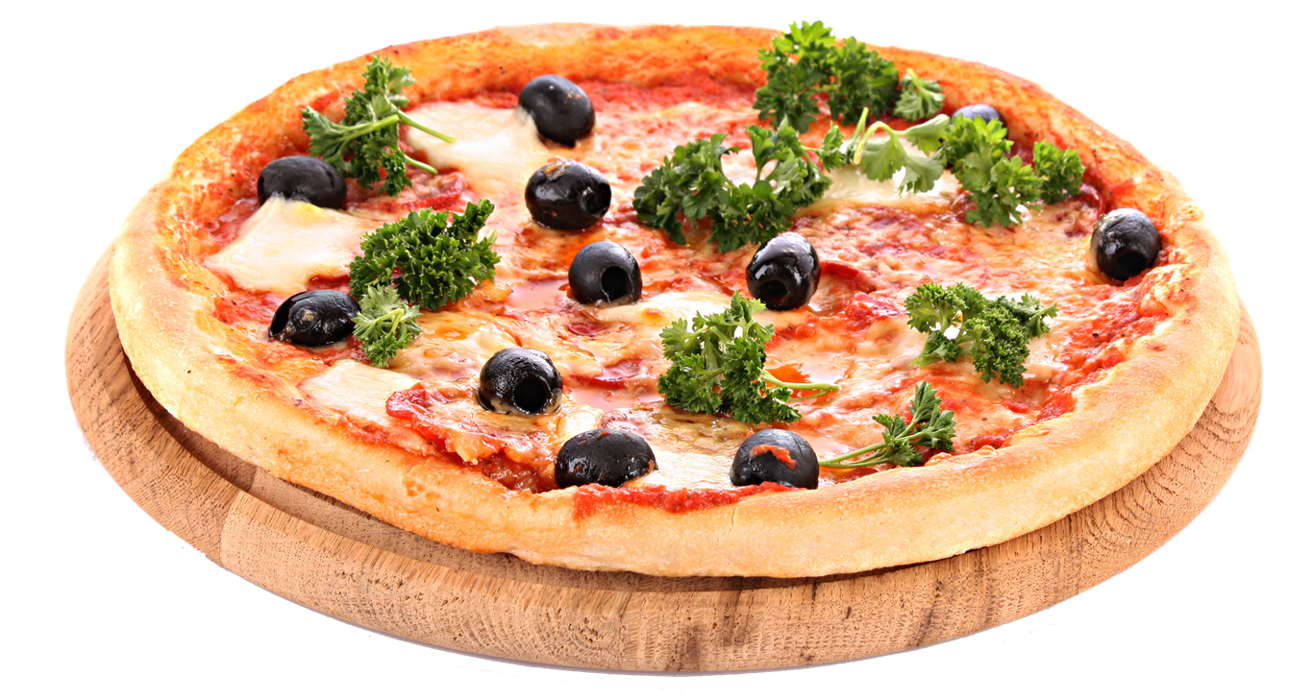

Slide 2
Special Lunch Deals
Special lunch can be a great deal if you order this two meal for only $20 until holidays.
Fruity Bunch
Crazy Burger
Perfect Taste of healthy fruit Salad.
Perfect Taste of beef bacon burger with double cheese.
DEAL 01
DEAL 02
This deal is only available from December to January.

Slide 3
Special Lunch Deals
Special lunch can be a great deal if you order this two meal for only $25 until holidays.
Strawberry Cheesy Pizza
Huge Burger
Perfect Taste of Strawberry bread with Cheese.
Perfect Taste of beef burger, onion, lettuce and with double cheese.
DEAL 03
DEAL 04
This deal is only available from December to January.

Slide 4
GET MORE

Slide 5
EXCITING

Slide 6
LUNCH DEALS

Slide 7
Option 02
Toasted bread with vegetable, tomato and shanghai rolls
Option 04
Fruit Salad (mixed with different kind of fruits banana, strawberry, apple, mangoes, orange and berries)
Option 01
Special Fried Shark’s Fin
Option 03
Shrimp rice paella

Slide 8
Option 06
Burger Bun with patty, bacon and double cheese
Option 08
Toasted bread with vegetable, tomato and shanghai rolls with hot cake
Option 05
Hot cake with berries, strawberries and creamy sweet sauce on top
Option 07
Special Fruit Salad with free mango drink

Slide 9
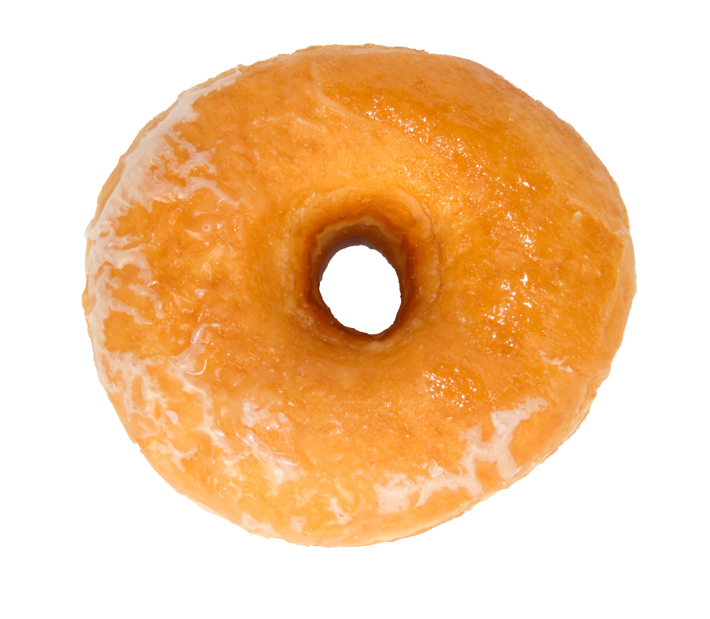
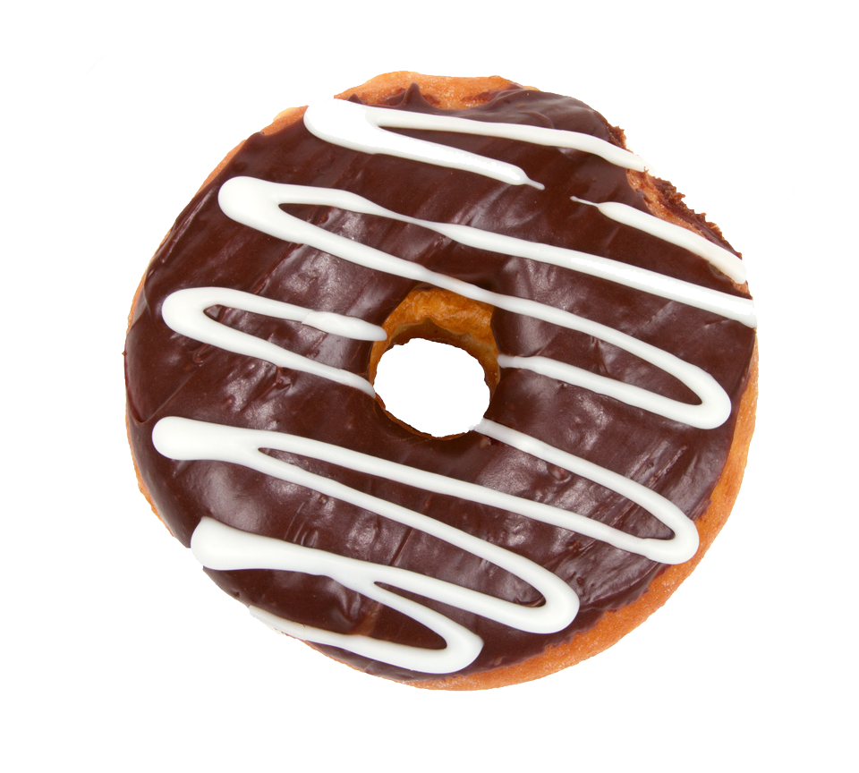
NEW BREAD
Sweet DOnut
Flavored fruit donut.

Slide 10
Special Lunch Deals
$12
$8
Special lunch can be a great deal if you order all this meal for only $50 until holidays.
$14
$12
LIMITED TIME OFFER

Slide 11
ITEMS
Option 01
Fruit Salad (mixed with different kind of fruits banana, strawberry, apple, mangoes, orange and berries)
HOT
Option 02
Different Flavored Shark’s Fin
Option 03
Hot cake with pizza and coffee

Slide 12
Option 04
Fruit Salad (mixed with different kind of fruits banana, strawberry, apple, mangoes, orange and berries)
ITEMS
HOT
Option 05
Different Flavored Shark’s Fin
Option 06
Hot cake with pizza and coffee

Slide 13
