Slide 2
The No. 1 Fast Food in the Universe!
A-12, Street#04, Pizzchiger, USA
1-800-123-4567

Slide 3
ENJOY

Slide 4
THE BEST

Slide 5
FOOD

Slide 6
IN TOWN

Slide 7
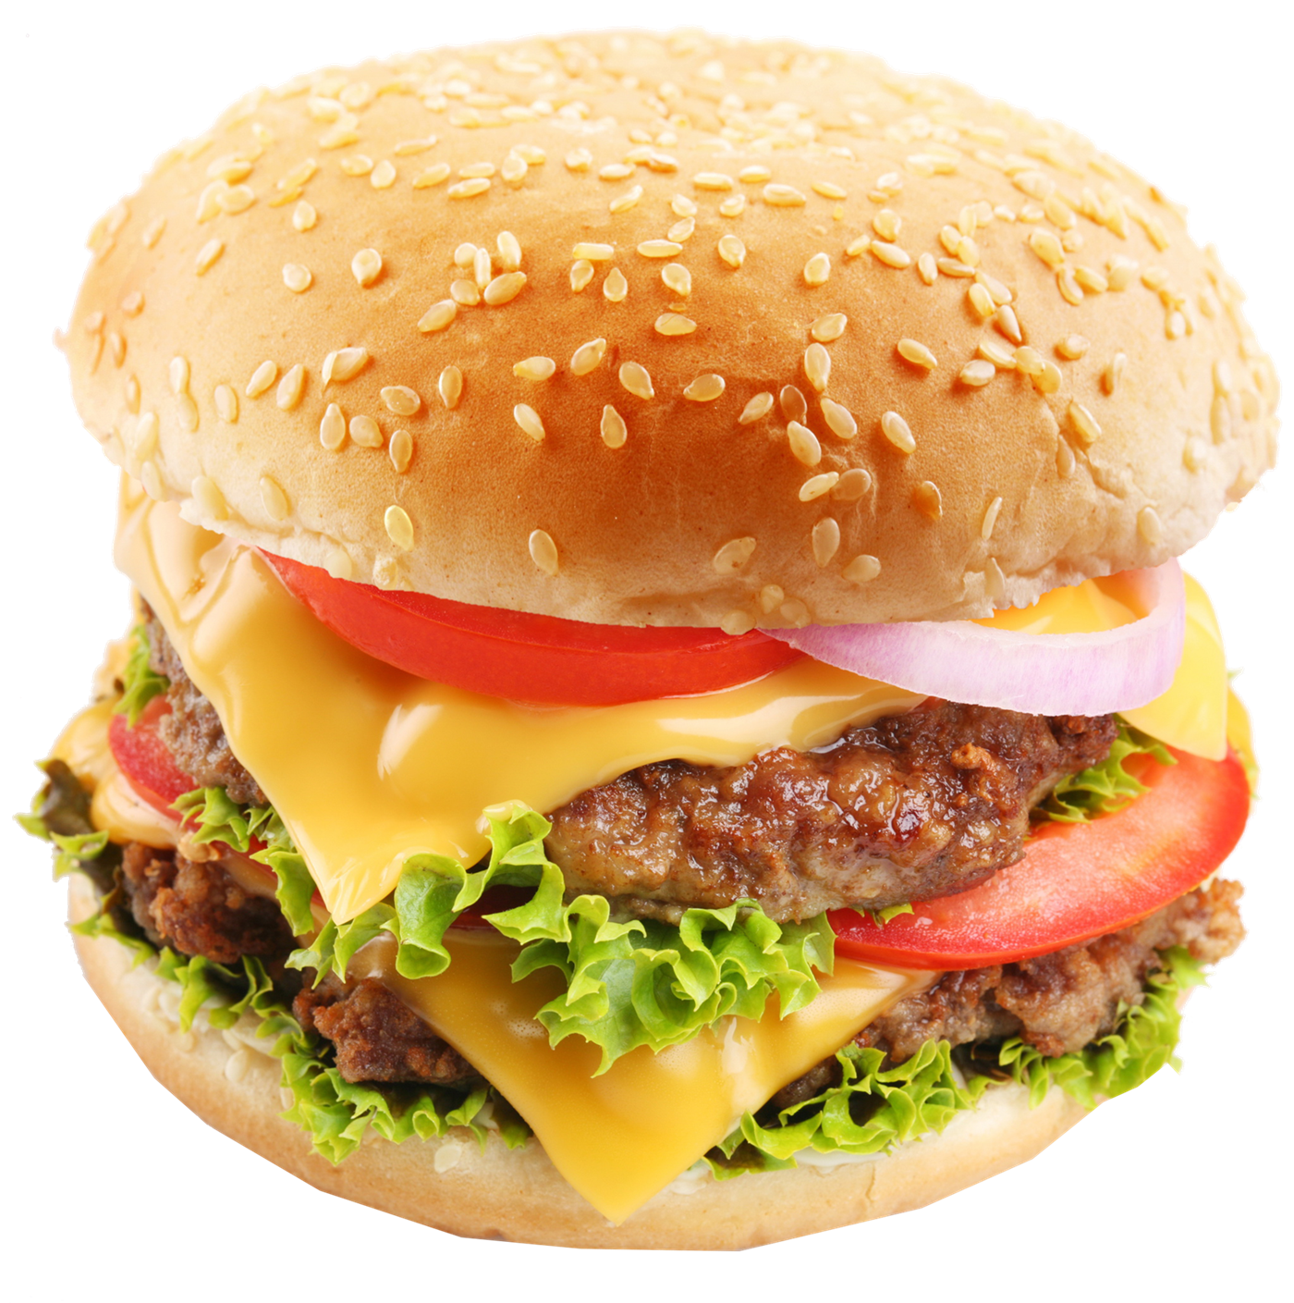
Classic Burger
Special Burger | 1 Drink | Coffee
‘$15’
The famous triple cheeseburger on town with crispy lettuce, tomato, onion, beef patty and creamy sauce.

Slide 8
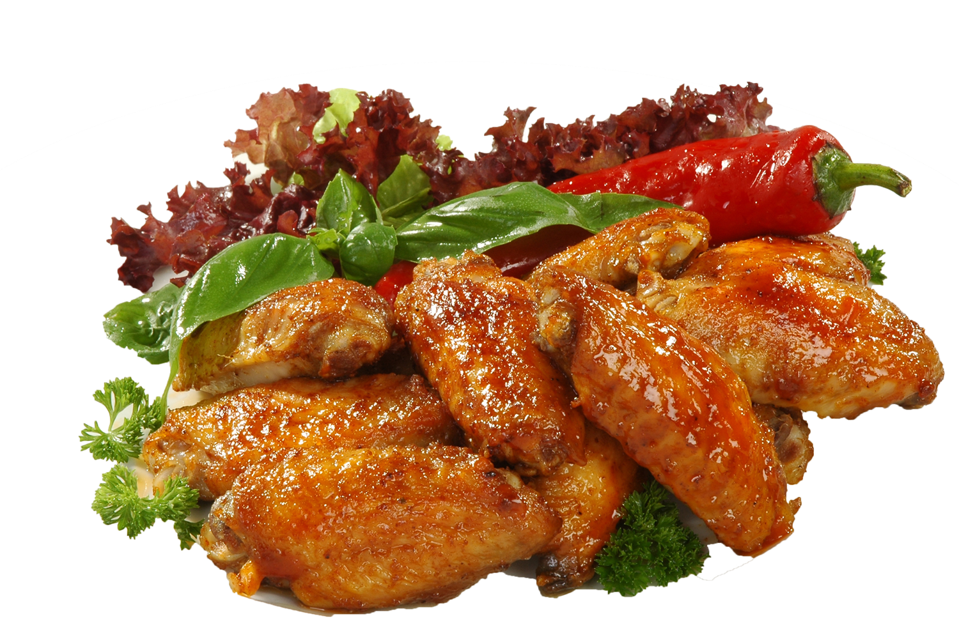
Sweet & Spicy Chicken
Full Chicken | 4 Drink | Salad
‘$10’
Feel the amazing taste of sweet and spicy chicken mixed with broccoli.

Slide 9
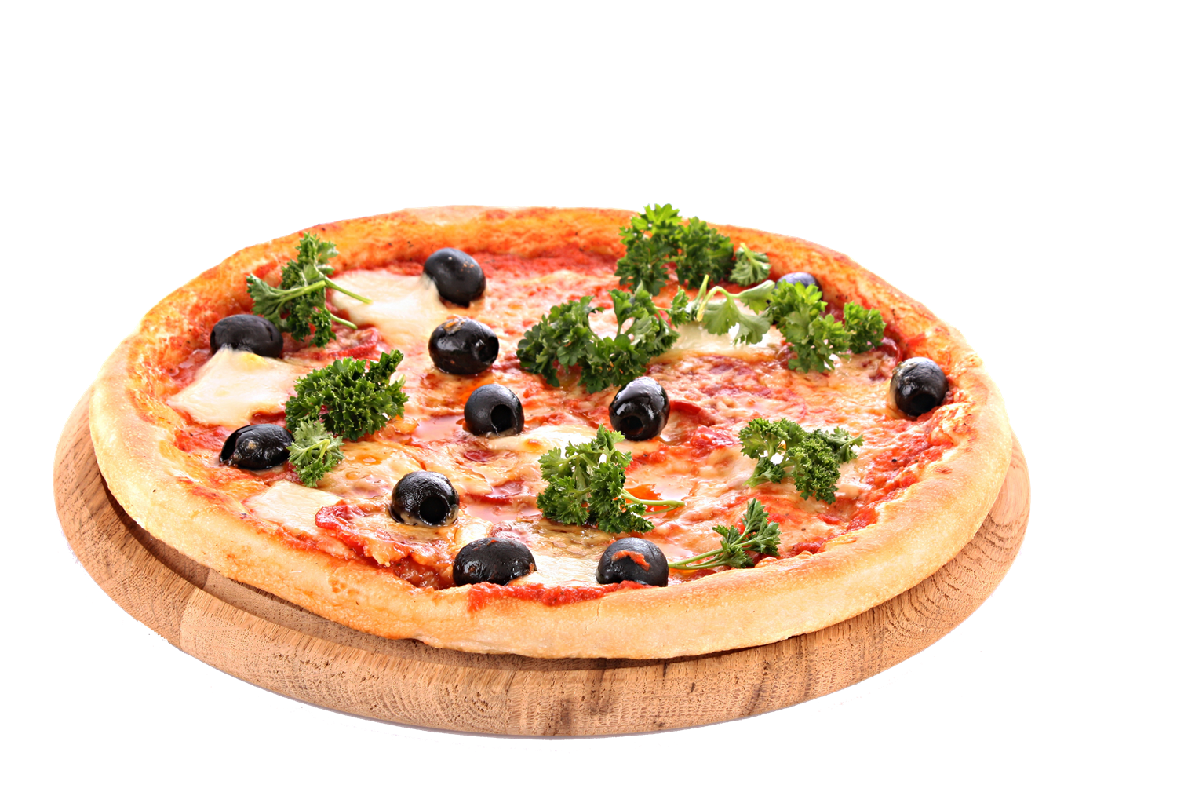
Cheesy Pizza
Special Pizza | 1 Drink | Garlic Bread
‘$12’
The ultimate combination of tasty peperoni, sliced mushroom, onions, broccoli and cheese.

Slide 10
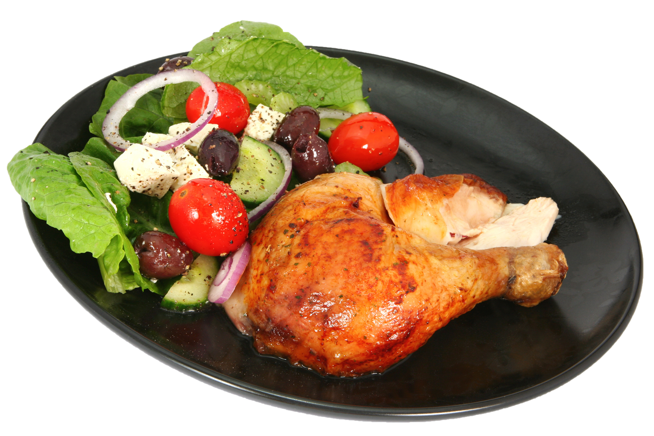
Chicken
Barbecue
Leg Peace | 1 Drink | Salad
‘$12’
Chicken Barbecue with salad (lettuce, grapes, tomatoes, onion and cucumber)

Slide 11
GET

Slide 12
BEST FAMILY

Slide 13
DINE IN

Slide 14
OFFER

Slide 15
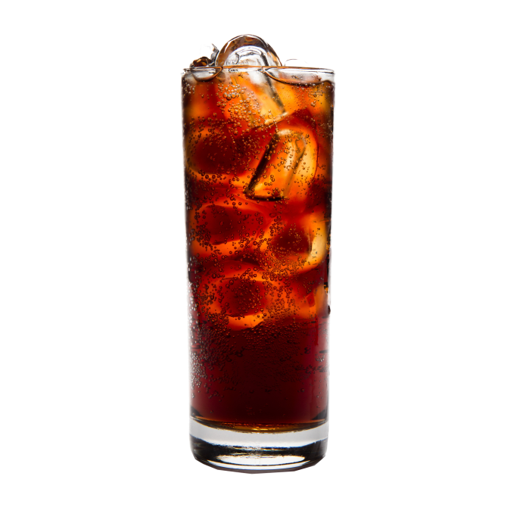
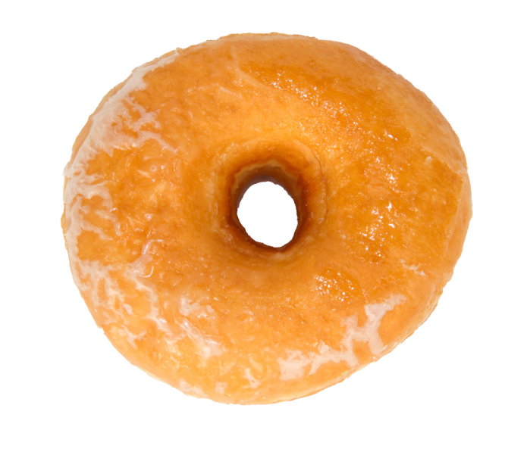
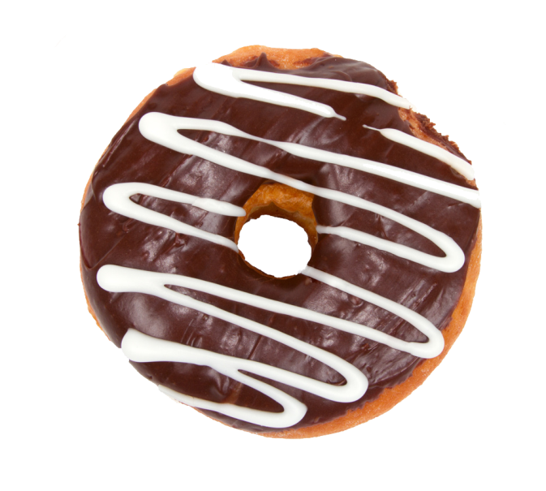
Combo Meals
Sweet & Spicy Chicken | 2 Drink | 2Donut
‘$18’
Sweet & Spicy Chicken with 2 Iced Tea Drink with your 2 choices flavored donut.

Slide 16
The No. 1 Fast Food in the Universe!
A-12, Street#04, Pizzchiger, USA
1-800-123-4567

