Slide 1
Facebook.com/pizzger
INFO@pizzger.com
1-800-123-4567

Slide 2
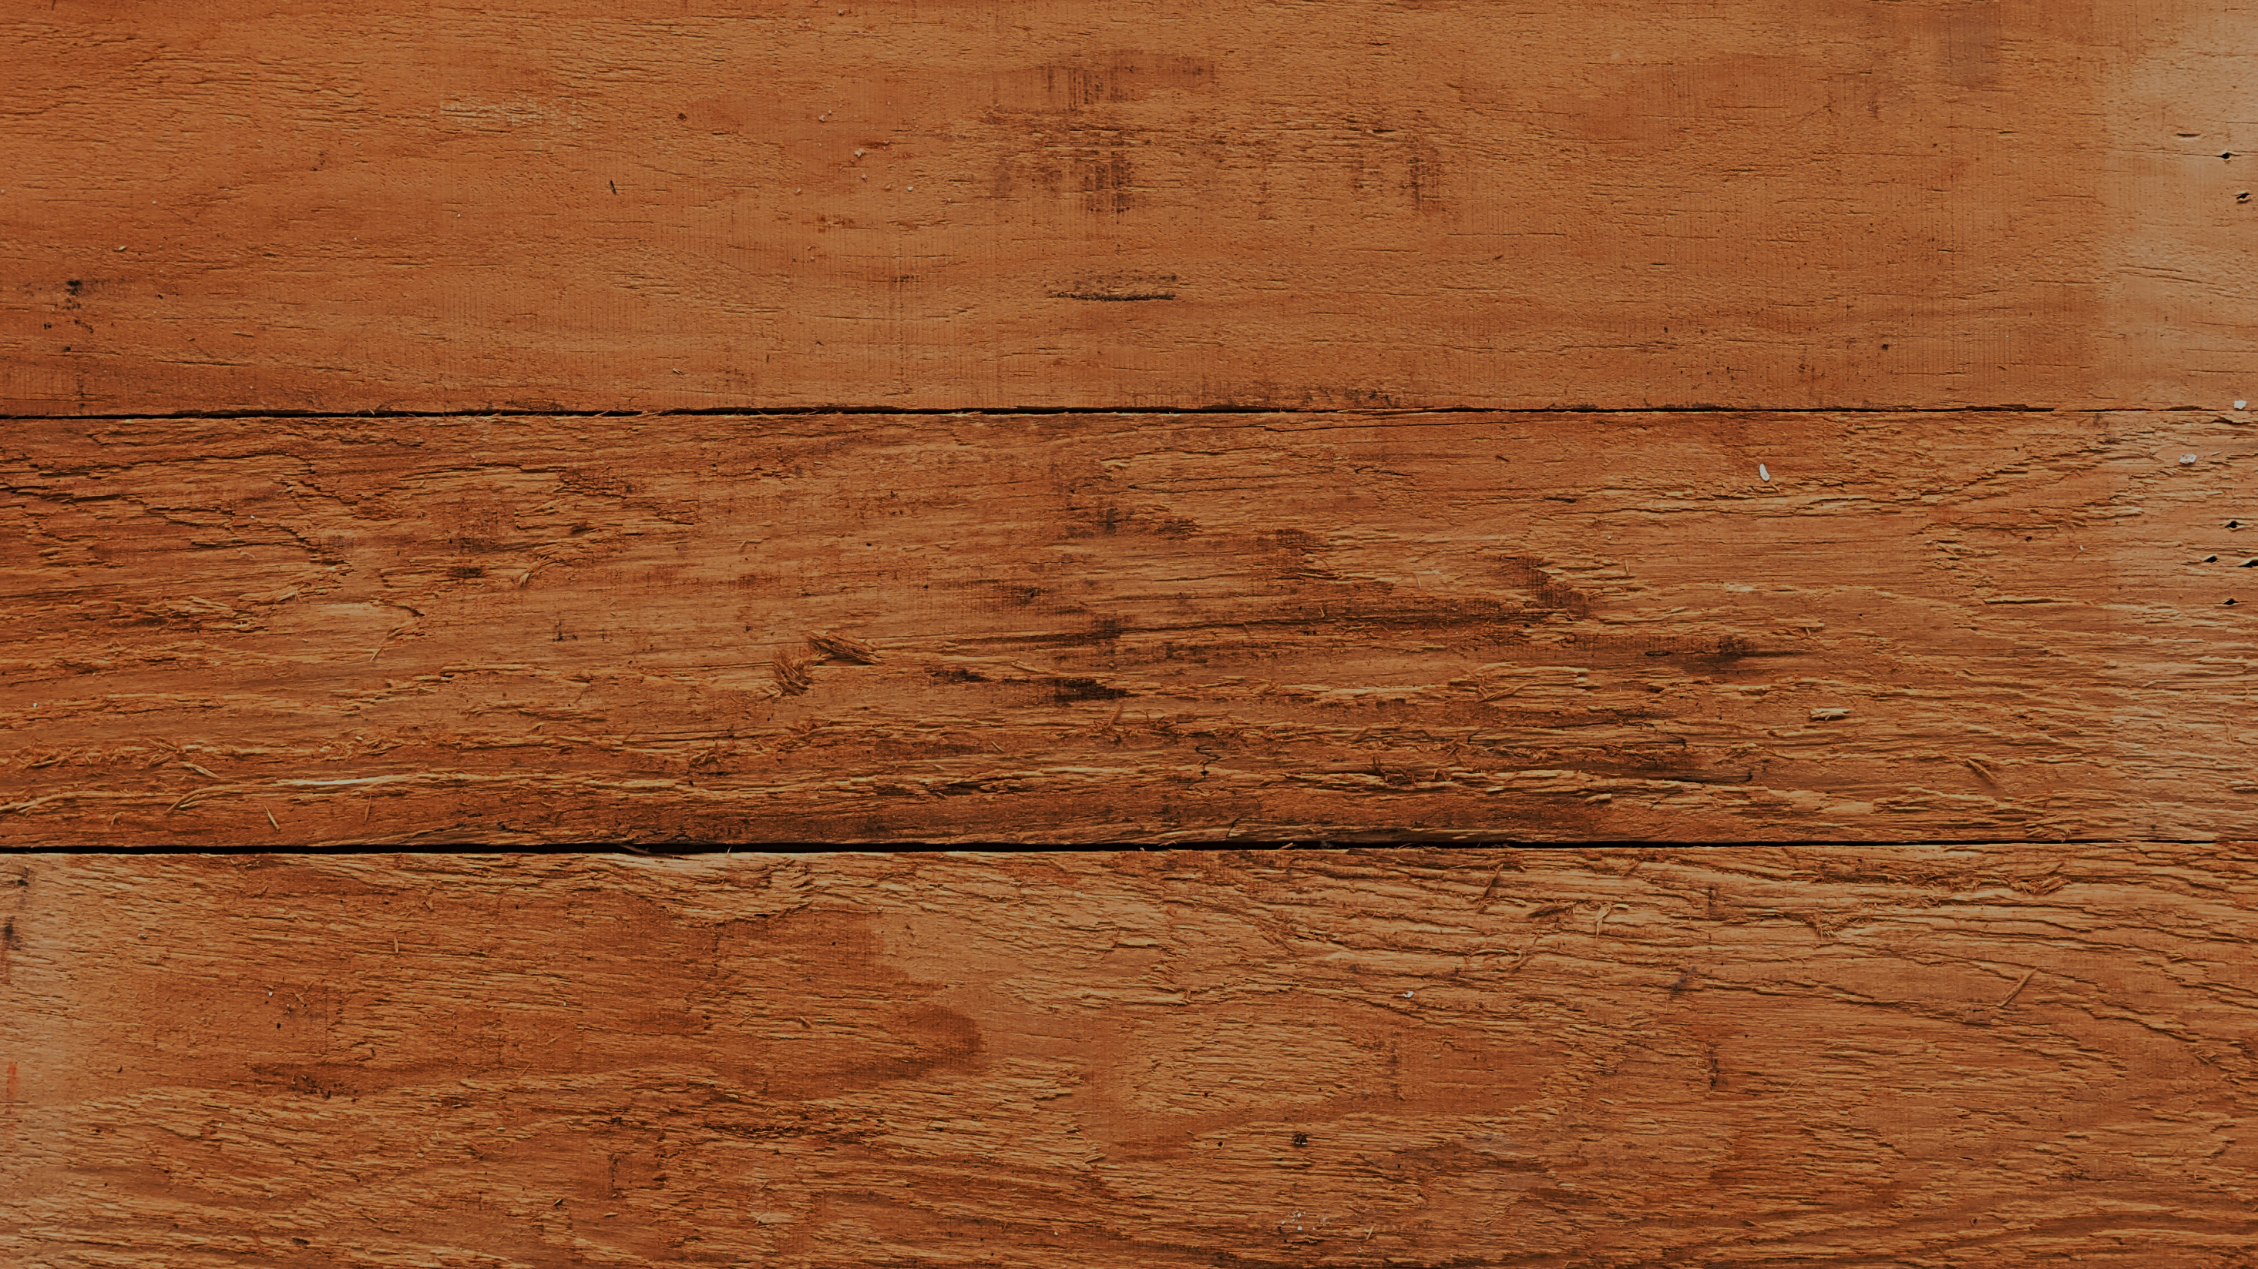
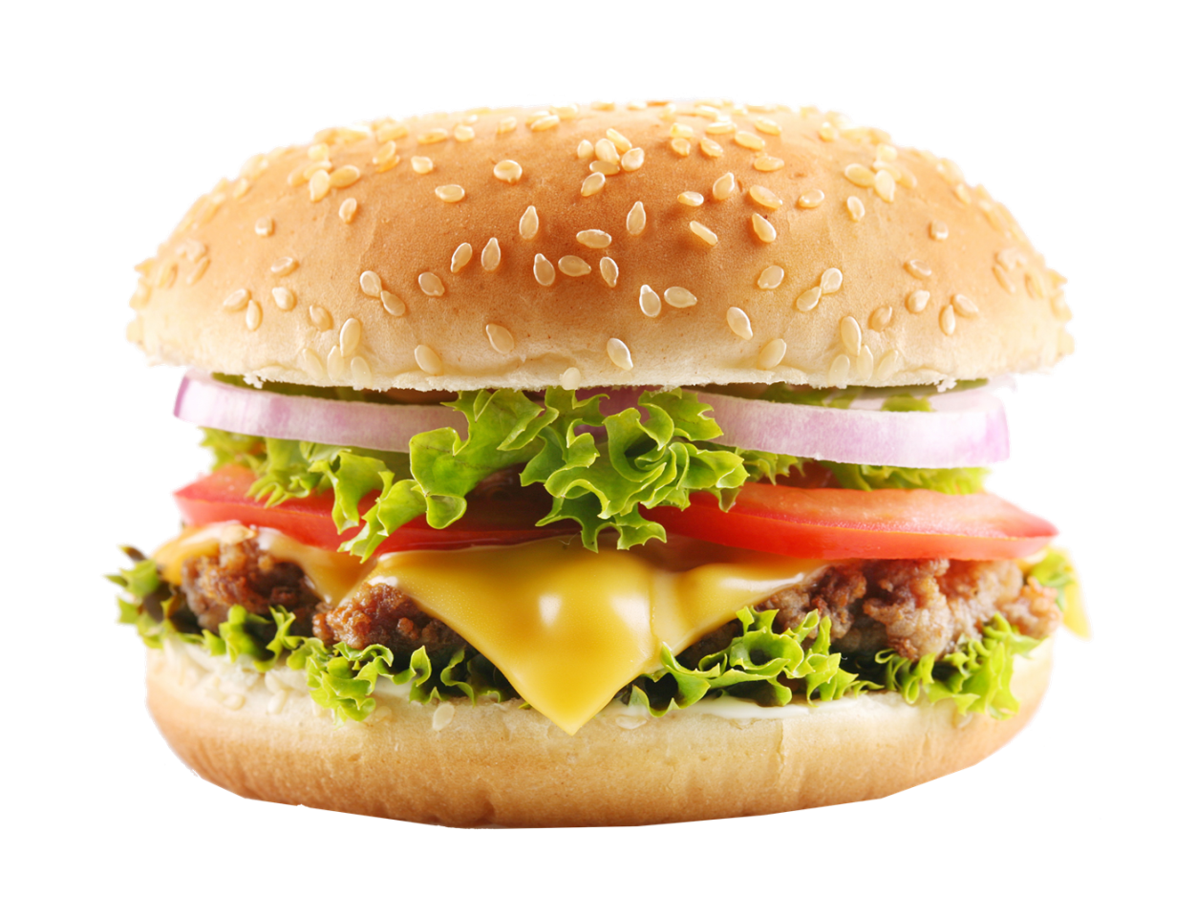
DOUBLE CHEESE
BURGER
Double Cheese, Tomato, Onion, Crispy Lettuce, Patty
All burgers have natural beef patties, topped with fresh crispy lettuce, sliced tomatoes, onions, mayo & ketchup on toasted sesame seed bun.
$12

Slide 3
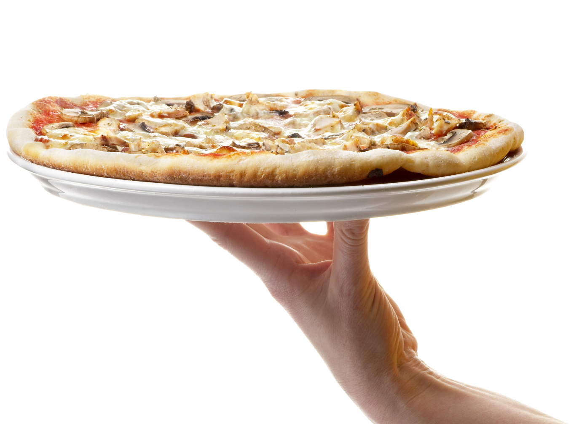
TASTY
PIZZA BITE
Combination of meat and fresh vegetables
Our Best Seller
$8

Slide 4
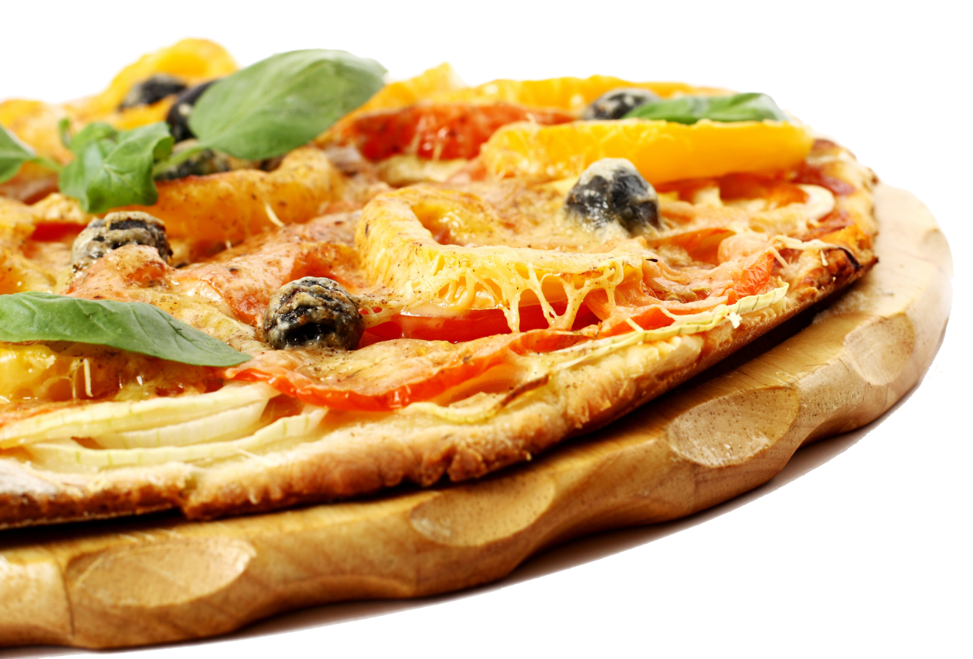
EXCLUSIVE
OFFER
FAMILY MANHATTAN PIZZA
ONLY FOR
$9

Slide 5
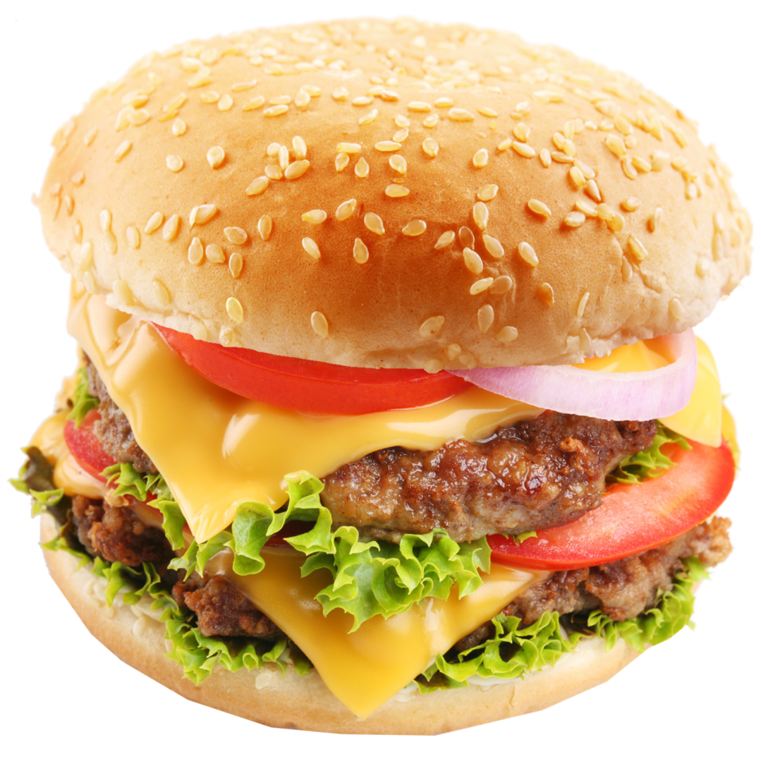
MEGA CHEESE
BURGER FEAST
Triple Cheese, Tomato, Onion, Crispy Lettuce, Patty
All burgers have natural beef patties, topped with fresh crispy lettuce, sliced tomatoes, onions, mayo & ketchup on toasted sesame seed bun.
$12

Slide 6
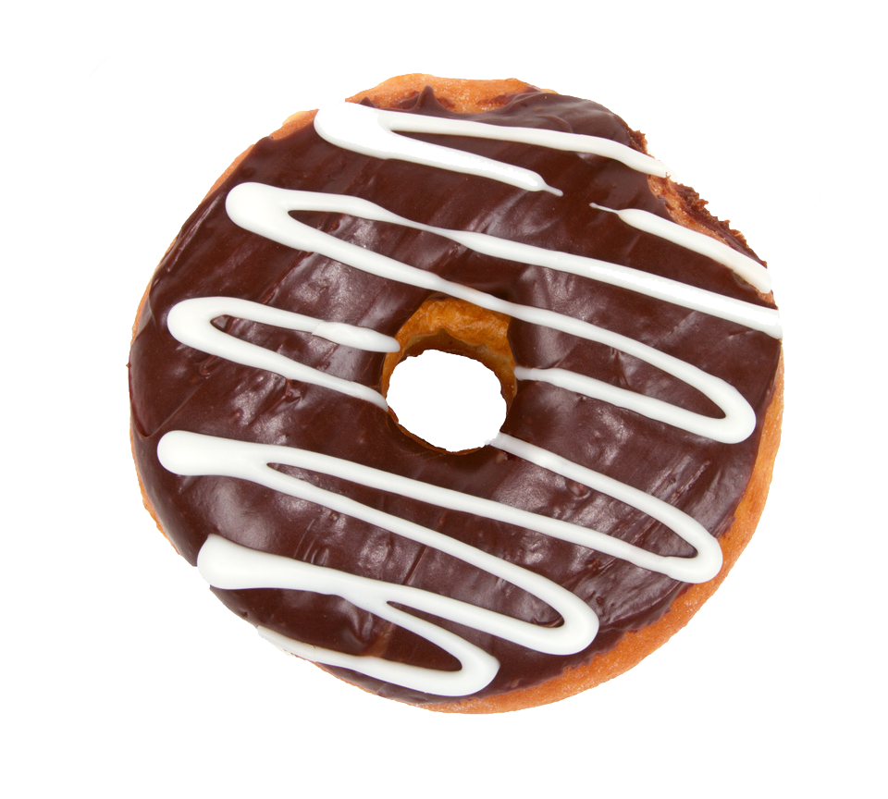
CRAZY CHOCOLATE
DONUT
Hershey Chocolate Donut
You will love the taste of this donut filled with Hershey chocolate on the top with vanilla.
$6

Slide 7
Facebook.com/pizzger
INFO@pizzger.com
1-800-123-4567

